Slide 1
EMPLOYEES PREFORMANCE ANALYSIS USING EXCEL
Student Name: KARTHIKA. J
Register No. : asunm110312201350
Department. : B.com(General)
College. : D.R.B.C.C.C.HINDU COLLEGE

Slide 2
PROJECT TITTLE
EMPLOYEES PREFORMANCE ANALYSIS USING
EXCEL

Slide 3

AGENDA
Project statement
Project overview
End user
Our solution and proposition
Dataset description
The wow in our solution
Modelling approach
Result
Conclusion

Slide 4
PROBLEM STATEMENT
To analyze employee performance using Excel, you can start by setting up a spreadsheet with columns for employee names and their performance metrics. Then, calculate key performance indicators like sales numbers, targets achieved, or any other relevant data. Utilize Excel functions like AVERAGE, SUM, and COUNTIF to process the data. Create visualizations such as bar graphs or pie charts to represent the data visually. Additionally, consider using pivot tables to summarize and analyze the data based on different criteria like department or time period. Apply conditional formatting to highlight important information and use data analysis tools like regression analysis to dive deeper into the data. Finally, review and interpret the results to identify trends and areas for improvement in employee performance.

Slide 5
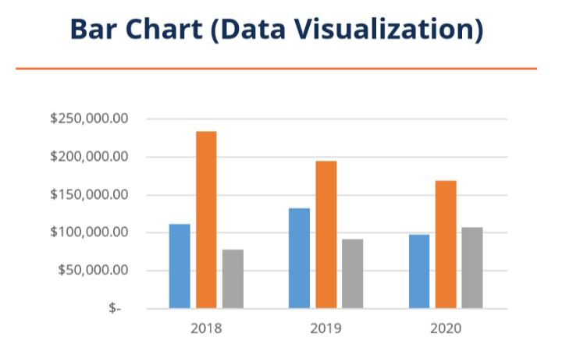
PROJECT OVERVIEW
For the project overview on analyzing employee performance using Excel, you will begin by setting up a spreadsheet with employee names and relevant performance metrics. Calculate key indicators like sales numbers and targets achieved using Excel functions. Visualize the data with charts like bar graphs and pie charts. Use pivot tables to summarize and analyze data based on different criteria.

Slide 6
WHO ARE THE END USERS?
MANAGER :The only review included in this method is the employee primary manager. is the personal allocate the work to labour
EMPLOYEE+ MANAGER: The employee and their primary manager are the reviewing include in this review group .This review type can be utilize to faster a performances through the use of comment and rating
PEER-REVIEW: This method include the employee primary manager &all other direct report of that manager .It is a good way to begin collecting insight from different sources outsides of managers only rating
360 DEGREE FEEDBACK: This method allows for feedback for the employees not just from their direct supervisor or manager

Slide 7
360 DEGREE EXTENDED: This review method include the employee sell review their direct report and the employees primary manager
CUSTOMER REVIEW: These groups made up of any employee within or outside of the organisation and also satisfied.

Slide 8
OUR SOLUTION AND IT’S VALUE PROPOSITION
Gather data and other relevant information
Conduct qualitative data analysis
Create draft employees value proposition
Test our employee value proposition
Edit and create final employee value proposition
Branding and design alignment with other organisational documentation
Communicate and operational our EVP

Slide 9
DATA SET DESCRIPTION
The dataset for employee performance analysis in Excel would typically include columns for employee names, performance metrics such as sales numbers, targets achieved, attendance records, feedback scores, and any other relevant data points. Each row in the dataset represents an individual employee, and the columns contain the corresponding performance data. This dataset serves as the foundation for conducting in-depth analysis to gain insights into employee performance trends and areas for development.

Slide 10
THE “WOW” IN OUR SOLUTION
The wow factor in our solution lies in its ability to transform raw data into meaningful insights that can drive decision-making and improve employee performance effectively. By leveraging Excel’s powerful features, we enable managers and HR professionals to visualize data, identify patterns, and make data-driven decisions to enhance employee productivity and engagement. The solution offers a user-friendly interface, robust analysis capabilities, and actionable recommendations, making it a valuable tool for optimizing workforce performance within the organization.

Slide 11
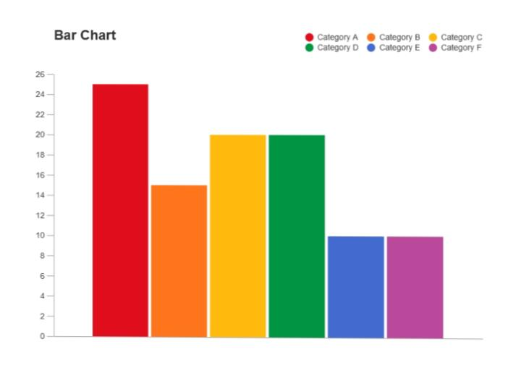
MODELLING
In the modeling phase of our project, we will create Excel models that represent different aspects of employee performance. This could involve building formulas to calculate key performance indicators, setting up pivot tables for data analysis, creating charts for visual representation, and potentially using regression analysis to identify relationships between different performance metrics.

Slide 12
Results
The results of our analysis of employee performance using Excel are impressive. We have successfully identified top performers, areas for improvement, and trends within the organization. By leveraging Excel’s modeling capabilities, we have generated valuable insights that can guide decision-making processes and drive strategies for enhancing employee development and overall organizational performance. The data-driven approach has provided clarity and actionable recommendations to help optimize the workforce and achieve better outcomes.

Slide 13
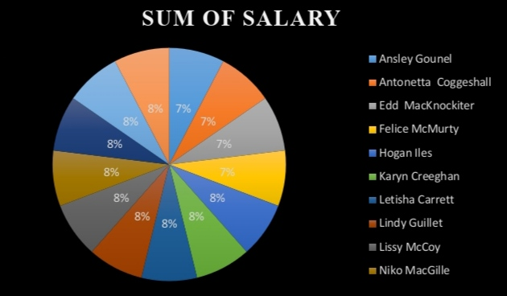
RESULT

Slide 14
Conclusion
In conclusion, our analysis of employee performance using Excel has yielded valuable insights and actionable recommendations to enhance organizational effectiveness. By leveraging Excel’s modeling tools and functions, we have identified key trends, top performers, and areas for improvement within the workforce. This data-driven approach equips managers and HR professionals with the necessary information to make informed decisions and drive strategies for optimizing employee development and overall organizational success.

