Slide 1
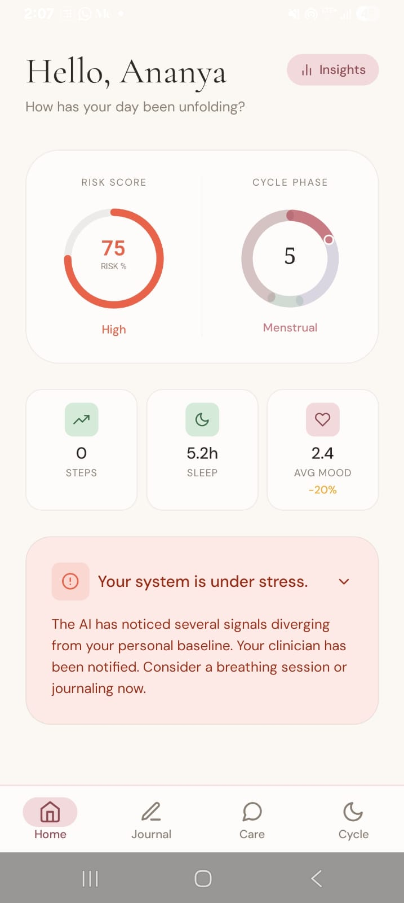
NIRAL THIRUVIZHA 3.0 · REGIONAL REVIEW
NIRANTHARA
AI-Driven Continuity & Risk Intelligence for Depression Care
Know if the treatment is actually working.
TEAM LIGHTY
Karthika Krishna M · Catherin Lighty S
Anna University Regional Campus, Tirunelveli
Patient home — live risk score

Slide 2
THE PROBLEM
The Problem Statement
“How might we utilize AI chatbots and machine learning to address the challenges of incomplete alleviation of depression symptoms, patient attrition, and loss of follow-up in mental health treatment?”
Mental health recovery requires continuous care, but treatment is often limited to scheduled consultations
Patients may discontinue therapy or medication before completing treatment
Emotional and behavioural changes between appointments may go unnoticed
Clinicians have limited visibility into a patient's day-to-day mental well-being
Existing digital tools provide support but rarely deliver predictive, clinician-focused decision support
NIRANTHARA
2

Slide 3
LANDSCAPE
Existing Solutions & Research Gap
Existing Solution
Limitation
THE RESEARCH GAP
Mood Tracking Apps
Depend on manual self-reporting
No unified platform combines continuous monitoring, AI-powered risk prediction, clinician decision support, and treatment outcome evaluation.
AI Chatbots
Limited integration with clinical workflows
Hospital Records / EHR
Monitor only during scheduled consultations
Wearables
Track physical activity, limited mental-health intelligence
NIRANTHARA closes it
NIRANTHARA
3

Slide 4
OUR SOLUTION
Our Solution: Niranthara
NIRANTHARA is an AI-powered platform that enables continuous mental-health monitoring, conversational support, intelligent risk prediction, clinician decision support, and treatment-outcome evaluation — within a single ecosystem.
Continuous Mood Monitoring
AI Conversational Support
Risk Prediction
Clinician Dashboard
Personalized Intervention
Outcome Tracking
Not a therapist replacement. Not another chatbot with a mood diary — a continuity layer that lives between clinical visits.
NIRANTHARA
4

Slide 5
HOW IT'S BUILT
System Architecture
1
Patient App
React Native / Expo — offline-first mobile client
2
Backend Services
Node 20 / Express 5 — auth, encryption, orchestration, cron
3
AI Processing Module
Python / FastAPI — 10 ML routers, single boundary module
4
Database
Firebase Firestore — real-time integration bus, zero polling
5
Clinician Dashboard
React 19 / Vite — live onSnapshot risk views for the care team
Five independent services. One continuous system.
NIRANTHARA
Care Team
5

Slide 6
UNDER THE HOOD
Technology Stack
Frontend
Backend
Database
React Native · Expo · React 19 · Vite
Node 20 · Express 5
Firebase Firestore
AI & Machine Learning
Cloud & APIs
Dev Tools
Python · FastAPI · PyTorch · XGBoost · HuggingFace Transformers
Firebase Admin · Google Health API
Git · GitHub
Only technologies actually implemented and demonstrable in the running project.
NIRANTHARA
6

Slide 7
THE ENGINE
The AI and ML Engine
Sentiment Analysis
Detects emotional patterns in journal and chat text
Mood Input
Conversational AI
Supportive, context-aware patient interactions
AI Analysis
Risk Prediction
Identifies patients requiring clinical attention
Risk Prediction
Explainability (SHAP)
Shows the clinician why a risk score was given
Recommendation
Dashboard
Every clinical decision comes from a trained model — zero keyword hardcoding.
NIRANTHARA
7

Slide 8
PATIENT JOURNEY
System Workflow
1
2
3
4
User Login
Mood Check-in
Journal Entry
AI Analysis
5
6
7
8
Risk Prediction
Clinician Dashboard
Intervention
Progress Tracking
NIRANTHARA
8

Slide 9
WHAT MAKES US DIFFERENT
Key Innovations
1
2
3
Continuous Monitoring
AI-Based Risk Prediction
Clinician Decision Support
4
5
6
Outcome Tracking
Personalized AI Assistance
Multilingual Support (Tamil / Tanglish)
NIRANTHARA
9

Slide 10
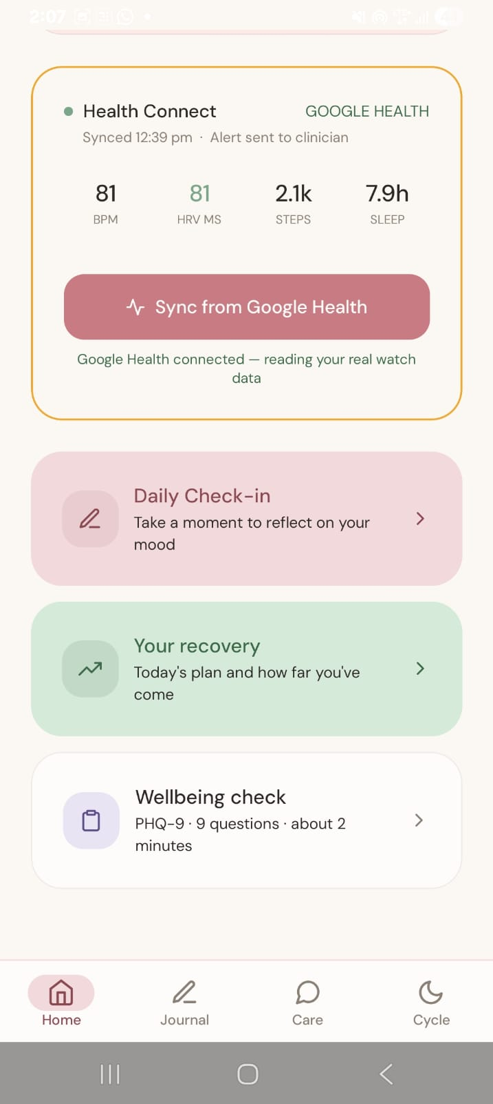
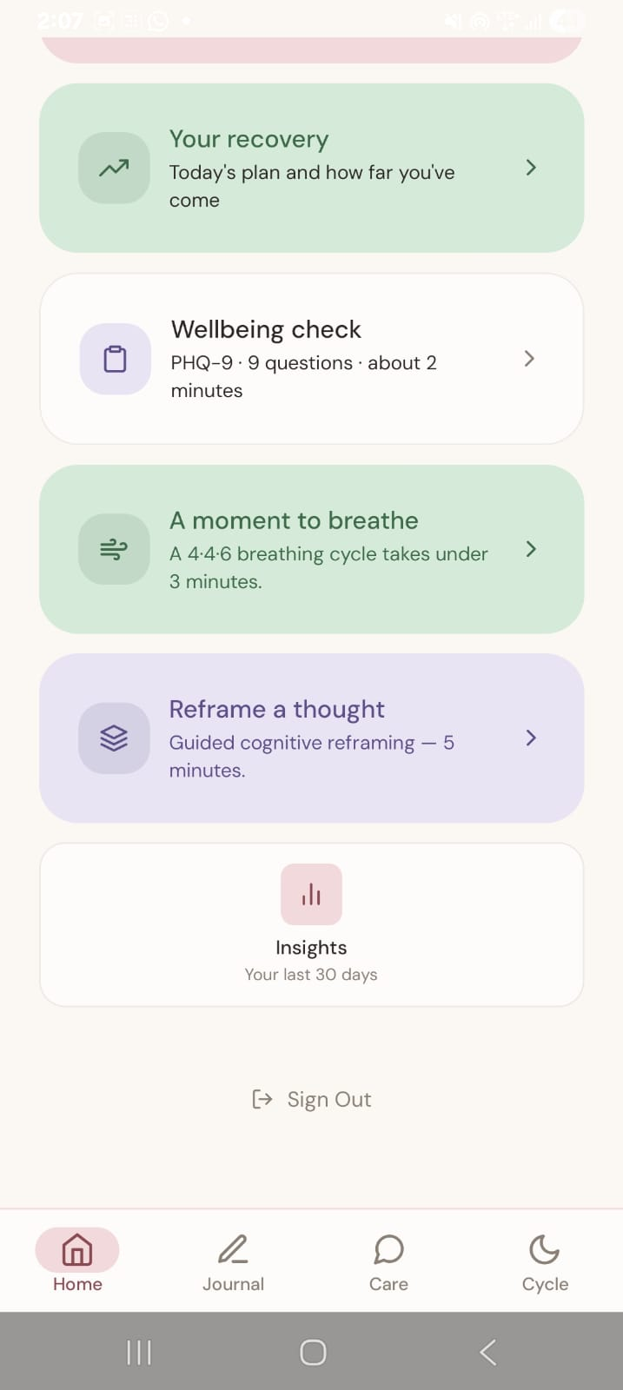
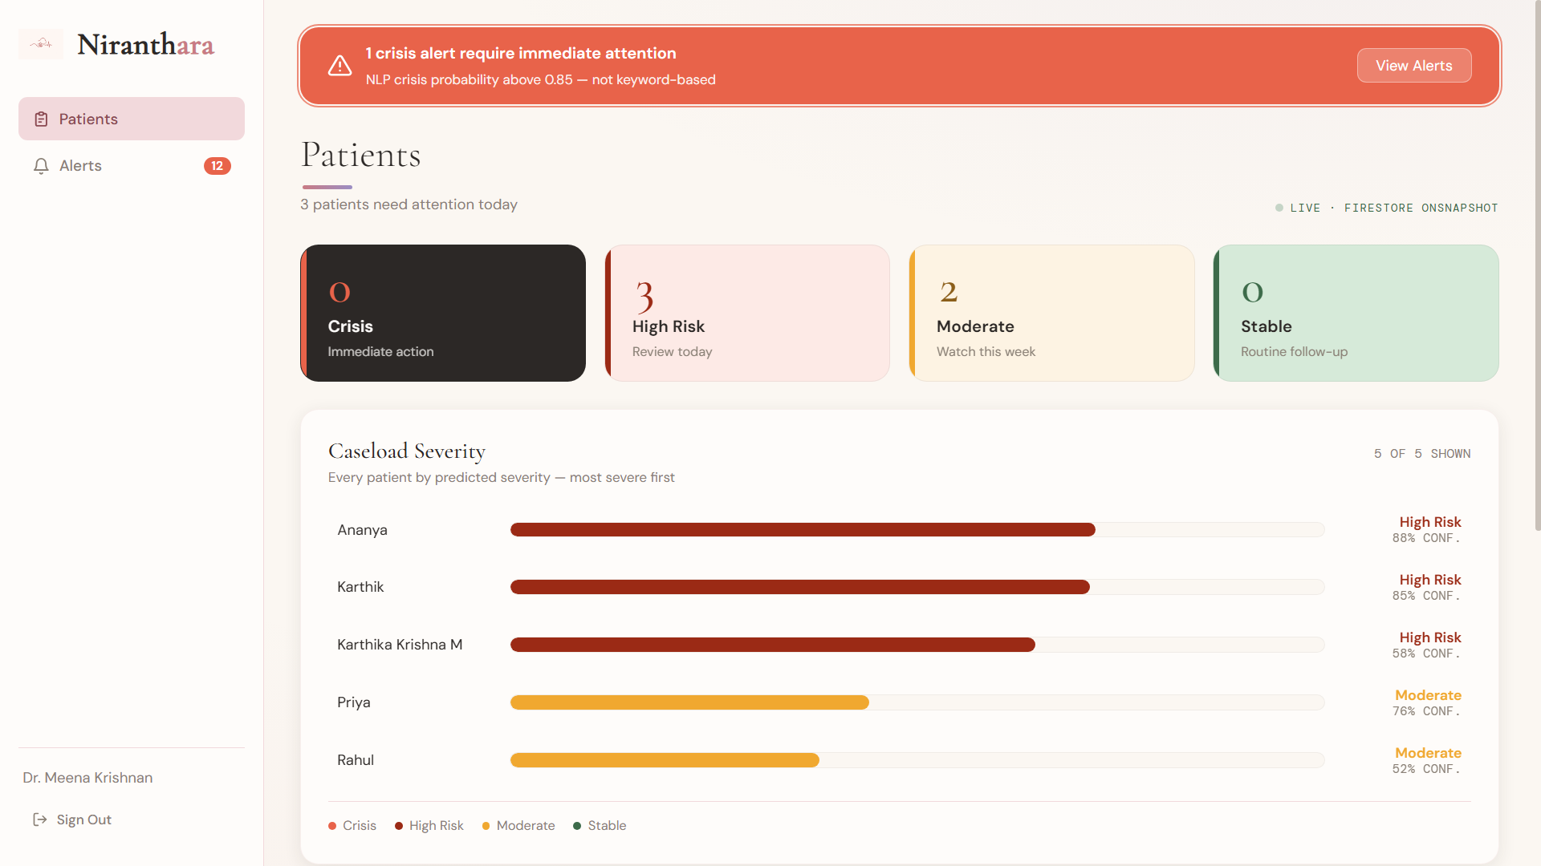
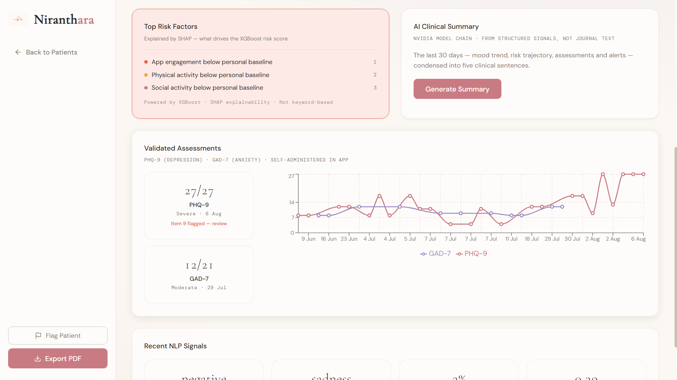
SEE IT LIVE
Application Demonstration
Clinician dashboard — live triage
Patient Home — live risk score
Recovery & wellbeing actions
Guided recovery tools
SHAP risk factors & AI summary
NIRANTHARA
10

Slide 11
IMPACT
Expected Outcomes
1
2
3
4
5
Earlier Identification
Improved Continuity
Better Patient Engagement
AI-Assisted Decisions
Enhanced Monitoring
of mental-health risks
of care between appointments
through daily, low-friction check-ins
for the clinician, not in place of them
of treatment progress over time
NIRANTHARA
11

Slide 12
SUSTAINABILITY
Business Model
Target Users
Value Proposition
Revenue Opportunities
Hospitals
AI-assisted monitoring
Institutional subscriptions
Mental Health Clinics
Clinical decision support
Enterprise licensing
Universities
Continuous care
Strategic partnerships
Counselling Centres
NIRANTHARA
12

Slide 13
ROADMAP
Future Scope
Clinical Validation
Cloud Deployment
Cross-Platform Support
Wearable Integration
Enhanced Privacy & Security
Advanced Predictive Analytics
NIRANTHARA
13

Slide 14
THE COMPARISON
Why Choose NIRANTHARA?
Capability
Conventional Solutions
NIRANTHARA
Continuous Monitoring
✗
✓
AI Risk Prediction
✗
✓
Clinician Dashboard
Limited
✓
Outcome Tracking
✗
✓
Personalized Support
Limited
✓
“NIRANTHARA transforms mental healthcare from reactive treatment to proactive, continuous, AI-assisted care.”
NIRANTHARA
14

Slide 15
IN SUMMARY
Conclusion
NIRANTHARA demonstrates how AI can strengthen continuity in depression care by connecting patients, clinicians, and intelligent decision support within one integrated platform. By enabling continuous monitoring, early risk identification, and personalized interventions, it aims to improve treatment continuity and support better mental healthcare outcomes.
“Supporting clinicians. Empowering patients. Advancing mental healthcare through AI.”
Live risk score, updated every check-in
NIRANTHARA
15

Slide 16
THANK YOU
Questions & Discussion
Karthika Krishna M · Catherin Lighty S
Anna University Regional Campus, Tirunelveli
GitHub: github.com/KARTHIKAKRISHNA123/Niranthara-AI-Powered-Mental-Health-Continuity
NIRANTHARA

