Slide 1
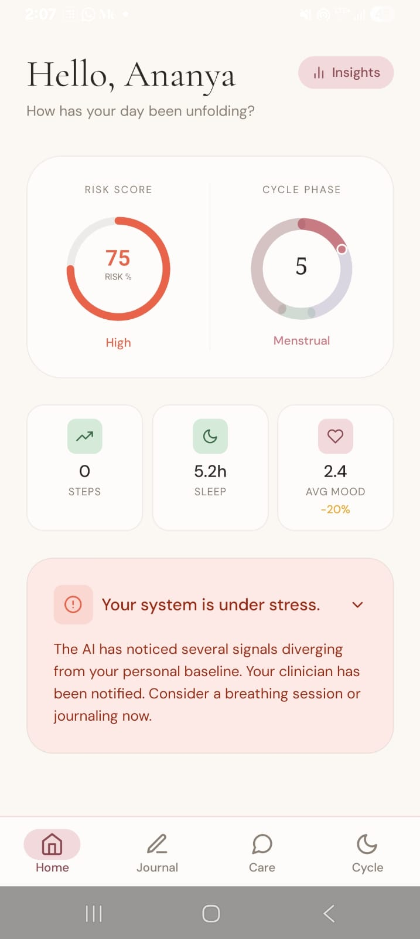
NIRAL THIRUVIZHA 3.0 · REGIONAL REVIEW
NIRANTHARA
AI-Driven Continuity & Risk Intelligence for Depression Care
From periodic consultations to continuous AI-assisted mental healthcare.
TEAM LIGHTY
Karthika Krishna M · Catherin Lighty S
Anna University Regional Campus, Tirunelveli
Guide: NavaBharathy M
Live patient app

Slide 2
THE CHALLENGE
Depression Recovery Isn't a Straight Line
"How might we utilize AI chatbots and machine learning to address the challenges of incomplete alleviation of depression symptoms, patient attrition, and loss of follow-up in mental health treatment?"
1
2
3
Incomplete Alleviation
Patient Attrition
Loss of Follow-Up
Symptoms often persist beneath the surface, even when overall scores appear to improve.
Patients discontinue therapy or medication before treatment is complete.
Emotional and behavioural changes between appointments often go unnoticed.
The monitoring gap: no signal reaches the clinician between visits.
Consultation
Daily Life
Emotional Change
Next Consultation
The challenge is not simply providing treatment — it is ensuring continuity of care between clinical visits.
NIRANTHARA
2

Slide 3
LANDSCAPE
Why Existing Tools Fall Short
Mood Tracking Apps
AI Chatbots
Hospital Records
Wearables
Depend on manual self-reporting
Limited integration with clinical workflows
Monitor only during scheduled consultations
Track activity, not mental-health signals
THE RESEARCH GAP
NIRANTHARA
closes it
No unified platform combines continuous monitoring, AI-powered risk prediction, clinician decision support, and treatment outcome evaluation.
NIRANTHARA
3

Slide 4
OUR SOLUTION
One Continuous Loop of Care
Mood Monitoring
AI Chat Support
Patient
Risk Prediction
Clinician Dashboard
Recovery Monitoring
AI Analysis
Loop
Personalized Intervention
Outcome Tracking
Personalized Intervention
Risk Prediction
Clinician Dashboard
Not a therapist replacement — a continuity layer that lives between clinical visits.
NIRANTHARA
4

Slide 5
HOW IT'S BUILT
System Architecture
1
Patient App
ORCHESTRATION LAYER
INTEGRATION BUS
A single boundary module connects orchestration to intelligence — every inference call passes through one interface.
Firestore acts as a live integration bus — the dashboard updates in real time with zero polling.
2
Backend
3
AI Engine
4
Firestore
5
Clinician Dashboard
backend/utils/aiClient.js
axios · 15s timeout
45s override for LLM paths
onSnapshot listeners
users · moodLogs · cycleLogs
chatLogs · clinicianAlerts
6
Clinician
NIRANTHARA
5

Slide 6
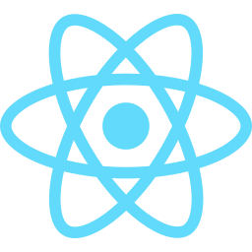











UNDER THE HOOD
Technology Stack
Frontend
Backend
Database
AI Engine
Cloud
Dev Tools
Only technologies actually implemented and demonstrable in the running project.
NIRANTHARA
6

Slide 7
THE ENGINE
The AI Intelligence Pipeline
Patient input
AI processing
Clinician output
1
2
3
4
5
6
Mood
Journal
Sentiment Analysis
Risk Prediction
Explainability
Clinician Dashboard
Patient input
Patient input
AI processing
AI processing
Explainable output
Clinician output
Every clinical decision comes from a trained model — zero keyword hardcoding.
NIRANTHARA
7

Slide 8
PATIENT JOURNEY
How NIRANTHARA Works
1
2
3
4
Login
Mood Check-in
Journal
AI Analysis
5
6
7
8
Risk Prediction
Dashboard Alert
Intervention
Recovery Tracking
NIRANTHARA
8

Slide 9
WHAT MAKES US DIFFERENT
Key Innovations
1
2
3
4
5
Continuous Monitoring
Explainable AI
Clinician Decision Support
Treatment Outcome Tracking
Multilingual Support
Signals observed between visits, not just during them
SHAP-attributed risk scores a clinician can interrogate
Risk intelligence delivered in real time
Every intervention paired with a measured effect
English, Tamil, and Tanglish understood
NIRANTHARA
9

Slide 10
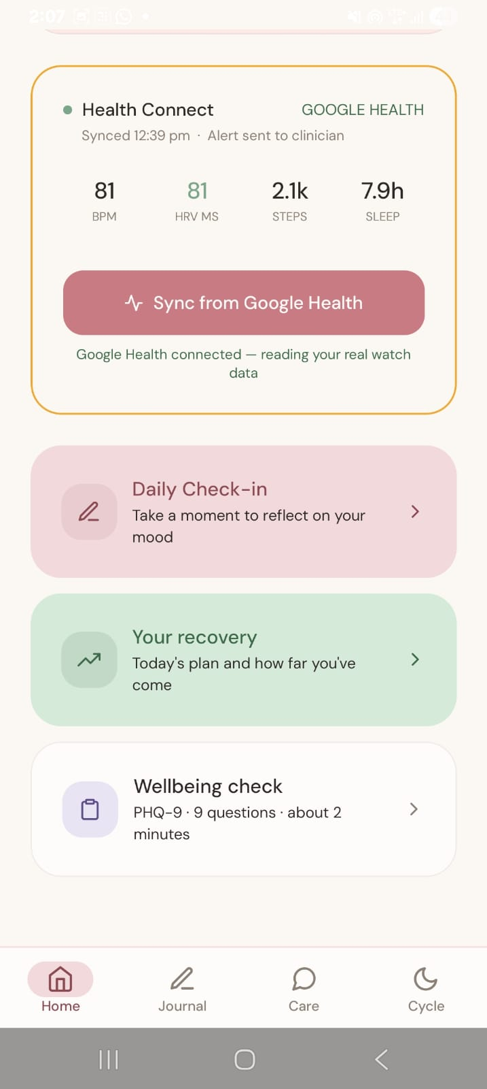
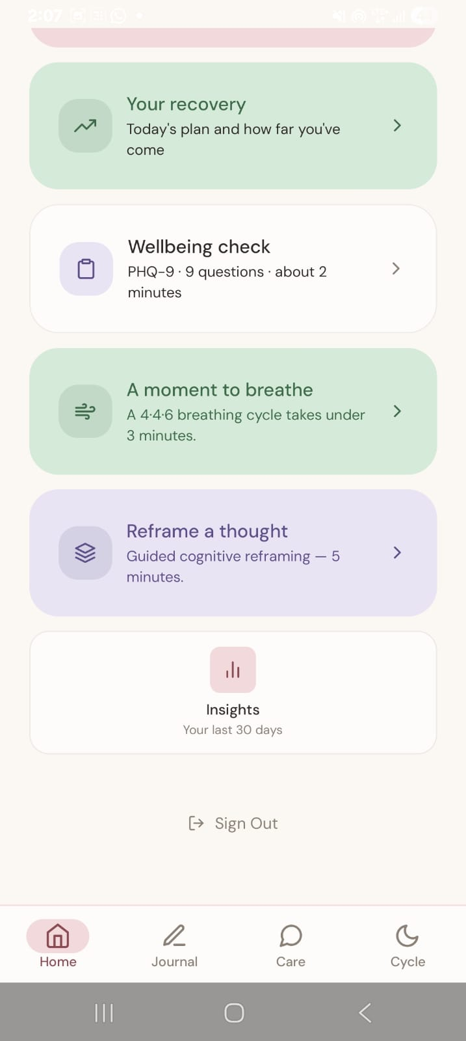
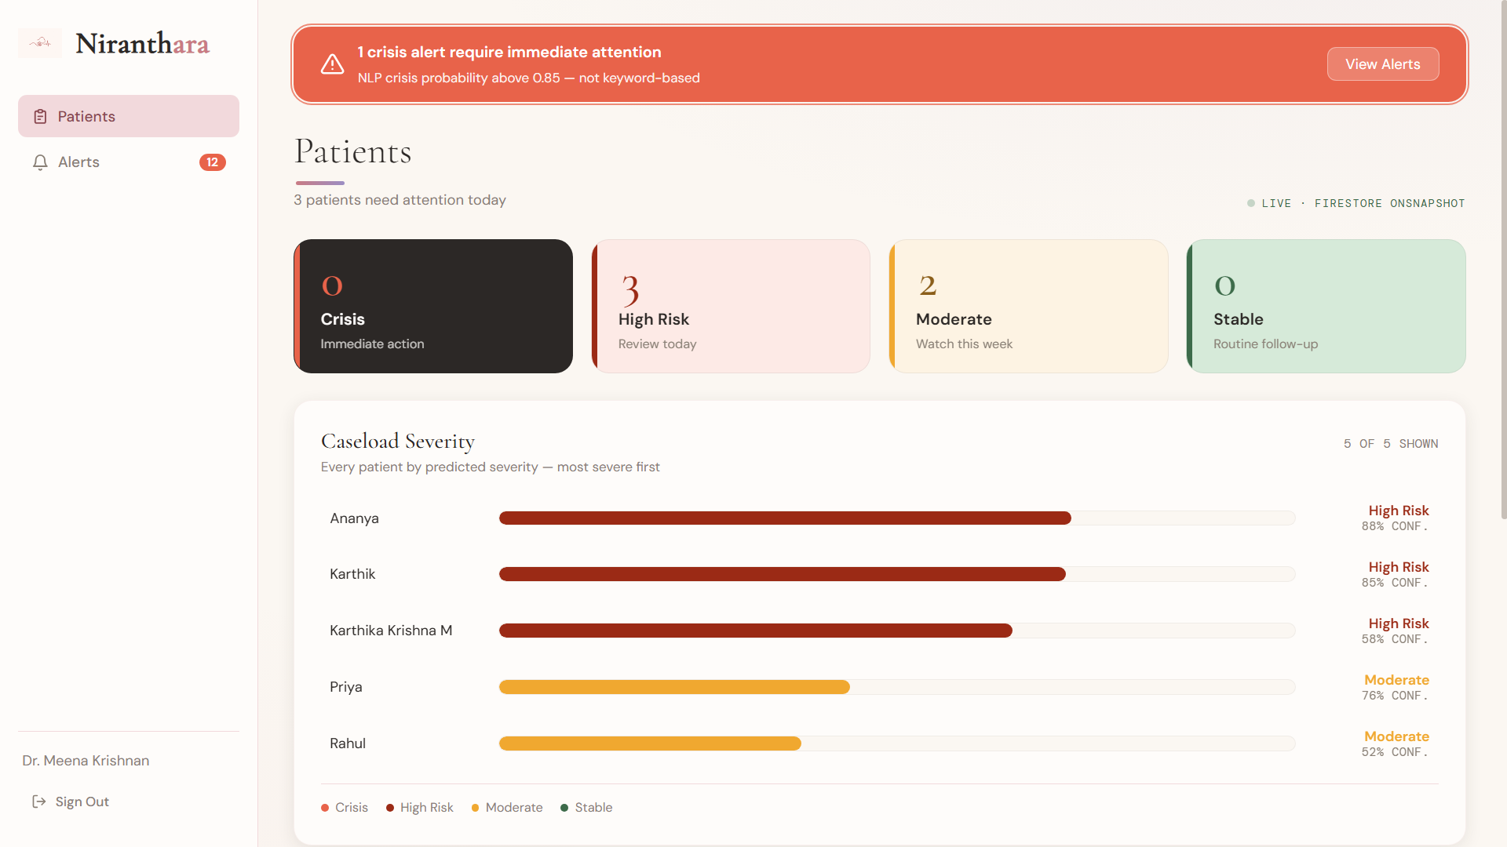
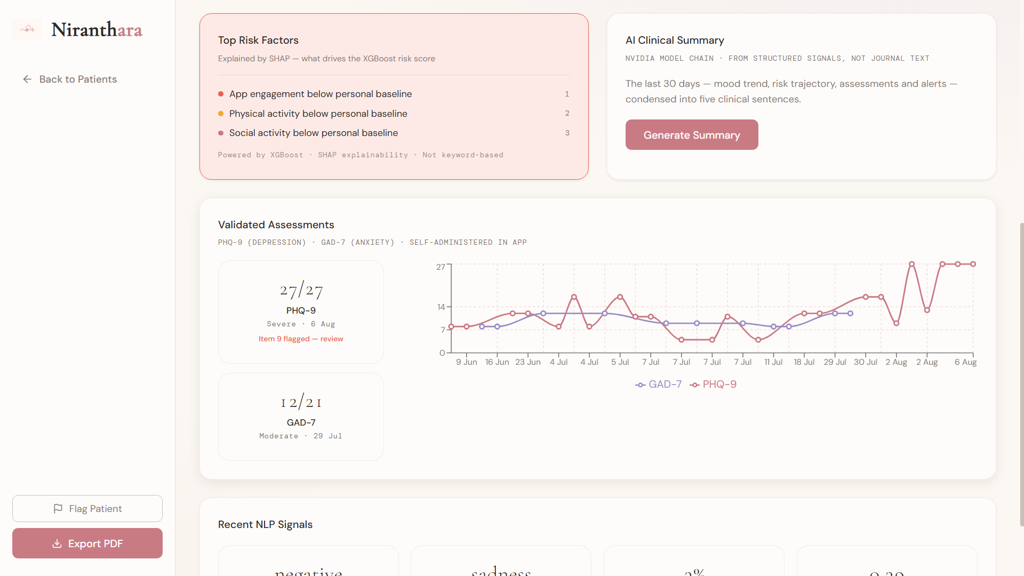
SEE IT LIVE
Application Demonstration
Mobile →
Dashboard
Risk view & alerts
Home — live risk score
Recovery actions
Guided recovery
Patient detail — SHAP
NIRANTHARA
10

Slide 11
IMPACT
What This Enables
1
2
3
4
5
Earlier Risk Identification
Improved Continuity of Care
Better Patient Engagement
AI-Assisted Clinical Decisions
Continuous Treatment Monitoring
NIRANTHARA
11

Slide 12
SUSTAINABILITY
Business Model
Target Customers
NIRANTHARA Platform
Value Delivered
Revenue Model
Hospitals
Continuous monitoring
Earlier identification
Institutional subscription
Universities
AI risk intelligence
Clinical decision support
Enterprise licensing
Mental Health Clinics
Clinician dashboard
Continuous care
Healthcare partnerships
Counselling Centres
WHO WE SERVE
WHAT WE BUILT
WHY IT MATTERS
HOW WE SUSTAIN
NIRANTHARA
12

Slide 13
ROADMAP
Future Roadmap
Prototype
Clinical Validation
Hospital Pilot
Cloud Deployment
Large Scale Adoption
1
2
3
4
5
Currently at: Prototype — implemented and verified.
NIRANTHARA
13

Slide 14
THE COMPARISON
Why NIRANTHARA
Capability
Conventional Solutions
NIRANTHARA
Continuous Monitoring
✗
✓
AI Risk Prediction
✗
✓
Clinician Dashboard
◐
✓
Outcome Tracking
✗
✓
Personalized Support
◐
✓
NIRANTHARA
14

Slide 15
IN SUMMARY
Conclusion
Patient
1
Continuous monitoring beyond clinical visits
AI
2
AI-assisted clinician decision support
3
Personalized and proactive mental healthcare
Clinician
“Because mental health doesn't pause between appointments, neither should care.”
NIRANTHARA
15

Slide 16
THANK YOU
Questions & Discussion
Karthika Krishna M · Catherin Lighty S
Anna University Regional Campus, Tirunelveli
GitHub: github.com/KARTHIKAKRISHNA123/Niranthara-AI-Powered-Mental-Health-Continuity
NIRANTHARA

