Slide 1
CGB1121 – PYTHON PROGRAMMING END SEMESTER REVIEW
Department of Computer Science and Engineering
Academic Year: 2025 – 2026 (Even Semester)
Batch No. :08
Register Number :927625BCS068,927625BCS105
Name :KARTHIKA S,NETHRA V
Year : I
Semester : II
Section : B
Date :04.06.2026

Slide 2
Title of the Project
ONLINE SHOPPING CART MANAGER

Slide 3
Abstract
The Online Shopping Cart Manager is a Python-based application designed to simulate the core functionality of an e-commerce shopping cart system. This project uses lists and basic data structures to store and manage items selected by users. It allows users to add new products, remove existing items, update quantities, and view the cart contents efficiently . The system dynamically calculates the total cost based on the items and their quantities, ensuring accurate billing. By implementing fundamental programming concepts such as loops, conditional statements, and functions, this project demonstrates how real-world online shopping platforms manage cart operations.Overall, the project provides a simple yet effective simulation of an online shopping cart, enhancing understanding of data management and user interaction in Python applications.

Slide 4
Abstract with CO/PO Mapping
Abstract | CO | POs | PSO
The Online Shopping Cart Manager is a Python-based application that simulates the basic functions of an e-commerce system. It allows users to add, remove, and update items in a shopping cart using simple data structures like lists . The system automatically calculates the total cost and provides an easy way to manage cart items. This project demonstrates basic programming concepts such as loops, conditions, and functions, and helps in understanding how online shopping systems work in a simple way. | CO1 CO2 CO3 CO4 | PO1 PO2 PO3 PO4 PO5 PO6 PO7 PO8 PO9 PO10 PO11 | PSO1 PSO2

Slide 5
Introduction
The Online Shopping Cart Manager is a simple project developed using Python programming. This application is designed to simulate the basic functions of an online shopping system. It allows users to add products, remove items, update quantities, and calculate the total price automatically. The project uses basic Python concepts such as lists, loops, functions, and conditional statements to manage the cart operations. The main aim of this project is to understand how Python can be used to handle data and perform real-world applications like online shopping systems

Slide 6
Python Programming - Concepts Used
This project uses basic Python programming concepts to implement the shopping cart system. Lists are used to store product names and prices. Conditional statements (if-else) help in making decisions such as adding or removing items. Loops are used to display products and repeat menu options. Functions are used to organize the code into small, reusable blocks. Variables are used to store user inputs and calculate the total cost. These concepts together help in building a simple and efficient shopping cart application.

Slide 7
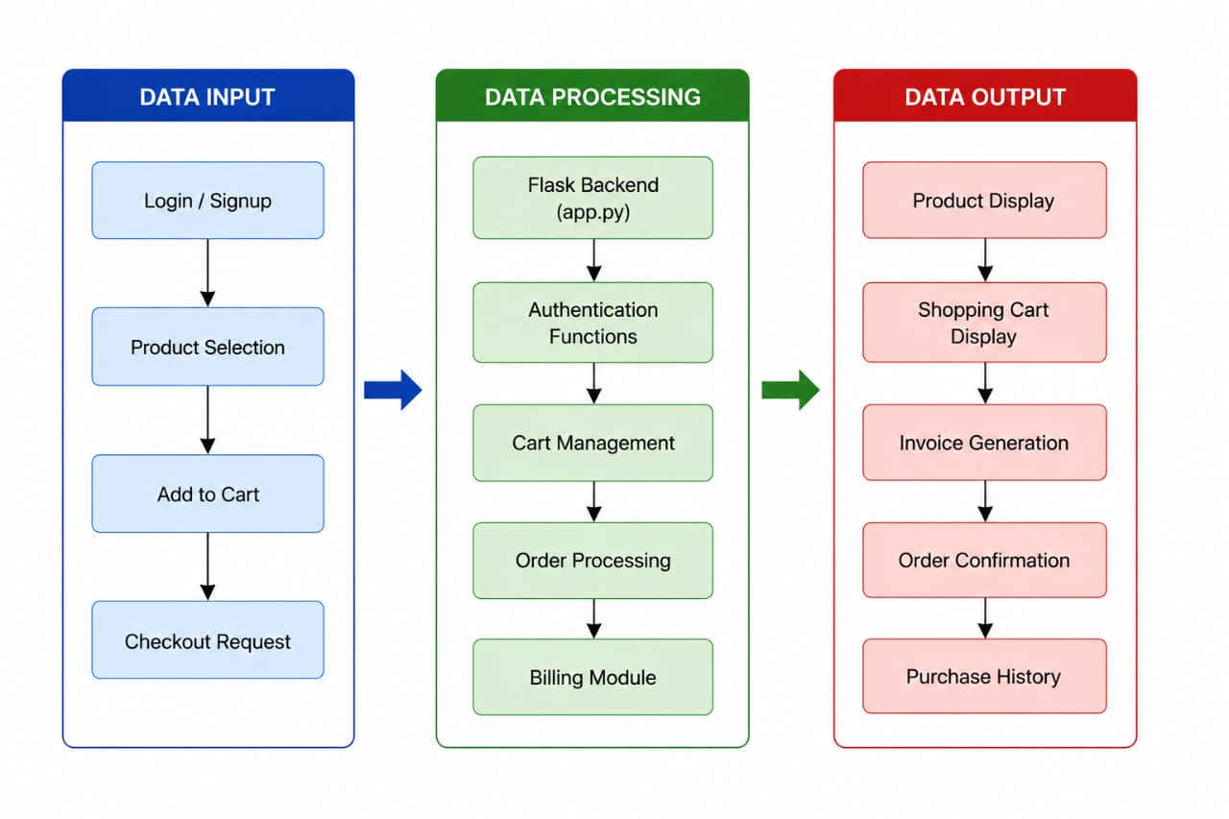
Proposed Architecture

Slide 8
Proposed Architecture - Description
The proposed architecture of the Online Shopping Cart Manager consists of three main components: user interface, processing unit, and data storage. The user interface allows users to interact with the system by selecting options such as adding or removing products. The processing unit handles the logic of the program using Python concepts like loops, functions, and conditional statements. Data storage is managed using lists to store product names, quantities, and prices. When the user performs an action, the system processes the input, updates the cart, and displays the updated total amount. This simple architecture ensures easy execution and smooth functioning of the application.

Slide 9
List of Modules
User Interface Module – Displays menu options and collects user input.
➤Product Management Module – Stores available product details such as name and price.
➤Cart Management Module – Handles adding, removing, and updating items in the cart.
➤Billing Module – Calculates the total cost based on selected items and quantity.
➤Display Module – Shows the updated cart details and final bill to the user.

Slide 10
Description of Modules
The Online Shopping Cart Manager consists of several important modules that work together to perform the shopping operations. The User Interface Module is responsible for displaying the menu and collecting input from the user. The Product Management Module stores product details such as names and prices using lists. The Cart Management Module handles operations like adding, removing, and updating items in the cart. The Billing Module calculates the total cost based on the selected products and their quantities. Finally, the Display Module shows the updated cart details and the final bill to the user. All these modules together ensure smooth and efficient functioning of the system

Slide 11
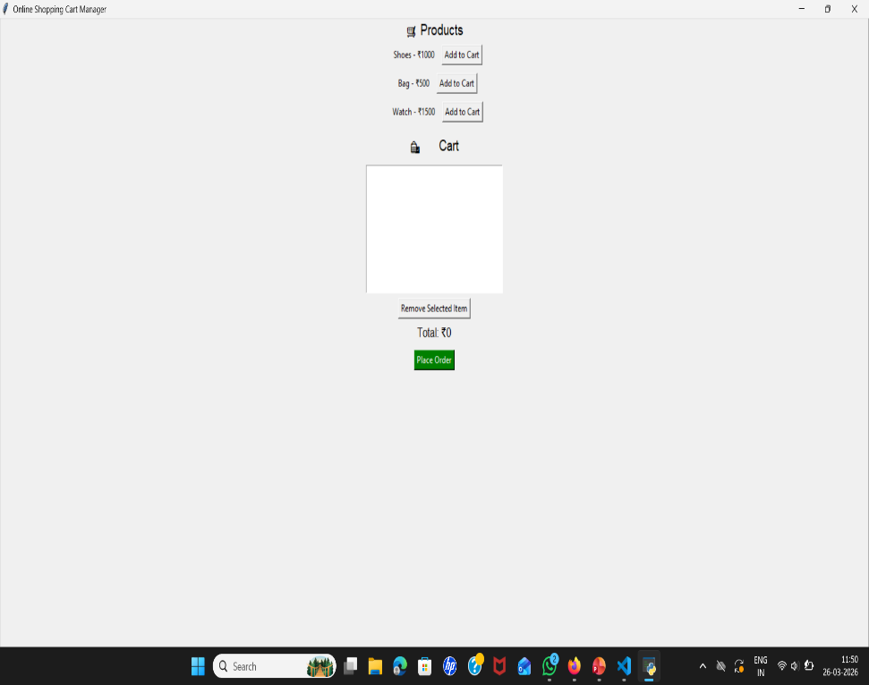
Results and Discussion
Output Screenshot:
Description:
This is a GUI-based Online Shopping Cart Manager application.
Users can view products (Shoes, Bag, Watch) with prices.
Click “Add to Cart” to add items.
Selected items appear in the Cart section.
Items can be removed using “Remove Selected Item”.
The Total amount updates automatically.
“Place Order” is used to complete the purchase.

Slide 12
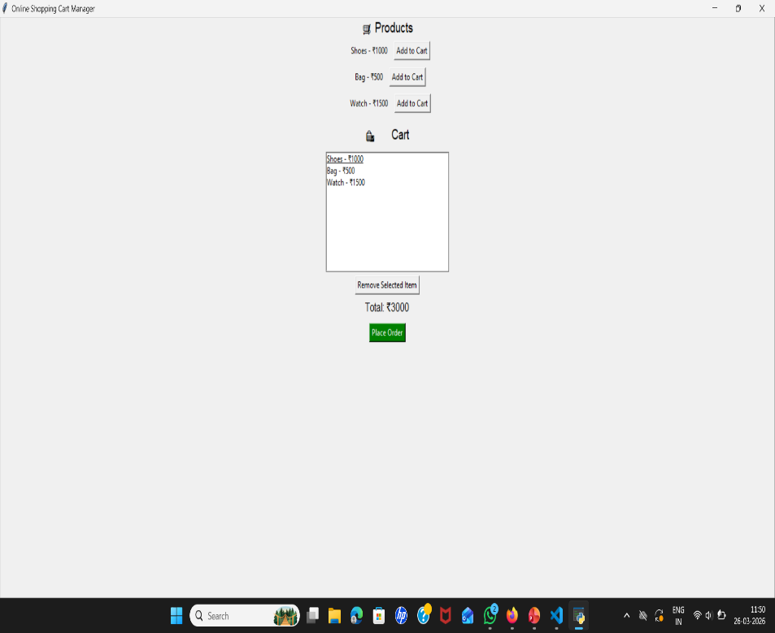
Results and Discussion(Cont..)
Output Screenshot:
Description:
This image shows the Online Shopping Cart Manager after items are added.
All products (Shoes, Bag, Watch) are added to the Cart.
The cart displays each item with its price.
The Total amount is updated to ₹3000.
Users can remove items using “Remove Selected Item”.
The “Place Order” button is used to complete the purchase.

Slide 13
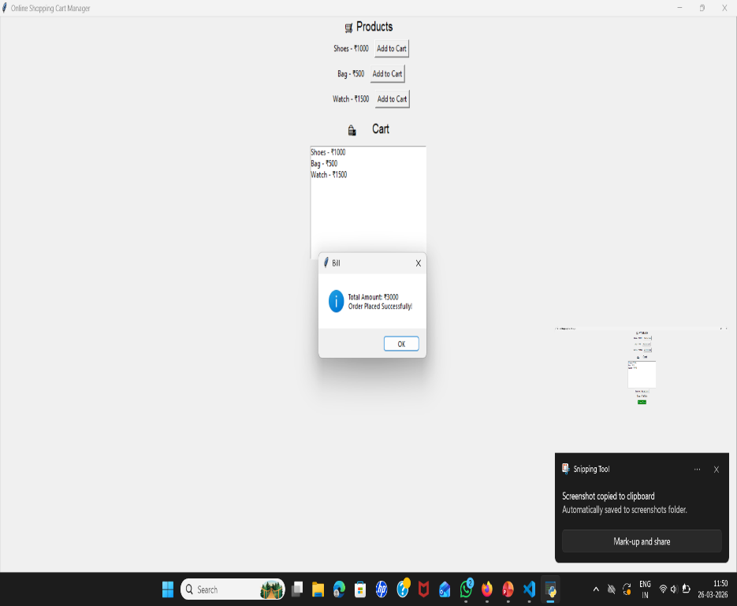
Results and Discussion(Cont..)
Output Screenshot:
Description:
This image shows the Online Shopping Cart Manager after items are added.
All products (Shoes, Bag, Watch) are added to the Cart.
The cart displays each item with its price.
The Total amount is updated to ₹3000.
Users can remove items using “Remove Selected Item”.
The “Place Order” button is used to complete the purchase.

Slide 14
Conclusion
The Online Shopping Cart Manager project successfully demonstrates the basic working of an e-commerce system using Python and Tkinter GUI. It allows users to add products, manage cart items, and generate a bill in a simple and user-friendly interface.This project helped in understanding important programming concepts such as data handling, functions, and user interaction through graphical interfaces. It also shows how frontend and backend logic work together in real-world applications.Overall, this project provides a strong foundation for developing more advanced shopping applications and improves practical knowledge in Python programming.

Slide 15
Thank You
Any queries???

