Slide 1

Mr.Doc
Personal health copilot
Project overview, technology stack, and the experience updates you requested
Product and UX summary · 24 October 2026

Slide 2
TECHNOLOGY
Languages and framework choices
No large frontend framework
APP FLOW
The interface uses native HTML, CSS and JavaScript. The Python backend uses the standard library for its local web server and API requests.
Browser app
Python server
Requests
HTML · CSS · JavaScript
Standard library · port 8000
Three.js
Interactive 3D anatomy and character scenes.
OCR · chat · voice
QRCode.js
Offline QR generation in the browser.
Python standard library
Local browser data
AI services
Saved records
HTTP server, JSON, file handling and outbound API requests.
localStorage · FHIR-style JSON
Gemini · optional Claude
Pillow + pypdfium2
Optional image and PDF support for OCR workflows.
FHIR-style means structured data; it is not an ABDM/ABHA integration.
Interface languages: English, Hindi, Telugu and Tamil. Voice uses Gemini TTS with browser speech fallback.
MR.DOC / PROJECT OVERVIEW
02

Slide 3
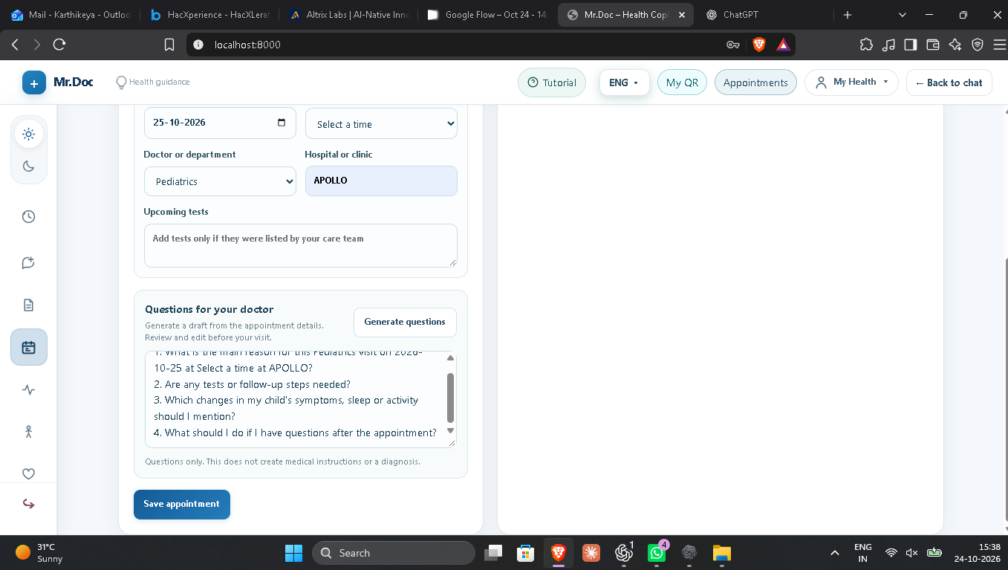
PRODUCT EXPERIENCE
Appointment planning
Appointment details
Date and time
Use clear dropdown controls for date and available time.
Doctor or department
Offer common specialties and clinician types as selectable options.
Questions for the visit
Generate questions from the appointment and specialty.
Compact result
Show highlighted discussion points in a small popup, not a full page or editable question field.
The screenshot shows the current form with generated questions inline. The popup behavior above is the requested refinement.
MR.DOC / PROJECT OVERVIEW
03

Slide 4
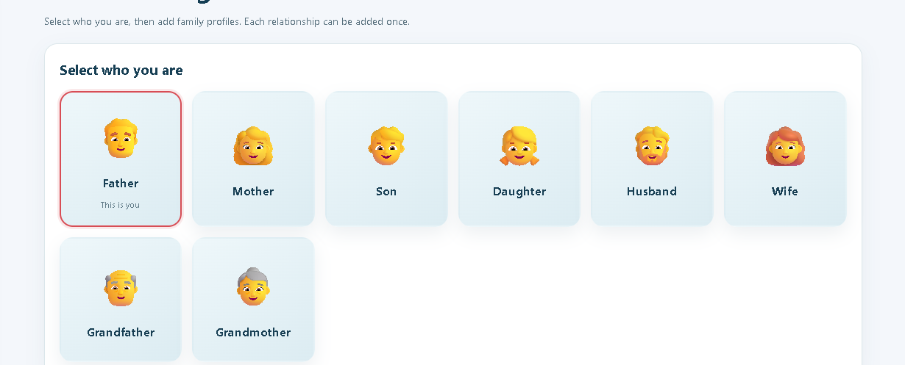
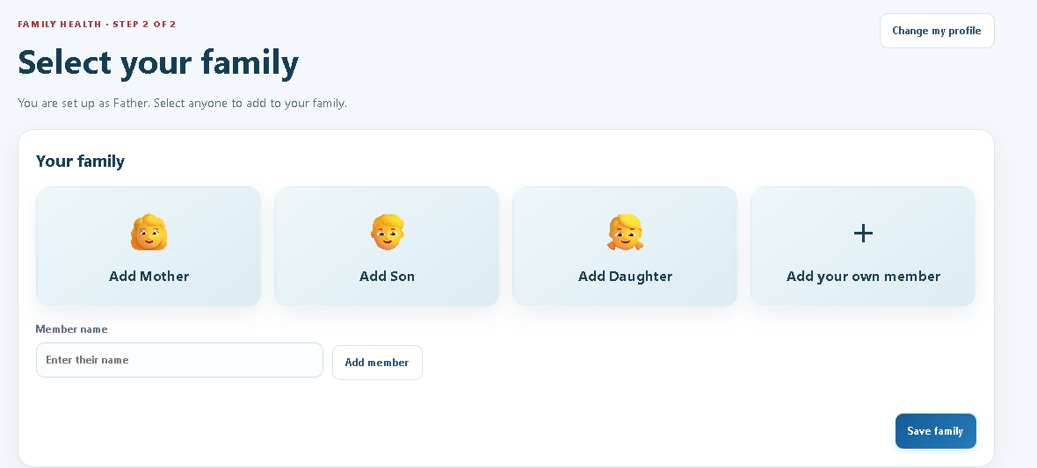
PRODUCT EXPERIENCE
Family profiles
Two-step setup
1 Choose who is using Mr.Doc
Father, Mother, Son or Daughter, with a simple custom option.
2 Confirm, then add family
Show family choices only after the user confirms their own profile.
Separate records
Each selected relationship gets its own profile and health history.
The requested experience removes extra relationship choices from the initial identity screen.
MR.DOC / PROJECT OVERVIEW
04

Slide 5
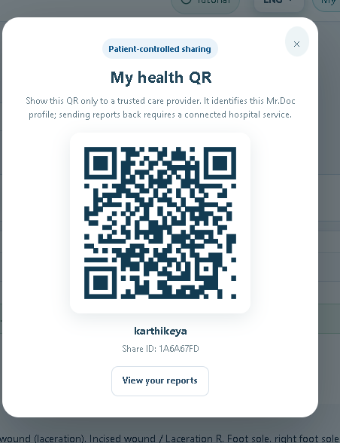
PRODUCT EXPERIENCE
Health QR and navigation
A patient-controlled profile identifier
QR screen
Include a clear “Check your reports” action beside the profile QR.
Top navigation
Remove the duplicate “Your reports” button because reports already have a sidebar entry.
My Health menu
Open on click and stay open while the user selects an option.
Profile menu
Keep My Profile and My Family; remove the duplicate My Health QR item.
The local QR identifies a Mr.Doc profile. Hospital report delivery needs authenticated hospital API or FHIR integration.
MR.DOC / PROJECT OVERVIEW
05

Slide 6
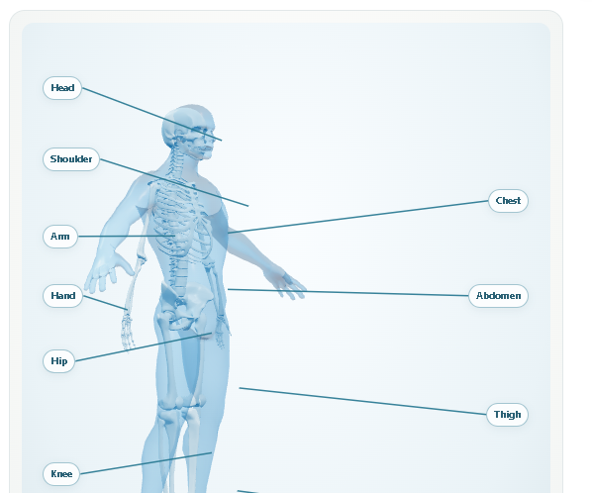
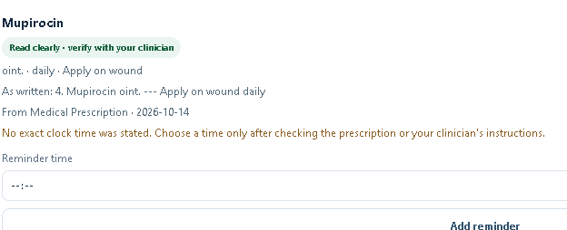
PRODUCT EXPERIENCE
Anatomy view and medicine reminders
Requested refinements
Keep rotation in place
Rotate the model around its own center; keep labels anchored to their correct body parts.
Reduce reminder size
Make “Add reminder” compact but easy to find.
Do not infer dosing times
If the prescription gives no clock time, ask the user to check clinician instructions.
MR.DOC / PROJECT OVERVIEW
06

Slide 7
PRODUCT EXPERIENCE
Personal guidance and patient safety
Support built around the person’s saved information
Wellness guidance
Diet, sleep, habits and general wellbeing can use saved age and records as context.
Doctor discussion support
Summarize relevant history and prepare questions for the clinician.
English, Hindi, Telugu and Tamil
Telugu voice input and spoken answers follow the selected language.
Record gaps stay visible
Missing medicine names, dosage, timing or clinical details are left unclear, never guessed.
Mr.Doc does not diagnose
Tutorial update
It helps explain records and organize care conversations.
Refresh the walkthrough so it matches the current navigation, appointment popup and family setup.
MR.DOC / PROJECT OVERVIEW
07

Slide 8
CONNECTIONS AND NEXT STEPS
Integration boundaries
Available within the current prototype
Requires provider access
Local profile QR
Hospital reports
Generated offline and used to identify a local Mr.Doc profile.
Authenticated hospital API or FHIR connection.
Browser notifications
Smartwatch data
Appointment and report reminders depend on browser permission and app state.
Apple Health, Android Health Connect, Fitbit or another provider API.
Health data
ABDM / ABHA
Saved in browser localStorage and represented with FHIR-style JSON resources.
FHIR-style data does not itself authenticate an ABHA ID or connect to ABDM.
Project stack
HTML · CSS · JavaScript · Python · Three.js · QRCode.js · Gemini · optional Anthropic Claude
Based on the project README, code and screenshots supplied for this overview.
MR.DOC / PROJECT OVERVIEW
08

