Slide 1

ACADEMIC YEAR 2026-27
S5 PROJECT WORK I | FINAL REVIEW
CLIMATESHIELD AI
REAL-TIME FLOOD PREDICTION AND EARLY WARNING SYSTEM
USING ML FOR TAMIL NADU RIVER BASINS
BIP PROJECT ID
2026MIN332
PROJECT TYPE
ACADEMIC PROTOTYPE
BATCH MEMBERS
Karthikeyan M (7376242IT193)
Jaya Prakash S (7376242IT185)
Rohith K (7376242IT277)
GUIDE
Prof. Anandan P
Associate Professor Level II
Department of Computer Science and Engineering

Slide 2
PROJECT WORK PLAN
Aim
To develop a machine-learning-based system that forecasts daily river-discharge conditions for selected Tamil Nadu river basins and supports flood-risk assessment as decision support.
Objectives
• Select stations and document source, units, sampling cadence and data availability.
• Validate, clean and align rainfall and discharge data; preserve raw source files and provenance.
• Engineer lagged, rolling, cumulative and seasonal features using only information available at forecast time.
• Train and compare a persistence baseline with Ridge, Decision Tree, Random Forest, Gradient Boosting and XGBoost.
• Evaluate 1-, 3- and 7-day forecasts with MAE, RMSE, R²/NSE and flood-event metrics.
• Present forecast, data status and risk interpretation through a Streamlit dashboard and FastAPI service.
Scope and target
Current supplied scores evaluate daily modelled GloFAS discharge (m³/s), not directly measured river water level. Updates are daily near-real-time, not sub-hourly sensor telemetry.

Slide 3
EFFECTIVE UTILIZATION OF THE MODERN TOOL
Data Sources: Open-Meteo Historical Weather and Flood APIs; GloFAS modelled daily discharge; optional gauge validation from CWC / NWDP / India-WRIS if obtained.
Data Processing: Python, pandas and NumPy for ingestion, validation, cleaning, timestamp alignment and temporal feature generation.
Machine Learning: scikit-learn for persistence, Ridge Regression, Decision Tree, Random Forest and Gradient Boosting; XGBoost for gradient boosting.
Visualization: Streamlit dashboard, Plotly and Matplotlib for historical replay, forecast plots, metric comparisons and status display.
API Layer: FastAPI endpoints for predictions, station information, model performance and health checks.
Testing and Configuration: pytest, YAML configuration, validation reports, smoke tests and experiment result files.
Development Tools: VS Code, Git/GitHub and an AI coding agent (Antigravity), with generated code reviewed and tested by the team.
Model note: LSTM remains an originally considered candidate but no LSTM scores are present in the supplied 144-record results file.

Slide 4
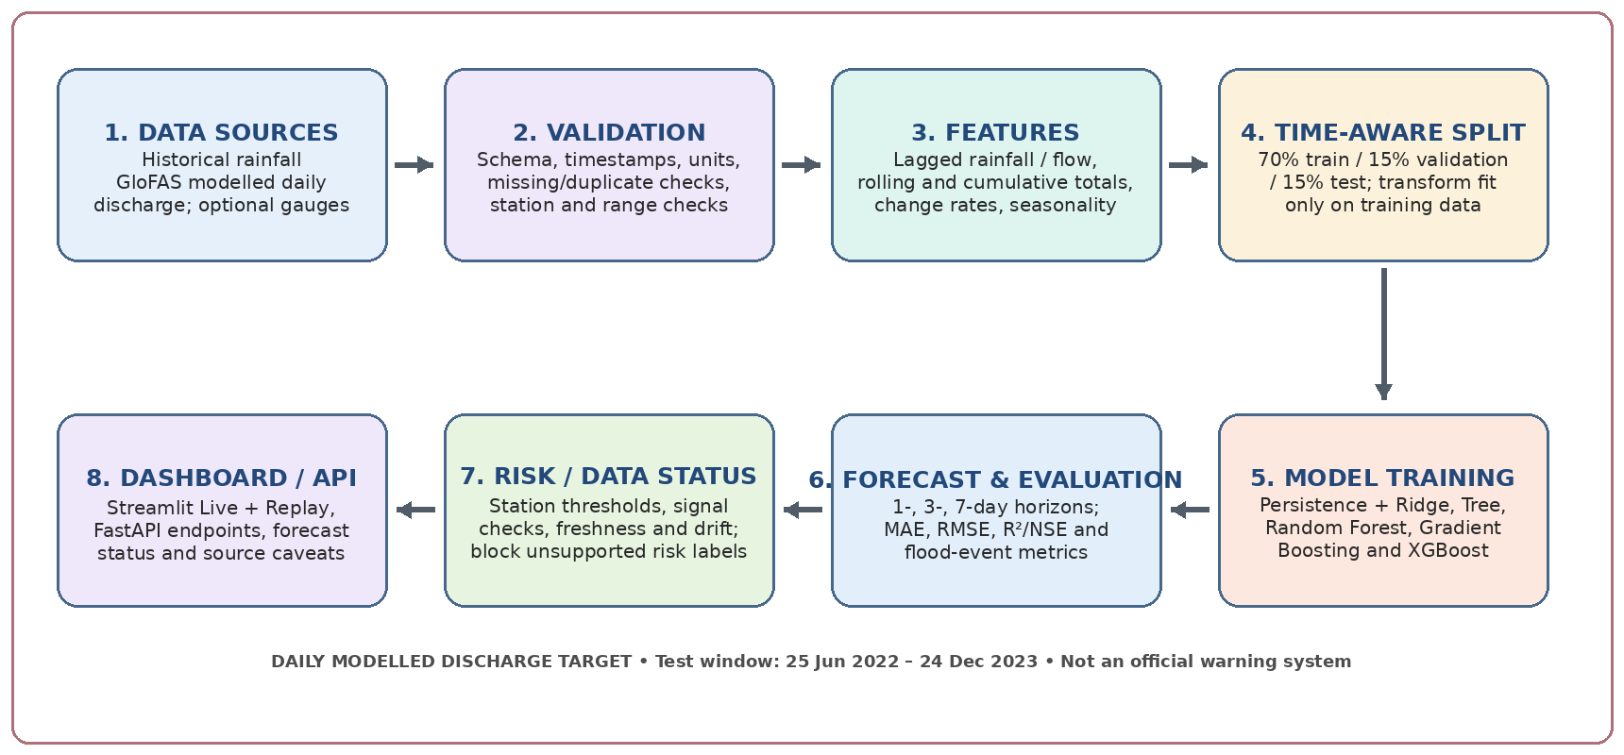
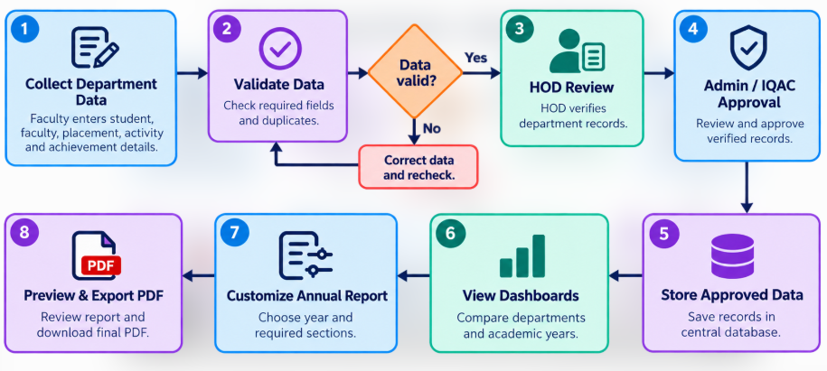
PROPOSED METHODOLOGY (FLOW CHART)

Slide 5
PROPOSED METHODOLOGY (GANTT CHART)
Phase
W1
W2
W3
W4
W5
W6
W7
W8
W9
W10
W11
W12
W13
W14
W15
W16
W17
Problem definition & literature
Data source / station selection
Data validation & EDA
Target & temporal features
Baseline / ML model training
Evaluation & event metrics
Live layer, dashboard & API
Testing, validation & report
Indicative 17-week plan; model pipeline and dashboard implemented; gauge validation, data extension and fetch/drift refinements remain open.

Slide 6
MODULES
1. Data & Source Configuration
Open-Meteo historical weather and Flood/GloFAS APIs; station IDs, coordinates, units and date windows.
2. Data Validation & Alignment
Check schema, timestamps, ranges, missing/duplicate observations, units and daily time alignment.
3. Temporal Feature Engineering
Lagged rainfall/flow, rolling and cumulative rainfall, rates of change and seasonal terms; no future leakage.
4. Forecasting Models
Persistence baseline, Ridge, Decision Tree, Random Forest, Gradient Boosting and XGBoost. LSTM has no score in the supplied file.
5. Evaluation & Risk Layer
1-, 3- and 7-day evaluation, event metrics, station signal checks, data freshness and drift status.
6. Dashboard & API
Streamlit Live/Replay dashboard, forecast/status cards, CSV/JSON downloads and FastAPI endpoints.

Slide 7
MODELS AND PERFORMANCE SCORES
PRIMARY DEMONSTRATION: TN_CAU_TRICHY | TARGET: MODELLED DAILY DISCHARGE (m³/s)
Test window: 25 Jun 2022 – 24 Dec 2023 | Train: 2,551 rows | Validation: 546 | Test: 548
Horizon | Best RMSE model | MAE (m³/s) | RMSE (m³/s) | R² / NSE | Persistence RMSE
1-day | Ridge | 0.8654 | 2.4969 | 0.6585 | 2.6684
3-day | Ridge | 1.7516 | 3.8650 | 0.1817 | 4.4910
7-day | Ridge | 2.1144 | 4.0330 | 0.1091 | 5.0495
1-DAY R² 0.6585
Ridge | RMSE 2.4969 m³/s
3-DAY R² 0.1817
Ridge | RMSE 3.8650 m³/s
7-DAY R² 0.1091
Ridge | RMSE 4.0330 m³/s
Across 24 station–horizon groups, Ridge had the lowest RMSE in 16. Negative R² records increased with lead time: 4/48 (1 day), 28/48 (3 days), and 36/48 (7 days).
Interpretation: R²/NSE are regression fit metrics, not classification accuracy. Results are station-specific forecasts of Open-Meteo/GloFAS modelled discharge on a roughly 5 km grid—not verified gauge water levels. Event thresholds use training-set 95th percentiles, not official CWC warning/danger levels; gauge validation and station-grid checks remain pending.

Slide 8
ADVANTAGES AND LIMITATIONS
ADVANTAGES
LIMITATIONS
• Reproducible comparison across eight station IDs and three forecast horizons.
• Persistence baseline makes it possible to test whether ML adds value.
• Combines MAE, RMSE, R²/NSE and event-oriented metrics.
• Dashboard supports Live and Historical Replay modes.
• Freshness/drift status, CSV/JSON outputs and modular API design improve traceability.
• Target is modelled GloFAS discharge on a roughly 5 km grid, not measured gauge flow or direct water level.
• Daily cadence only; this is near-real-time, not sensor-to-screen real-time.
• Stored history ends 31 Dec 2023; extension and retraining are planned.
• Gauge validation is not yet complete; several station locations fail the signal rule.
• Predictive skill weakens at longer horizons for many model/station combinations.
• Fetch timeouts/drift flags need refinement; percentile event thresholds are not official flood levels.

Slide 9
CONCLUSION AND FUTURE WORK
Conclusion
ClimateShield AI is a modular academic prototype for daily river-discharge forecasting at selected Tamil Nadu locations. The data pipeline, features, model evaluation and Streamlit Live/Replay dashboard are reported as implemented; the live fetch works but timeout/fallback and drift handling still need tuning.
Key experimental finding
In the supplied 144 records, Ridge achieved the lowest RMSE in 16 of 24 station/horizon groups. Negative R² became much more common at 3- and 7-day horizons. Modelled-discharge results should not be presented as validated water-level or official warning accuracy.
Next steps
Extend the daily archive and retrain; validate at least one station against CWC gauge records; verify station coordinates and grid-cell selection; backtest a known flood event and warning lead time; refine fetch/drift handling; add per-season analysis and feature explanations such as SHAP.

Slide 10
COST BENEFIT ANALYSIS
COSTS
• Open-source Python, scikit-learn, XGBoost, Streamlit, FastAPI and pytest reduce license costs.
• Main effort is development, data-quality work, testing and maintaining the pipeline.
• Network use, storage, optional hosting and gauge-data integration may add future costs.
• No dedicated sensor hardware is required for the present daily-data prototype.
BENEFITS
• Automates the daily forecast and makes 1-, 3- and 7-day comparisons accessible.
• Historical Replay helps examine forecasts against later observations.
• Status messages, source caveats and exported scores support traceable analysis.
• Open-source tools make the prototype reusable and extendable.
OVERALL ANALYSIS
The prototype has low direct software-licensing cost, but no quantified institutional savings have been measured. Its practical value depends on better data coverage, gauge validation, event-based backtesting and reliable daily updates. Results are decision-support research and do not replace official CWC / IMD / Tamil Nadu SDMA warnings.

Slide 11
INDIVIDUAL CONTRIBUTIONS TO THE WORK
Batch Members: Jaya Prakash S (7376242IT185) | Karthikeyan M (7376242IT193) | Rohith K (7376242IT277)
Research & Data Analysis
ML Models & Evaluation
Dashboard, API & Testing
Member: Jaya Prakash S
• Review flood-forecasting literature and existing systems.
• Document the problem, objectives, scope and research context.
• Support source provenance and data-quality review.
• Contribute to report and reference preparation.
Member: Karthikeyan M
• Develop and compare baseline / ML forecasting models.
• Define temporal features, target horizons and validation design.
• Analyze MAE, RMSE, R²/NSE and event scores.
• Interpret station-wise results and forecast limitations.
Member: Rohith K
• Build the Streamlit forecast and historical replay views.
• Integrate the FastAPI prediction and health endpoints.
• Present risk/status messages, freshness and drift caveats.
• Support system testing, documentation and demonstration.

Slide 12
REFERENCES (JOURNAL PAPERS / BOOKS / WEBSITE REFERENCES)
REFERENCES (IEEE-style listing)
[1] M. Asif et al., “Review and Intercomparison of Machine Learning Applications for Short-term Flood Forecasting,” Water Resources Management, vol. 39, 2025.
[2] “Water Level Prediction Model Applying a Long Short-Term Memory (LSTM)-Gated Recurrent Unit (GRU) Method for Flood Prediction,” Water, vol. 14, no. 14, 2221, 2022.
[3] W. Sanders et al., “Data-Driven Flood Alert System (FAS) Using Extreme Gradient Boosting (XGBoost) to Forecast Flood Stages,” Water, vol. 14, no. 5, 747, 2022.
[4] A. Faruq et al., “River water level forecasting for flood warning system using deep learning long short-term memory network,” IOP Conference Series: Materials Science and Engineering, vol. 821, 2020.
[5] Central Water Commission (CWC), Hydro-Meteorological Observation and flood forecasting resources. https://cwc.gov.in/
[6] Open-Meteo, Flood API documentation (modelled GloFAS discharge). https://open-meteo.com/en/docs/flood-api
[7] Open-Meteo, Historical Weather API documentation. https://open-meteo.com/en/docs/historical-weather-api
[8] scikit-learn documentation. https://scikit-learn.org/stable/ ; XGBoost documentation. https://xgboost.readthedocs.io/
[9] Streamlit documentation. https://docs.streamlit.io/ ; FastAPI documentation. https://fastapi.tiangolo.com/

Slide 13
APPENDIX: 1-DAY TEST RESULTS BY STATION
Best model = lowest RMSE among six supplied candidates | Horizon = 1 day(s)
Station | Best model | MAE | RMSE | R² / NSE | Persistence RMSE | RMSE reduction
Cauvery - Trichy TN_CAU_TRICHY | Ridge | 0.8654 | 2.4969 | 0.6585 | 2.6684 | 6.4%
Vaigai - Madurai TN_VAI_MADURAI | Ridge | 2.7110 | 5.3874 | 0.7214 | 5.8402 | 7.8%
Noyyal - Tiruppur TN_NOY_TIRUPPUR | Ridge | 4.7361 | 7.9316 | 0.8143 | 8.8961 | 10.8%
Thamirabarani - Tirunelveli TN_THA_TIRUNELVELI | Ridge | 0.2890 | 1.3889 | 0.7261 | 1.7862 | 22.2%
Palar - Vellore TN_PAL_VELLORE | Random Forest | 0.1649 | 0.5170 | 0.6978 | 0.6182 | 16.4%
Bhavani TN_BHA_BHAVANI | Ridge | 0.0637 | 0.1174 | 0.7293 | 0.1333 | 11.9%
Cauvery - Musiri TN_CAU_MUSIRI | Ridge | 0.1013 | 0.3327 | 0.5258 | 0.3740 | 11.0%
Cauvery - Mettur TN_CAU_METTUR | Persistence | 0.0136 | 0.0328 | 0.6962 | 0.0328 | 0.0%
29-10-2026
Values apply to each station, tested period and modelled daily discharge target. R² is not classification accuracy; event thresholds are training-set 95th percentiles, not official CWC levels.

Slide 14
APPENDIX: 3-DAY TEST RESULTS BY STATION
Best model = lowest RMSE among six supplied candidates | Horizon = 3 day(s)
Station | Best model | MAE | RMSE | R² / NSE | Persistence RMSE | RMSE reduction
Cauvery - Trichy TN_CAU_TRICHY | Ridge | 1.7516 | 3.8650 | 0.1817 | 4.4910 | 13.9%
Vaigai - Madurai TN_VAI_MADURAI | Ridge | 4.3703 | 8.3040 | 0.3382 | 10.2938 | 19.3%
Noyyal - Tiruppur TN_NOY_TIRUPPUR | Ridge | 9.4190 | 14.6915 | 0.3626 | 16.8075 | 12.6%
Thamirabarani - Tirunelveli TN_THA_TIRUNELVELI | Ridge | 0.5761 | 2.3773 | 0.1976 | 3.2774 | 27.5%
Palar - Vellore TN_PAL_VELLORE | Ridge | 0.3960 | 0.9907 | -0.1094 | 1.1618 | 14.7%
Bhavani TN_BHA_BHAVANI | Ridge | 0.1219 | 0.1887 | 0.3029 | 0.2205 | 14.4%
Cauvery - Musiri TN_CAU_MUSIRI | Ridge | 0.1792 | 0.4811 | 0.0085 | 0.5996 | 19.8%
Cauvery - Mettur TN_CAU_METTUR | Persistence | 0.0285 | 0.0559 | 0.1191 | 0.0559 | 0.0%
29-10-2026
Values apply to each station, tested period and modelled daily discharge target. R² is not classification accuracy; event thresholds are training-set 95th percentiles, not official CWC levels.

Slide 15
APPENDIX: 7-DAY TEST RESULTS BY STATION
Best model = lowest RMSE among six supplied candidates | Horizon = 7 day(s)
Station | Best model | MAE | RMSE | R² / NSE | Persistence RMSE | RMSE reduction
Cauvery - Trichy TN_CAU_TRICHY | Ridge | 2.1144 | 4.0330 | 0.1091 | 5.0495 | 20.1%
Vaigai - Madurai TN_VAI_MADURAI | Ridge | 5.3214 | 9.6813 | 0.1007 | 12.2038 | 20.7%
Noyyal - Tiruppur TN_NOY_TIRUPPUR | Ridge | 11.7148 | 17.2736 | 0.1130 | 20.5449 | 15.9%
Thamirabarani - Tirunelveli TN_THA_TIRUNELVELI | Decision Tree | 0.6763 | 2.3624 | 0.2075 | 3.5158 | 32.8%
Palar - Vellore TN_PAL_VELLORE | Random Forest | 0.4382 | 0.9979 | -0.1252 | 1.3349 | 25.2%
Bhavani TN_BHA_BHAVANI | Random Forest | 0.1491 | 0.2160 | 0.0907 | 0.2739 | 21.1%
Cauvery - Musiri TN_CAU_MUSIRI | Xgboost | 0.1450 | 0.4908 | -0.0316 | 0.6534 | 24.9%
Cauvery - Mettur TN_CAU_METTUR | Persistence | 0.0406 | 0.0705 | -0.4003 | 0.0705 | 0.0%
29-10-2026
Values apply to each station, tested period and modelled daily discharge target. R² is not classification accuracy; event thresholds are training-set 95th percentiles, not official CWC levels.

