Slide 1

CONVERSATIONAL AI CHATBOT
CREATIVE AND INNOVATIVE PROJECT
IT7611
SUBMITTED BY
Karthikeyan J M (2018506049)
Dinesh V (2018506028)
Abinaya A (2018506003) BATCH: 20

Slide 2
ABSTRACT
Conversational AI chatbot using deep learning is an interesting problem in the natural language processing.
A chatbot is a software program designed to simulate conversation with human users, especially over the Internet.
Chatbots provide the assistance to the required information quickly and efficiently.
The first chat bot was made by Joseph Weizenbaum.
Each of these commands should be written by the developer separately using string analysis.
Smart chatbots rely on AI when they are communicating with users.
Instead of pre-prepared answers, the bot responds with best possible suggestions on the topic.

Slide 3
OBJECTIVE
To develop a generative based conversational chatbot using Seq2Seq with Attention mechanism for society and enterprise applications.

Slide 4
SCOPE
Conversational AI Chatbot using Deep Learning is an interesting problem in the field of Natural Language Processing.
Chatbot is a Software program that generates response based on given input to mimic human conversations in text or voice mode. These applications are designed to simulate human-human interactions.
In the past, methods for constructing chatbot architectures have relied on hand-written rules and templates or simple statistical methods.
With the rise of deep learning, these models were quickly replaced by end-to-end trainable neural networks.
To overcome these limitations, we try to develop a generative based conversational chatbot using Seq2Seq with Attention mechanism for society and enterprise applications.

Slide 5
Existing Models
Among current chatbots, many are developed using rule-based techniques, simple machine learning algorithms or retrieval-based techniques which do not generate good results.
Especially when dealing with real world data the sentences may be long enough where it may lead to the failure of the existing models.

Slide 6
Proposed Model
As a solution to this problem we propose Seq2Seq model with attention mechanism using modern-day techniques.
For developing Seq2Seq AI Chatbot, we propose a encoder-decoder attention mechanism architecture. This encoder-decoder will be using Recurrent Neural Network with LSTM (Long-Short-Term-Memory) cells.
The novelty in our project is that we use attention mechanism to our encoder-decoder Seq2Seq AI Chatbot which helps in giving human like responses based on selection of inputs.

Slide 7

Sequence-Sequence
A sequence is an ordered list of symbols. For Ex:
A sequence of webpages visited by a user, ordered by the time of access.
A sequence of words or characters typed on a cellphone by a user, or in a text such as a book.
A sequence of products bought by a customer in a retail store.
A sequence of symptoms observed on a patient at a hospital.
The task of sequence prediction consists of predicting the next symbol of a sequence based on the previously observed symbols. For example, if a user has visited some webpages A, B, C, in that order, one may want to predict what is the next webpage that will be visited by that user to prefetch the webpage.

Slide 8
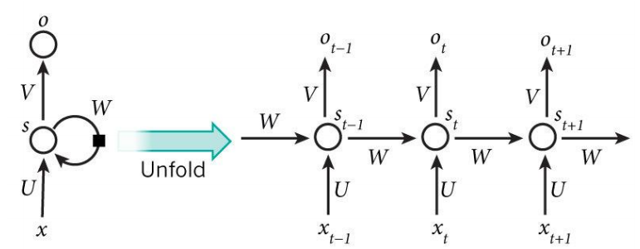
Recurrent Neural Networks
Recurrent Neural Networks, or RNNs, were designed to work with sequence prediction problems.
Recurrent means the output at the current time step becomes the input to the next time step. At each element of the sequence, the model considers not just the current input, but what it remembers about the preceding elements.
Why RNN?
To maintain word order
To share parameters across the sequence

Slide 9
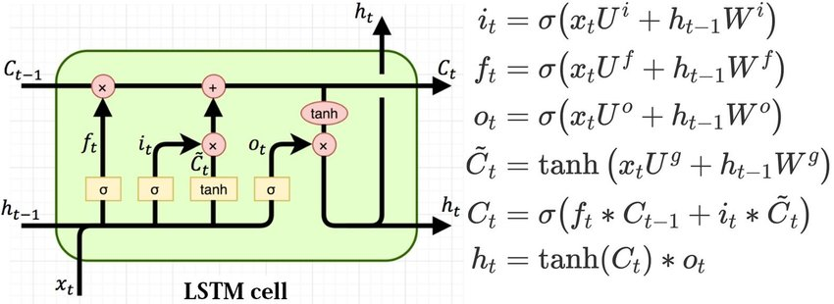
Long Short-Term Memory
Long Short-Term Memory (LSTM) networks are a type of recurrent neural network capable of learning order dependence(long-term dependencies) in sequence prediction problems.
This is a behavior required in complex problem domains like machine translation, speech recognition, and more.

Slide 10
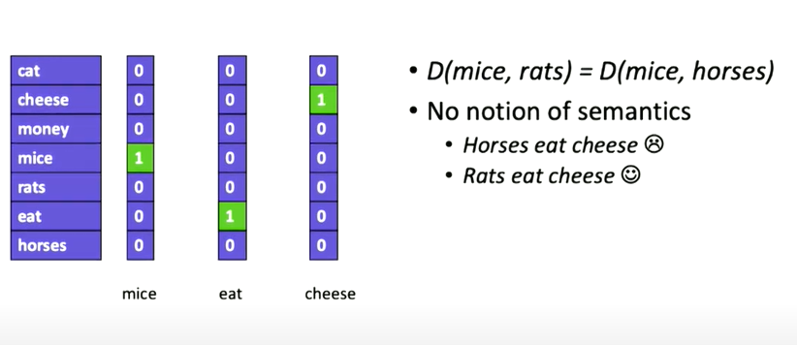
Word Representation: One-hot
No Semantic Meaning

Slide 11
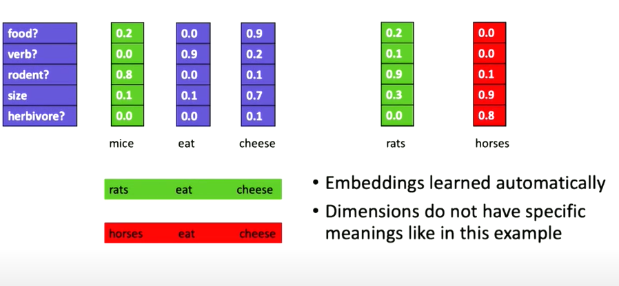
Word Embeddings
Enable semantics.
Measures distance between words in semantic space

Slide 12
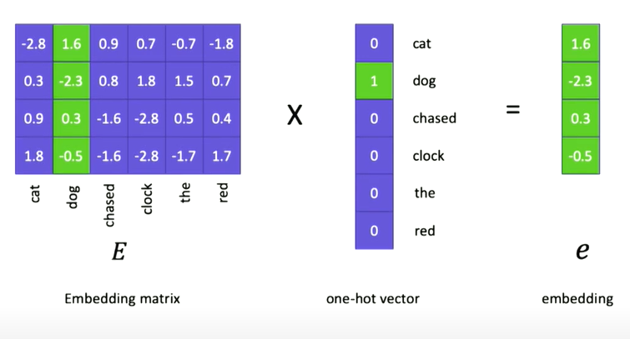
From one-hot to Embeddings
Embedding matrix is a learned parameters of the model.
Embedding vector for the particular word.

Slide 13
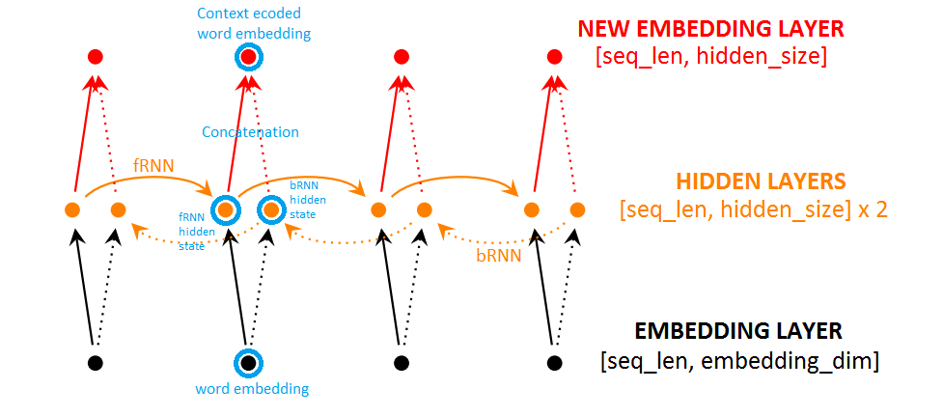
Bidirectional RNN
Bidirectional Recurrent Neural Networks (BRNN) connect two hidden layers of opposite directions to the same output. With this form of generative deep learning, the output layer can get information from past (backwards) and future (forward) states simultaneously.

Slide 14
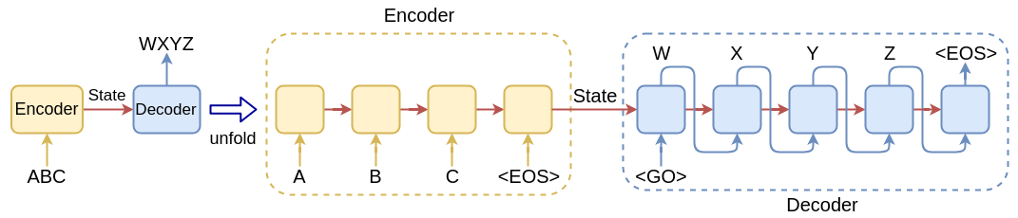
Seq2Seq model or RNN Encoder-Decoder
RNN Encoder–Decoder, consists of two recurrent neural networks (RNN) that act as an encoder and a decoder pair. An “encoder” RNN reads the source sentence and transforms it into a rich fixed-length vector representation, which in turn in used as the initial hidden state of a “decoder” RNN (context vector) that generates the target sentence. The encoder maps a variable-length source sequence to a fixed-length vector, and the decoder maps the vector representation back to a variable-length target sequence.

Slide 15
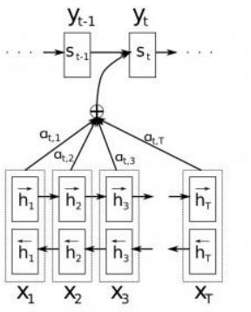
Attention Mechanism(Bahdanau Attention)
The attention mechanism, allows the decoder to selectively look at the input sentence while decoding. This takes the pressure off the encoder to encode every useful information from the input.
The idea of the attention mechanism is to form direct short-cut connections between the target and the source by paying “attention” to relevant source content.

Slide 16
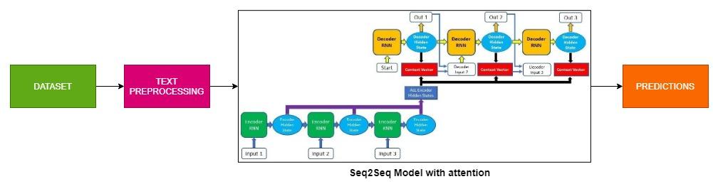
Architecture of Seq2Seq model with Attention Mechanism

Slide 17
Dataset : Cornell Movie Dialogs Corpus
This corpus contains a large metadata-rich collection of fictional conversations extracted from raw movie scripts.
220,579 conversational exchanges between 10,292 pairs of movie characters
Involves 9,035 characters from 617 movies
In total 304,713 utterances
Movie metadata included: Genres, Release year, IMDB rating, Number of IMDB votes
Character metadata included:
Gender (for 3,774 characters)
Position on movie credits (3,321 characters)

Slide 18
TECHNICAL STACK
Google Colab
NumPy Stack(NumPy, Pandas, SciPy, Matplotlib)
TensorFlow 1.4
Flask

Slide 19
IMPLEMENTATION & ALGORITHM
Load dataset into colab notebook
Pre-process the data
Build the Seq2Seq model with attention
Split the data to encoder and decoder inputs
Train the model
Evaluate the model with predictions

Slide 20
PREPROCESSING - I
Step 1:
Read from 'movie_conversations.txt'
Create a list of [list of line_id's]
Output Ex: ['L194', 'L195', 'L196', 'L197']
Step 2:
Read from 'movie-lines.txt'
Create a dictionary with ( key = line_id, value = text )
They do not!
They do to!
I hope so.
She okay?
Let's go.
Wow
Okay -- you're gonna need to learn how to lie.
No
I'm kidding. You know how sometimes you just become this "persona"? And you don't know how to quit?

Slide 21
PREPROCESSING - II
Step 3:
Get lists of all conversations as Questions and Answers
[questions]
[answers]
Question and answers are come from same conversation. As because there will be a question with the response.
Ex: For our first conversation
Q Can we make this quick? Roxanne Korrine and Andrew Barrett are having an incredibly horrendous public break- up on the quad. Again.
A Well, I thought we'd start with pronunciation, if that's okay with you.
Step 4:
Clean Text:
Text to lowercase
Replacing certain words as follow:
Ex:
text = re.sub(r"i'm", "i am", text)
text = re.sub(r"he's", "he is", text)
text = re.sub(r"she's", "she is", text)

Slide 22
PREPROCESSING - III
Step 5:
Filter out the Questions and Answers that are too short/long
Minimum & Maximum length are 2 & 5
Step 6:
Get each word and its count from filtered questions and answers in vocab dictionary
Get each word and its count from filtered questions and answers in Question and Answer vocab dictionary
Step 7:
Create vocabulary index with total number of words appear more than 2 times in vocab dictionary
6281 words which appear more appear more than 2 times
Step 8:
For each codes(<EOS>,<PAD>,<UNK><GO>) ,increment vocabulary index to 1 for each existing code
Same for question and answer vocab.
Now vocab index will be 6285

Slide 23
PREPROCESSING - IV
Step 9:
Create index vocabulary from vocabulary index dictionary
index vocabulary dict_items([(0, 'what'), (1, 'good'), (2, 'stuff'), (3, 'she'), (4, 'okay'), (5, 'they'),......
......., (6283, '<PAD>'), (6284, '<EOS>'), (6285, '<UNK>'), (6286, '<GO>')])
Step 10:
Add EOS tag at the end of each answer
Ex: the real you → the real you <EOS>
Step 11:
Again filter out words in by comparing words in filtered question and words in vocabulary index and replace the words that are not present in the vocabulary index dictionary with the <UNK> tag.
Do the same for filtered answer

Slide 24
Building Seq2Seq Model with Attention
Building the encoder model with Bi-directional LSTM with their hidden states collectively fed into the attention model which is a feedforward neural network with a fixed window size with some weights.
Building the decoder model with Uni-LSTM with context vectors from the attention mechanism is fed into the decoder model and corresponding outputs are generated with the use of decoder initial state and context vectors.
Building the Bahdanau Attention model with their inputs from the encoder hidden states and generating the context vectors from a fixed window size.
Configuring the model with Adam optimizer and Sequence loss function and configuring the parameters such as rnn size, embedding size, batch size, epochs, learning rate, etc.
Splitting the dataset into train and test dataset with question dictionary fed into encoder model and answer dictionary fed into the decoder model and preparing the validation dataset based on the batch size mentioned.
Training the seq2seq model with feeding the data with the help of embedding vectors to predict the correct output.
Compute the accuracy and loss by comparing the output generated with the true words.
Update the parameters of the model until minimal loss is achieved.
Testing the model with validation data with feeding the validation data sentences and predicting the output with the true words and measuring the bleu score.
High bleu score measures the accuracy of the model.
End

Slide 25
Frontend TechStack
HTML
CSS
AJAX
Bootstrap
JavaScript
FLASK

Slide 26
Frontend Implementation
GUI (graphical user interface) was developed using flask app.
Flask app that provides a chat interface to the user, to interact with our seq2seq model.
The reply method in the code is called via an AJAX request from index.js.
It sends the text from user to our seq2seq model, which returns a reply.
The reply is passed to index.js and rendered as text in the chat box.

Slide 27
Evaluation Metrics
BLEU Score: The closer a machine translation is to a professional human translation, the better it is BLEU, a method for automatic evaluation of machine translation.
N-gram: It is a sequence of words occurring within a given window where n represents the window size.
Precision: Sum of the clipped n-gram counts for all the candidate sentences in the corpus divide by the number of candidate n-grams.
Adam Optimizer: It combines the best properties of the AdaGrad and RMSProp algorithms to provide an optimization algorithm that can handle sparse gradients on noisy problems.
Accuracy: It is defined as the percentage of correct predictions for the test data.
Loss: A loss function, also known as a cost function, takes into account the probabilities or uncertainty of a prediction based on how much the prediction varies from the true value.

Slide 28
PERFORMANCE ANALYSIS

Slide 29
Cofigurations
Parameters | Config1 | Config2 | Config3 | Config4 | Config5 | Config6 | Config7 | Config8 | Config9 | Config10
Batch Size | 128 | 128 | 512 | 512 | 128 | 512 | 512 | 1024 | 1024 | 1024
Embedding Size | 2048 | 2048 | 1024 | 2048 | 128 | 512 | 512 | 512 | 1024 | 2048
RNN Size | 1024 | 2048 | 1024 | 1024 | 128 | 512 | 512 | 512 | 512 | 1024
Learning Rate | 0.001 | 0.001 | 0.001 | 0.001 | 0.001 | 0.001 | 0.001 | 0.001 | 0.001 | 0.001
Epochs | 50 | 50 | 80 | 80 | 50 | 80 | 80 | 50 | 50 | 50
Keep Probability | 0.75 | 0.8 | 0.85 | 0.90 | 0.8 | 0.75 | 0.85 | 0.85 | 0.90 | 0.90
Minimum Learning Rate | 0.0001 | 0.0001 | 0.0001 | 0.0001 | 0.0001 | 0.0001 | 0.0001 | 0.001 | 0.0001 | 0.0001
Learning Rate Decay | 0.99 | 0.99 | 0.99 | 0.99 | 0.9 | 0.99 | 0.99 | 0.99 | 0.99 | 0.99

Slide 30
RESULTS
Results | Config1 | Config2 | Config3 | Config4 | Config5 | Config6 | Config7 | Config8 | Config9 | Config10
Average Accuracy | 0.575 | 0.533 | 0.641 | 0.639 | 0.344 | 0.637 | 0.639 | 0.638 | 0.629 | 0.634
Average Loss | 0.334 | 0.515 | 0.129 | 0.129 | 1.289 | 0.157 | 0.148 | 0.189 | 0.165 | 0.130
BLEU Score | 30.99 | 26.39 | 36.13 | 36.52 | 11.98 | 34.77 | 35.74 | 38.67 | 38.77 | 39.06

Slide 31
BLEU Scores Comparison
Research Paper | BLEU score
K. Cho, B. van Merrienboer, et.al - “Learning Phrase Representation RNN Encoder-Decoder for Statistical Machine Translation” | 33.3
D. Bahdanau, K. Cho, Y. Bengio - “Neural Machine Translation By Jointly Learning To Align And Translate ” | 35.63
Sutskever, O. Vinyals, Q. Le – “Sequence to Sequence Learning with Neural Networks” | 36.5
A. Sordoni, M. Galley, et.al – “A Neural Network Approach to Context-Sensitive Generation of Conversational Responses” | 33.0
Proposed Approach – “Conversational AI Chatbot” | 39.06

Slide 32
COMPARISON GRAPHS

Slide 33
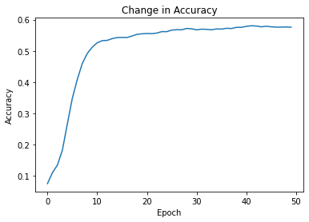
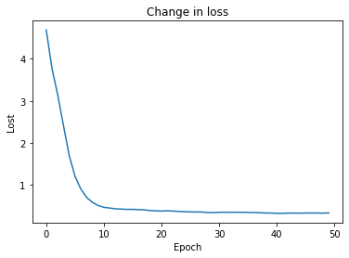
Configuration 1
Accuracy and Loss

Slide 34
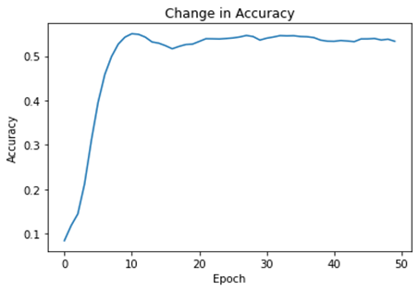
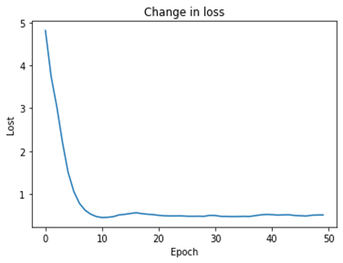
Configuration 2
Accuracy and Loss

Slide 35
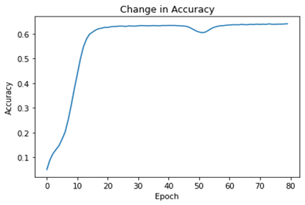
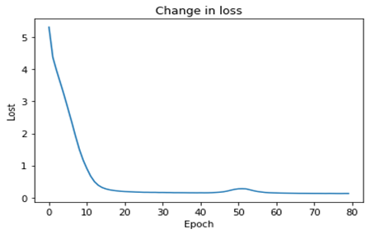
Configuration 3
Accuracy and Loss

Slide 36
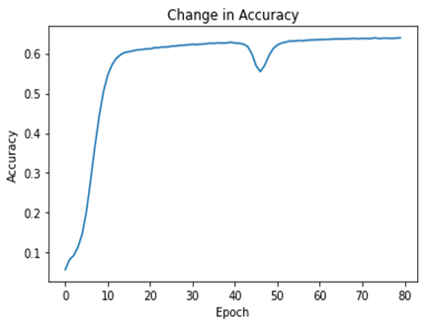

Configuration 4
Accuracy and Loss

Slide 37
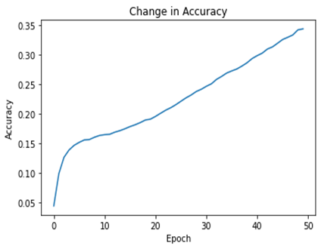
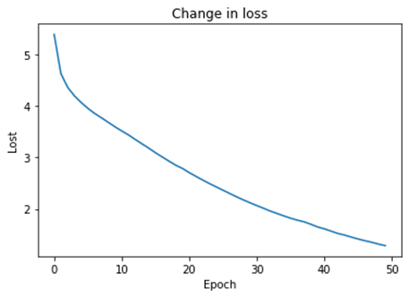
Configuration 5
Accuracy and Loss

Slide 38
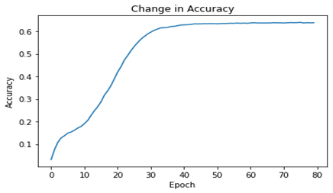
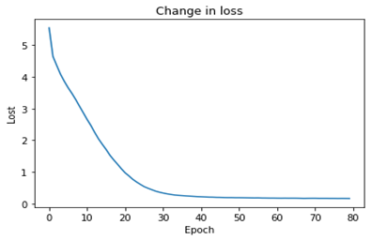
Configuration 6
Accuracy and Loss

Slide 39
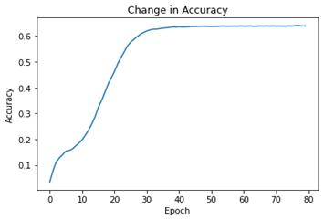

Configuration 7
Accuracy and Loss

Slide 40
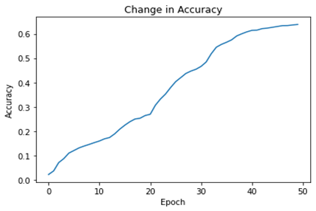
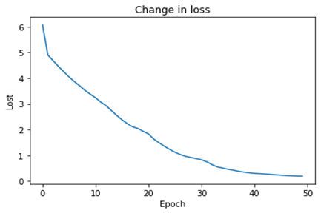
Configuration 8
Accuracy and Loss

Slide 41
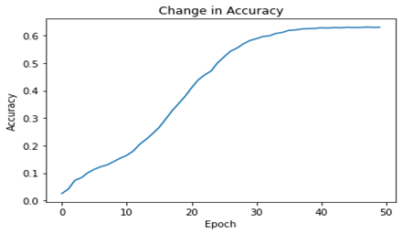
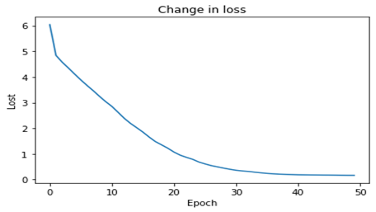
Configuration 9
Accuracy and Loss

Slide 42
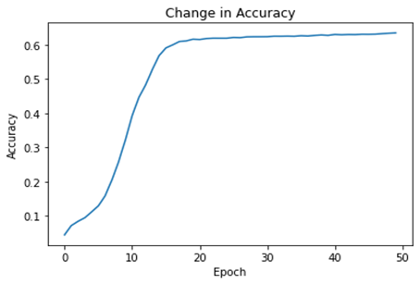
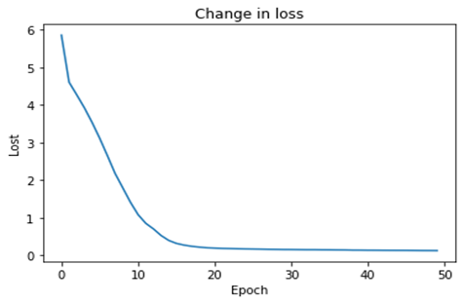
Configuration 10
Accuracy and Loss

Slide 43
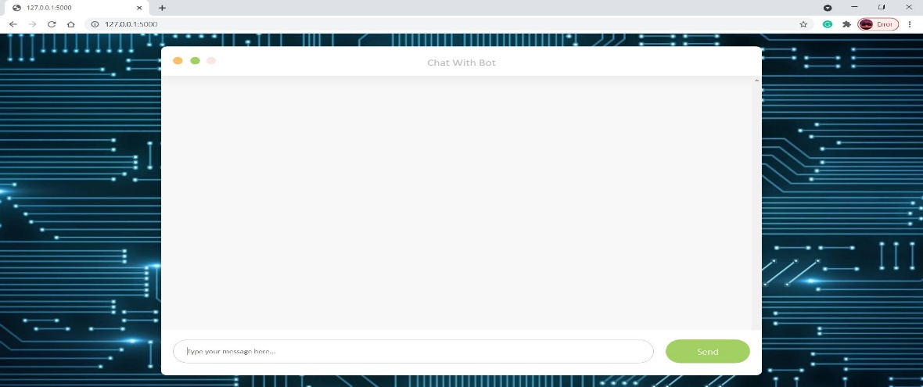
Initial Chatbot

Slide 44
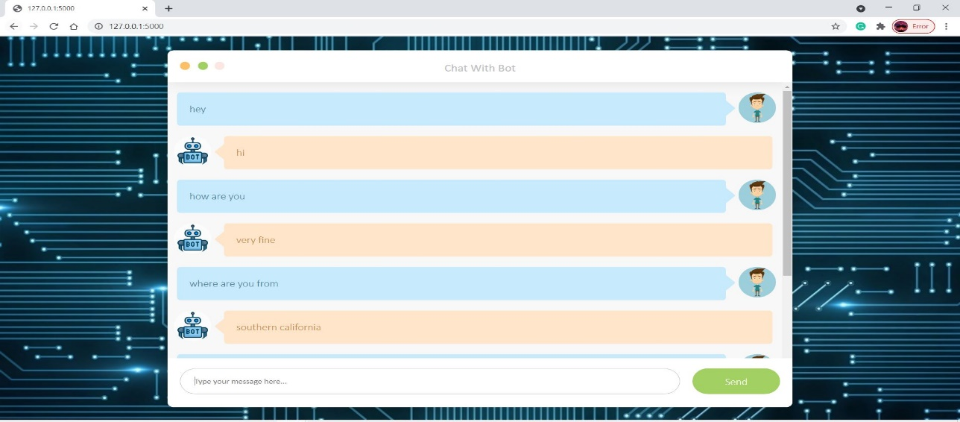
ChatBot Window with chats

Slide 45
FUTURE WORKS
To use different attention mechanism like Luong attention mechanism
To optimize different parameters to improve the performance of the chatbot
To deploy the model using cloud services so that the organizations could benefit from our application.

Slide 46
Conclusion
The performance of the training was analyzed with the help of automatic evaluation metrices and by comparing output responses for a set of source utterances.
We can also try different combination of hyperparameters.
The training of Cornell movie subtitles corpus produced result which needs further improvement and attention on training parameters.
We can also judge the quality of dataset by using another similar dataset with the Hyperparameters we tried for cornel data.

Slide 47
REFERENCES
[1] K. Cho, B. van Merrienboer, C. Gulcehre, D. Bahdanau, F. Bougares, H. Schwenk,and Y. Bengio ,(2014), “Learning Phrase Representations using RNN Encoder-Decoder for Statistical Machine Translation”, vol 1406.1078, pp 1724–1734.
[2] D. Bahdanau, K. Cho, and Y. Bengio, (2014), “Neural Machine Translation by Jointly Learning to Align and Translate”, vol 1409.0473.
[3] I. Sutskever, O. Vinyals, and Q. Le. CoRR, (2014), “Sequence to Sequence Learning with Neural Networks”, vol 1409.3215.
[4] O. Vinyals, and Q. Le, (2015), “A Neural Conversational Model”, vol 1506.05869.
[5] A. Sordoni, M. Galley, M. Auli, C. Brockett, Y. Ji, M. Mitchell, J.-Y. Nie, J. Gao, B. Dolan, (2015), “A Neural Network Approach to Context-Sensitive Generation of Conversational Responses”, vol 1506.06714, pp 196–205.
[6] K. Yao, G. Zweig, and B. Peng, (2015), “Attention with Intention for a Neural Network Conversation Model”, vol 1510.08565.

Slide 48
THANK YOU

