Slide 1

Chhattisgarh Swami Vivekanand Technical University University Teaching Department Department of Computer Science and Engineering
Presented By
KARTIK PANDEY
Roll No. 300012822006
Branch Data Science
Minor Project Presentation
On
GENEYE: AI-Driven Social Optics for a Positive Feed.
Priyanshu Tiwari
Roll No. 300012822045
Branch Data Science
Prabhudayal Vaishnav
Roll No. 300012822032
Branch Data Science
Dr. J. P. Patra
Associate Professor & HOD, Department of CSE

Slide 2
Content
Objective – Goals of the project
Problem Statement – Challenges in social media content
Literature Survey – Existing tools, gaps, and GENEYE’s contribution
Research Methodology – Approach, tools, and development process
Expected Outcomes – What the project aims to achieve
Results & Discussions – Current progress and partial achievements
Scope of Project – Future possibilities and expansion
Progress So Far – Completed and ongoing components
References – Books, research papers, websites

Slide 3
Objective
Build a personalized AI-driven browser extension
Allow user-defined control over hidden topics (politics, sports, etc.)
Minimize harmful, toxic, and irrelevant exposure
Promote mental well-being and productivity
Provide transparency & trust through statistics

Slide 4
Problem Statement
The Challenge with Social Media Feeds
Exposure to toxic, violent, or misleading content
Overload of political debates or irrelevant topics
Limited user control in existing tools
Impacts mental health, focus, and trust
GENEYE empowers users with AI + customizable filters to take back control of their feeds.

Slide 5
Literature Survey
Current Solutions: Keyword filters (low accuracy), AI moderation tools like Perspective API and OpenAI (accurate but limited customization).
Limitations: Cannot filter by user preferences, slow real-time performance, no feedback/statistics.
Research Gap: Lack of AI-driven, customizable, real-time filtering for social media feeds.
GENEYE Contribution: Combines AI analysis with user-controlled topic filters, blur/hide modes, and a statistics dashboard.

Slide 6
Research Methodology
1. Configuration: You, the user, provide an OpenRouter API key and choose which content categories to filter and how to display them (blurred or hidden).
2. Injection: When you visit X.com, the content.js script is automatically injected into the page.
3. Detection: This script watches for new posts appearing on the page in real-time using a MutationObserver. 4. AI Scoring: background.js securely sends the post's text to the Llama 3.3 70B model via the OpenRouter API, which returns scores for each configured category.
5. Filtering and Statistics : The scores are sent back to content.js. If a score for an active filter is above a set threshold, the post is either hidden or blurred on the page.

Slide 7
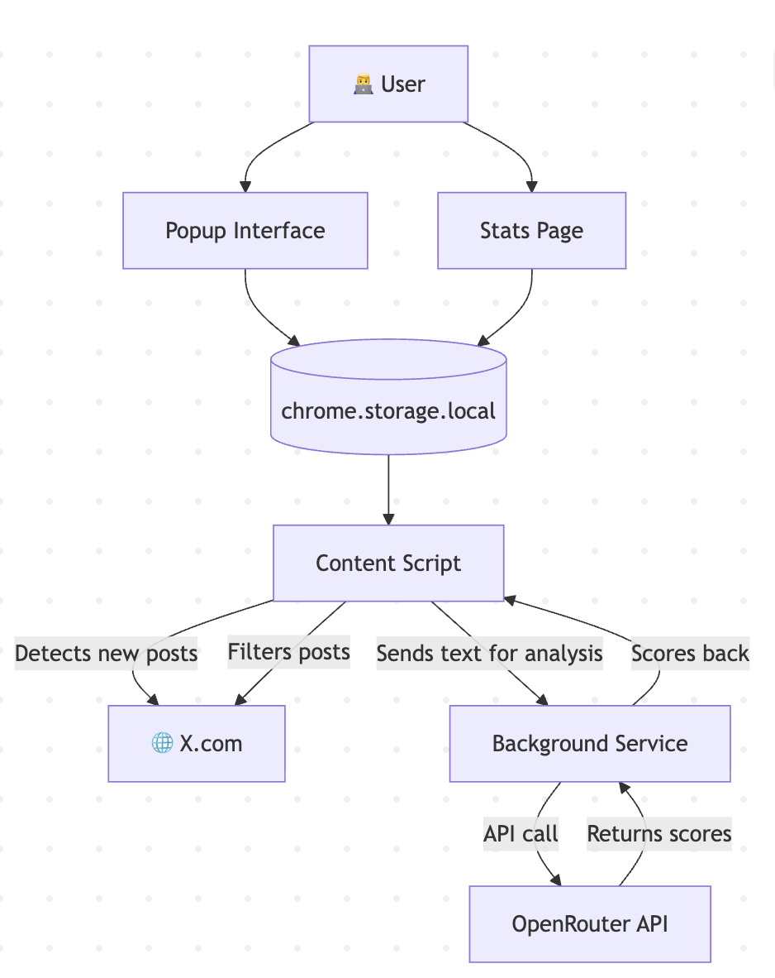
Flow Diagram:-

Slide 8
Expected Outcome/Outcome
A functional AI-driven extension
Feeds free of toxic, irrelevant, or user-selected unwanted content
Customizable filters for different categories
Transparent statistics of filtered posts
Enhanced user mental well-being & productivity

Slide 9
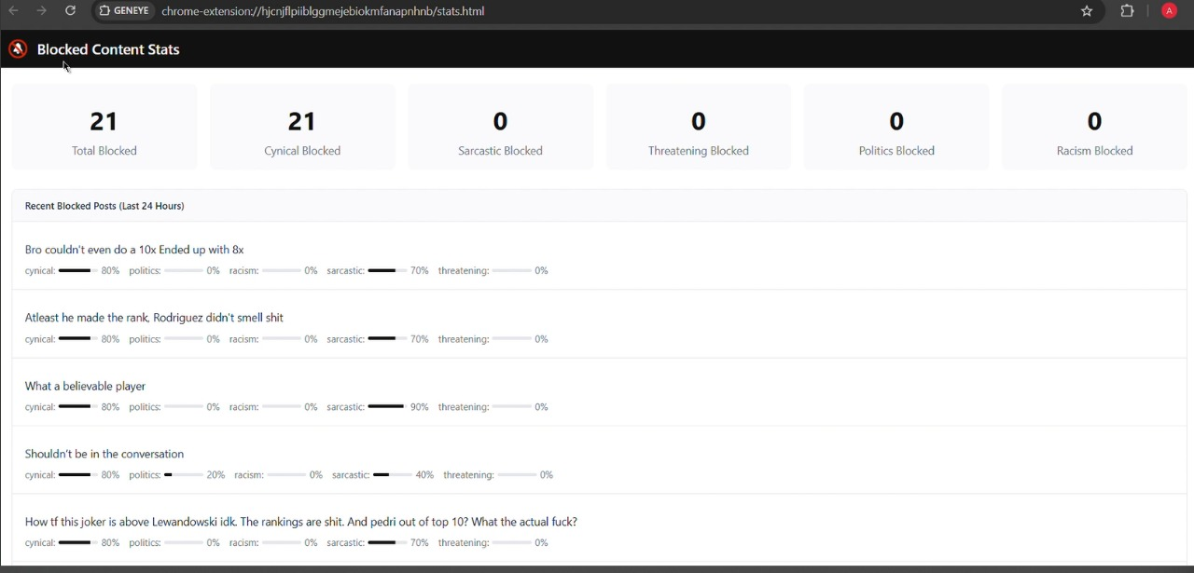
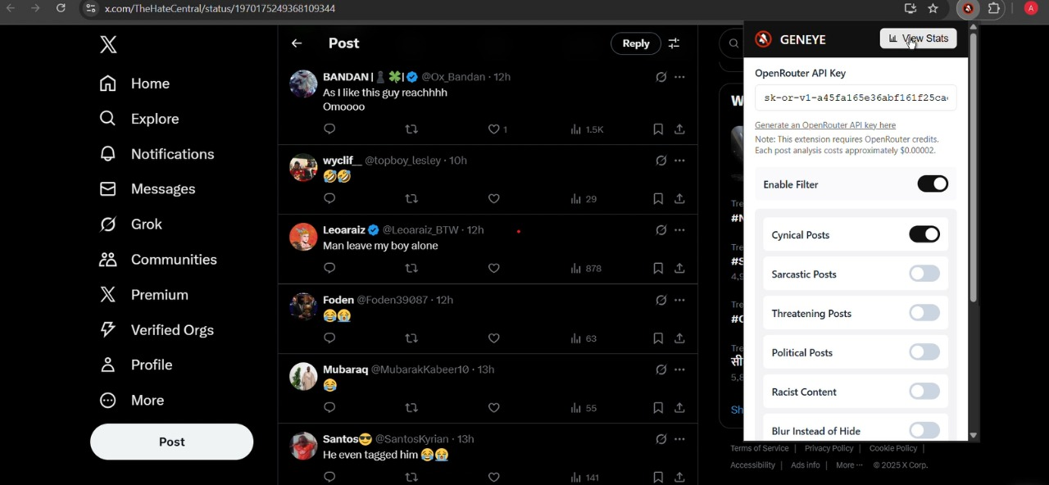
Result/Discussions *(Screen shots)*
Screenshots of Filter Control with their Statistics

Slide 10

Execution Video

Slide 11
Scope of Project
Expansion to more platforms (Facebook, Instagram, YouTube)
Advanced categories (ads, celebrity gossip, religion, sensitive news)
Mobile app version for cross-device experience
AI-based trend analysis & reports
Potential collaborations with mental health organizations

Slide 12
Progress So far
Core AI-based filtering logic implemented and tested
Topic filters (politics, Cynical, violence) partially functional
Blur/Hide modes working in feeds
Caching system integrated but needs optimization
Statistics dashboard in prototype stage with limited analytics
Initial testing and debugging started
➡️ The project has achieved basic functionality, but further improvements, optimization, and testing are still in progress.

Slide 13
References
Books
Russell, S., & Norvig, P. (2021). Artificial Intelligence: A Modern Approach (4th Ed.). Pearson. — Fundamental concepts of AI and algorithms.
Goodfellow, I., Bengio, Y., & Courville, A. (2016). Deep Learning. MIT Press. — Deep learning principles and applications.
Aggarwal, C. (2018). Machine Learning for Social Media. Springer. — Techniques for AI in social media content analysis.
Research Papers
Chandrasekaran, M., et al. (2023). “AI-Based Content Moderation: Techniques and Challenges,” Journal of AI Research. — Overview of AI methods for content filtering.
Smith, J. (2022). “Toxicity Detection in Social Media: A Survey,” International Conference on Social Computing. — Analysis of social media toxicity detection.
Fortuna, P., & Nunes, S. (2018). “A Survey on Automatic Detection of Hate Speech in Text,” ACM Computing Surveys, 51(4), 85. — Techniques for detecting harmful online content.

Slide 14
Websites / Online Documentation
OpenRouter AI Documentation: https://openrouter.ai/docs — Unified API platform for AI model integration.
Mozilla MDN Web Docs: https://developer.mozilla.org/en-US/docs/Mozilla/Add-ons/WebExtensions — Browser extension development guide.
Perspective API – Google Jigsaw: https://perspectiveapi.com/ — AI tool for content moderation.
OpenAI Moderation API: https://platform.openai.com/docs/guides/moderation — API for detecting harmful content in text.
Harvard Digital Review (2022). “Content Moderation and Mental Health” — Study on social media impact on mental health.

Slide 15
Thank you

