Slide 1

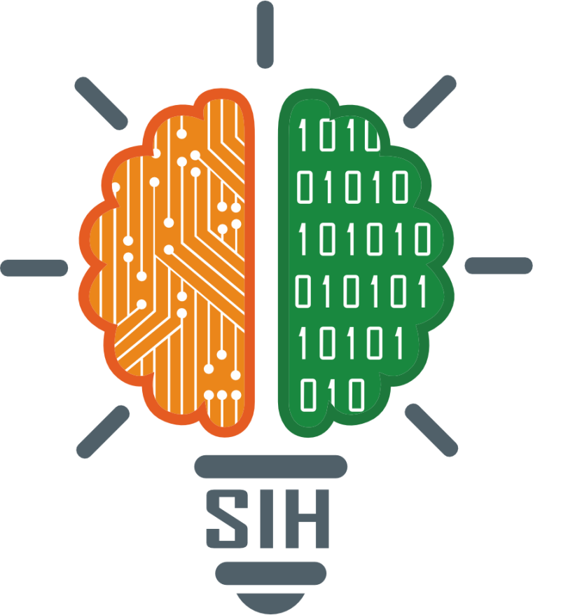
SMART INDIA HACKATHON 2025
Problem Statement ID – SIH25219
Problem Statement Title- Mobile-based EHR
Companion for ASHA Workers in Low-Internet Areas
Theme- MedTech / BioTech / HealthTech
PS Category- Software
Team ID-
Team Name- Hack Slayer

Slide 2
Mobile-based EHR Companion for ASHA Workers
Hack Slayer
Proposed Solution
A Smart Health Companion App that empowers ASHA workers and PHC staff with multilingual support and seamless data sync.
It enables secure data collection and storage in rural areas without internet.
The app provides once connectivity is available.
Supports regional languages automatic sync and voice input for easy use by health workers.
Includes reminders and role-based dashboards for vaccination and ANC check-ups.
How the Solution Addresses the Problem
Works offline in low/no internet areas
Easy data entry with local language & voice
Timely reminders for patient follow-ups
Less paperwork, fewer errors
Real-time data for PHC staff
Innovation and Uniqueness of the Solution
Offline-first design for rural use
Voice & multilingual support
Auto-sync for seamless data transfer
ABDM integration for national use

Slide 3
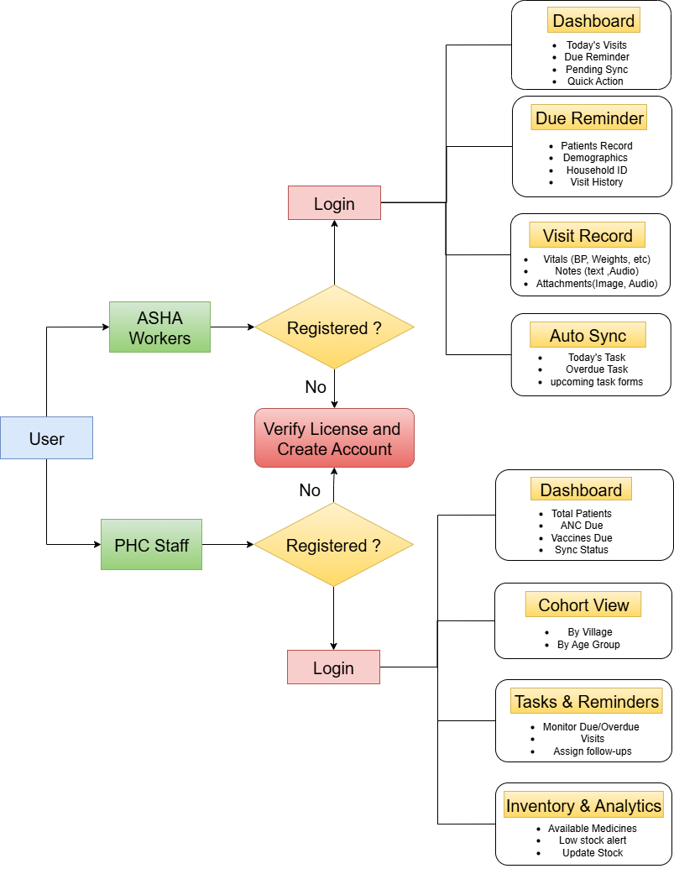
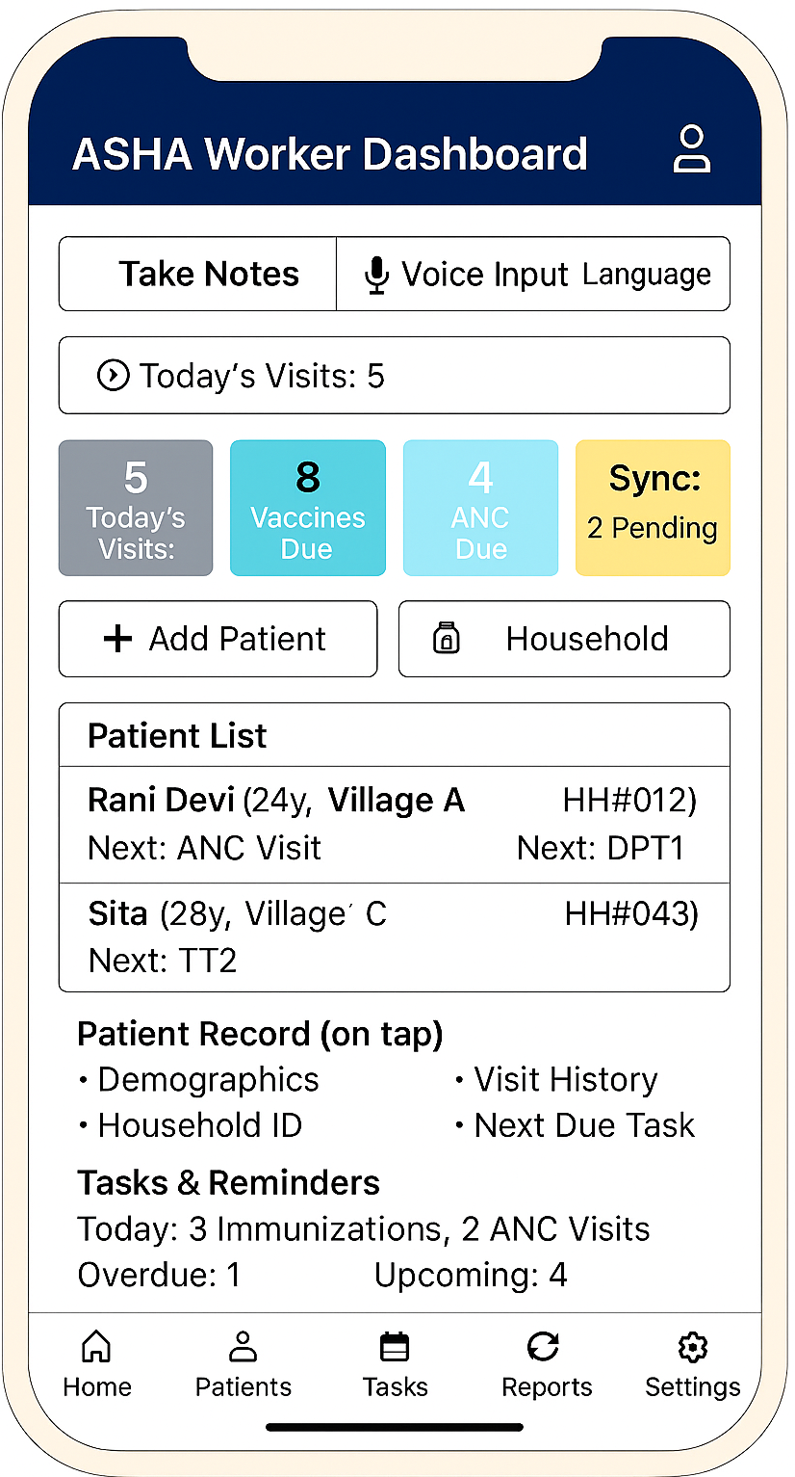
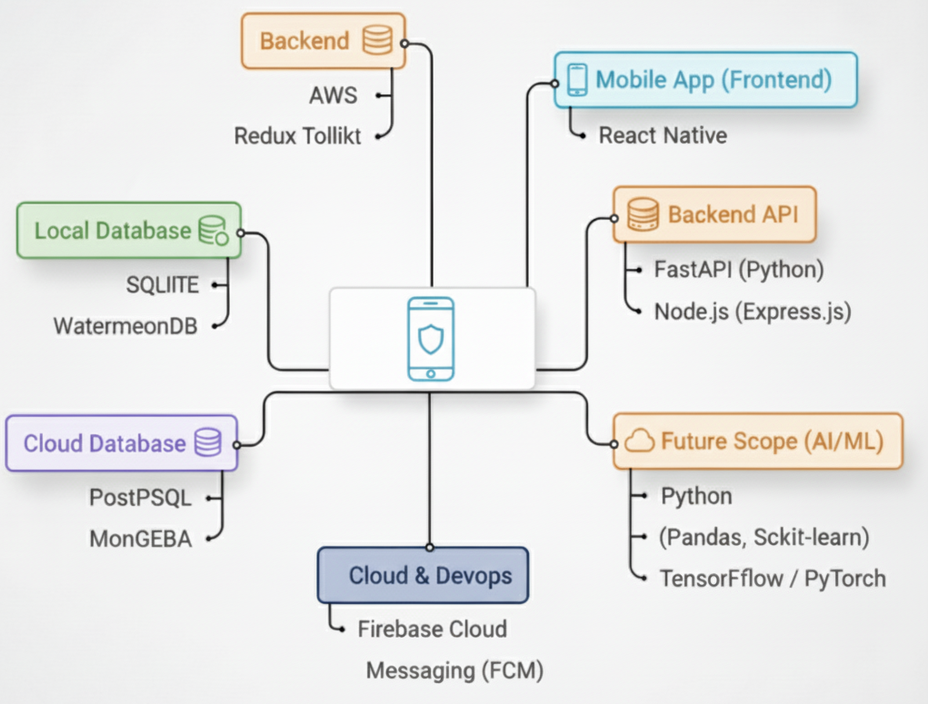
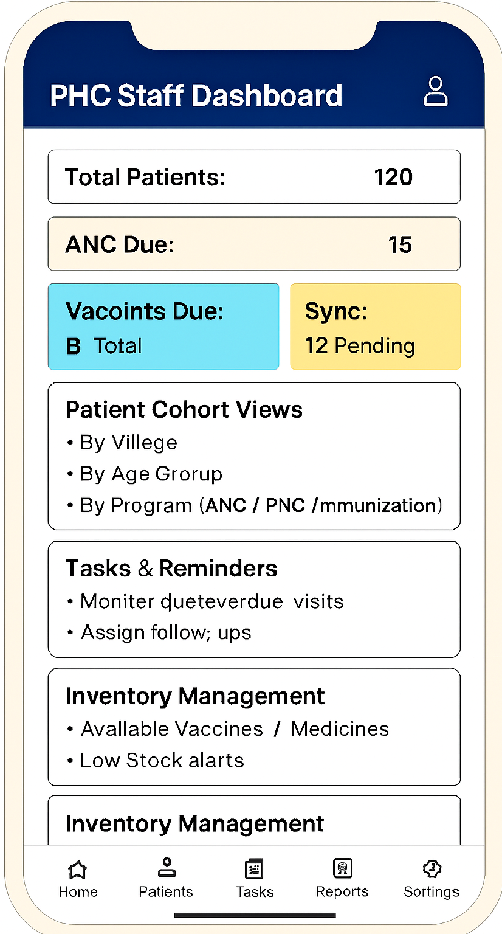
TECHNICAL APPROACH
Hack Slayer
Fig 1- Tech Stack
Fig 2- App Workflow & UI

Slide 4
FEASIBILITY AND VIABILITY
Hack Slayer
FEASIBILITY
Technical: React Native app, FastAPI backend, secure DB, offline sync.
Operational : Training digital tools for ASHAs typically requires half-day workshops [6].
Financial: Digital health pilots in India average ₹5–7 lakh per PHC [7].
Regulatory: Aligned with ABDM/NDHM standards.
VIABILITY
Coverage: 1 PHC app supports 20,000 villagers[9].
Efficiency: Digital tools reduce ASHA documentation time by ~30% and error by ~35% [8].
Impact: +25–30% ANC & vaccination adherence;
–35% missed visits [4].
Integration: Links with ABDM/Health ID for national programs .
Case Study 1:Semi‑Urban PHC (Madhya Pradesh) [4] | Case Study 2: Rural PHC (Chhattisgarh) [5]
Context: ASHAs face 2–3 week reporting delays with paper registers. | Context: Remote tribal areas miss ANC visits due to distance & no reminders.
Intervention: Digital tools + joint counseling with Anganwadi workers. | Intervention: PHC outreach + mobile health services.
Impact: No reporting delays (real-time sync) & 30% faster task assignment. | Impact: ANC adherence +28%, missed visits –35%.

Slide 5
IMPACT AND BENEFITS
Hack Slayer
Impact
Time Savings & Efficiency: ASHA workers save around 5 hours per week by replacing paper registers with mobile data entry, giving them more time for patient care [8].
Error Reduction: Digital forms and auto‑validation cut manual entry errors by up to 40%, improving record accuracy.
Real‑Time Visibility: PHC staff get real-time rural health data, enabling faster task assignment (+30% efficiency) with no reporting delays.
Patient Outcomes: Automated reminders boost ANC & vaccination adherence by 25–30%, reducing missed visits by 35% [4].
Benefits
Improved Health Records: Clean, structured, and instantly available data for decision‑making.
Reduced Paperwork: Eliminates manual registers and lowers administrative burden for ASHA & PHC staff.
Better Monitoring: Dashboards enable supervisors to track coverage, overdue cases, and performance in real time.
Integration Ready: Scalable to national health platforms (ABDM/NDHM) for seamless interoperability.

Slide 6
RESEARCH AND REFERENCES
Hack Slayer
References
Varshney, Prateek, et al. "Stake holder perspectives on the role of accredited social health activists (ASHAs) in Indian public mental healthcare space: A qualitative study." Journal of Family Medicine and Primary Care 11.11 (2022): 7308-7315.
Mahmood, Hana, et al. "Community health worker-based mobile health (mHealth) approaches for improving management and caregiver knowledge of common childhood infections: a systematic review." Journal of global health 10.2 (2020): 020438.
Garg, P. K., et al. "An evaluation of ASHA worker’s awareness and practice of their responsibilities in rural Haryana." Natl J Community Med 4.1 (2013): 76-80.
Gopalakrishnan, Lakshmi, et al. "Association between coordinated counseling from both ASHA and Anganwadi Workers and maternal health outcomes: a cross-sectional study from Madhya Pradesh and Bihar, India." PLOS global public health 4.11 (2024): e0003639.
India: Bringing primary health care to remote populations in Chhattisgarh
UNICEF Annual Report 2020 | UNICEF
NITI Aayog Releases Report ‘Investment Opportunities in India’s Healthcare Sector’
WHO Guidelines
Home :: National Health Mission

