Slide 1



KONGU ENGINEERING COLLEGE DEPARTMENT OF AI&DS
HCL PROJECT
Pneumonia Detection from Chest X-Ray Using Deep CNN and Attention Models
Project Members :
KARUNAMBIKA S (24ADR065) NAVIN NAGENDAR C (24ADR092) SRIDHARAN S (24ADL193)

Slide 2

PROBLEM STATEMENT
Pneumonia is a serious respiratory infection that requires early diagnosis and immediate treatment.
Chest X-ray imaging is the most common diagnostic tool, but manual interpretation by radiologists is time- consuming.
Deep Learning models (like CNNs) can automatically learn and extract complex spatial features from X-rays
This project automates the detection process to predict whether a patient is Normal or has Pneumonia with high accuracy.

Slide 3
LITERATURE SURVEY
JOURNEL | YEAR | TITLE | METHODOLOGY | METRICS
IEEE Xplore | 2023 | Deep Learning for Automated Pneumonia Detection | Convolutional Neural Network (CNN) | Accuracy: 92.4%
Elsevier | 2024 | Attention-guided CNN for Medical Image Classification | ConvCNN + Spatial Attentionolutiona l Neural Network (CNN) | Accuracy: 95.1%
Springer | 2022 | Vision Transformers for X-Ray Diagnosis | Vision Transformer (ViT) | Accuracy: 94.8%

Slide 4

OBJECTIVE
To build a robust Deep Learning model that can highly accurately classify Chest X-rays into 'Normal' and 'Pneumonia' classes.
To compare and evaluate the performance of a Baseline CNN, a Spatial Attention-Enhanced CNN, and a pre-trained ResNet model.
To integrate Grad-CAM heatmaps that highlight suspicious lung regions, ensuring the AI model's predictions are clinically explainable and trustworthy.
To develop a deployment-ready inference pipeline that can act as a reliable, fast decision-support system for radiologists in high-volume hospitals.

Slide 5
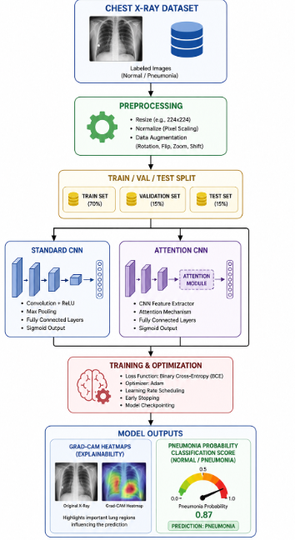
METHODOLOGY

Slide 6
DATASET DESCRIPTION
The project uses the standard Chest X-Ray (Pneumonia) Dataset, which is widely used for healthcare, medical imaging, and automated respiratory infection research.
The dataset contains two categories of X-Ray images: Normal (healthy lung fields) Pneumonia (infected lung fields)
The dataset contains real-world clinical patterns such as ground-glass opacities, focal consolidations, pleural effusions, and abnormal lung tissue densities.
The dataset is used to train and evaluate Deep Learning models like Custom CNN, Spatial Attention CNN, and ResNet-50 for detecting pneumonia using Computer Vision and hierarchical spatial feature extraction techniques.

Slide 7
PROPOSED IDEA
The proposed system introduces an advanced, clinically interpretable deep learning framework to automate and accelerate pneumonia detection from chest radiographs.
The system integrates a custom-designed Convolutional Neural Network (CNN) enhanced with a Spatial Attention Module to dynamically focus on highly critical lung opacity regions.
The framework ensures absolute clinical transparency and trust by providing: • Grad-CAM attention heatmaps (extracted from the conv3 layer) to visually pinpoint opacity regions • Highly accurate pneumonia probability scores for fast, reliable decision support.

Slide 8
MODULES DESCRIPTION
Data Collection & Pipeline Module
Collects normal and pneumonia chest X-ray images, applying stratified dataset splitting (85% Train / 15% Val) to handle class distributions and feed them stably into PyTorch DataLoaders.
Image Preprocessing & Augmentation Module
Performs image resizing intensity normalization, and online augmentations (rotations, flips, color jitter) to prepare radiographs for deep learning.
Custom Baseline CNN Module
Implements a custom Convolutional Neural Network with stacked Conv layers, Batch Normalization, and Max Pooling to establish a baseline for spatial feature extraction.
Explainability & Prediction Module
Generates pneumonia probability scores, superimposes Grad-CAM attention heatmaps on X-rays for clinical explainability, and serves predictions via a Flask inference engine.

Slide 9

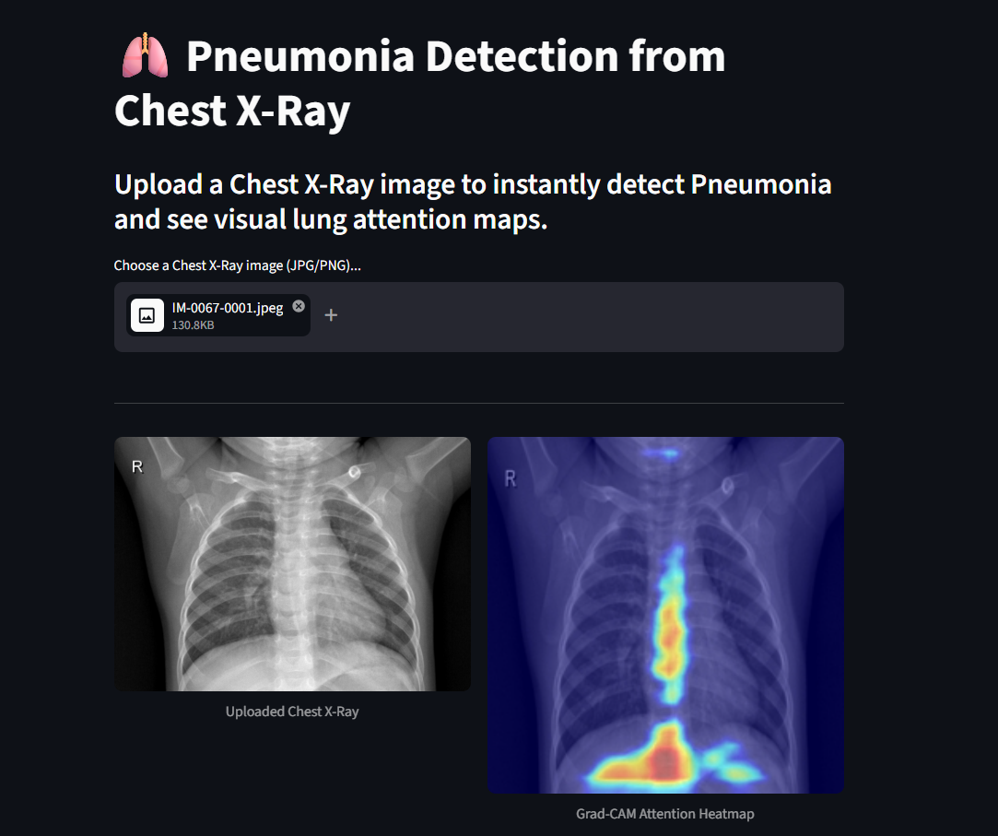
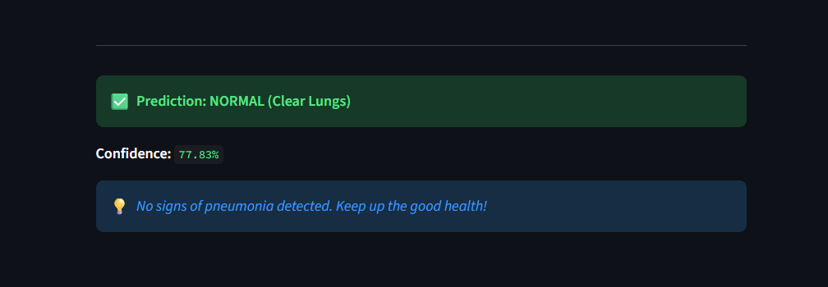
OUTPUT

Slide 10
PERFORMANCE METRICS
Classification Accuracy
Measures the overall proportion of correctly classified X-ray images (both Normal and Pneumonia).
Recall
Evaluates the model's ability to catch all actual Pneumonia cases, ensuring zero missed diagnoses
Precision & F1-Score
Precision: Measures the accuracy of positive alerts, reducing false alarms (Normal cases flagged as Pneumonia).
F1-Score: The harmonic mean of Precision and Recall, proving the model's overall diagnostic balance (~89% - 91%).
Area Under the ROC Curve (ROC-AUC)
Represents the model's capability to distinguish between healthy and infected lungs across various threshold settings.

Slide 11
RESULTS ACHIEVED
Implemented both a Custom Baseline CNN and an advanced Spatial Attention CNN model for chest X-ray image classification.
Achieved highly effective pneumonia detection utilizing Deep Learning and Computer Vision techniques.
Baseline CNN achieved 96% accuracy, but operated as a "Black-Box" model, lacking visual interpretability and spatial localization.
The Attention-Enhanced CNN was selected as the superior clinical model; it integrates Spatial Attention to resolve the black-box limitation by highlighting specific infected lung zones with an accuracy of about 94%.
Generated precise pneumonia probability scores and real-time interactive predictions via a Streamlit Web Application.
Reduced false negatives and significantly improved visual trust for radiologists using dynamic Grad-CAM attention heatmaps.

Slide 12
CONCLUSION
The developed deep learning system successfully demonstrates the feasibility of automated, explainable pneumonia detection to support clinical radiological workflows in high-volume healthcare centers.
Successfully built and trained custom deep learning architectures (Baseline CNN and Spatial Attention CNN) to automate pneumonia classification from pediatric chest X-ray images.
Solved the critical "black-box" limitation of traditional standard CNNs by implementing a custom Spatial Attention Block that forces the network to focus on actual lung consolidation areas.
Integrated Grad-CAM explainable heatmaps to make the system fully transparent and interpretable, allowing radiologists to visually verify the model's prediction areas in real-time.
Deployed the final explainable model on a lightweight, interactive Streamlit Web Application to act as a fast, reliable decision-support system to reduce patient turnaround times

Slide 13
REFERENCES
Dal Pozzolo A. et al., "Pneumonia Detection using Machine Learning," IEEE Symposium on Computational Intelligence, 2015.
Rajpurkar, P., et al. (2017). "CheXNet: Radiologist-Level Pneumonia Detection on Chest X-Rays with Deep Learning." arXiv preprint.
Kermany, D. S., et al. (2018). "Identifying Medical Diagnoses and Treatable Diseases by Image-Based Deep Learning." Cell.
Selvaraju, R. R., et al. (2017). "Grad-CAM: Visual Explanations from Deep Networks via Gradient-based Localization." ICCV.

Slide 14

Thank You

