Slide 1

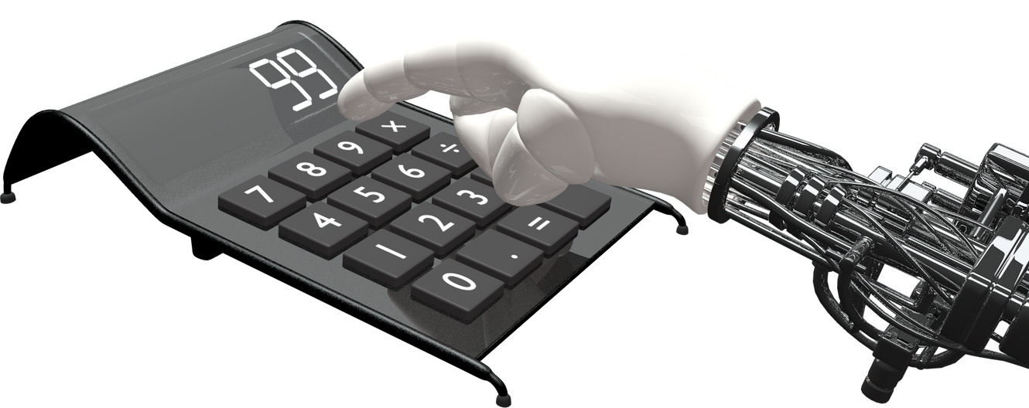
Foodie
Forecast
PRESENTED BY:
JYOTI RANA (05415611922)
KASAK (02715611922)
PREETI (04215611922)

Slide 2



Introduction
In the modern era, understanding customer feedback is crucial for maintaining customer satisfaction and loyalty. However, manually analyzing large volumes of customer feedback data can be time-consuming and prone to errors. This project seeks to address this challenge by developing a machine learning model that can automatically predict the current status of customer feedback based on demographic and feedback data. The model will be trained and evaluated for its accuracy in classifying feedback as positive or negative, providing the company with a reliable tool for quickly and accurately assessing customer sentiments. To address this issue, this project leverages machine learning and classification algorithms to predict the customer feedback as positive or negative. By analyzing historical order data and real-time information, the system aims to provide precise and reliable status updates, enhancing the overall services.
https://www.entrepreneurshipinabox.com/wp-content/uploads/online-food-ordering-system.jpg
https://www.google.com/url?sa=i&url=https%3A%2F%2Fwww.culturemonkey.io%2Femployee-engagement%2Fpeer-feedback-examples%2F&psig=AOvVaw2cXCFn2FjzYID-9Kj9qaif&ust=1722261607694000&source=images&cd=vfe&opi=89978449&ved=0CBEQjRxqFwoTCMCNnM_yyYcDFQAAAAAdAAAAABAR

Slide 3

AIM OF PROJECT
The aim of this project is to develop a machine learning model capable of predicting the current status of customer feedback for an online food service. By leveraging various customer demographic and feedback data, the model aims to accurately classify customer feedback as positive or negative, thereby providing actionable insights for improving customer satisfaction and service. By training a model on historical order data and real-time information, the platform will:
Provide accurate, real-time updates on the status of orders.
Enhance customer satisfaction by reducing uncertainty and improving communication.
Optimize the order processing pipeline by predicting potential delays.

Slide 4
PROCESS
COLLECT THE DATA
IMPORTING
LIBRARIES
EDA ON DATASET
ENCODING
LOGISTIC REGRESSION
PANDAS
K NEAREST NEIGHBOUR
NUMPY
TRAIN – TEST SPLIT
SKLEARN
NAÏVE BAYES
SUPPORT VECTOR CLASSIFIER
DECISION TREE CLASSIFIER
APLLY DIFFERENT CLASSIFICATION MODELS
RANDOM FOREST CLASSIFIER
PREDICTION
ACCURACY

Slide 5
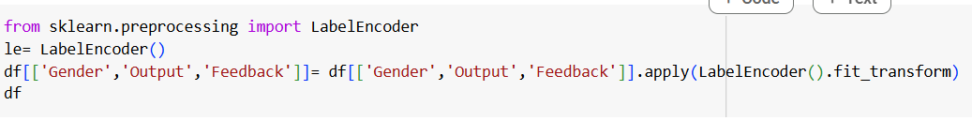
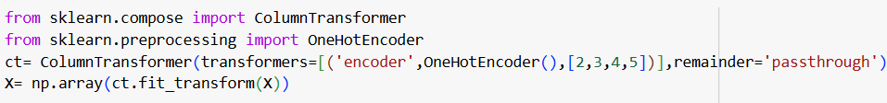
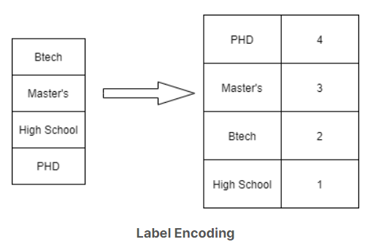
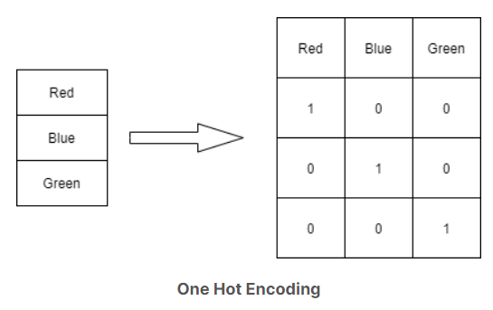
ENCODING
Encoding is a technique of converting categorical variables into numerical values so that it could be easily fitted to a machine learning model.
ENCODING
LABEL
ONE HOT
https://ai-ml-analytics.com/encoding/
https://ai-ml-analytics.com/encoding/

Slide 6
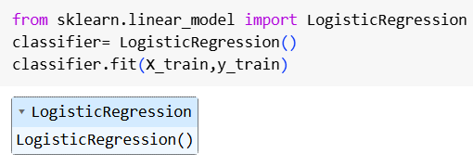
CLASSIFICATION MODELS
1. LOGISTIC REGRESSION
Logistic regression is used for binary classification where Sigmoid function is used , that takes input as independent variables and produces a probability value between 0 and 1.
Y
1
Yes/ No
Threshold value
0
No/ Yes
X
https://www.geeksforgeeks.org/understanding-logistic-regression/

Slide 7
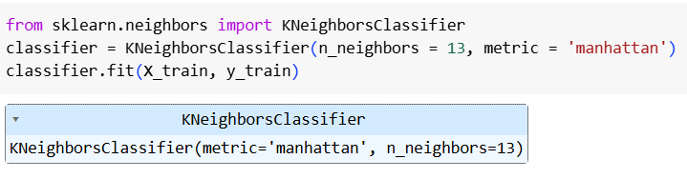
2. K NEAREST NEIGBOUR
The K-Nearest Neighbors (KNN) algorithm operates on the principle of similarity.
It predicts the label or value of a new data point by considering the labels or values of its K nearest neighbors in the training dataset.
Y
Y
Y
K = 5
X
X
X
- CLASS A
- CLASS B
- NEW DATA POINT
https://www.geeksforgeeks.org/k-nearest-neighbours/

Slide 8
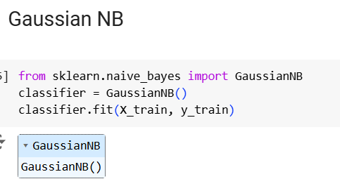
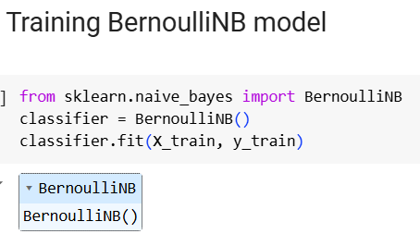
P(A∣B)=P(B)P(B∣A)P(A)​
3. NAÏVE BAYES CLASSIFIER
The “Naive” part of the name indicates the simplifying assumption made by the Naïve Bayes classifier. The classifier assumes that the features used to describe an observation are conditionally independent, given the class label. The “Bayes” part of the name refers to Reverend Thomas Bayes, an 18th-century statistician and theologian who formulated Bayes’ theorem.
Posterior
Priori
Likelihood
P(A∣B)=P(A)P(B∣A)
​ P(B)
Marginal
https://www.geeksforgeeks.org/naive-bayes-classifiers/

Slide 9
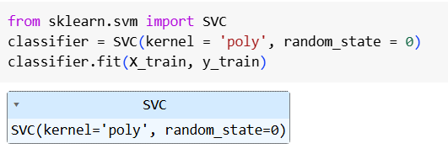
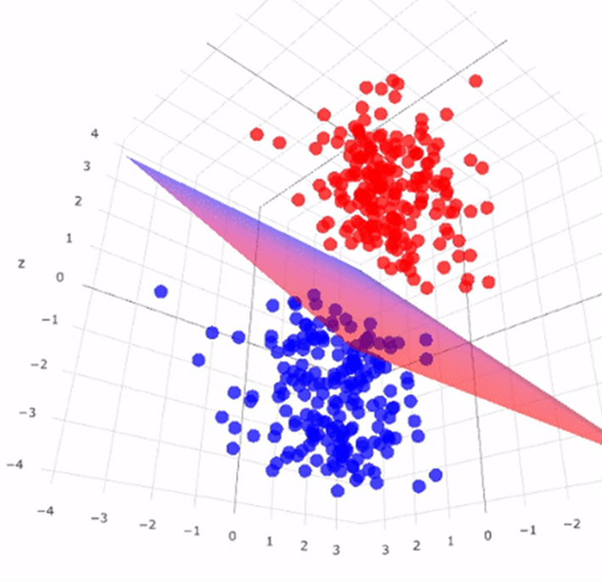
4. SUPPORT VECTOR CLASSIFIER
An algorithm that classifies data by finding an optimal line or hyper plane that maximizes the distance between each class in an N-dimensional space.
Y
Optimal Hyperplane
Support Vector
X
https://miro.medium.com/v2/resize:fit:938/1*Lsun5-t67owndP0iTV9DNQ.png
https://www.geeksforgeeks.org/support-vector-machine-algorithm/

Slide 10
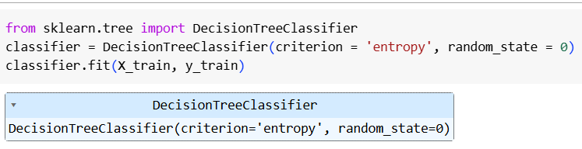
5. DECISION TREE CLASSIFIER
An algorithm where the data is continuously split according to a certain parameter. The tree can be explained by two entities, namely decision nodes and leaves. The leaves are the decisions or the final outcomes. And the decision nodes are where the data is split.
ROOT NODE
INTERMEDIATE NODE
LEAF
NODE
DECISION
https://www.geeksforgeeks.org/decision-tree/

Slide 11
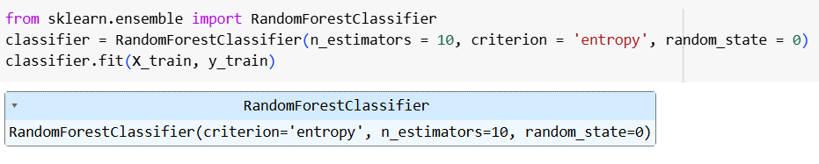
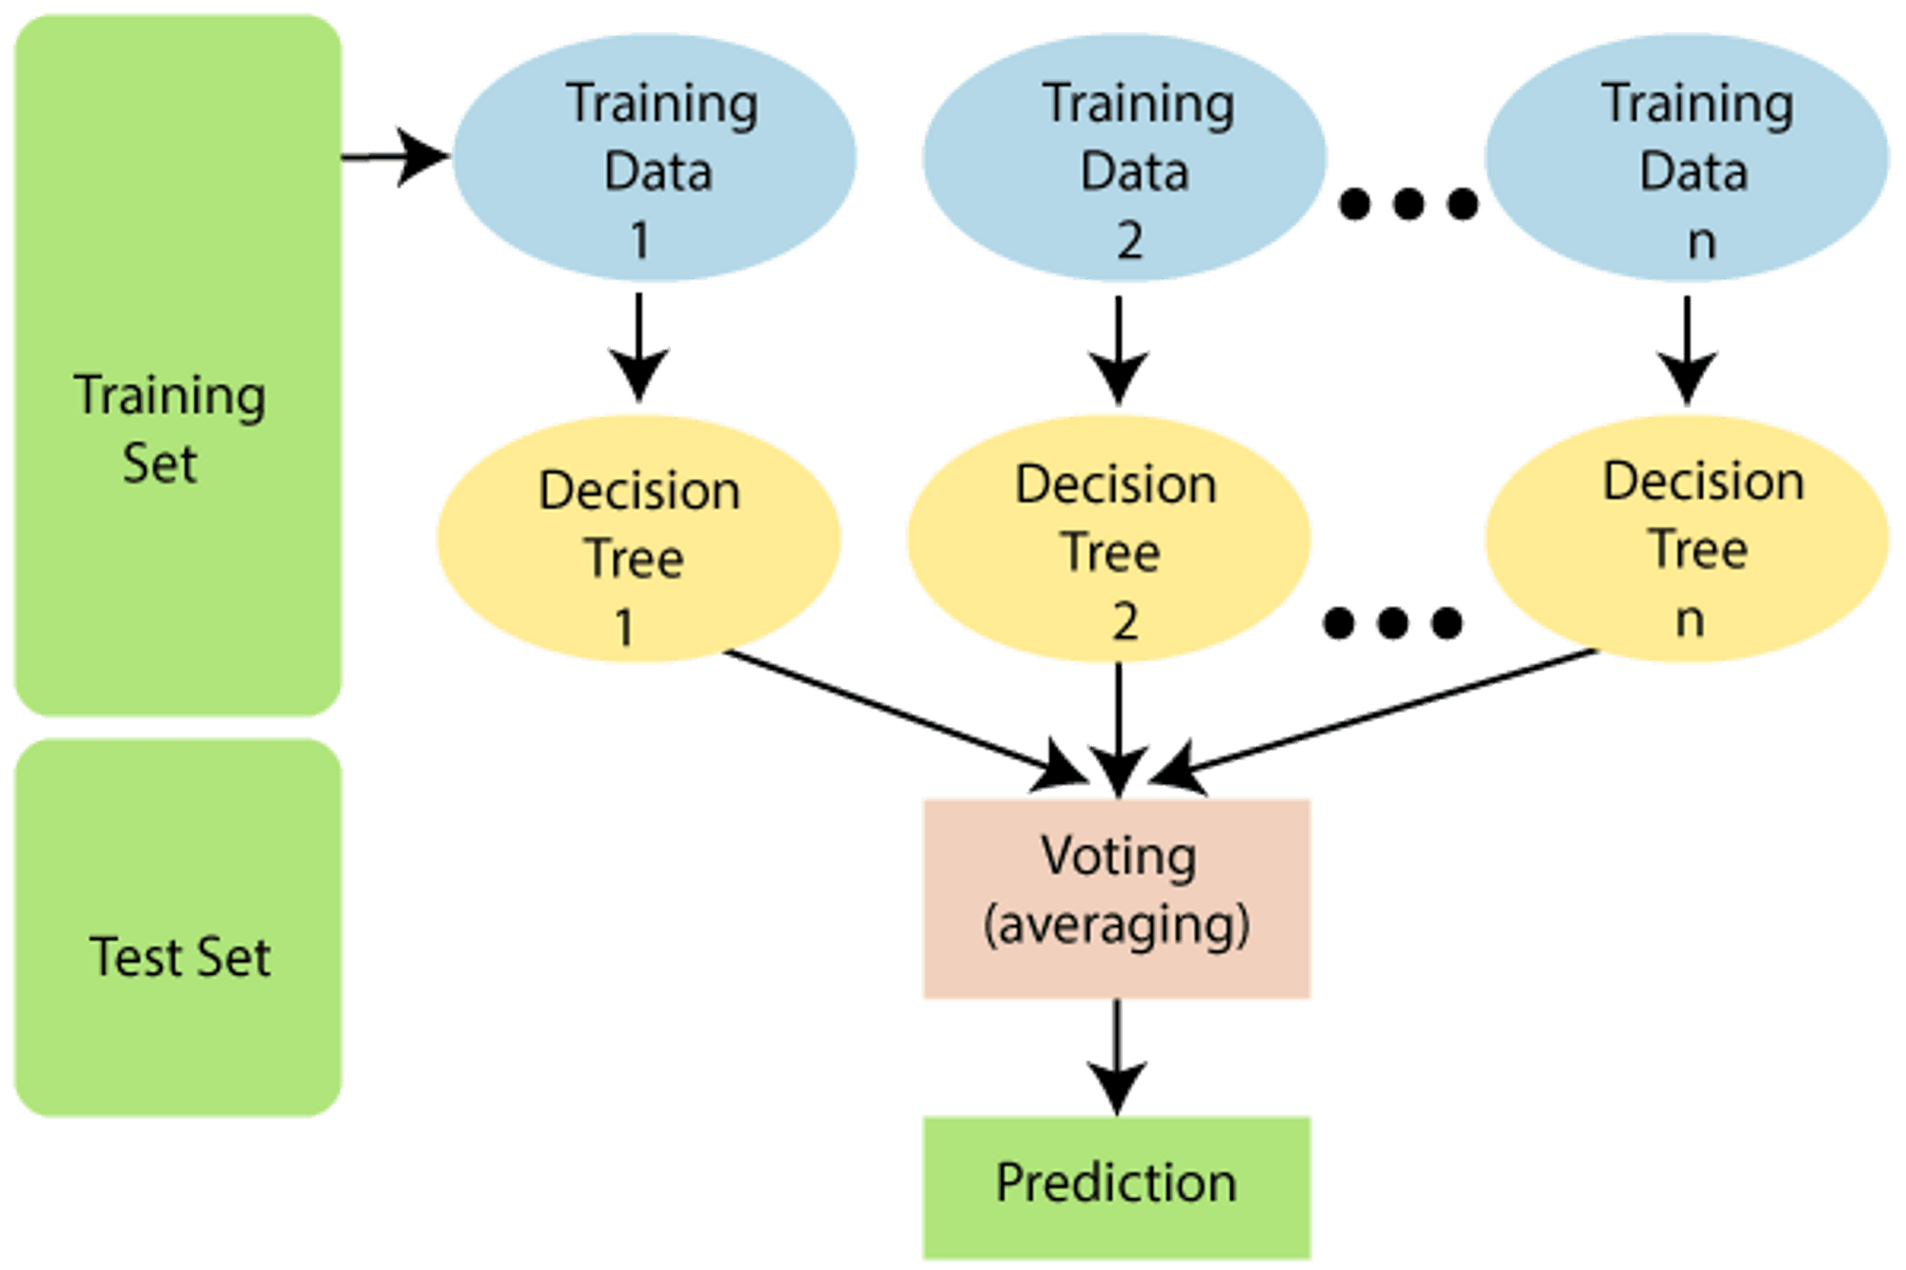
6. RANDOM FOREST CLASSIFIER
It is a set of decision trees (DT) from a randomly selected subset of the training set and then It collects the votes from different decision trees to decide the final prediction..
https://www.geeksforgeeks.org/random-forest-algorithm-in-machine-learning/

Slide 12
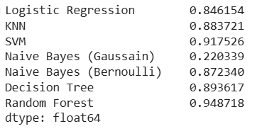
CONCLUSION
MODELS & ACCURACY
Random forest is the most effective model for this task, providing the best prediction accuracy. However, both Support Vector Regression and K nearest neighbor also offer strong predictive capabilities. Future work could focus on further tuning these models and exploring additional factors to enhance predictive performance even more

Slide 13


