Slide 1

Aggregation On Student Mid-Term Data
Name: KASARAM HARSHAVARDHAN
REG.NO: 40110565
GUIDE NAME: MS.V.GOWRI MANOHARI M.E.(Ph.D)

Slide 2
Presentation Outline
Course Certificate
Introduction
Objectives
System Architecture / Ideation Map
Module Implementation
Application Snapshots
Results and Discussions
Conclusion & Future work
References

Slide 3
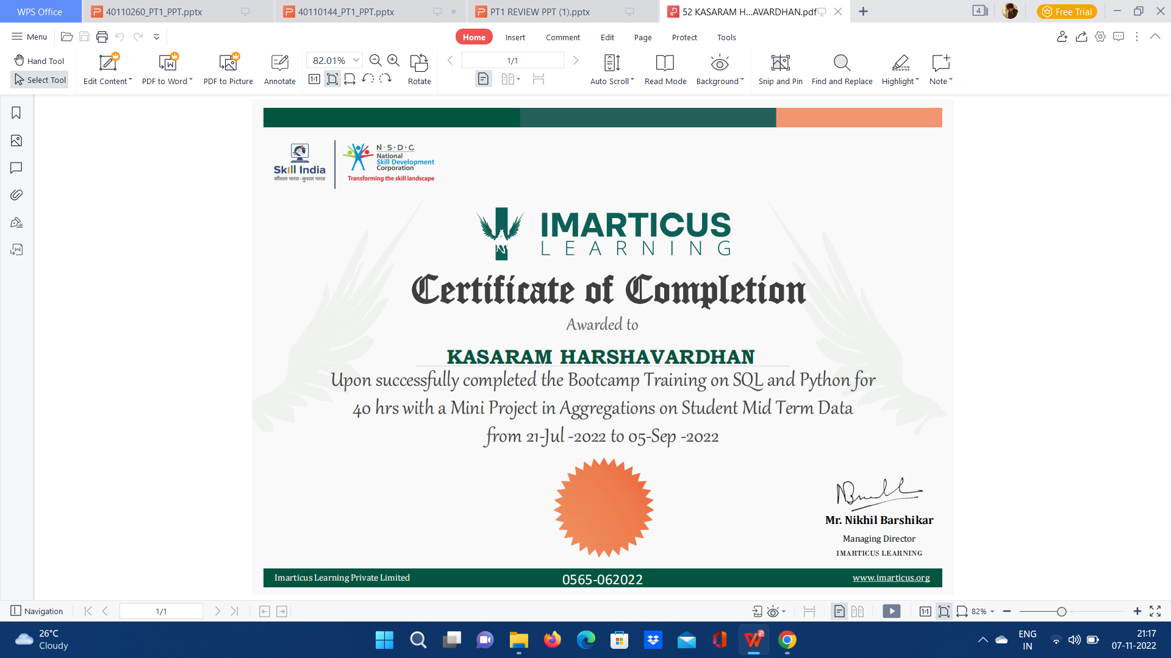
Course Certificate

Slide 4
Abstract
The definition of aggregate data is a collection of information from
multiple individuals that is summarized into an official data report.
The data is collected from individuals with a shared commonality, like
geographical location, association with an organization, or something
else of interest.

Slide 5
Introduction
MIN function is used to return the minimum value of an expression in a SELECT statement.
MAX function is used to return the maximum value of an expression in a SELECT statement.
COUNT function returns the number of rows that matches a specified criterion.
GROUP BY Statement is used to arrange identical data into groups with the help of some functions.
The ORDER BY Statement is used to sort the result-set in ascending or descending order.
The SUM function returns the total sum of a numeric column.

Slide 6
Introduction
Microsoft Excel is a spreadsheet developed by Microsoft for Windows, macOS, Android and iOS. It features calculation or computation capabilities, graphing tools, pivot tables, and a macro programming language called Visual Basic for Applications. SQL is Structured Query Language, which is a computer language for storing, manipulating and retrieving data stored in a relational database.
SQL stands for Structured Query Language. It is used for storing and managing data in relational database management system (RDMS).
All the RDBMS like MySQL, Informix, Oracle, MS Access and SQL Server use SQL as their standard database language.

Slide 7
Objectives
This project presents the method to upload an excel file containing the student midterm data into SQL server and perform aggregations like:
1)max
2)min
3)count
4)group by
5)order by
6)sum
The above aggregations can be performed on any variable. The excel data had 96 rows and 3 columns( Student, Midterm, Final). We chose ‘Midterm’ as the variable to perform aggregations on. We found that the least marks scored by a student is 62 and the maximum marks scored by a student is 97. Using this database we can find out the the performance of the students and analyse which student needs the most attention from the facilitator. We grouped the students based on their midterm marks in both ascending and descending order. We also grouped the students with their midterm marks. We also found the total midterm marks scored by all the 96 students.

Slide 8
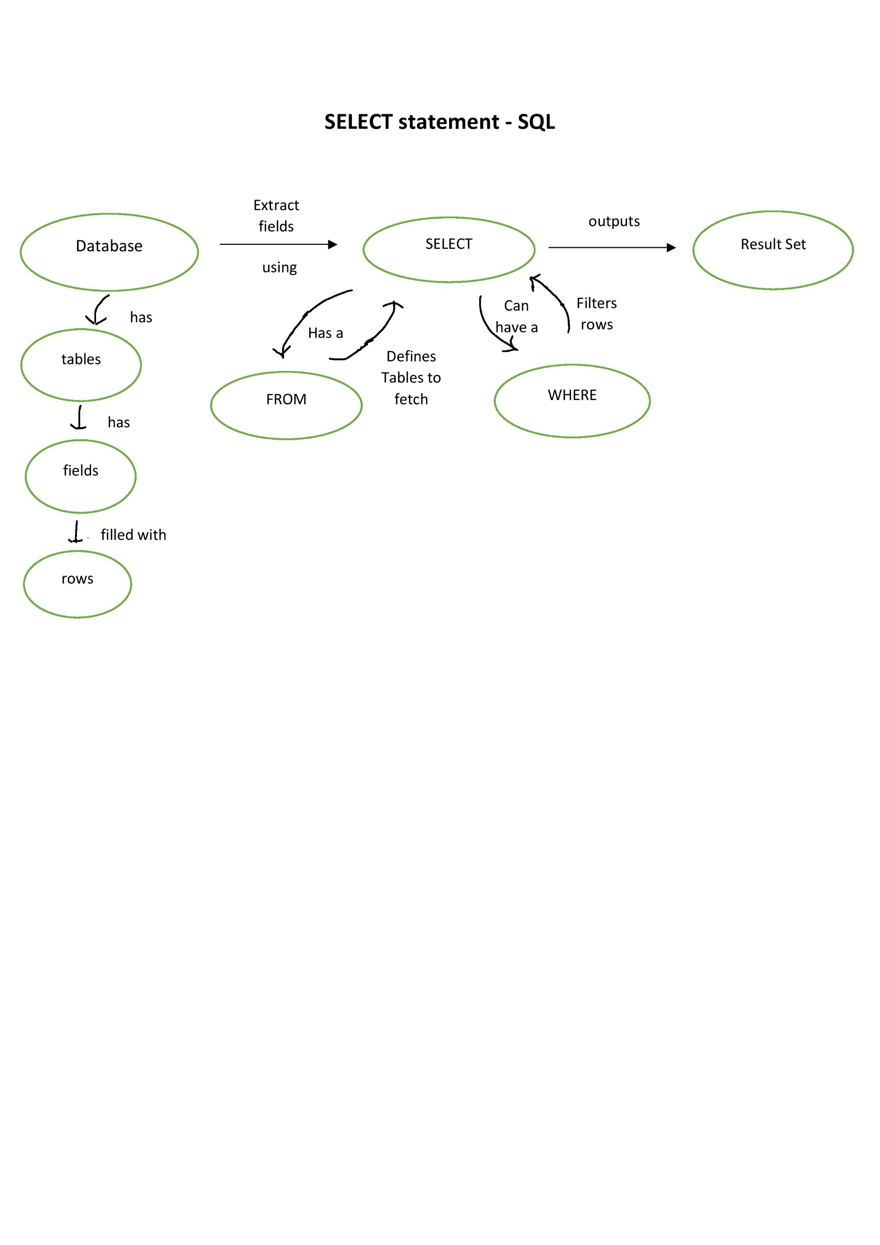
System Architecture/ Ideation Map
11 November 2021
Department of CSE

Slide 9
Project Implementation
START
Step 1: Create the database.
Step 2: Load the excel sheet to SQL server.
Step 3: Perform max operation on Midterm and display the output.
Step 4: Perform min operation on Midterm and display the output.
Step 5: Perform ascending and descending operations on Midterm and display the output .
Step 6: Find sum of midterm values and display the output.
Step 7: Count the number of Midterm values and display the output.
Step 8: Perform group by operations on Student and Midterm values and display the output.

Slide 10
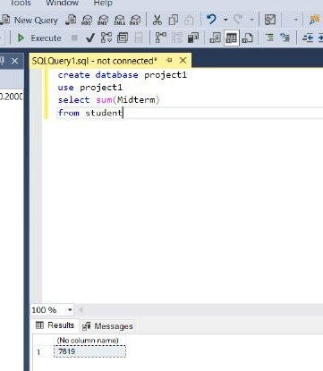
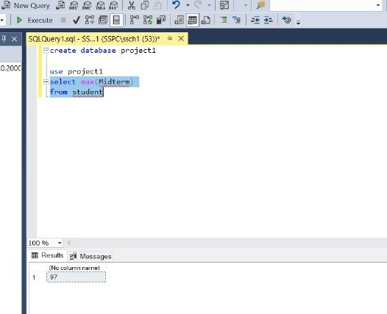
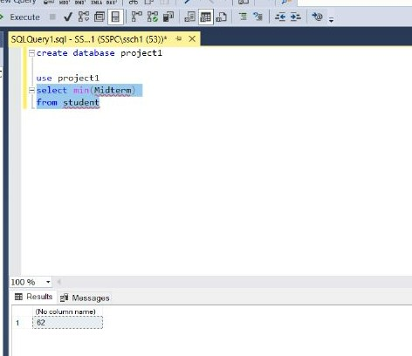
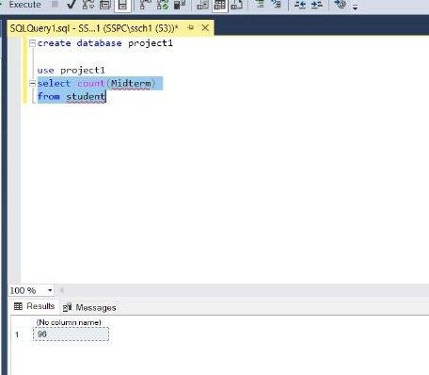
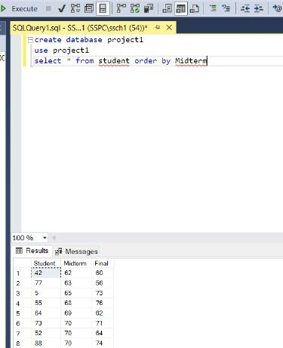
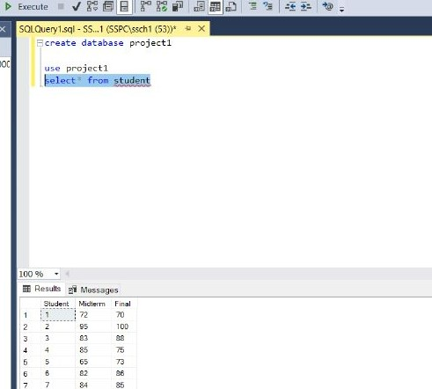
Sample Snapshot

Slide 11
Results and Discussion
We found that the maximum marks scored by the student in the mid term is 97 and the minimum marks scored by the student in the mid term is 62.
We found out that there were 96 students in total.
The sum of the mid term marks of all the students is 7619.
We also arranged the marks of the students in ascending order and descending order.
The scope of the tool is used to add the marks of the students in the data and also it is used to group them into who is highest and who is least.
This type of code is used by educational institutions to regroup students.

Slide 12
Conclusion
The project was a learning experience for me and our team and allowed me to improve upon my SQL and Oracle DBMS skills. I developed a usable database for student mid term data by which the marks of each individual can be separated accordingly. Me and our team look forward to seeing the database being put into actual use in future

Slide 13
References
https://www.innuy.com/blog/sql-benefits/
https://en.wikipedia.org/wiki/Microsoft_Excel
https://en.wikipedia.org/wiki/MySQL
https://www.aises.org/sites/default/files/documents/National%20Conference/Abstract%20Guidelines%20and%20Samples.pdf

Slide 14
THANK YOU

