Slide 1
Flight Delay Prediction using Graph Invariants
M.Tech Report Presentation
at
IIT Kharagpur
West Bengal-721302
Mohammed Kashif
21MA60R39
M.Tech
Computer Science and Data processing
November 16, 2022

Slide 2
Motivation
The Flight delay is inevitable and it plays an important role in both profits and losses of the airlines.
An accurate estimation of flight delay is critical for airlines because the results can be applied to increase customer satisfaction and the incomes of airline agencies.
The models that had been used to implement flight delay prediction is highly noninterpretable.

Slide 3
Today’s discussion
Feature Engineering
Linear regression
Multiple linear regression
Steps involved in the experiment
Simulate Data
Pairwise coefficient of correlation
Observations using R2 score
Results
Conclusion
Future work
Reference

Slide 4
Feature Engineering
Original available data have many attributes which may not be much useful.
Transforming raw data into features that better represent the underlying problem to the predictive models, resulting in improved model accuracy on unseen data.
Hence data simulation is done in this experiment.

Slide 5

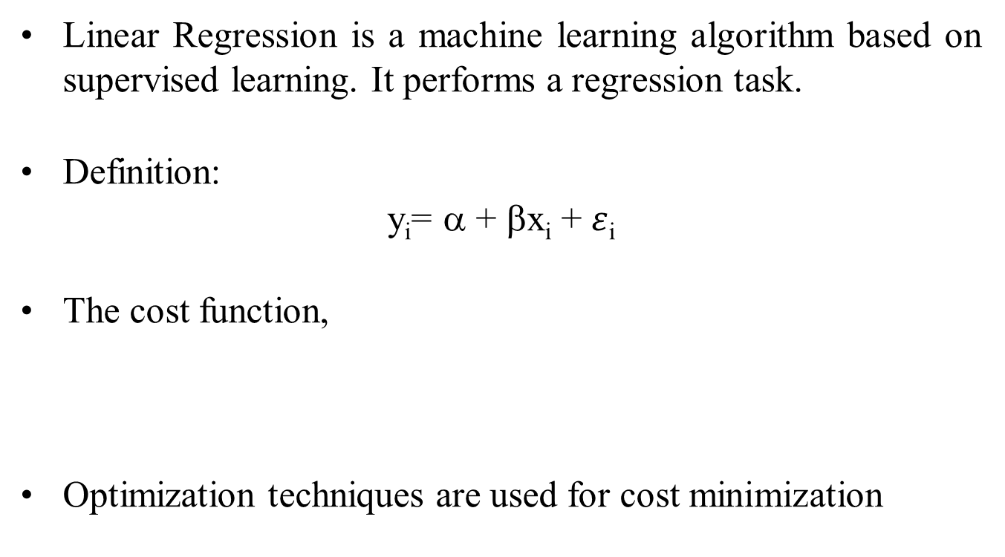
Linear regression
Linear Regression is a machine learning algorithm based on supervised learning. It performs a regression task.
Definition:
y_{i}= α + βx_{i} + $ε$_{i}
The cost function,
Optimization techniques are used for cost minimization

Slide 6
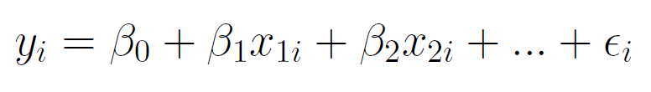
Multiple linear regression
Multiple linear regression has multiple predictors with one response variable,
Instead of a line, we now have a linear model, the relationship between each coefficient and its variable (feature) is linear.

Slide 7
Steps involved in the experiment
Simulate data using Poisson distribution
Regressor variables used:
Average departure delay (avgDD)
Average distance (avgDIST)
Maximum Indegree of flight (maxW)
Regularity of graph (Regularity)
Perform regression analysis
Fit the model and analyze performance
Regularity: Regularity of graph is a graph theoretic invariant used to capture geometric structural information

Slide 8
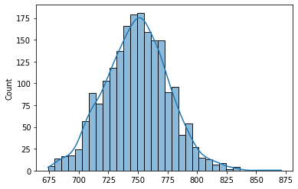
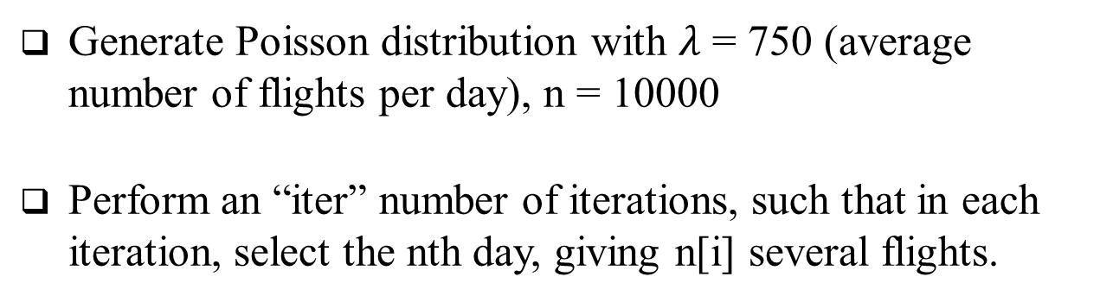
Simulate Data
Generate Poisson distribution with $λ$ = 750 (average number of flights per day), n = 10000
Perform an “iter” number of iterations, such that in each iteration, select the nth day, giving n[i] several flights.
Randomly select n[i] a number of flights (data points) from the original data.
Compute independent variables

Slide 9
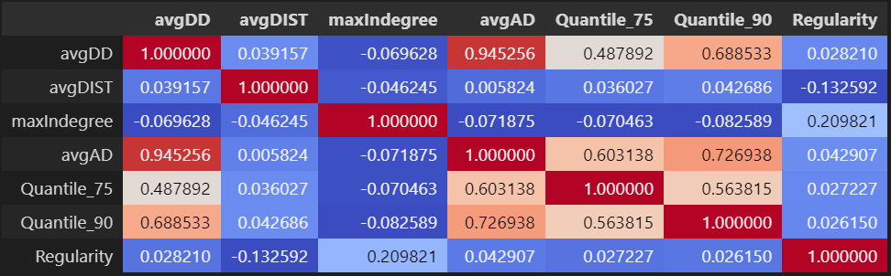
Pairwise coefficient of correlation

Slide 10
Observations
R2 score as performance measure:
Sr. No | avgDD | avgDist | Regularity | MaxIndegree | R2 Score | p-value
1 | 1 | 1 | 0 | 0 | 0.9468 | 2.20e-16
2 | 1 | 1 | 1 | 0 | 0.9468 | 2.20e-16
3 | 1 | 1 | 0 | 1 | 0.9469 | 2.20e-16
4 | 1 | 1 | 1 | 1 | 0.947 | 2.20e-16
A
Sr. No | avgDist | Regularity | MaxIndegree | R2 Score | p-value
1 | 1 | 0 | 0 | 0.9303 | 2.20e-16
2 | 1 | 1 | 0 | 0.9304 | 2.20e-16
3 | 1 | 0 | 1 | 0.9305 | 2.20e-16
4 | 1 | 1 | 1 | 0.9308 | 2.20e-16
B

Slide 11
Partial correlation coefficient
Sr. No | Var | Partial corr coeff | p-value
1 | avgDD | -0.330754115 | 9.46e-254
2 | avgDIST | 0.065209092 | 6.78e-11
3 | Regularity | 0.004533591 | 6.504109e-01
4 | MaxIndegree | -0.025339279 | 1.129671e-02

Slide 12
Conclusion:
Average departure delay and average distance have a high correlation with average arrival delay.
Regularity has the least correlation with average arrival delay. It is computationally expensive and has been tested to be statistically least significant.
Max-Indegree is coming out to be a statistically significant input variable for this regression model.

Slide 13
Future work:
Experiments with the Regularity of the graph, with some improvement, would be employed for performance improvement.
There is scope for further feature extraction from data with some simulation techniques, that will be studied and implemented in further work.
To work on various approaches to regression analysis to achieve better results.
After regression analysis, model will be built using different machine learning techniques for further improvement.

Slide 14
Reference
https://www.kaggle.com/datasets/yuanyuwendymu/airline-delay-and-cancellation-data-2009-2018?select=2018.csv
Flight delay prediction based on deep learning and the Levenberg‑Marquart algorithm. (Maryam Farshchian Yazdi1 , Seyed Reza Kamel2* , Seyyed Javad Mahdavi Chabok2 and Maryam Kheirabadi)-Journal of Big Data.
Introduction to Linear Regression Analysis. (Douglas C. Montgomery, Elizabeth A. Peck, G. Geoffrey Vining)
Analyzing the Regularity of Complete k-Partite Graph using Super Strongly Perfect Graphs. (R. Mary Jeya Jothi, Ebin Ephrem Elavathingaln)- 2015 Online International Conference on Green Engineering and Technologies (IC-GET 2015)

Slide 15
Thank You

Slide 16
Categorization of Data:
NOIR Classification
Nominal
Ordinal
Interval
Ratio
Categorical Data
(Qualitative)
Numeric Data
(Quantitative)

Slide 17
Performance Estimation:
We are to learn the metrics with which a classifier should be estimated.
There are mainly to things to be measured for a given classifier
MAE
MSE
RMSE
R-Squared
Adj R-Squared

Slide 18
Observations

