Slide 1

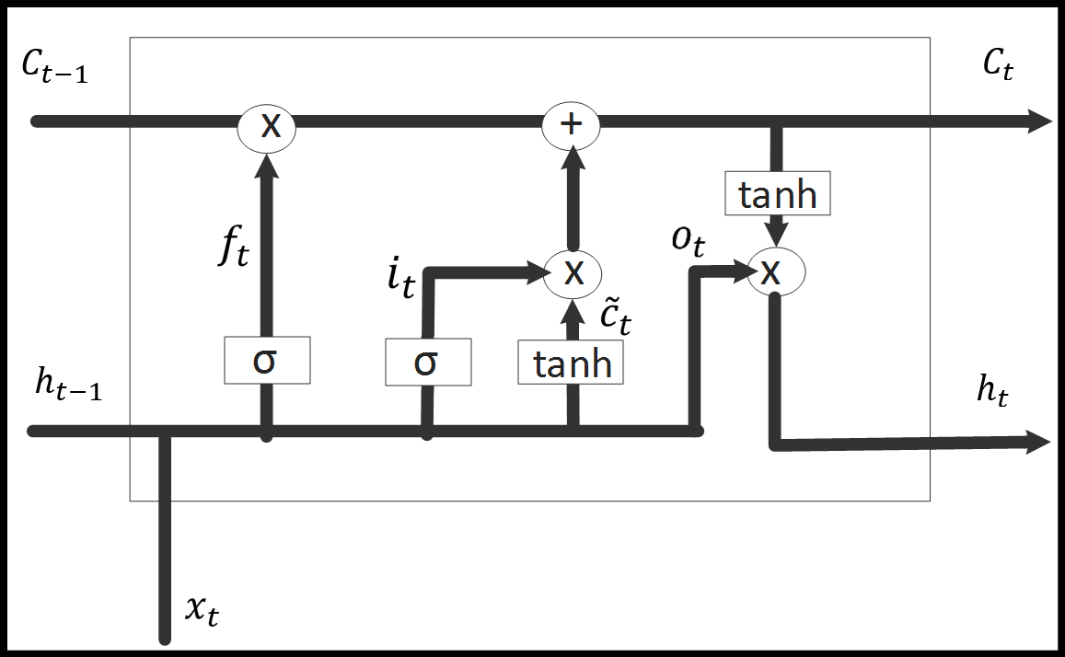

Long-Short Term Memory
Seminar Presentation
IIT Kharagpur
West Bengal-721301
Mohammed Kashif
21MA60R39
M-tech
Computer science and Data processing

Slide 2
Presentation Procedings …
Neural Network
Recurrent Neural Network
Limitations of RNNs
LSTM
LSTM features
Units of LSTM and functions
Working
Program Flow
Results
Conclusion
References

Slide 3

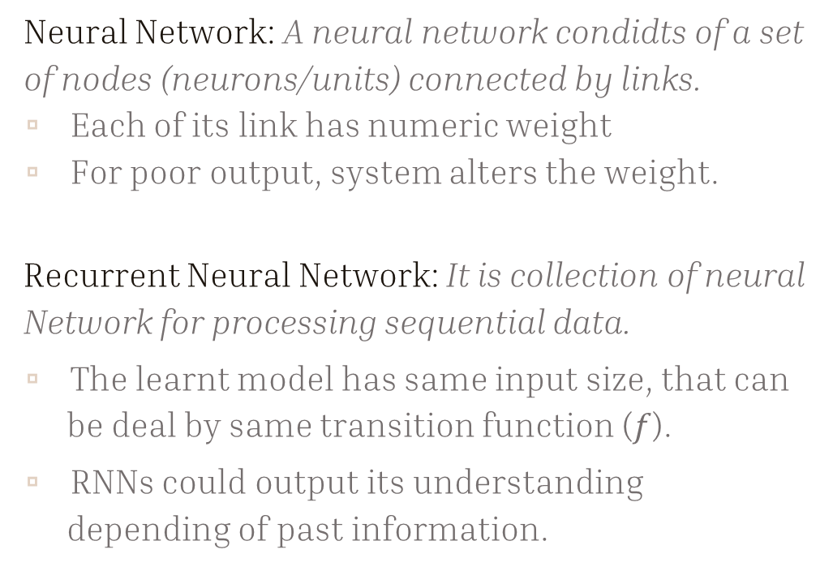






Neural Network and RNN.
Neural Network: A neural network condidts of a set of nodes (neurons/units) connected by links.
Each of its link has numeric weight
For poor output, system alters the weight.
Recurrent Neural Network: It is collection of neural Network for processing sequential data.
The learnt model has same input size, that can be deal by same transition function ($f$).
RNNs could output its understanding depending of past information.
Bias input
$$a_{j}$$
$$w_{j,i}$$
Kernel
g
f
$$a_{i}$$
Output
Activation function
$$h$$
$$f$$
$$x$$
$$h^{\left(t\right)}=f (h^{\left(t−1\right)},x^{\left(t\right)};θ)$$

Slide 4















Limitations of RNN:
$$h_{−1}$$
$$h_{0}$$
$$h_{1}$$
$$h_{2}$$
$$h_{3}$$
Short term dependencies
Long term dependencies
$$f_{−1}$$
$$f_{0}$$
$$f_{1}$$
$$f_{2}$$
$$x_{−1}$$
$$x_{0}$$
$$x_{1}$$
$$x_{2}$$
$$x_{3}$$

Slide 5
What is LSTM?
Long Short Term Memory Networks are special kind of RNN, has capability to learn long term depedencies.
In LSTM we use cell state to take past information and carry over many time steps.

Slide 6
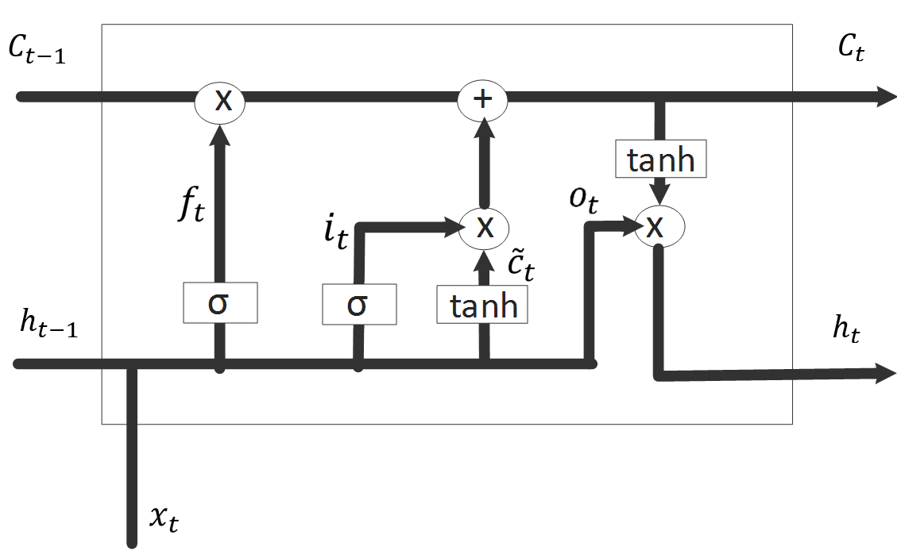
How LSTM is useful?
During forward propagation the gate control the flow of information. Similarly during backward propagation they control the flow of gradients
The vanishing gradient problem reduced considerably.
To some extent it has increases complexity due to different layers.
t-1
t+1
t

Slide 7




A complex idea can be conveyed with just a single still image, namely making it possible to absorb large amounts of data quickly.
Embedding:
Conversion of words and documents in machine useful/understandable format.
It allows us to capturing relationship among word.
Keras uses word2vect embeddings.
$$h_{−1}$$
$$h_{0}$$
$$h_{1}$$
$$h_{2}$$
$$h_{3}$$
O/p
$$f_{−1}$$
$$f_{0}$$
$$f_{1}$$
$$f_{2}$$
$$x_{−1}$$
$$x_{0}$$
$$x_{1}$$
$$x_{2}$$
$$x_{3}$$
0.5
0.22
0.53
0.02
0.11
0.83
0.02
0.12
0.9
1.5
1.9
2.01
0.99
0.55
1.2
1.95
2.66
-0.36
This movie was so good

Slide 8
Working of LSTM:
Constant Error Carousel
Forget Gate
Input Gate
Output Gate
8

Slide 9
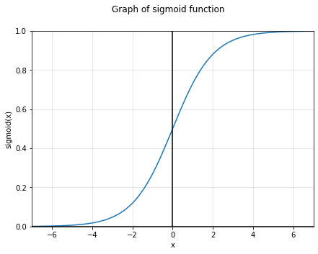
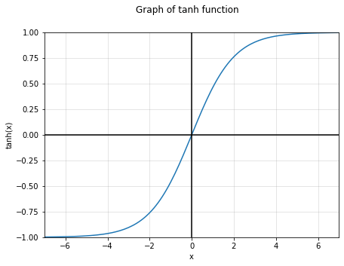
Working of LSTM:
Sigmoid
Constant Error Carousel
Forget Gate
Input Gate
Output Gate
tanh

Slide 10

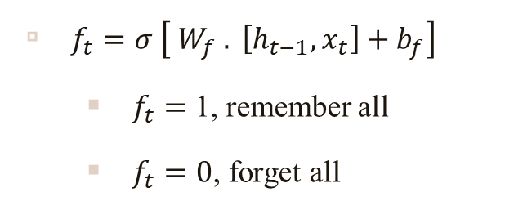
1. Constant Error Carousel
The LSTM has ability to manipulate information to the cell state, carefully regulated by different gate elements.(Memory cell)
Information regulated, considered from previous time step and present time step, to the output.
2. Forget Gate
$f_{t}=σ \left[ W_{f} . \left[h_{t−1},x_{t}\right]+b_{f}\right]$
$f_{t}=$ 1, remember all
$f_{t}=0$, forget all

Slide 11
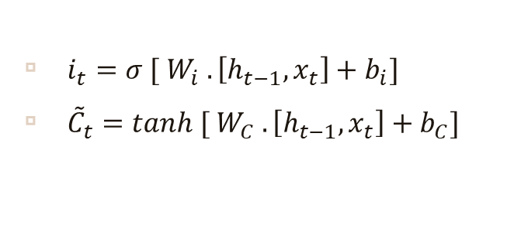

3. Input Gate
$i_{t}=σ [ W_{i} . \left[h_{t−1},x_{t}\right]+b_{i}]$
${\tilde{C}}_{t}=tanh [ W_{C} . \left[h_{t−1},x_{t}\right]+b_{C}]$
New state value:
$C_{t}= f_{t}∗C_{t−1}+{ i}_{t}∗{\tilde{C}}_{t}$

Slide 12

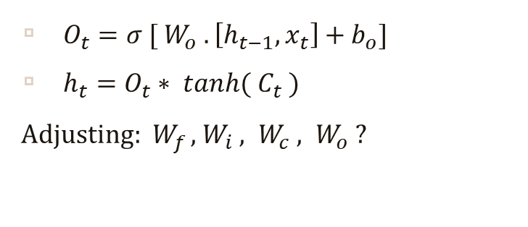


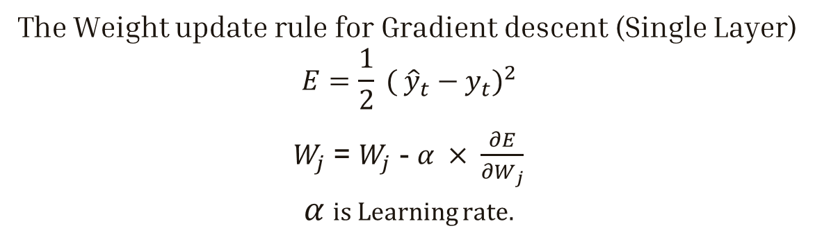
4. Output Gate
$O_{t}=σ [ W_{o} . \left[h_{t−1},x_{t}\right]+b_{o}]$
$h_{t}=O_{t}∗ tanh({ C}_{t} )$
Adjusting$: W_{f}$ , $W_{i} , W_{c} , W_{o}$ ?
The Weight update rule for Gradient descent (Single Layer)
$$E=\frac{1}{2} {( {\hat{y}}_{t}−y_{t})}^{2}$$
$W_{j}$ = $W_{j}$ - $α × \frac{∂E}{{∂W}_{j}}$
$α$is Learning rate.
Bias input
$$a_{j}$$
$$w_{j,i}$$
Kernel
g
f
$$a_{i}$$
Output
Activation function

Slide 13
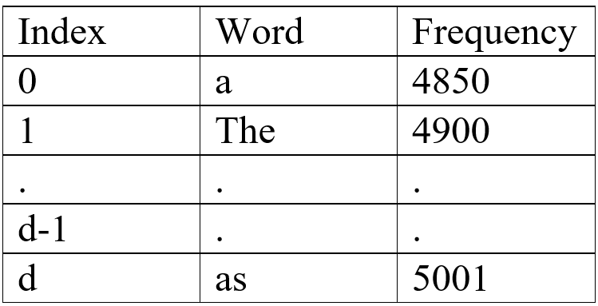
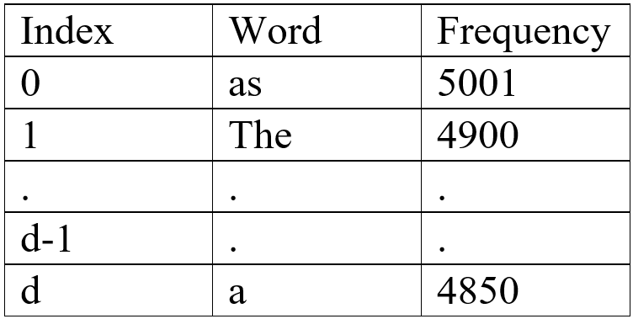
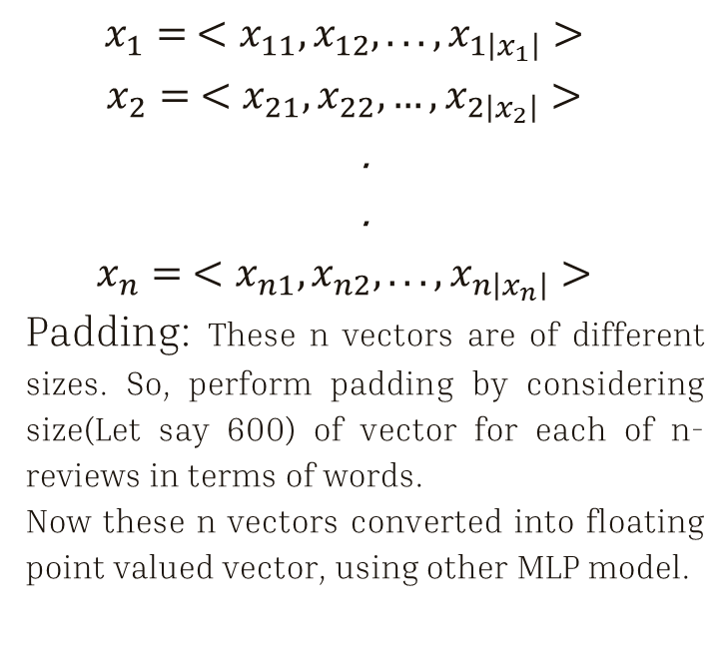
Embedding used in code:
$$x_{1}= <x_{11}, x_{12}, ..., x_{1\left|x_{1}\right|}>$$
$$x_{2}= <x_{21}, x_{22}, …, x_{2\left|x_{2}\right|}>$$
.
.
$$x_{n}= <x_{n1}, x_{n2}, ..., x_{n\left|x_{n}\right|}>$$
Padding: These n vectors are of different sizes. So, perform padding by considering size(Let say 600) of vector for each of n-reviews in terms of words.
Now these n vectors converted into floating point valued vector, using other MLP model.
Review | Sentiment
This is my favorite movie of all time. | Positive/Negative

Slide 14
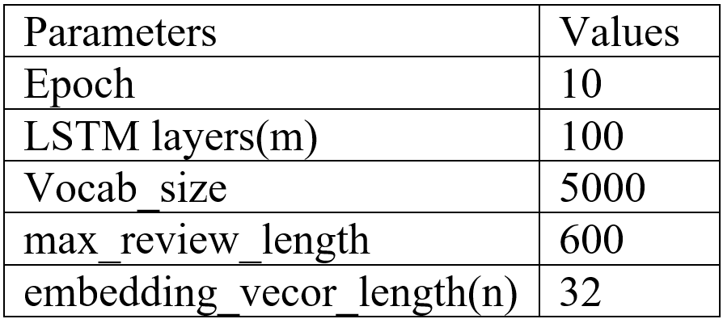
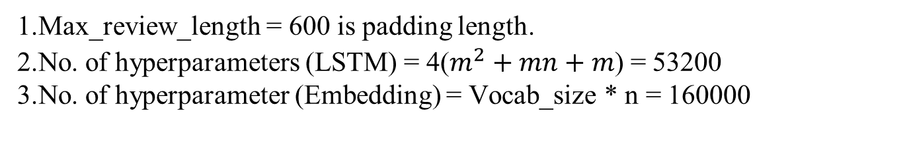
Results:
1.Max_review_length = 600 is padding length.
2.No. of hyperparameters (LSTM) = 4($m^{2}+mn+m$) = 53200
3.No. of hyperparameter (Embedding) = Vocab_size * n = 160000
Model accuracy under this parameter conditioning is,
85.00%

Slide 15
Conclusions:
Long term dependencies made it useful in various applications such as Language Translation, Sentiment analysis, image captioning etc.
Model has smooth control over amount of information the network retain/ discards.
The vanishing gradient problem addressed using cell state.
Large updates to weight during training – Exploding gradient (Gradient clipping is useful).

Slide 16
References:
http://colah.github.io/posts/2015-08-Understanding-LSTMs/
https://www.analyticsvidhya.com/blog/2021/06/the-challenge-of-vanishing-exploding-gradients-in-deep-neural-networks/
https://www.hindawi.com/journals/misy/2021/6654029/
https://www.hindawi.com/search/all/lstm/
https://medium.com/@dcameronsteinke/tf-idf-vs-word-embedding-a-comparison-and-code-tutorial-5ba341379ab0
Deep Learning, NLP, and Representations - colah's blog

Slide 17
Thank You

Slide 18
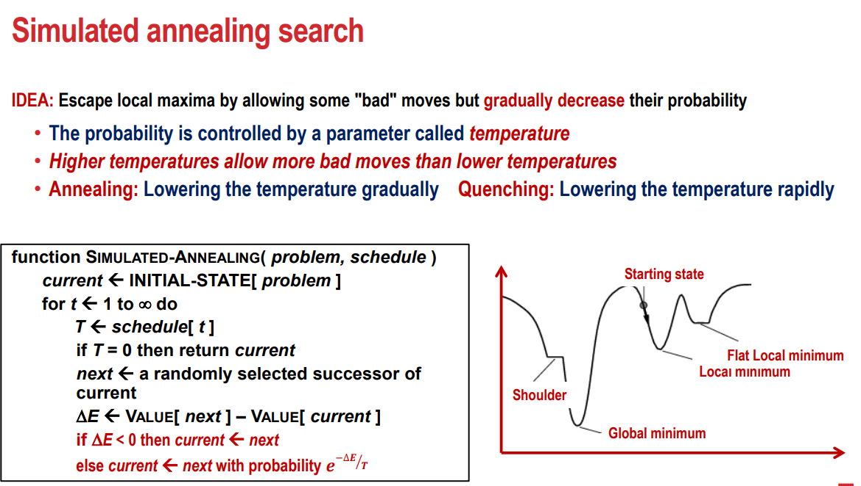

Slide 19
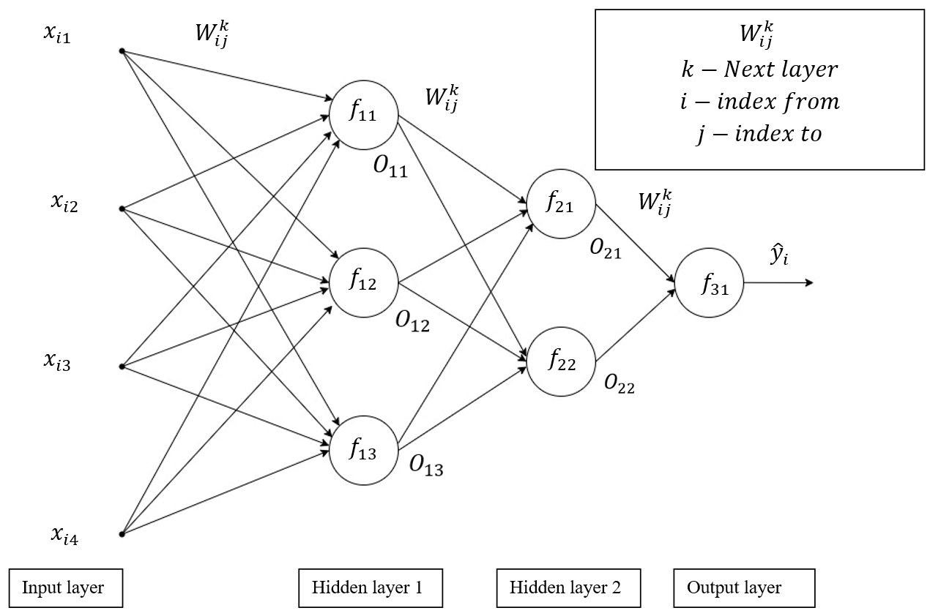

Slide 20
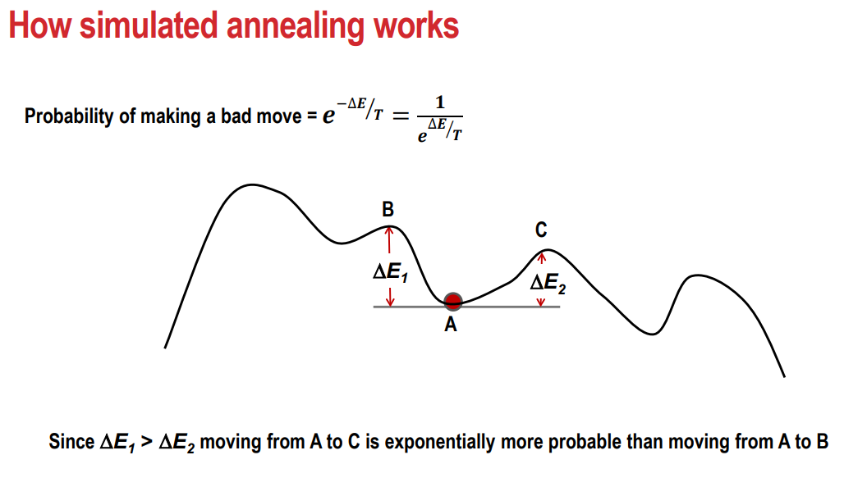

Slide 21



Funnel
Word to vector
Embedding
Data Nomralization
Concatenation ($h_{t−1},x_{t}$)
Forget Gate
$$f_{t}∗C_{t−1}$$
Delete Information
ff
Input Gate
$${ i}_{t}∗{\tilde{C}}_{t}$$
Add Information
Output
Output

Slide 22
A complex idea can be conveyed with just a single still image, namely making it possible to absorb large amounts of data quickly.
Embedding:
Conversion of words and documents in machine useful/understandable format.
It allows us to capturing relationship among word.
Methods: CBOW, Skipgram.
Keras uses word2vect embeddings.
$$h_{−1}$$
$$h_{0}$$
$$h_{1}$$
$$h_{2}$$
$$h_{3}$$
O/p
$$f_{−1}$$
$$f_{0}$$
$$f_{1}$$
$$f_{2}$$
$$x_{−1}$$
$$x_{0}$$
$$x_{1}$$
$$x_{2}$$
$$x_{3}$$
0.5
0.22
0.53
0.02
0.11
0.83
0.02
0.12
0.9
1.5
1.9
2.01
0.99
0.55
1.2
1.95
2.66
0.36
This movie was so good Bad

