Slide 1
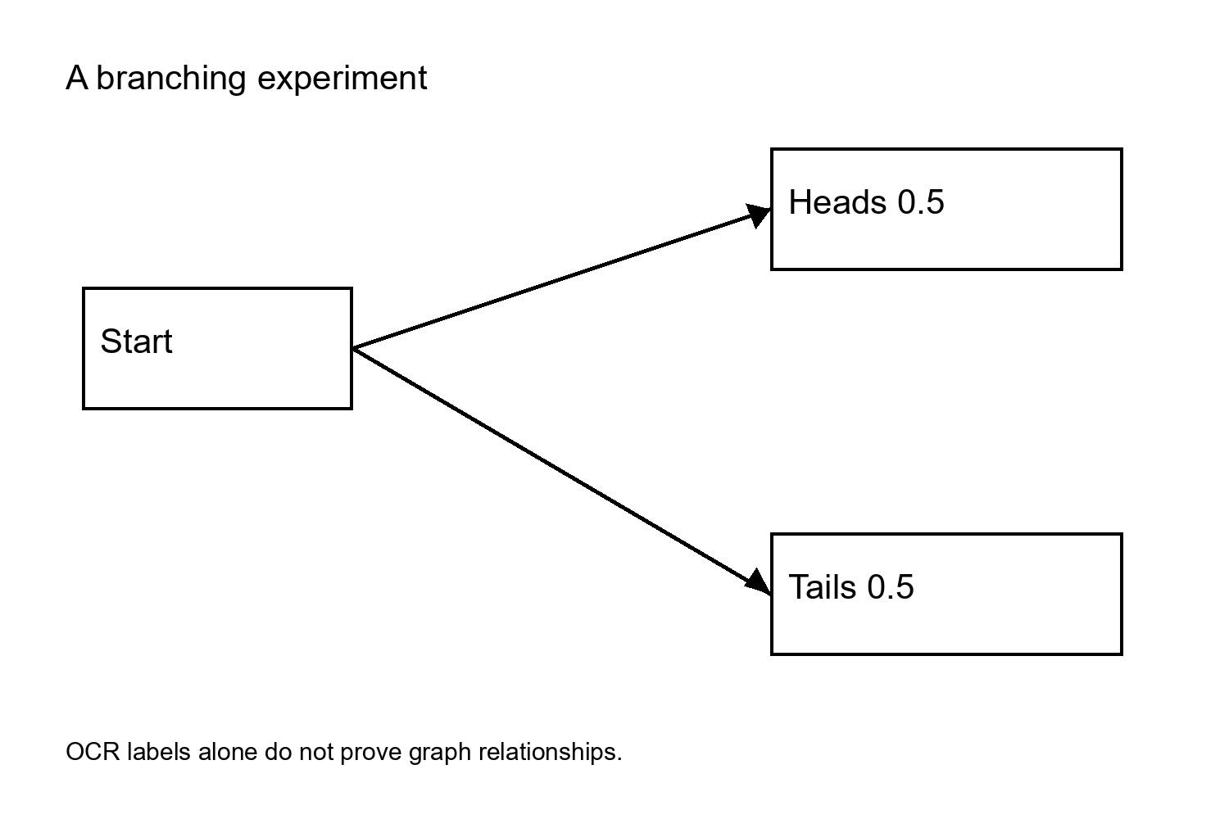
First slide: branching experiment

Slide 2
Second slide: Bayes fraction

