Slide 2
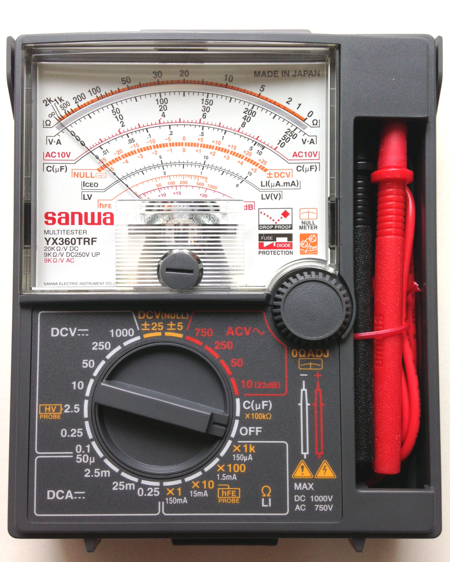
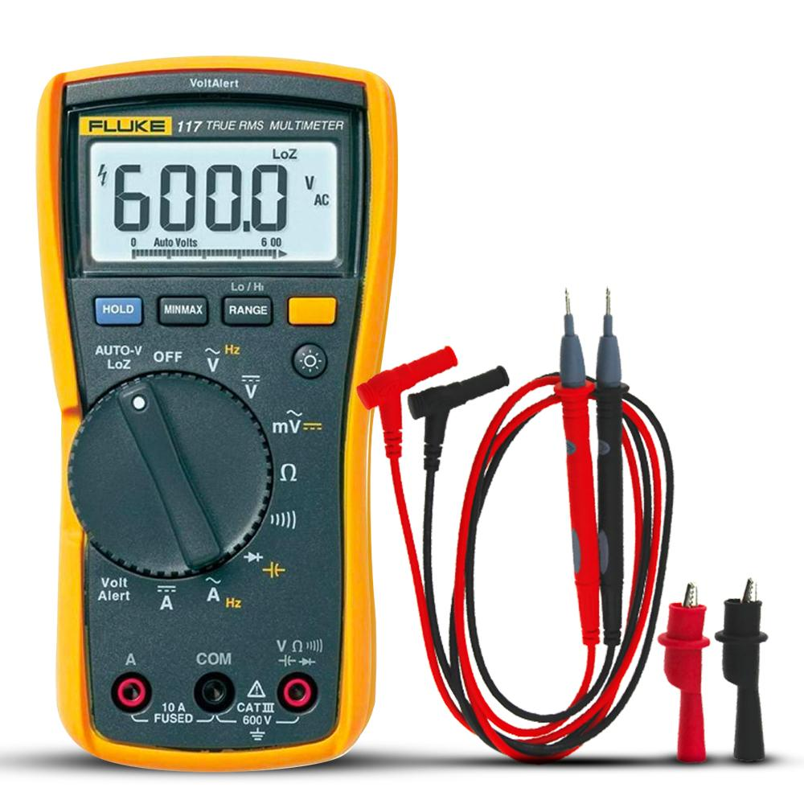
Multimeter

Slide 3
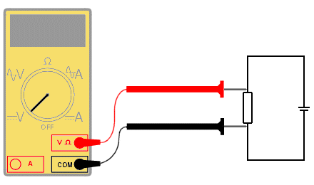
Voltage Measurement with a Multimeter

Slide 4
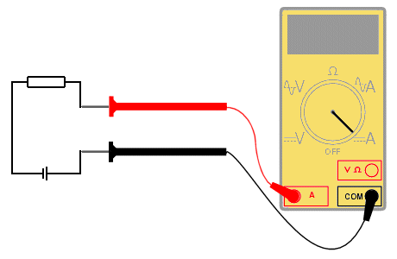
Current Measurement with a Multimeter

Slide 5
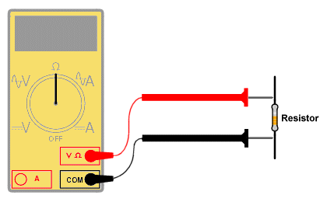
Resistance Measurement with a Multimeter

Slide 6
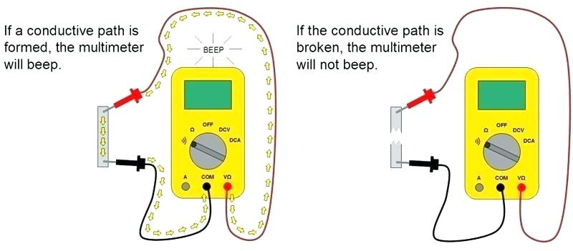
Continuity Check with a Multimeter

Slide 7
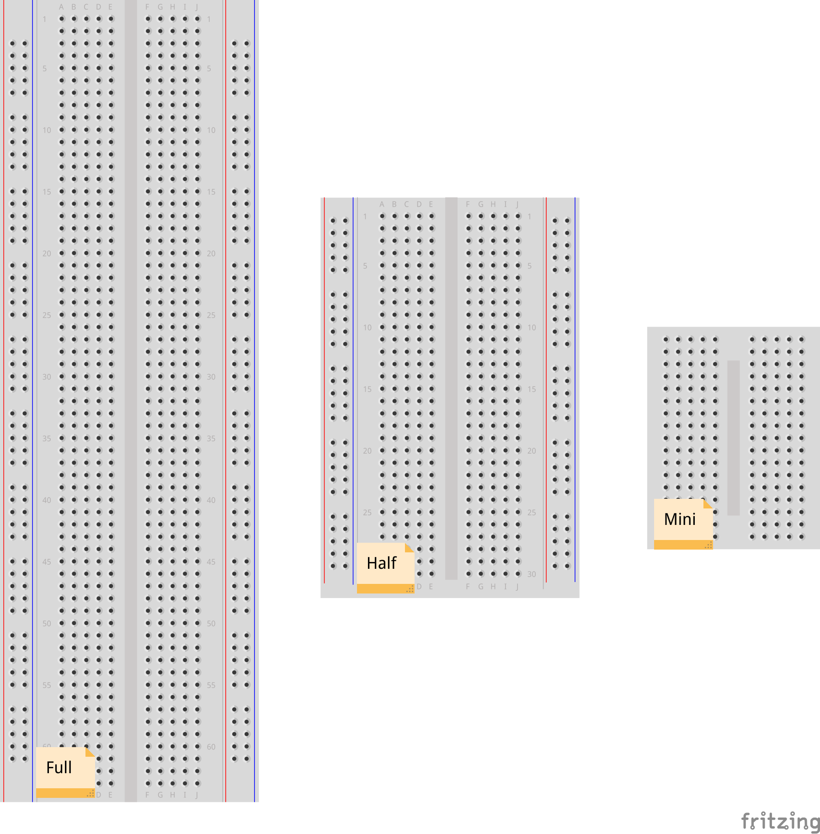
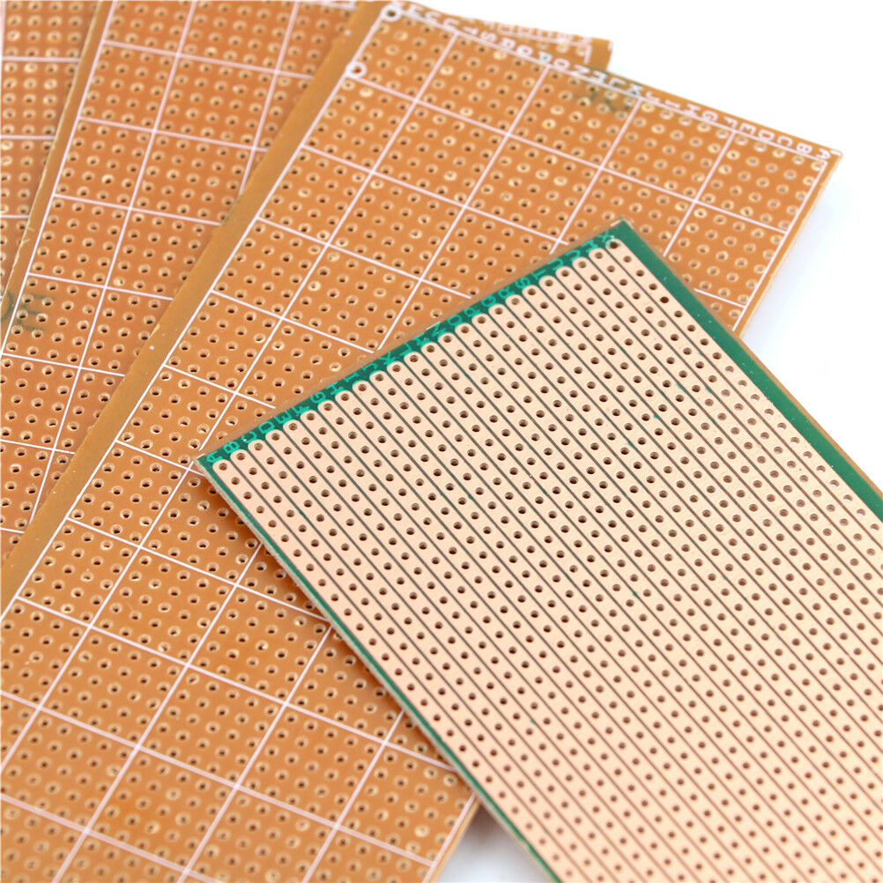
Circuit Boards: Breadboard & Veroboard
Breadboard
Veroboard

Slide 8
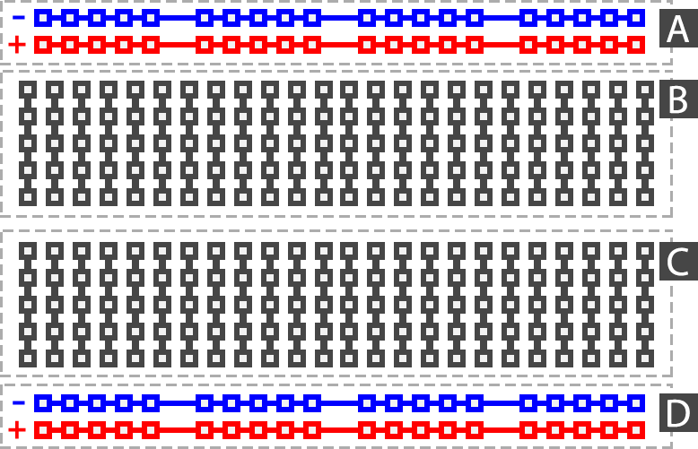
Breadboard
A : Power Rails
B : Circuit Area
C : Circuit Area
D : Power Rails

Slide 9
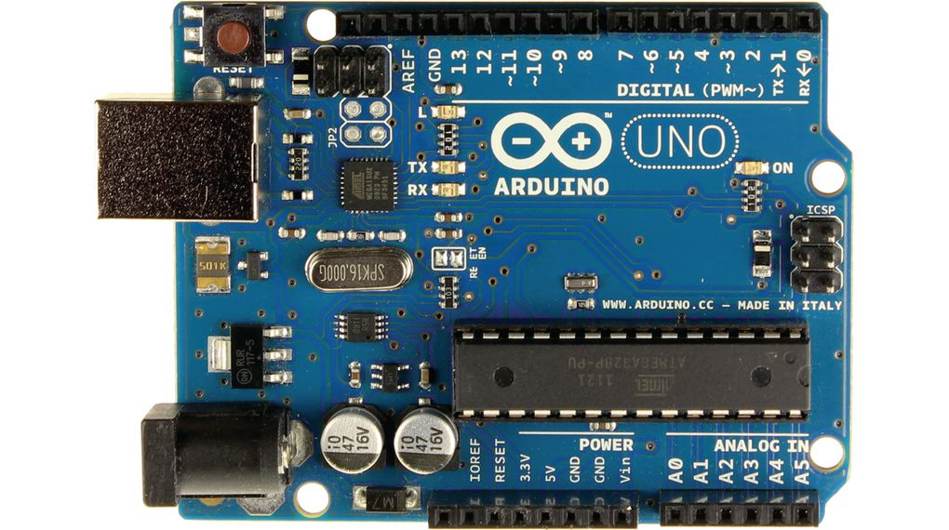
Arduino UNO
Reset Button
Digital Pin
Analog Pin
USB Port
Power Pin
Microcontroller
Power Jack

Slide 10
Arduino UNO Specefication
Microcontroller: ATmega328P
Operating Voltage: 5V
Input Voltage Limit: 6-20V
Input Voltage (recommended): 7-12V
Digital I/O Pins: 14 (D0-D13)
PWM Digital I/O Pins: 6 (D3,D5,D6,D9,D10,D11)
Analog Input Pins: 6 (A0-A5)
DC Current per I/O Pin: 40 mA
DC Current used for 3.3V Pin is 50 mA
Flash Memory: 32 KB, and 0.5 KB memory is used by the boot loader
Clock Speed: 16 MHz
Length: 68.6 mm
Width: 58.4 mm
Weight: 25 g

Slide 11
Arduino UNO Pinout
Ground
13
Digital Pin13
Reset
12
Digital Pin12
3.3V
11
Digital Pin11
PWM Pin
5V
10
Digital Pin10
PWM Pin
Ground
9
Digital Pin9
PWM Pin
Ground
8
Digital Pin8
Vin 7-12V
7
Digital Pin7
6
Digital Pin6
PWM Pin
Analog Pin0
A0
5
Digital Pin5
PWM Pin
Analog Pin1
A1
4
Digital Pin4
Analog Pin2
A2
3
Digital Pin3
PWM Pin
Analog Pin3
A3
2
Digital Pin2
Analog Pin4
A4
1
Digital Pin1
Serial Port TXD
Analog Pin5
A5
0
Digital Pin0
Serial Port RXD

Slide 12
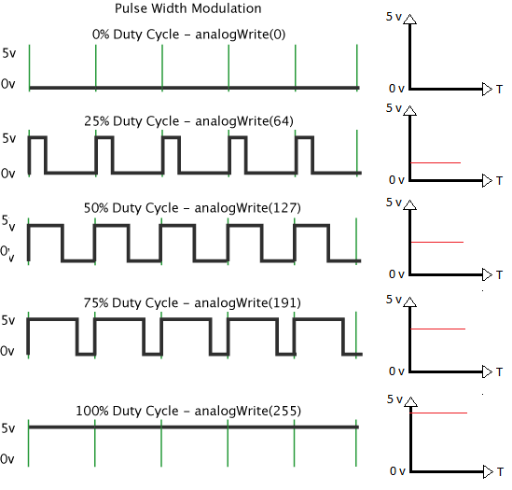
PWM: Pulse Width Modulation

Slide 21
PWM Pin
PWM Pin
13
13
Digital Pin13
12
12
Digital Pin12
A3
11
Digital Pin11
7
Digital Pin7
A4
10
Digital Pin10
6
Digital Pin6
Reset
9
Digital Pin9
5
Digital Pin5
3.3V
8
Digital Pin8
4
Digital Pin4
5V
3
Digital Pin3
Analog Pin0
A0
Ground
2
Digital Pin2
Analog Pin1
A1
Ground
Digital Pin9
1
Digital Pin1
Analog Pin2
A2
Vin 7-12V
0
Digital Pin0
Analog Pin3
A3
Analog Pin4
A4
Serial Port TXD
Analog Pin5
A5
Serial Port RXD

