Slide 1

OpenSSL Demo:
Team Members:
Member 1: Name: Tejesshree S
Reg no: 2022503524
Ph no: 90250 40835
Email: gowrikavinraja@gmail.com
Member 2: Name: Janani A
Reg no: 2022503502
Ph no: 81480 69677
Email: jananialagar.2410@gmail.com
Member 3: Name: Kathirvel M
Reg no: 2022503060
Ph no: 72999 91398
Email: kathirvelm2022@gmail.com
www.ngnlab.org

Slide 2
Implementation of secure file encrypting and decryption process using OpenSSL with both RSA and AES (asymmetric and symmetric cryptography)
Create 3 directories for Alice, Bob, CA
Create RSA private key and public key pair for all 3 of them in their respective directories.
Create a self-signed certificate for CA using it’s own private key.
Create certificate signing requests (CSRs) for Alice and Bob using their private key
CA signs Alice and Bob certificates using CA’s private key
Alice and Bob verify each other’s certificates
Alice encrypts a file using RSA (wont work for large files)
Alice generates a random AES symmetric key
Alice encrypts a file using AES-256-CBC (Cipher Block Chaining Mode). SHA-256 is used for password or key derivation
ALice encrypts AES symmetric key using Bob’s public key
Bob decrypts the AES key using his private key
Alice had signed the AES key file (symkey.pem) using her private key. Bob verifies the signature using Alice’s public key.

Slide 3
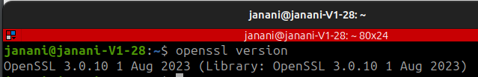
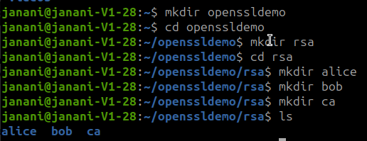
Checking OpenSSL Version in Ubuntu:
Creation of 3 folders - Alice, Bob, CA

Slide 4
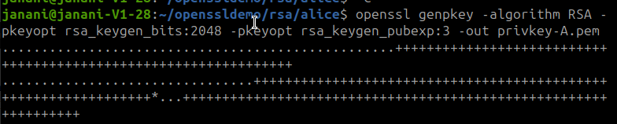
Alice generates public and private key - privkey-A.pem and pubkey-A.pem

Slide 5
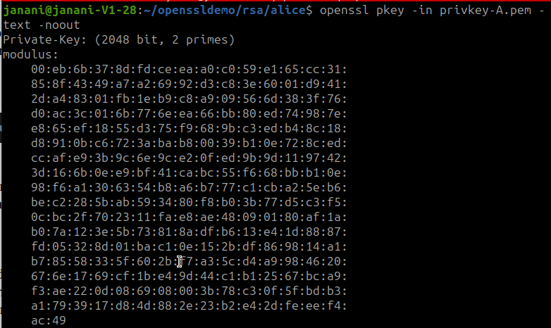
Viewing keys of Alice:

Slide 6
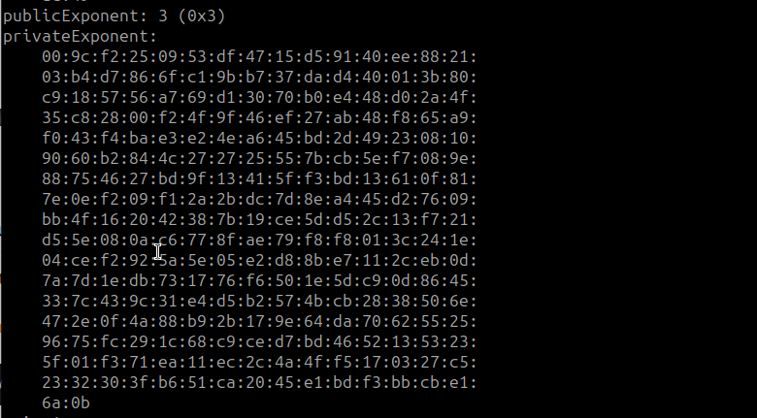
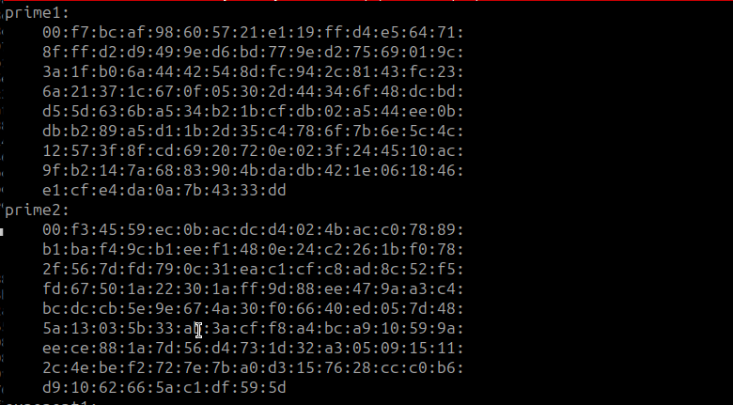

Slide 7
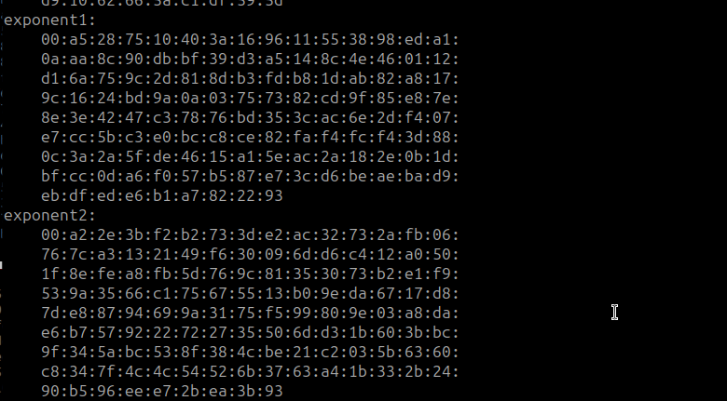
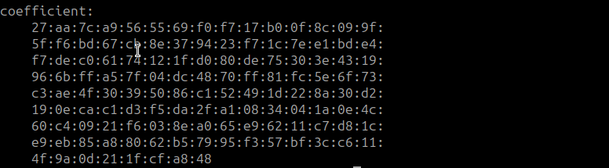

Slide 8
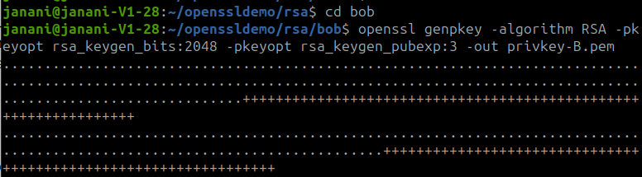
Creation of public and private keys of Bob - privkey-B.pem and pubkey-B.pem

Slide 9
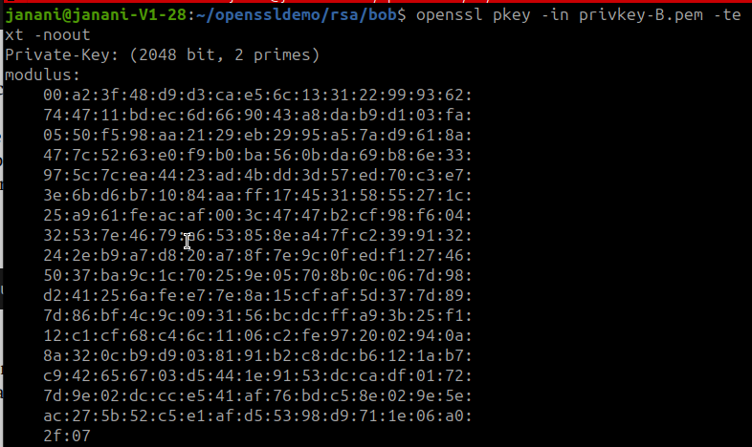
Viewing of keys of Bob:

Slide 10
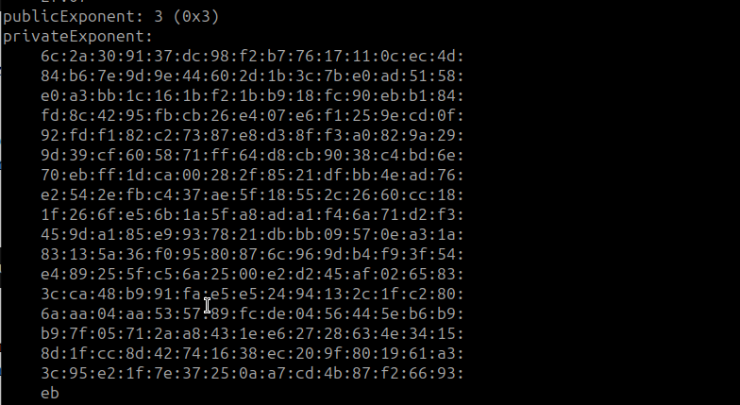
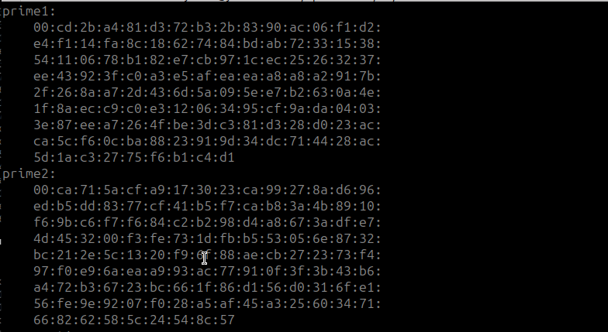

Slide 11
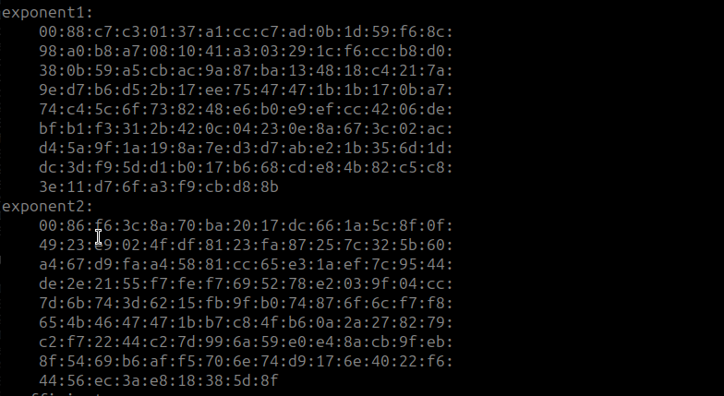
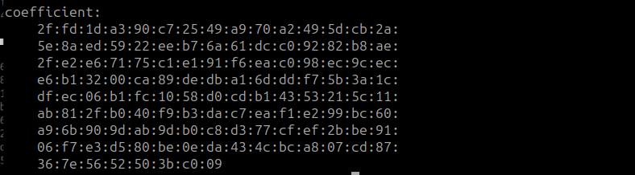

Slide 12
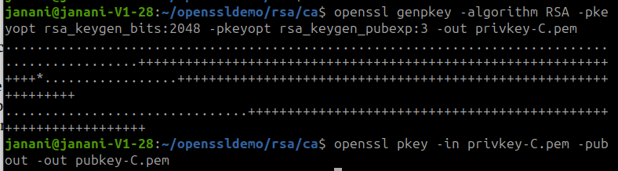
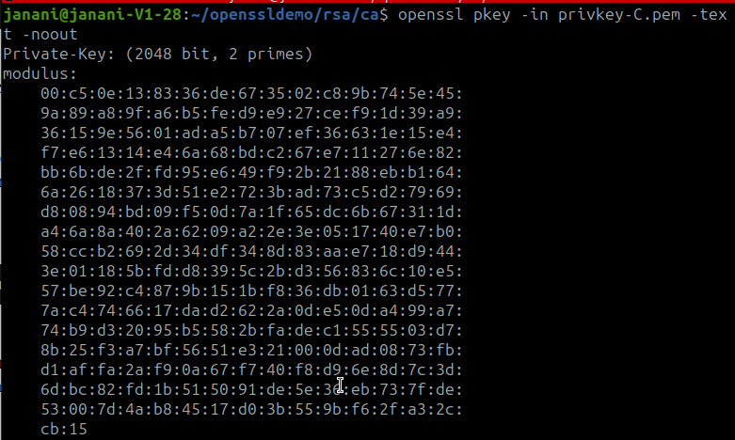
Creation of public and private keys of CA - privkey-C.pem and pubkey-C.pem

Slide 13
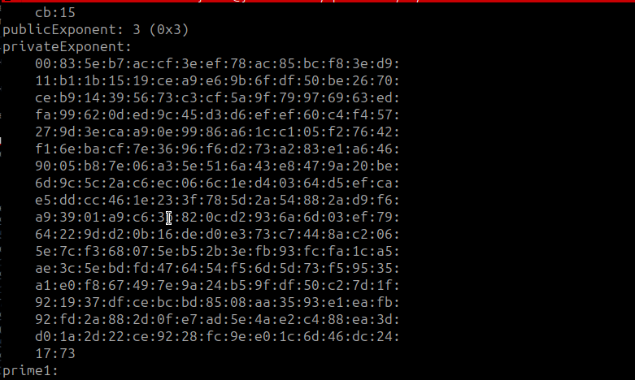
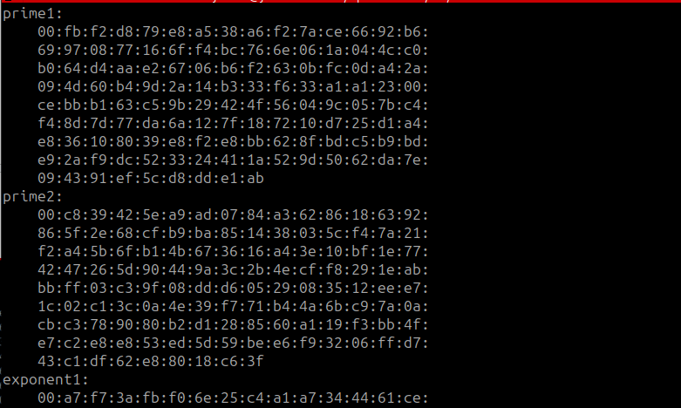

Slide 14
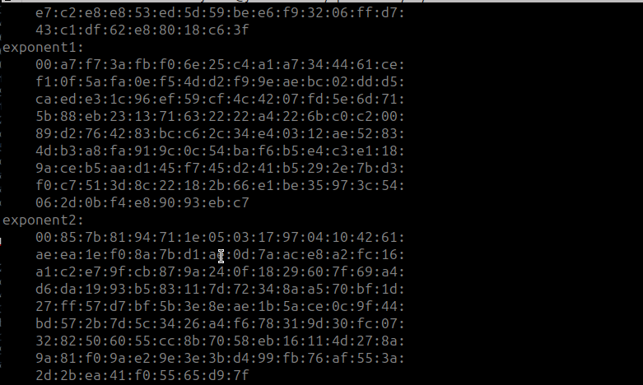
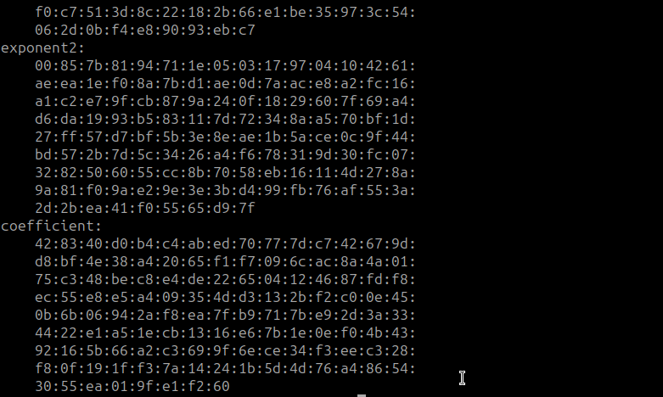

Slide 15
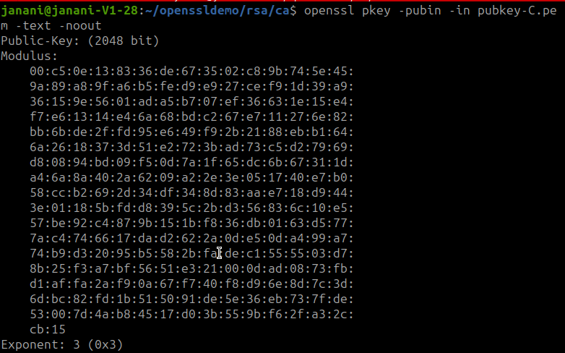

Slide 16
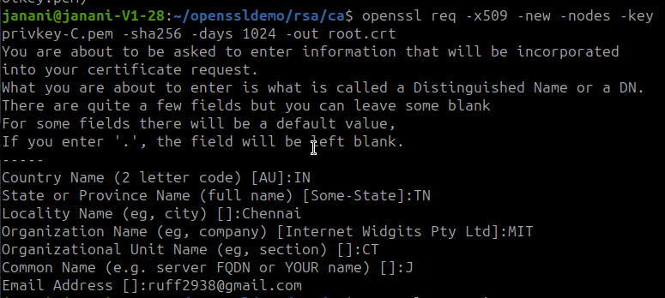
CA creates a self-signed certificate:
req -x509 -new → Generates a new self-signed certificate.
-key ca/rootkey.pem → Uses CA's private key to sign itself.
-sha256 → Uses SHA-256 hashing for integrity.
-days 365 → Certificate valid for 1 year.
-out ca/root.crt → Saves the CA certificate.

Slide 17
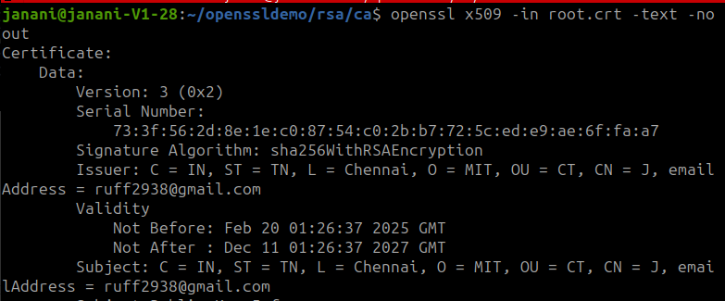
Viewing CA’s certificate:

Slide 18
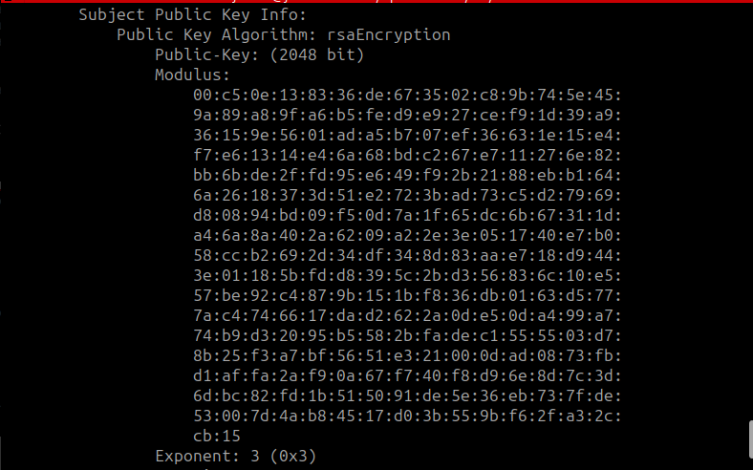

Slide 19
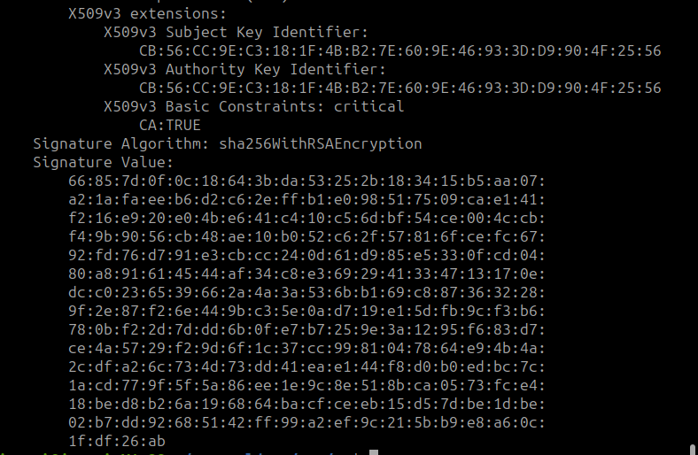

Slide 20
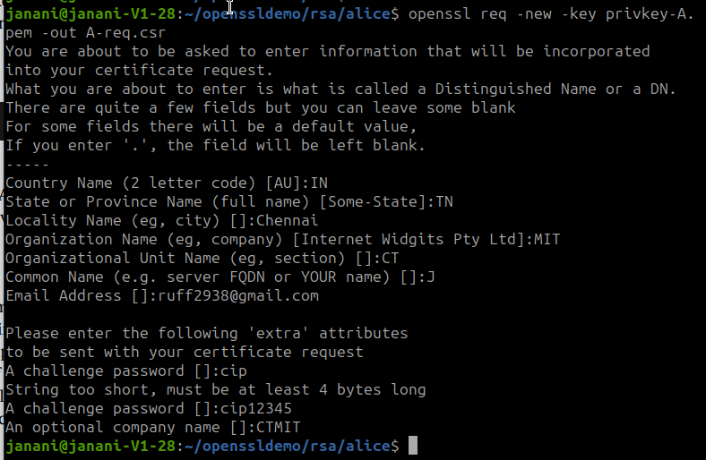
Alice creates Certificate Signing Request (CSR):
req -new → Generates a new CSR.
-key privkey-*.pem → Uses the entity's private key.

Slide 21
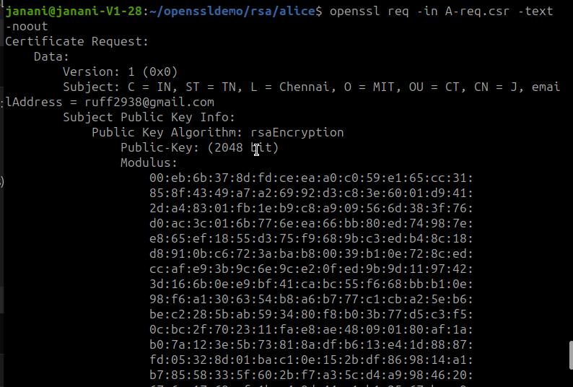


Slide 22
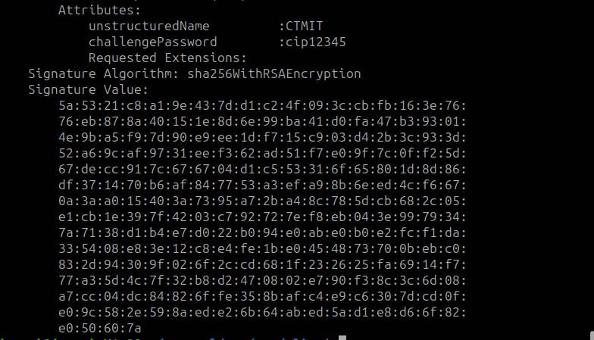

Slide 23
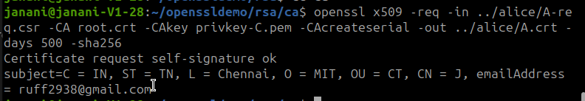
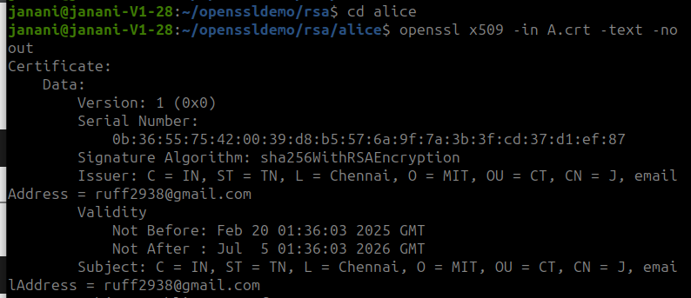
CA signs the CSR created by Alice:
x509 -req → Signs a CSR and issues a certificate.
-CA ca/root.crt → Uses CA’s certificate to establish trust.
-CAkey ca/rootkey.pem → Uses CA’s private key for signing.
-out A.crt → Saves signed certificate.

Slide 24
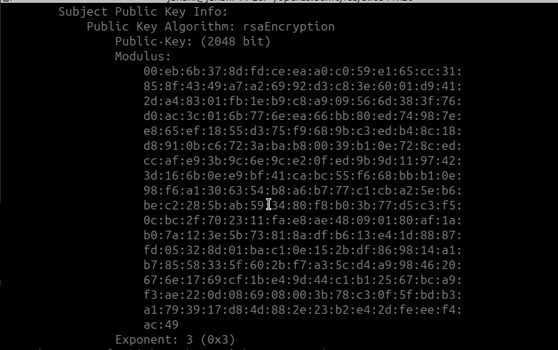
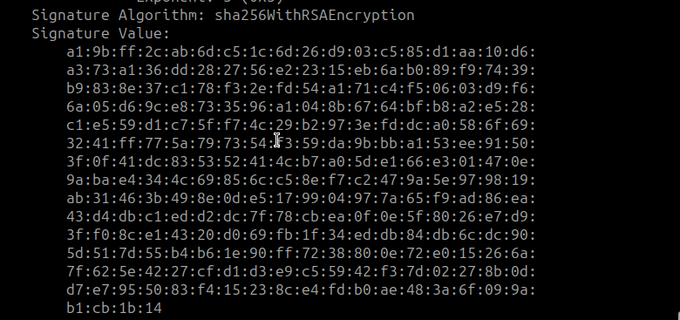

Slide 25
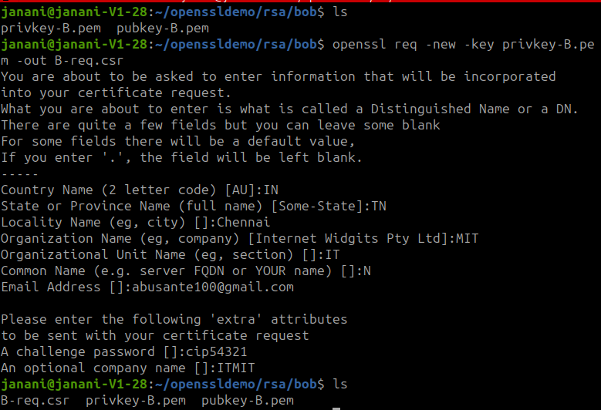
Bob creates a Certificate Signing Request (CSR):

Slide 26
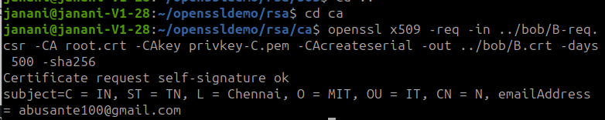
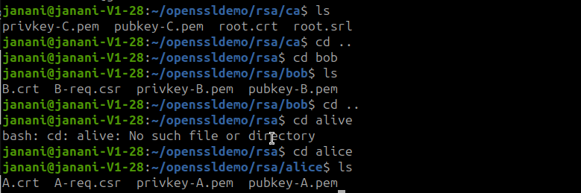
CA signs Bob’s CSR:

Slide 27
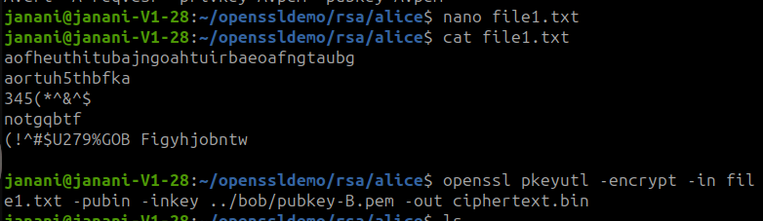
Alice verifies Bob’s certificate:
Alice gets Bob’s public key from his certificate:
Alice creates a file - file1.txt for sharing. Alice encrypts her file1.txt with Bob’s public key (although encrypting it with RSA key wont work for large files)

Slide 28
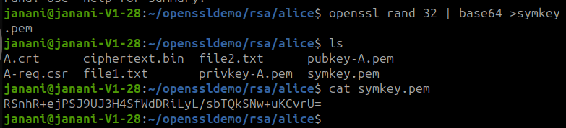
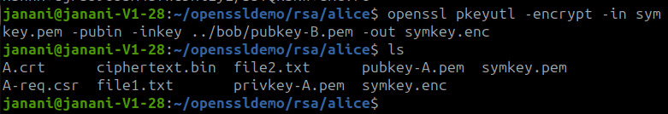
Alice generates symmetric key - symkey.pem:
rand -base64 32 → Generates a 32-byte symmetric key (AES-256).
-out symkey.pem → Saves the AES key.
Alice encrypts symkey.pem using Bob’s public key:

Slide 29
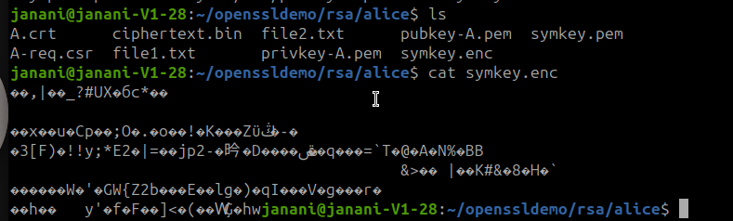
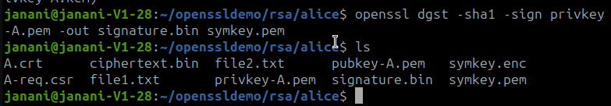
Alice hashes symkey.pem and encrypts it using her private key: (digital signature)

Slide 30
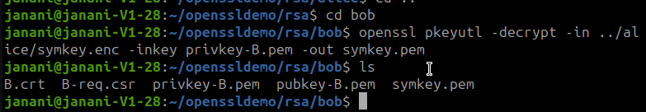

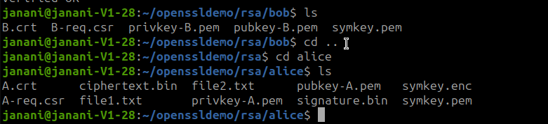
Bob decrypts symkey.enc using his private key:
Bob verifies the message is from Alice: (verifying digital signature)

Slide 31
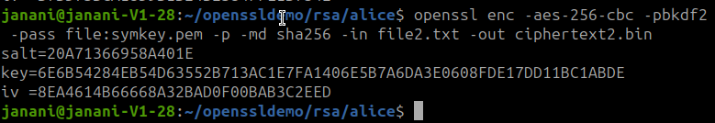
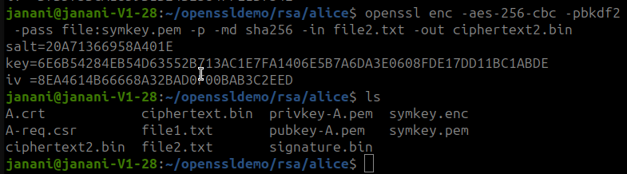
Alice encrypts her file2.txt with the symmetric key:

Slide 32
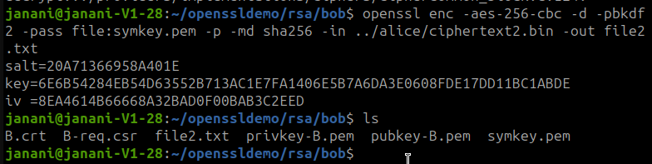
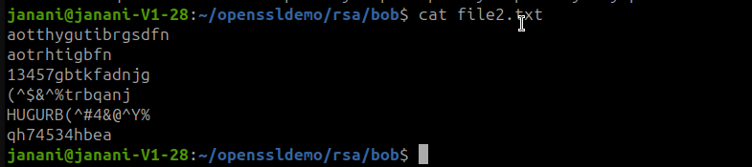
Bob decrypts ciphertext2.bin with same symmetric key:

Slide 33
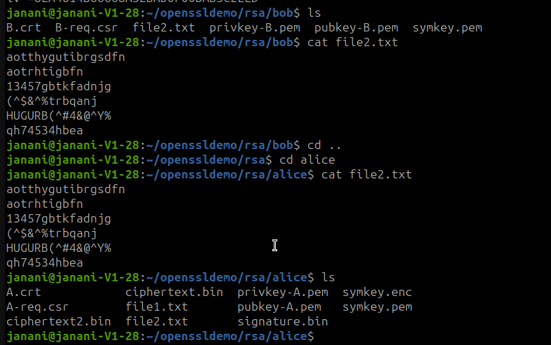

Slide 34
Thank You

