Slide 1
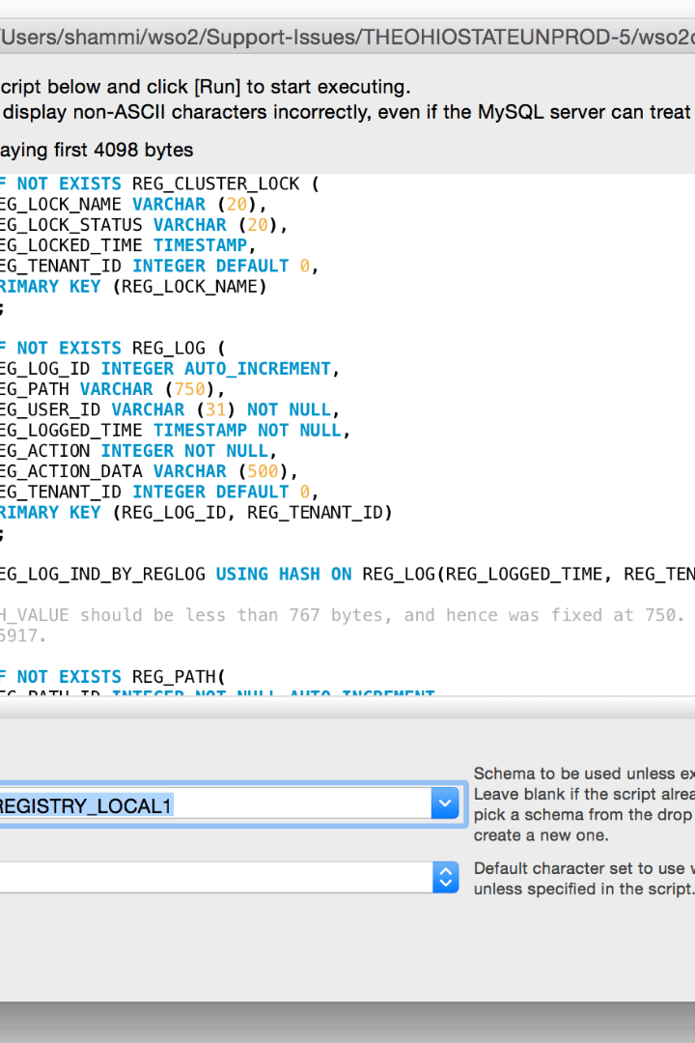


File Handling in Linux
Discover the essential file handling utilities in Unix-like operating systems. Learn how to copy, move, delete, create directories, list files, view file contents, search for text, and more.
by Pooja Kattegummula

Slide 2

Copying Files with cp
1
Syntax
2
Example
cp [options] source_file destination
cp file.txt /path/to/destination

Slide 3
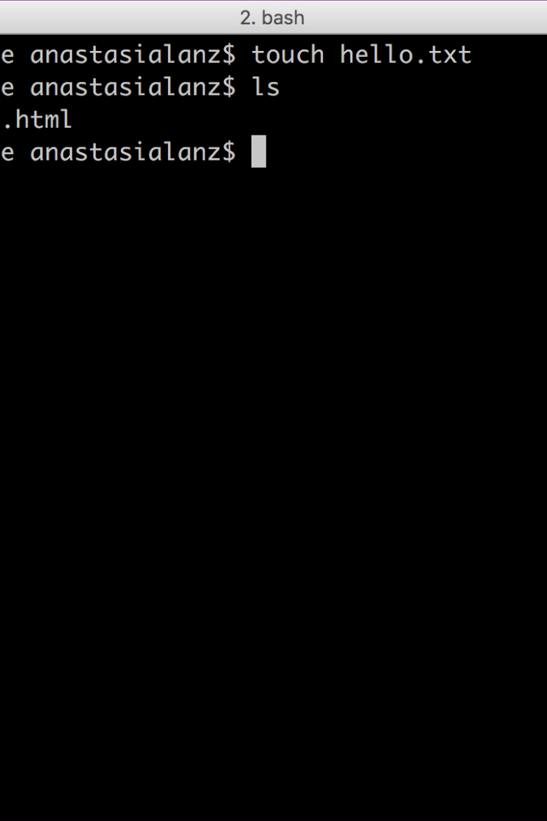
Moving/Renaming Files with mv
1
Syntax
mv [options] source destination
2
Example
mv file.txt new_name.txt

Slide 4
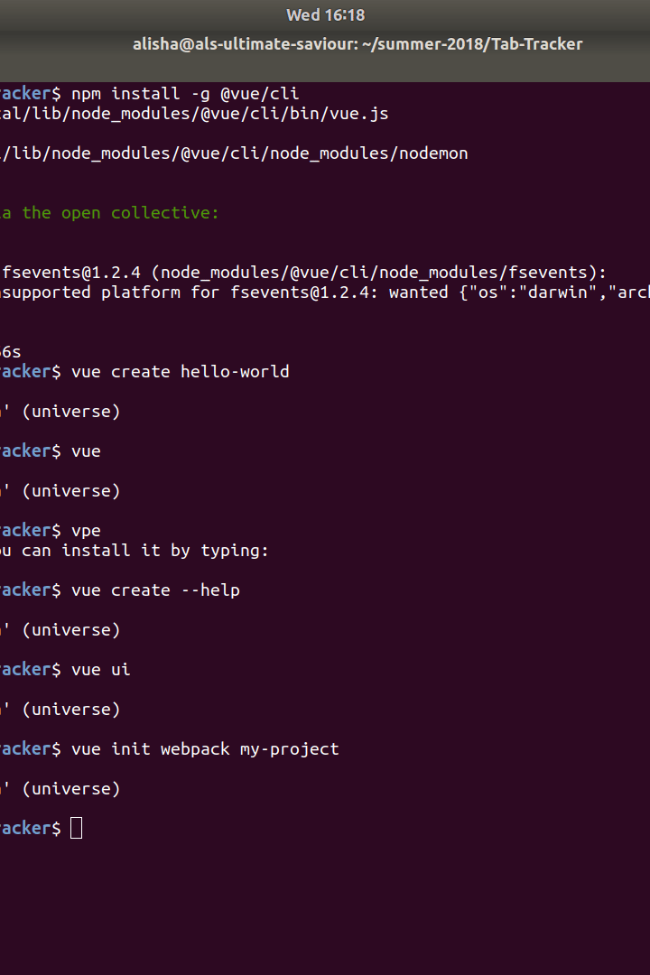
Removing Files with rm
1
Syntax
rm [options] file
2
Example
rm file.txt

Slide 5
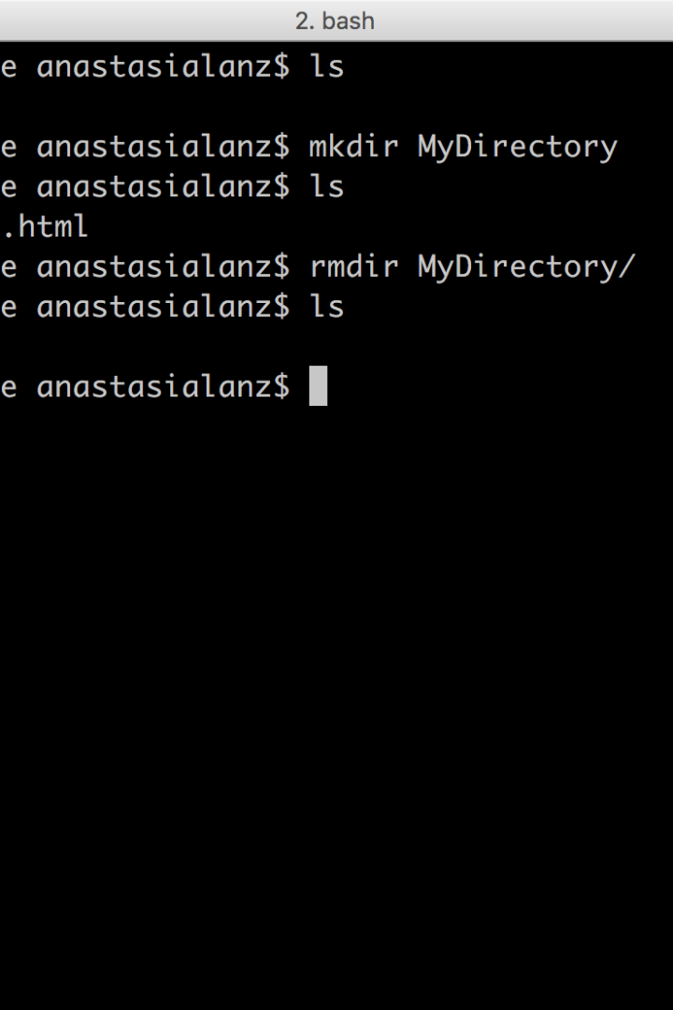
Creating Directories with mkdir
1
Syntax
mkdir [options] directory_name
2
Example
mkdir my_folder

Slide 6
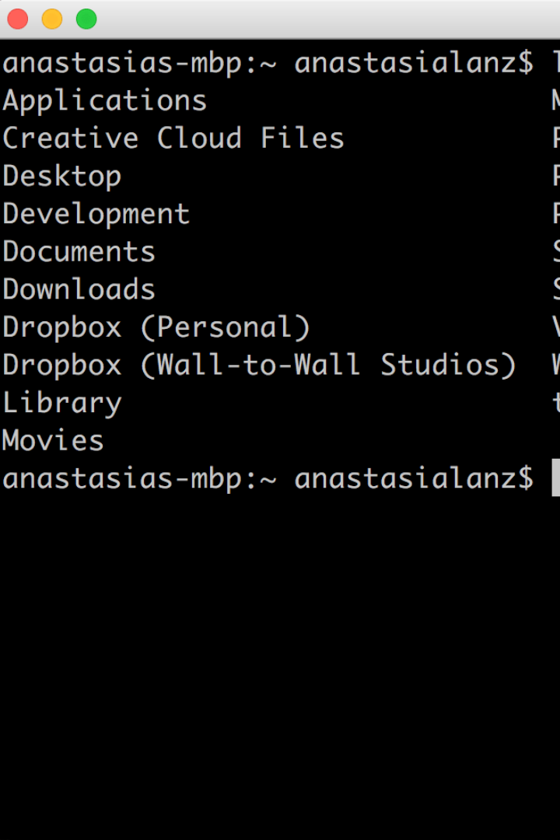
Listing Files and Directories with ls
1
Syntax
ls [options] [directory]
2
Example
ls -l /path/to/directory

Slide 7
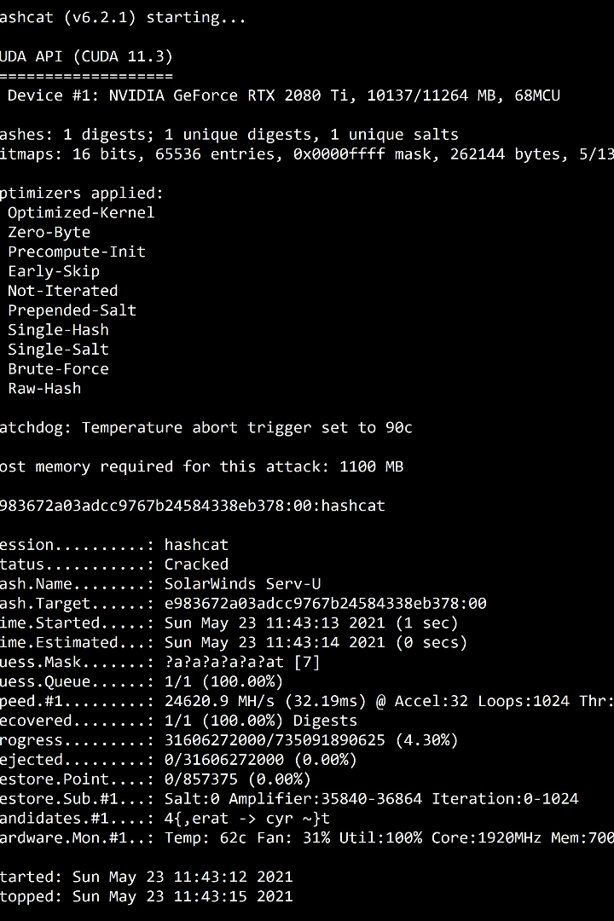
Viewing File Contents with cat
1
Syntax
cat [options] file
2
Example
cat myfile.txt

Slide 8
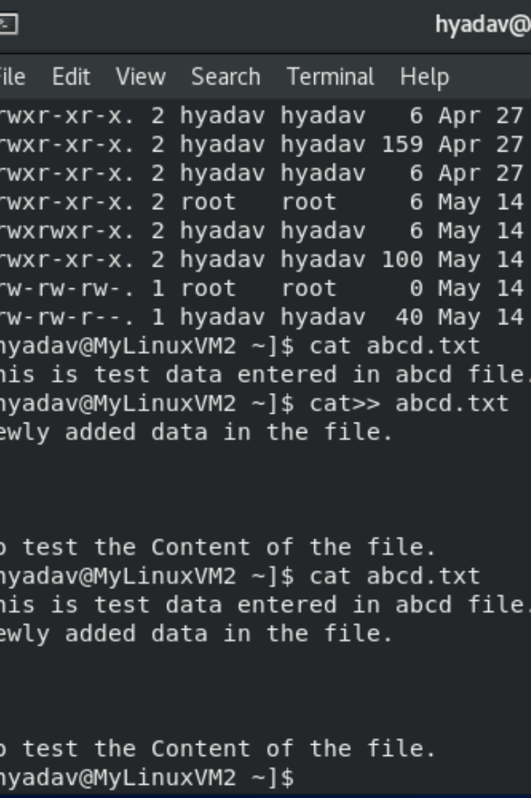
Displaying File Content Page by Page with less
1
Syntax
less [options] file
2
Example
less long_text_file.txt

Slide 9
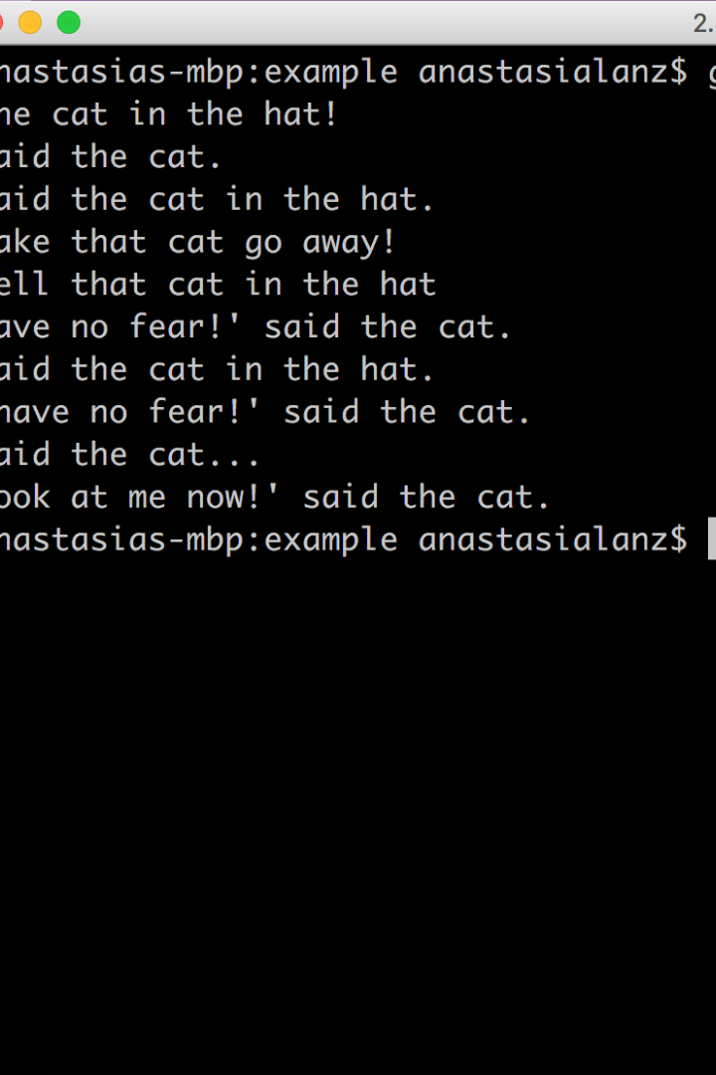
Searching for Text within Files with grep
1
Syntax
grep [options] pattern file
2
Example
grep "search_term" myfile.txt

Slide 10
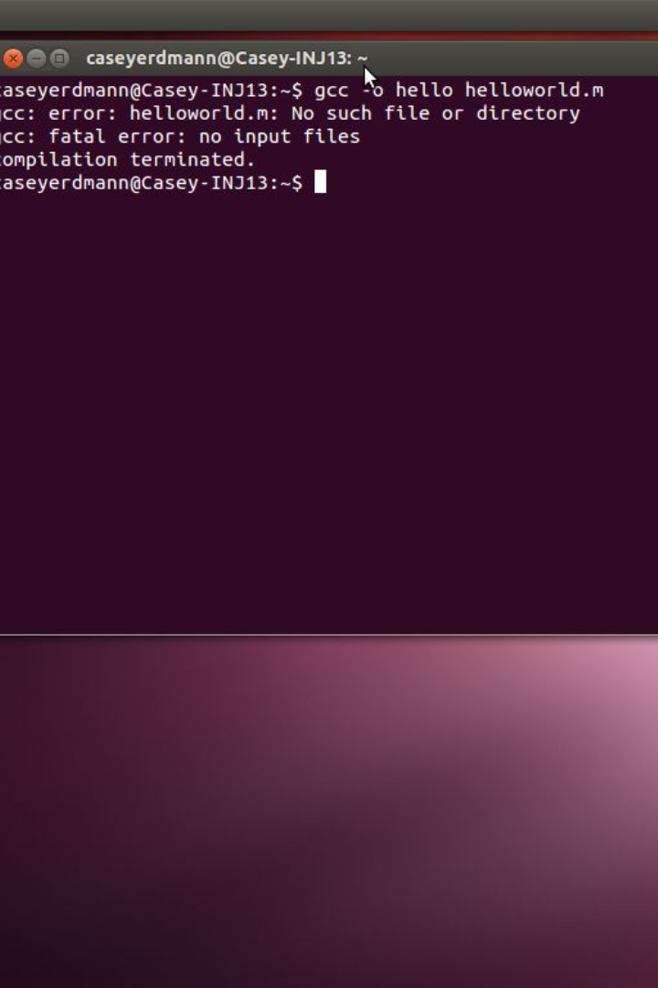
Creating Empty Files with touch
1
Syntax
touch [options] file
2
Example
touch newfile.txt

Slide 11

Archiving and Compressing Files with tar
1
Syntax (creating an archive)
2
Syntax (extracting an archive)
tar -cvf archive.tar file1 file2
tar -xvf archive.tar

