Slide 1

Exploratory Data Analysis on
AmbitionBox Data
By:
Kattela Harshitha

Slide 2
Objective
The objective of this project is to scrape company information from AmbitionBox and create a structured dataset containing details like company names, ratings, reviews, and industry types. Through exploratory data analysis, the project aims to identify top-rated companies, analyze the relationship between reviews and ratings, and understand how companies are distributed across various industries. This helps users gain insights into which companies are most positively perceived in the job market.

Slide 3
WebScraping details
The data was collected by web scraping from the AmbitionBox website.
https://www.ambitionbox.com/list-of-companies?campaign=homepage_companies_widget
Using the Requests library, the webpage content was fetched, and BeautifulSoup was used to parse the HTML. Relevant details such as company names, ratings, number of reviews, and company types were extracted by locating specific HTML tags and classes. The collected data was then cleaned and organized into a structured dataset for further analysis and visualization.

Slide 4
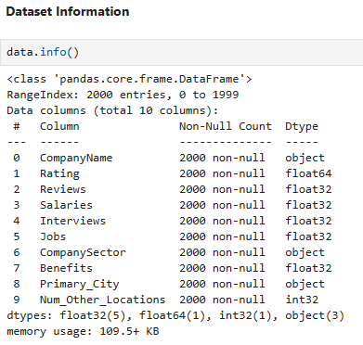
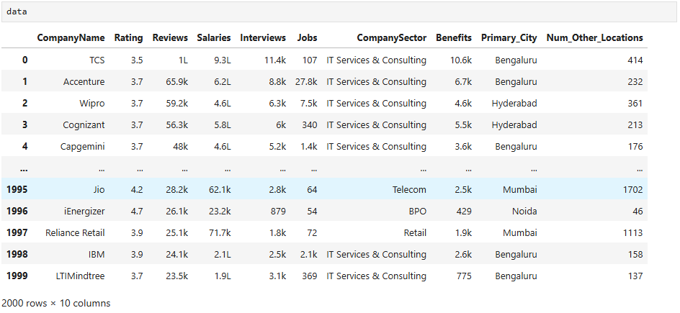
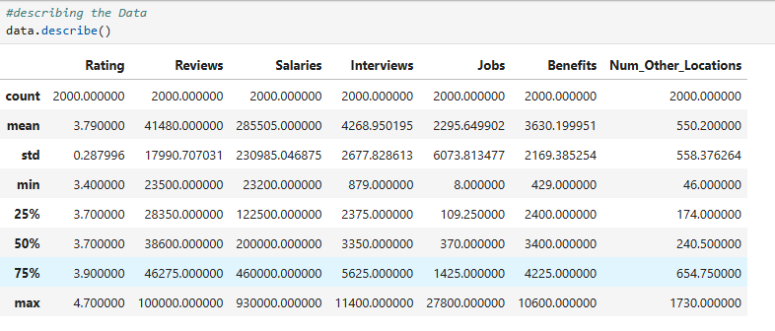

Slide 5
Exploratory Data Analysis
a. Data Cleaning Steps:
Checked for missing or null values .
Removed duplicate records to ensure data consistency.
Cleaned text columns by stripping unwanted spaces and special characters.
Converted data types where necessary.
Handled outliers in numerical columns like ratings and reviews to prevent extreme values from skewing the analysis.
b. Data Manipulation Steps:
Created a DataFrame from the scraped lists (company names, ratings, reviews, company types).
Renamed columns for better readability and understanding.
Extracted numeric values from textual data (for example, removing “reviews” text from review counts).
Sorted and grouped data to identify top-rated companies and analyze industry-wise patterns

Slide 6
UNIVARIATE ANALYSIS
Observation On Numerical Data
1. Distribution with KDE – Rating
Most ratings fall between 3.4 and 4.
The highest frequency (peak) is at 3.2.
Very few companies are rated below 3 or above 4.2, suggesting that most companies maintain an average to good reputation.
The distribution is right-skewed, indicating fewer companies with ratings above 4.1.
2. Distribution with KDE – Reviews
A large cluster of companies have reviews around 25,000–30,000.
A few companies stand out with more than 60,000 reviews → likely very large firms with strong visibility.
The distribution is right-skewed, showing a long tail of companies with very high reviews.
3. Distribution with KDE – Salaries
Most companies have salaries below 200,000 (clear peak on the left side).
A few companies show extremely high salary counts (>600,000, ~900,000).
The distribution is right-skewed, with a long tail toward high salaries.
4. Distribution with KDE – Interviews
Most companies have 2,000–3,000 interviews.
A few companies exceed 8,000–10,000 interviews.
The distribution is right-skewed, indicating only a small number of companies have more than 8,000 interviews.
5. Distribution with KDE – Jobs
Most companies have fewer than 500 jobs.
A few companies have more than 2,000 jobs.
The distribution is highly right-skewed.
6. Distribution with KDE – Num_Other_Locations
Most companies have 100–400 other locations.
A few companies spike around 1,400, indicating global or multi-branch presence.
The distribution is right-skewed, showing that only a few companies are highly globalized with very large branch networks.

Slide 7
Observation on Categorical Data
Count plot of Industry
IT Services & Consulting dominates with the highest count, indicating it is the most represented industry in the dataset.
BPO & Banking come next, but with significantly fewer entries.
Internet, Retail, and Telecom have the lowest counts.
Count plot of Primary City
Bengaluru leads with the highest number of records, followed by Mumbai and Hyderabad/Secunderabad.
Chennai & Noida have the lowest counts in this dataset.

Slide 8
Bivariate Analysis
Observation on Top 10 companies By Reviews
TCS has the highest number of reviews, indicating that it has a large number of employees or actively participates in reviews.
Accenture and Wipro also have a high number of reviews, but fewer compared to TCS.
Cognizant, Capgemini, Infosys, HCLTech, and Tech Mahindra are also in the top 10, indicating that they are highly reviewed as well.
Apart from IT companies, HDFC Bank and ICICI Bank also appear in the top 10, showing that finance companies receive a significant number of reviews too.
Observation on Top 10 Companies by jobs
Accenture and Wipro have the highest number of job counts, which means they have the most openings.
IBM, Amazon, Capgemini, and Infosys also have a good number of job counts.
Axis Bank and Teleperformance are also in the top 10, indicating high recruitment in the Banking and Telecom sectors.
Tech Mahindra and LTIMindtree are also in the top 10 but show comparatively lower recruitment with fewer job openings

Slide 9
Observation on Top Industries by Average Salary
IT Services & Consulting leads
This industry has the highest average salary, with a substantial margin of 433,636.
Banking and Internet Industries Follows
Internet and Banking have approximately the same average salary.
However, both are much lower compared to IT Services & Consulting.
BPO, Retail & Telecom
These industries have lower average salaries.
All are below 100,000 units, with Telecom showing the lowest among the displayed industries.
Observation on Total Job Openings by Primary City
Bengaluru has the highest number of job openings, i.e., 1.56 million, making it the top city for employment opportunities.
Mumbai has around 171,468 openings, which is much lower than Bengaluru.
Hyderabad/Secunderabad has 117,711 job openings, which is competing closely with Mumbai.
Chennai has fewer job opportunities, i.e., 28,809, compared to Hyderabad/Secunderabad and Mumbai.
Noida has the least number of job opportunities among all cities, i.e., 5,346.

Slide 10

THANK YOU

