Slide 1

Sentimental Analysis For Text And Emojis Using ML Algorithms
Presented by
Inchara S (MY.SC.U3BCA21262)
Sushma G S (MY.SC.U3BCA21253)
Gowri A Kaundinya (MY.SC.U3BCA21205)
Varshitha R (MY.SC.U3BCA21223)
Project supervisor
Dr. Manohar N
Vice Chairperson and Assistant Professor,
Amrita Viswa Vidyapeetham,
Mysuru.

Slide 2
Introduction to the broad area of research Sentimental analysis is a natural language processing technique. It determines the tone or the sentiment expressed in a text, such as a review, comment or tweet.
The broad area of research:
Polarity Detection
Emotion recognition
Opinion Mining
Sarcasm detection
Fields in which it is used are:
Marketing
Social media monitoring
Customer feedback analysis

Slide 3
Introduction to specific area of research (Including Text and Emojis)
Emojis are pictographs used in online communication to represent facial expressions, symbols, and objects.
They have become widely used in digital communication, including text messages and social media.
Emojis play a crucial role in conveying emotional cues that might be challenging to express through text alone.

Slide 4
Problem definition
To develop a sentiment analysis program that can accurately interpret the words and emoticons used to convey different moods in Facebook comments on various postings.
The solution aims to provide insights into user reactions, distinguish between positive, negative, and neutral attitudes, and direct content optimization and engagement strategies in order to increase audience involvement and brand perception.
Creating a model that can precisely ascertain the emotional underone or feeding conveyed in a text message plus emoji combination.

Slide 5
Objectives of the Project
Emotion Detection: Analyze comments to detect emotions and determinetheir polarity.
Multi-modal data handling: It allows models to process and analyze text and emojis together for better comprehension.
By analysing text and emojis together will increase the prediction of polarity.

Slide 6
Scope of the project
Extract features from text and emojis for sentiment analysis, including word frequencies, sentiment-laden words, and emoji patterns.
Tool that helps you examine the way people interact with a brand online-scope.
Online platforms help creators to understand audience reactions, enabling them to adjust content strategy accordingly.

Slide 7
Literature Review
Authors | Paper title | Methods used | Observations | Advantages | Disadvantages
1. Byung kyu Yoo, Julia Rayz 2.Anatoliy Surikov, and Evgniia Egorova 3. Mohd Amanullah, Shamimarabejum and others | Understanding emojis for sentiment analysis Alternative method sentiment analysis using emojis and emoticons An algorithm and method for sentiment analysis using the text and emoticons | Word2Vec model, ML Algorithms ROC Curve Word2Vec SVM,NB,RF,LSTM,CNN. | Emojis are replacing emotions and are used in simiar Context. Emojis and emoticons are used togeter are rare. Our findings showed that a model trained just on emotional indications has good metrics with an accuracy of 85%, which is comparable to the Word2Vec model. This model proposed an 6% of novelty. Analysing both text and emoticon is better than analysing only text. | Emojis impact sentimental analysis accuracy positively The ensemble technique appears to be a universal remedy for the challenging challenge of incorporating emotional indicators in a single space of predictors. Using different algorithms RNC,R, DO they reduce over fitting problem and gives positive effect in S.A. | Emojis representing objects or concepts show high similarity score with related words but not with emotional words Emoji and emoticon use in sentiment analysis has the drawback of potential ambiguity. It cannot perform on multilingual data.

Slide 8
Literature Review
Authors | Paper title | Methods used | Observations | Advantages | Disadvantages
4. lChuchu Liu a, Fan Fang a, Xu Lin b, Tie Cai c, Xu Tan c, Jianguo Liu d, Xin Lu a 5. Geetika Vashisht, Manisha Jailia | Improving Sentiment analysis accuracy with emoji embedding Emojis Based Sentiment Analysis | CEmo-LSTM Model: Classification algorithms Evaluation metric Rule-based approach opinion mining, text mining, sentiment classification, NLP- Natural Language Processing, ML- Machine Learning | Emojis as features but haven't fully explored different emoji usages in sentiment analysis. Importance of considering emojis in sentiment analysis, particularly for languages with complex syntax and semantics. This paper presents a systematic division of work of researchers in the field together with the research issues and challenges in the area of Emoticons (Emojis) based Sentiment Analysi | Emojis significantly improve sentiment recognition compared to text-only posts. Emojis generally enhance sentiment recognition accuracy. Deep learning algorithms, particularly CEmo-LSTM and LSTM, achieve the highest accuracy. It needed by the marketing agencies or the businesses to make new strategies, improve the existing strategies and to understand the market trends and competitors. | Replacing emoji tag words with sentiment words slightly reduces algorithm performance, contradicting the hypothesis that emoji tag word ambiguity affects sentiment recognition. Emojis in mining the opinions still has a long way to go before attaining the confidence level demanded by practical applications

Slide 9
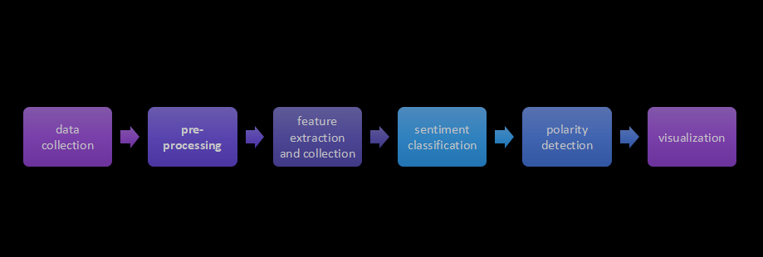
System Architecture of the Proposed System

Slide 10
Work done so far
Literature review
Data collection
Modification of dataset
Preprocessing
Polarity detection

Slide 11
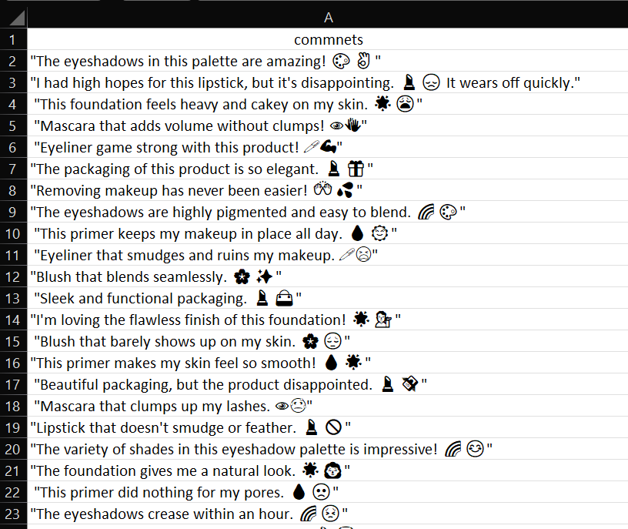
Dataset

Slide 12
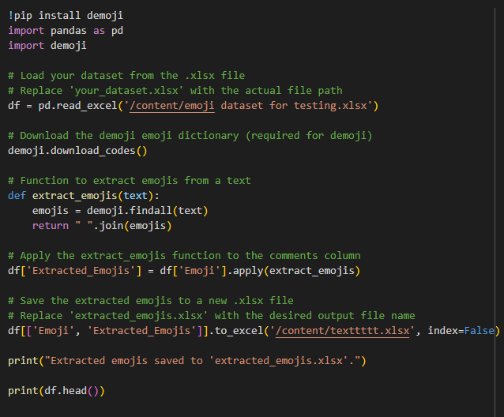
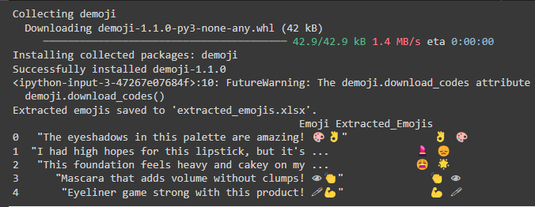
Implementation
Emoji extraction

Slide 13
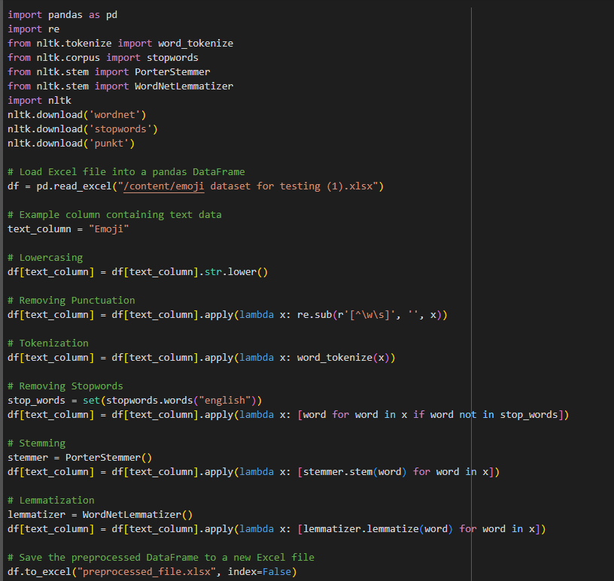
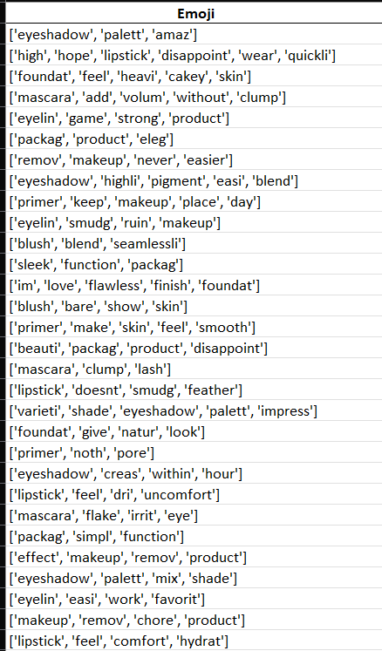
Text preprocessing

Slide 14
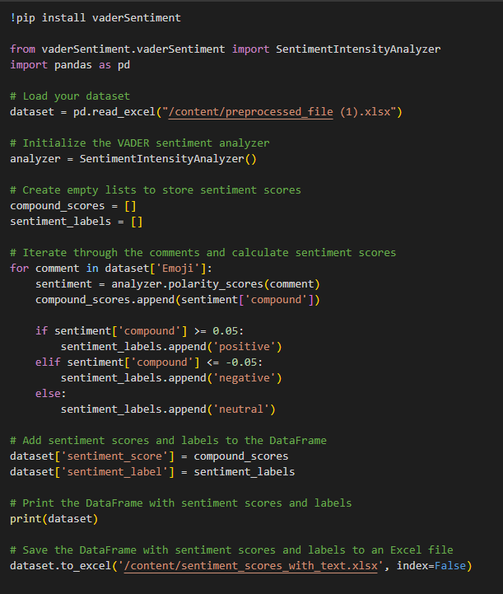
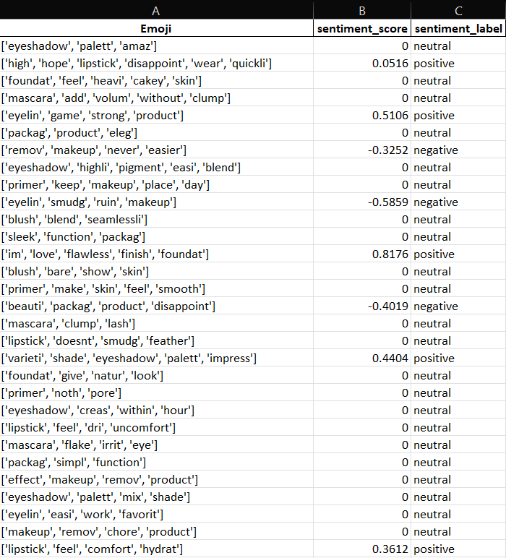
Assigning polarity for text

Slide 15
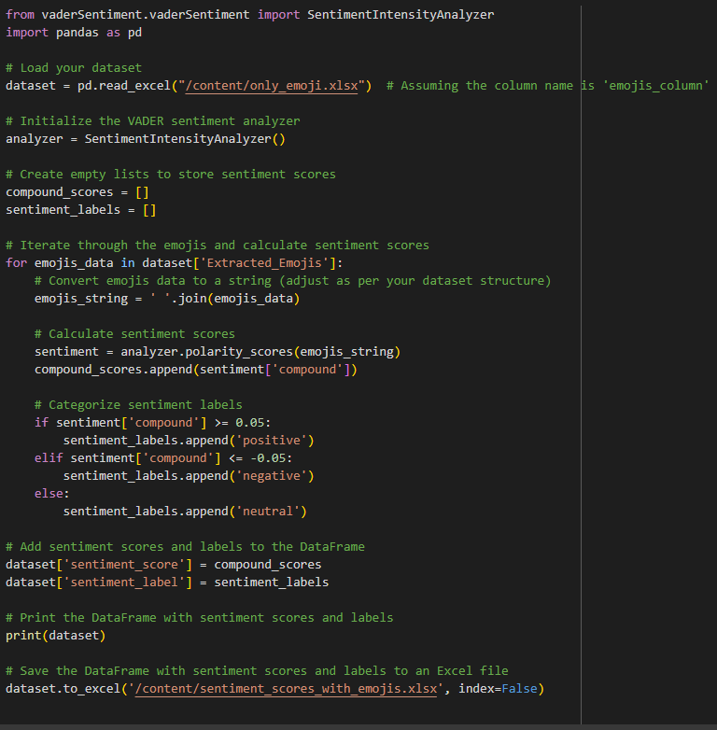
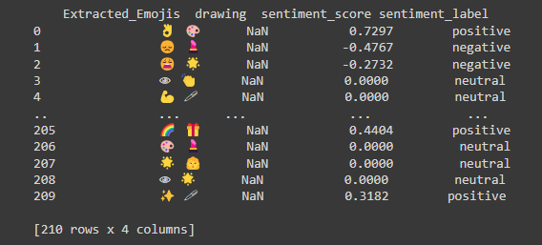
Assigning polarity for emoji

Slide 16
References
Ai W., Lu X., Liu X., Wang N., Huang G., Mei Q. (2017). Untangling emoji popularity through semantic embeddings, in Paper Presented at the Eleventh International AAAI Conference on Web and Social Media (Montreal, QC: ).
M. Datar and P. Kosamkar, "A Novel Approach for Polarity Determination Using Emoticons: Emoticon-Graph", Advances in Intelligent Systems and Computing, pp. 481-489, 2016. IEEE paper
M. Boia, B. Faltings, C. Musat and P. Pu, "A:) Is Worth a Thousand Words: How People Attach Sentiment to Emoticons and Words in Tweets", Intemational Conferenceon Social Computing (SocialCom) Alexandria VA, pp. 345-350, 2013.
H. Wang and J. Castanon, "Sentiment expression via emoticons on social media", IEEE International Conference on Big Data Santa Clara, pp. 2404-2408, 2015.
E. Cambria and B. White, "Jumping NLP Curves: A Review of Natural Language Processing Research [Review Article]", Computational Intelligence Magazine, vol. 9, no. 2, pp. 48-57, 2014.

Slide 17
Thank You

