Slide 1

TIE 203
System Design Studio
Sensors, I2C, & Basic Closed Loop Control
Prof. Dr. Eng. Amr T. Abdel-Hamid

Slide 2
What are Going to Explore today?
Basics of sensors (IMU focus) & Mic?
How (UART, I²C, SPI) connect sensors?

Slide 3
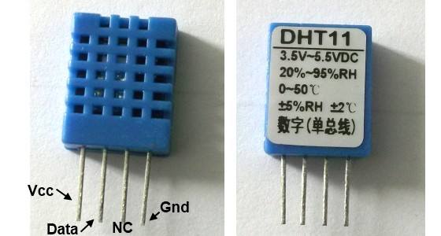
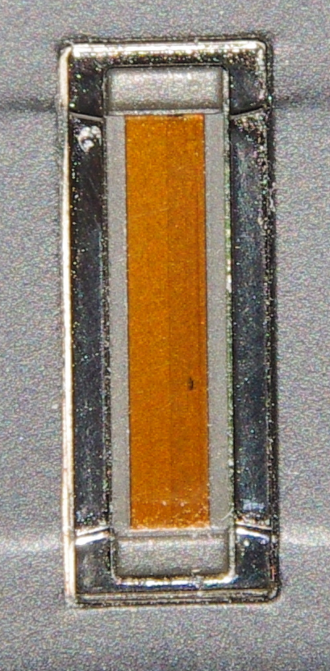
What are Sensors?
American National Standards Institute (ANSI) Definition
A device which provides a usable output in response to a specified measurand
A sensor acquires a physical parameter and converts it into a signal suitable for processing (e.g. optical, electrical, mechanical)
Sensors can be designed for virtually every physical and chemical quantity
including weight, velocity, acceleration, electrical current, voltage, temperatures etc.
chemical compounds.
Why Sensors are important?

Slide 4
Why Sensors are Important?
Motors are the muscles – they provide motion and power.
Processor is the brain – it makes decisions.
Sensors are the senses – they tell the system what’s happening.
Smart Node
Actuator
Muscles
Sensor Allows Autonomy
(Automation)
Processor
Physical Environment
Brain
Sensor
Senses

Slide 5
Endless Phenomenon
Stimulus | Quantity
Acoustic | Wave (amplitude, phase, polarization), Spectrum, Wave Velocity
Biological & Chemical | Fluid Concentrations (Gas or Liquid)
Electric | Charge, Voltage, Current, Electric Field (amplitude, phase, polarization), Conductivity, Permittivity
Magnetic | Magnetic Field (amplitude, phase, polarization), Flux, Permeability
Optical | Refractive Index, Reflectivity, Absorption
Thermal | Temperature, Flux, Specific Heat, Thermal Conductivity
Mechanical | Position, Velocity, Gyroscope, Acceleration, Force, Strain, Stress, Pressure, Torque

Slide 6
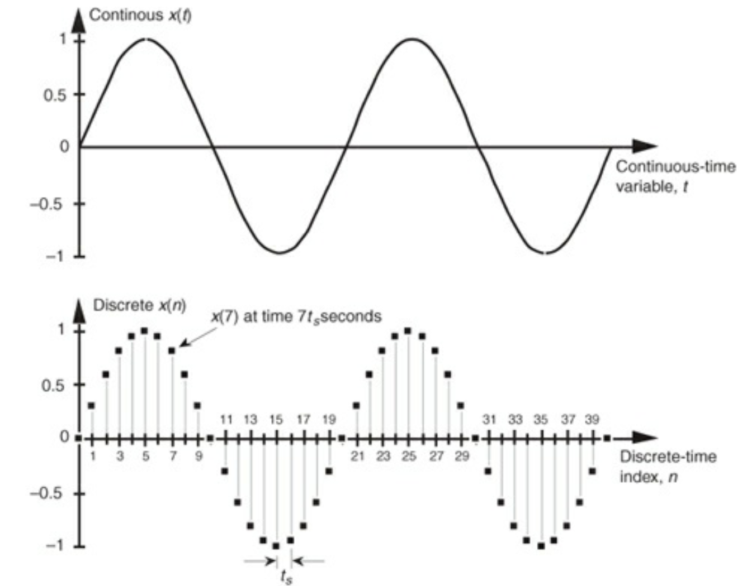
Signals
Sensors generate signals
Definition: a signal s is a mapping from the time domain D_{T} to a value domain D_{V}:
s: D_{T} → D_{V}
D_{T} : continuous or discrete time domain
D_{V} : discrete value domain.

Slide 7
Buses = the Nervous System
Just like in a body: sensors are the senses, the ESP32 is the brain, buses are the nerves carrying information that lets the boat act.
UART → Simple Nerve Path
Point-to-point, like a direct reflex from sensor to brain.
Will use it to connect to computer
SPI → Fast Signal Pathways
High-speed channels for sensors that need lots of data (like vision or storage).
Usually used for Cameras not used today
I²C → Shared Nerve Bundle
Many sensors share the same “nerve line,” each with its own address.
Used to connect IMU to the processor
Smart Node
Processor
Buses
Sensor
Physical Environment

Slide 8
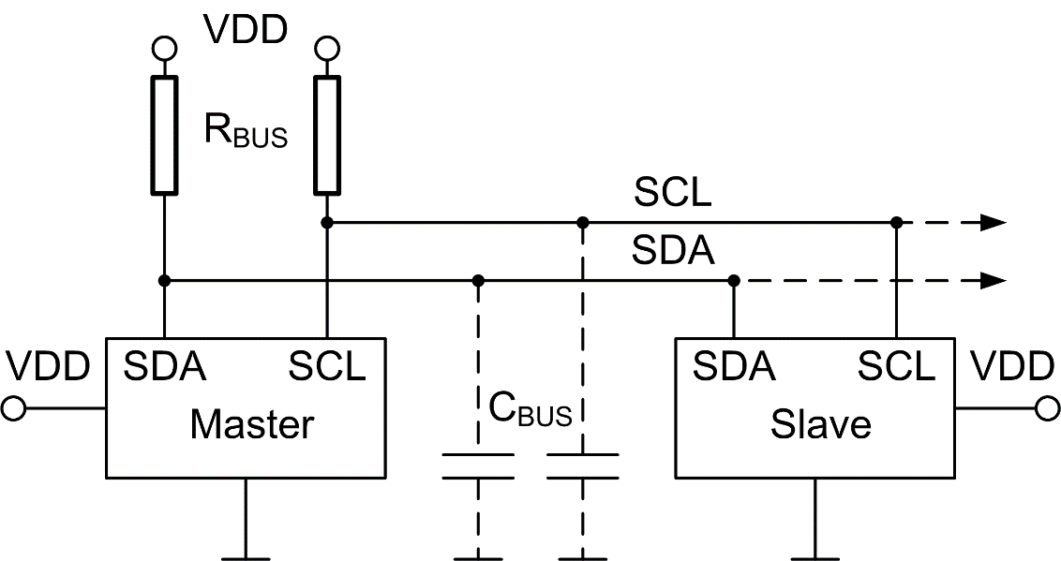
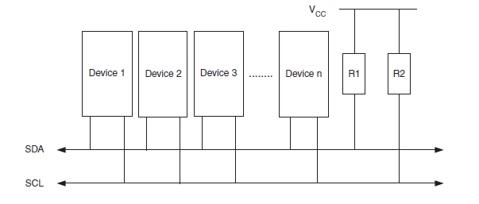
Two-Wire-Interface (I²C)
One wire is clock, one is data
Open collector principle!
But, how can a device be identified?
Source: Microchip

Slide 9
I2C: A Protocol with address!
There is (by now) ONE master, who generates the clock and the address
If the R/W field is “high“ the master continues with data and the selected slave pulls the ACK field and reads the data
If the R/W is “low“ the master stops after the address and the slave continues the transmission

Slide 10
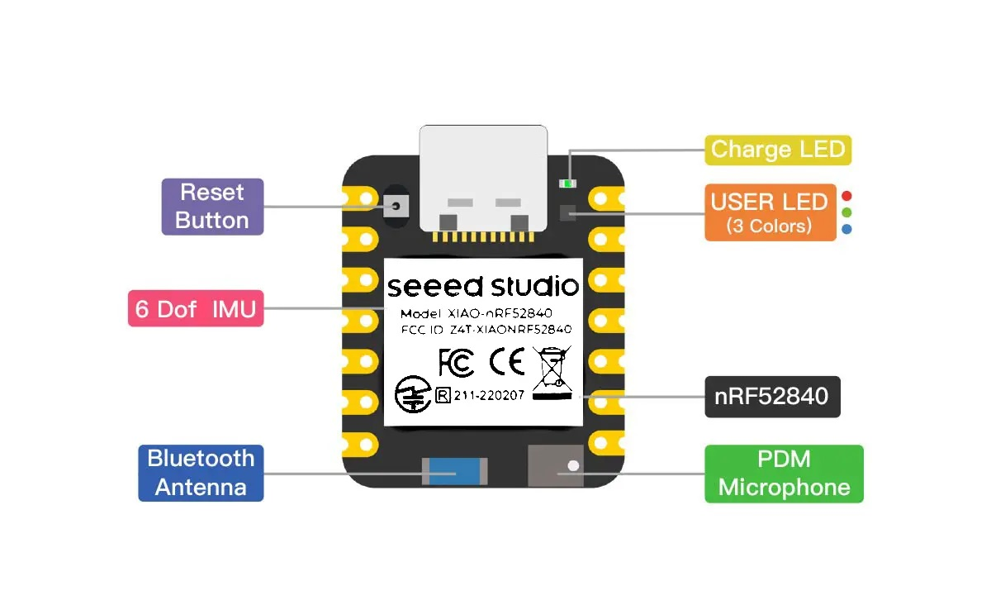
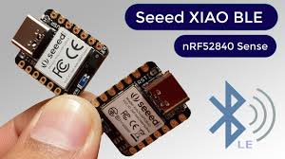
The new Processor: XIAO nRF52840 Sense
Ultra-compact Seeed Studio development board
Very low power nRF52840 MCU (ARM Cortex-M4F, 64 MHz, BLE 5.0)
Onboard 6-axis IMU (LSM6DS3TR-C) → measures acceleration & rotation
Built-in PDM digital microphone (for audio/voice projects)
Interfaces: UART, I²C, SPI, GPIO, ADC, PWM
Tiny size (20 × 17.8 mm), low power consumption
Think of it as a tiny “brain + ear + balance sensor” in one board.

Slide 11
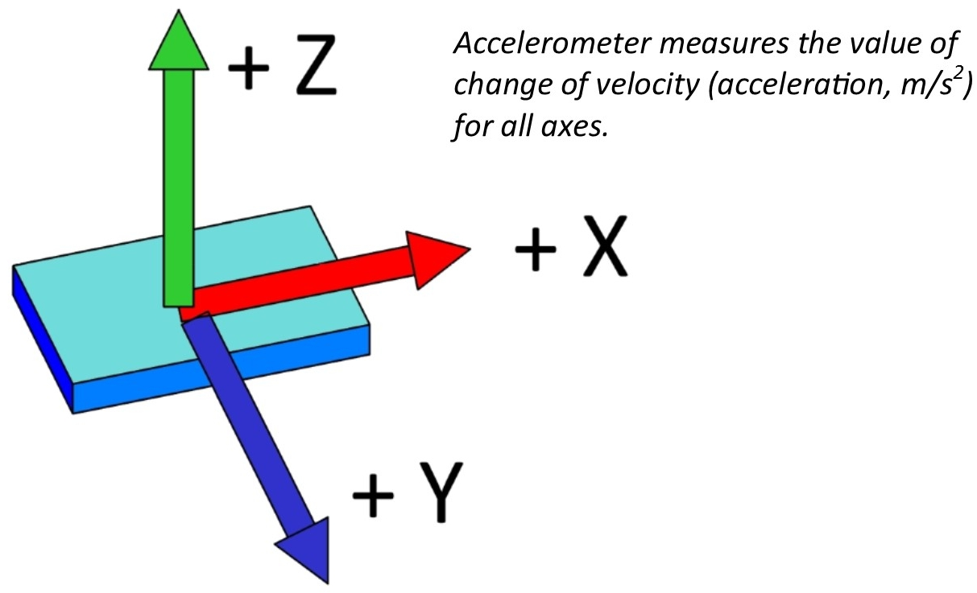
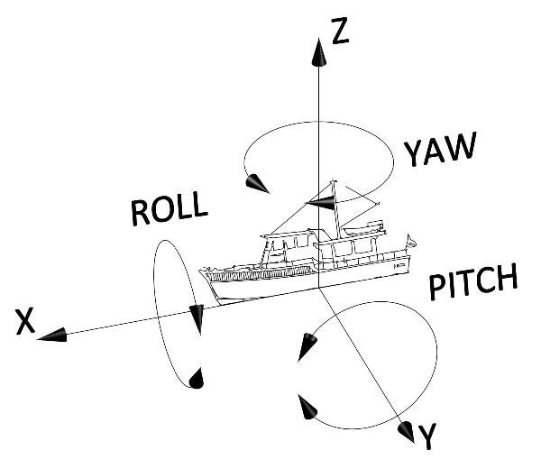
Why IMU Sensors?
IMU (Inertial Measurement Unit) provides motion feedback.
An IMU combines:
Accelerometer → tilt & linear acceleration
Gyroscope → angular velocity (rotation rate)
Optional Magnetometer → compass heading (Not in our module)
IMU output = roll, pitch, yaw → tells us orientation.

Slide 12
Accelerometer (Theory)
Measures acceleration in X, Y, Z axes. (m/S²)
Senses gravity.
detects leaning left/right, nose up/down, wave surges.
Not going to be used today in the lab (m/S²)
Can we use it to calculate velocity?

Slide 13
Gyroscope (Theory)
Measures angular velocity around X, Y, Z axes.
Key use: yaw-rate (rotation left/right).
On the boat: detects turning speed and fast changes.
Limitations: drifts over time.

Slide 14
Why IMU?
An IMU turns acceleration + rotation into useful motion intelligence.
Area
What the IMU Detects
Example AIoT Output
Sports
Gait, jump, swing speed, impact, balance
Technique feedback, activity class, injury-risk flag
Health & Rehab
Posture, range of motion, tremor, falls
Exercise counter, fall alert, rehab progress
Robotics & Drones
Tilt, yaw rate, vibration, sudden motion
Stabilization, navigation, crash detection
Industrial Tools
Vibration, tool motion, shock events
Tool-wear warning, maintenance alert
Vehicles & Logistics
Harsh braking, crash, tilt, package shock
Driver score, accident event, shipment quality log
AR / Wearables
Head/hand orientation and gesture patterns
Gesture control, immersive motion tracking
Today’s lab link: record AX/AY/AZ + GX/GY/GZ.
1

Slide 15
Proposed Projects
Item
1
Item
2
Item 1
Using AIOT for Innovation
ECG Node using AIoT
Sound Pollution Classifier
Smart Respiratory Monitor
Vibration Analysis for Tool Wear
Sports Analysis (for you to decide)
List is open for Innovation

Slide 16
References
https://docs.arduino.cc
http://docs.arduino.cc/tutorials/
http://www.instructables.com/tag/type-id/category-technology/channel-arduino/
https://www.arduino.cc/en/Reference/HomePage

Slide 17


