Slide 1


How to Present Yourself in
the Professional Market
King Khalid University (KKU)
KAUST Academy
Prepared By: Turki Alshuaibi

Slide 2
1. The Market Is a Funnel
2. The cheat code
3. Profile Anatomy
4. Getting Found and Getting Hired
5. Do's, Don'ts and Next Steps
Table of Contents

Slide 3
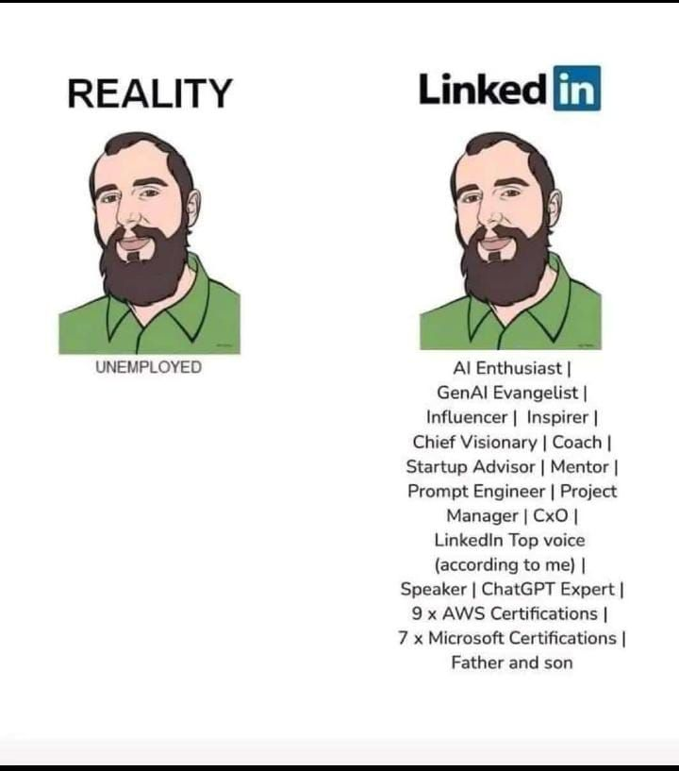

Slide 4
The market is funnel
● Averages across 60,000 companies:
○ ~180 applications per 1 hire
○ Applicant → interview: ~3%
○ Interview → hire: ~27%
● Cold applying = a 0.5% game on hard mode.
● Everything in this deck exists to change those odds.
180
apply
~5
get an interview
1
gets hired
per ~180 who apply cold
Source: CareerPlug Recruiting Metrics Report, hiring data from 60,000+ businesses.

Slide 5
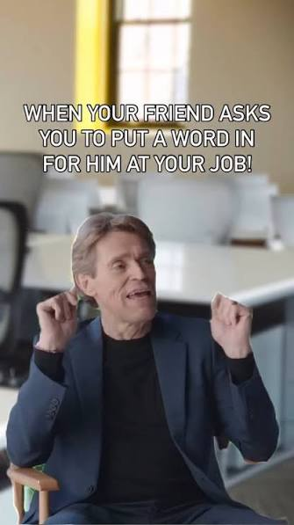
Referrals are a cheat code 🎮
● Referrals are 2% of applicants but 11% of hires: ~10x conversion.
● Career sites: ~120 applicants per hire. Referrals: ~10.
● Referred candidates are ~4x more likely to be hired, and ~10 days faster.
● One warm intro > 40 cold applications. Do the math 👀
Source: CareerPlug (60K businesses); Zippia 2026; ERIN enterprise study via SHRM.
Notes:
Skip the queue, the game switch from proving you are worthy to,

Slide 6

Your Profile Is a
Search Listing
Not a resume. A query result. 🔍

Slide 7
Three readers, one profile
🤖
🔍
🤝
THE AI
THE RECRUITER
THE HIRING MANAGER
Decides if you appear at all. Keywords, completeness, one clear lane.
~7 seconds. Photo, headline, current role. Decides whether to click.
Reads About and proof of impact. Decides trust and fit.
Optimize in that order. Humans never see what the machine filters out.

Slide 8
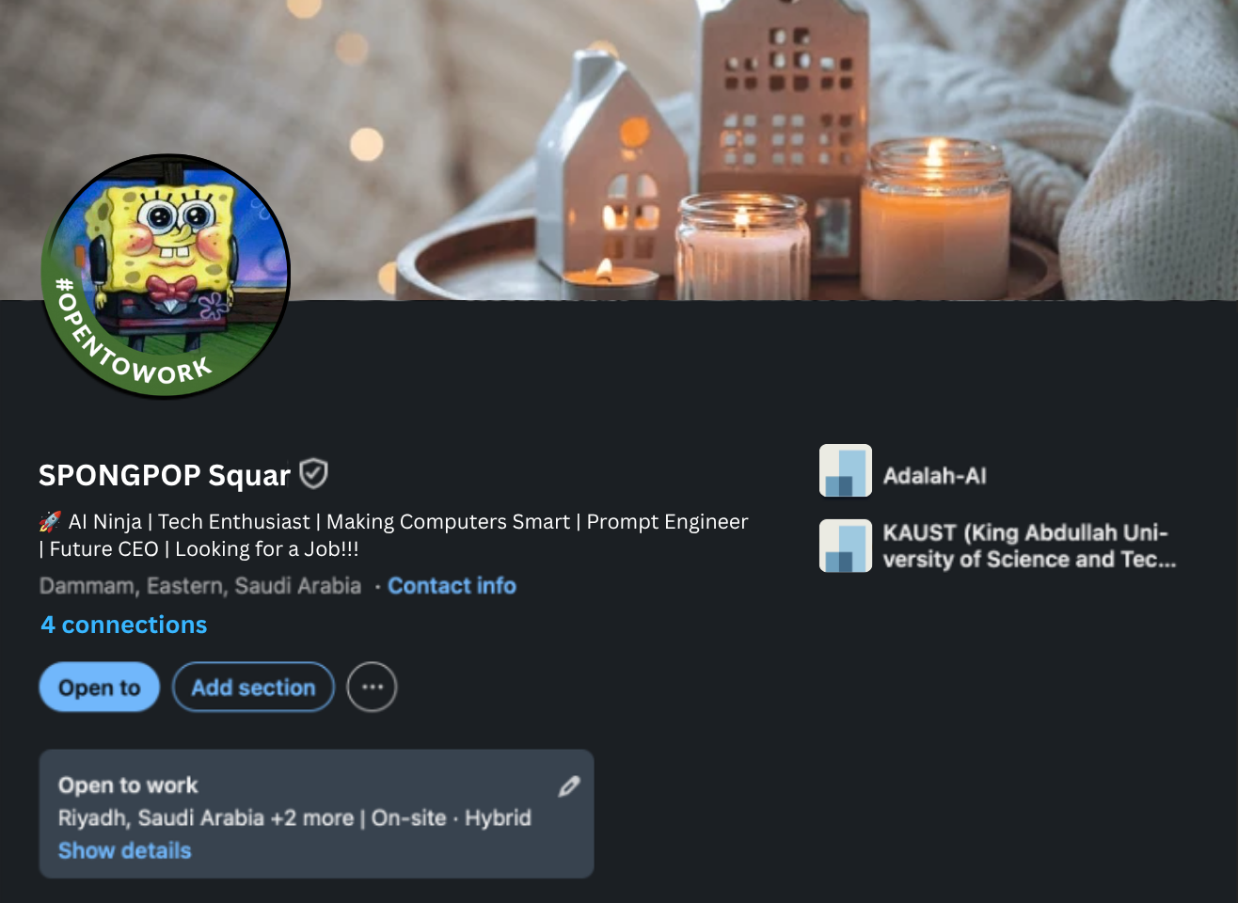
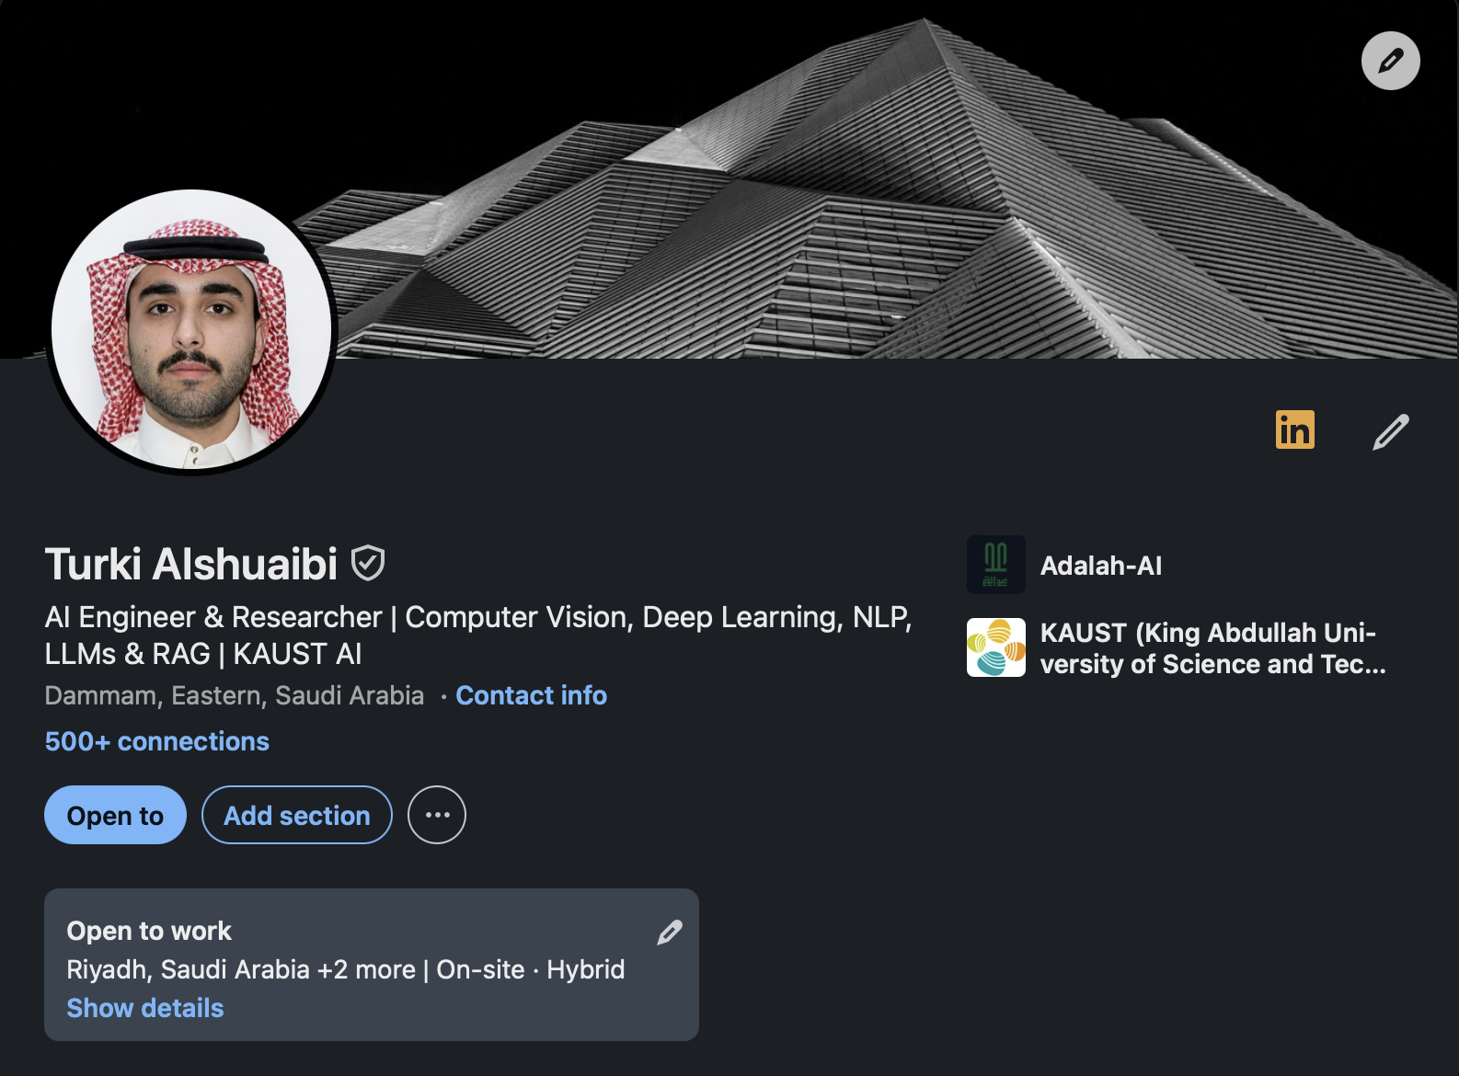
Profile anatomy I: the 7-second layer
● Photo: ~21x more views, ~36x more messages. Real headshot, clean background.
● Banner: free billboard. State your lane, not a sunset.
● Headline: weighted ~5x in recruiter search.
○ Formula: Role | Specialization | Proof
○ "AI Engineer | RAG evaluation, on-device ML" beats "Student at …"
Source: LinkedIn published data (photo, messages); recruiter search weighting analyses 2026.

Slide 9
Profile anatomy II: the machine layer
● About: the first 220 characters carry the weight. Open strong.
● Skills: the average profile lists fewer than 10. Fill them all, pin your top 3.
● Experience: What is your impact?
● Verification: a free trust badge for both readers.
More: Featured, Education, Licenses, Projects, Volunteering, Recommendations, Publications, Honors, Languages, Organization
~40x
more search appearances at All-Star completeness
+60%
more profile views once ID-verified
20+
skills screened for; most profiles list under 10
Source: The Interview Guys 2026; Leonar; CareerEnlightenment; LinkedIn published data.

Slide 10
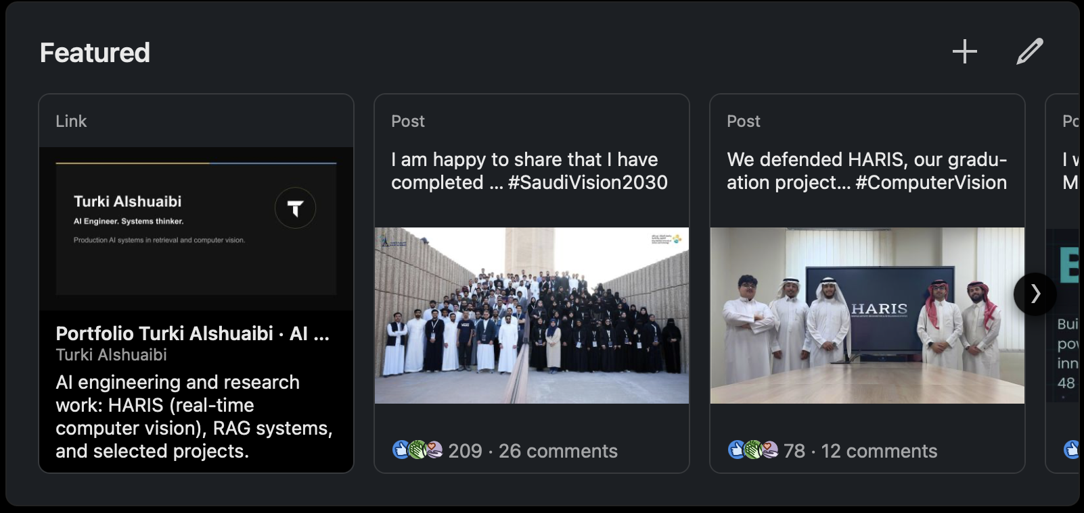
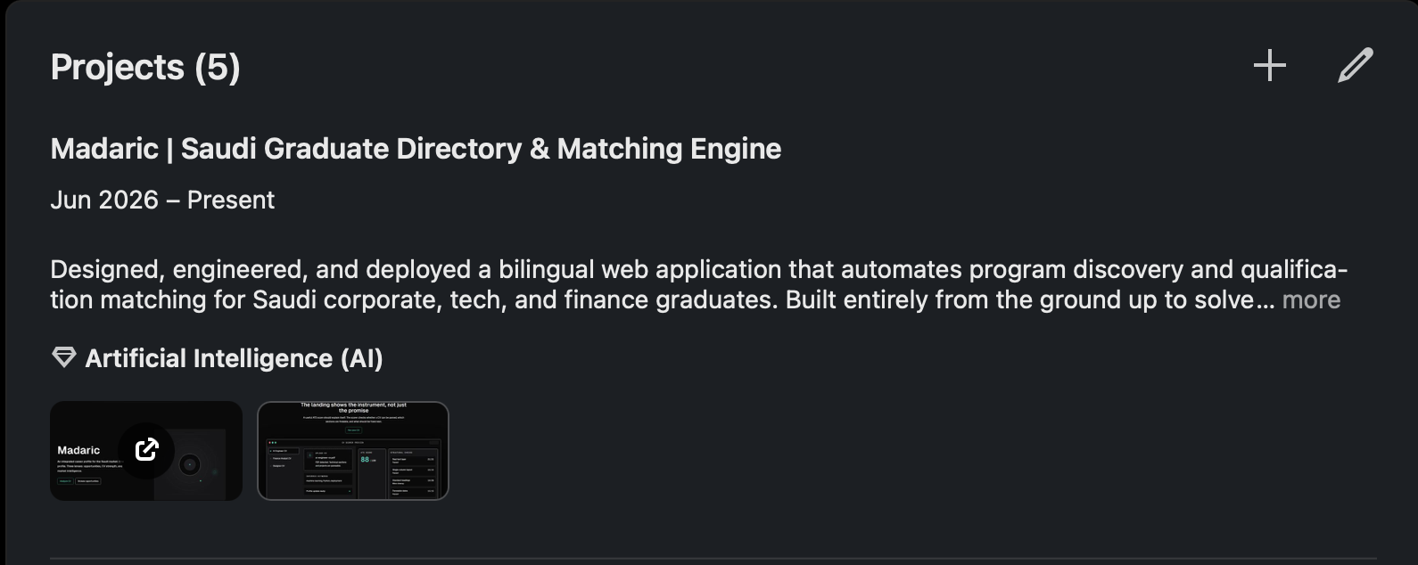
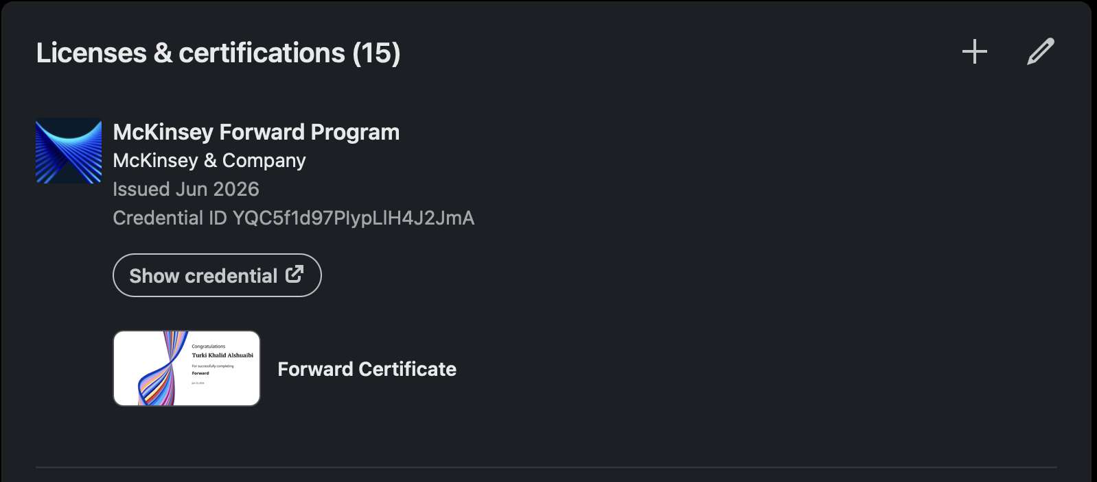
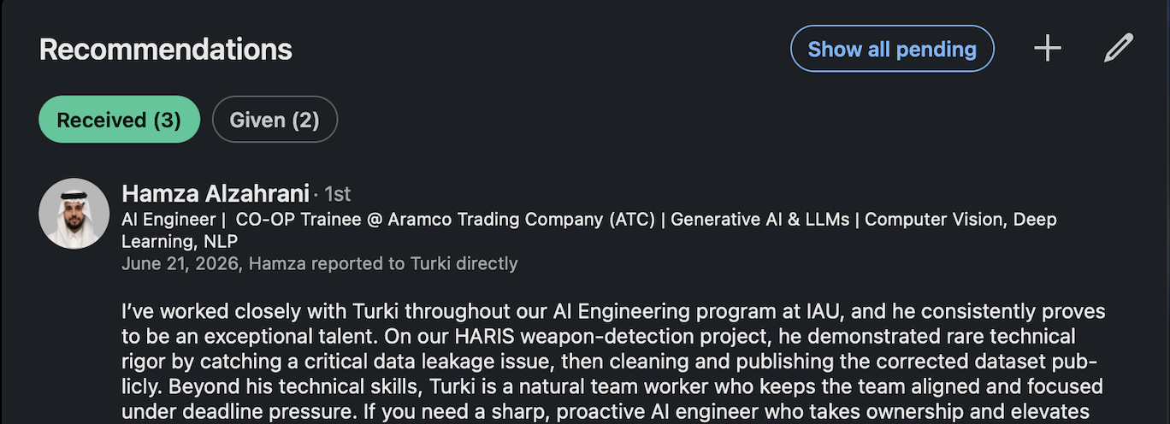
Profile anatomy III: the machine continued…
Featured
Projects
Licenses & certifications
Recommendations

Slide 11

Getting Found and
Getting Hired
Where offers actually come from 🏆

Slide 12
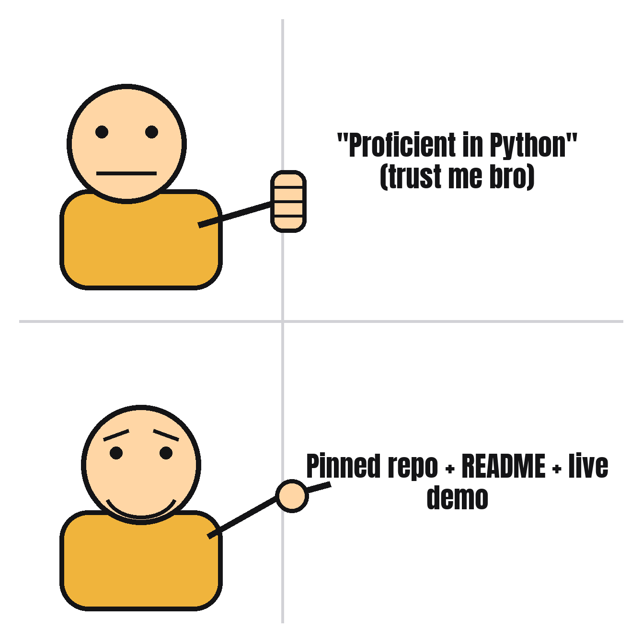
Proof beats claims 🧾
● 83% of technical hiring managers trust GitHub over the CV.
● 3-5 polished repos beat 15 tutorial clones.
● README + live demo or it didn't happen (84% want to see it run).
● Your repos are the interview before the interview.
Source: Beamery 2025 survey; hiring-manager portfolio surveys 2024-2026.

Slide 13
You picked the right year 🇸🇦
2026
150K+
the Kingdom's official Year of Artificial Intelligence
tech jobs expected to open in KSA this year
+26%
20,000
YoY AI hiring growth (+43% for data science roles)
SDAIA AI-specialist target; HUMAIN building in Riyadh + Dammam
Source: Saudi Press Agency (Mar 2026); Qureos; RemotePass 2025 Hiring Report; SDAIA; Semafor.

Slide 14
Do's and Don'ts
DO ✅
DON'T ❌
✅ One clear lane, everywhere
✅ All-Star profile, top 3 skills pinned
✅ Quantify: Problem → Action → Result
✅ Reply fast in the golden hour
✅ Showing off best side
❌ Post and ghost
❌ Links in the post body (-60%)
❌ Too many hashtags
❌ Keyword stuffing
❌ Inflating verifiable claims

Slide 15
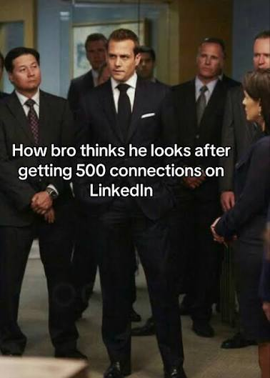
What to do next?
● Complete the profile
● Post regularly
● Connect with the right people
'Worth nothing, change into anything.’
-CG Chapter 144
(Don't forget to eat and sleep but Linkedin first)

Slide 16
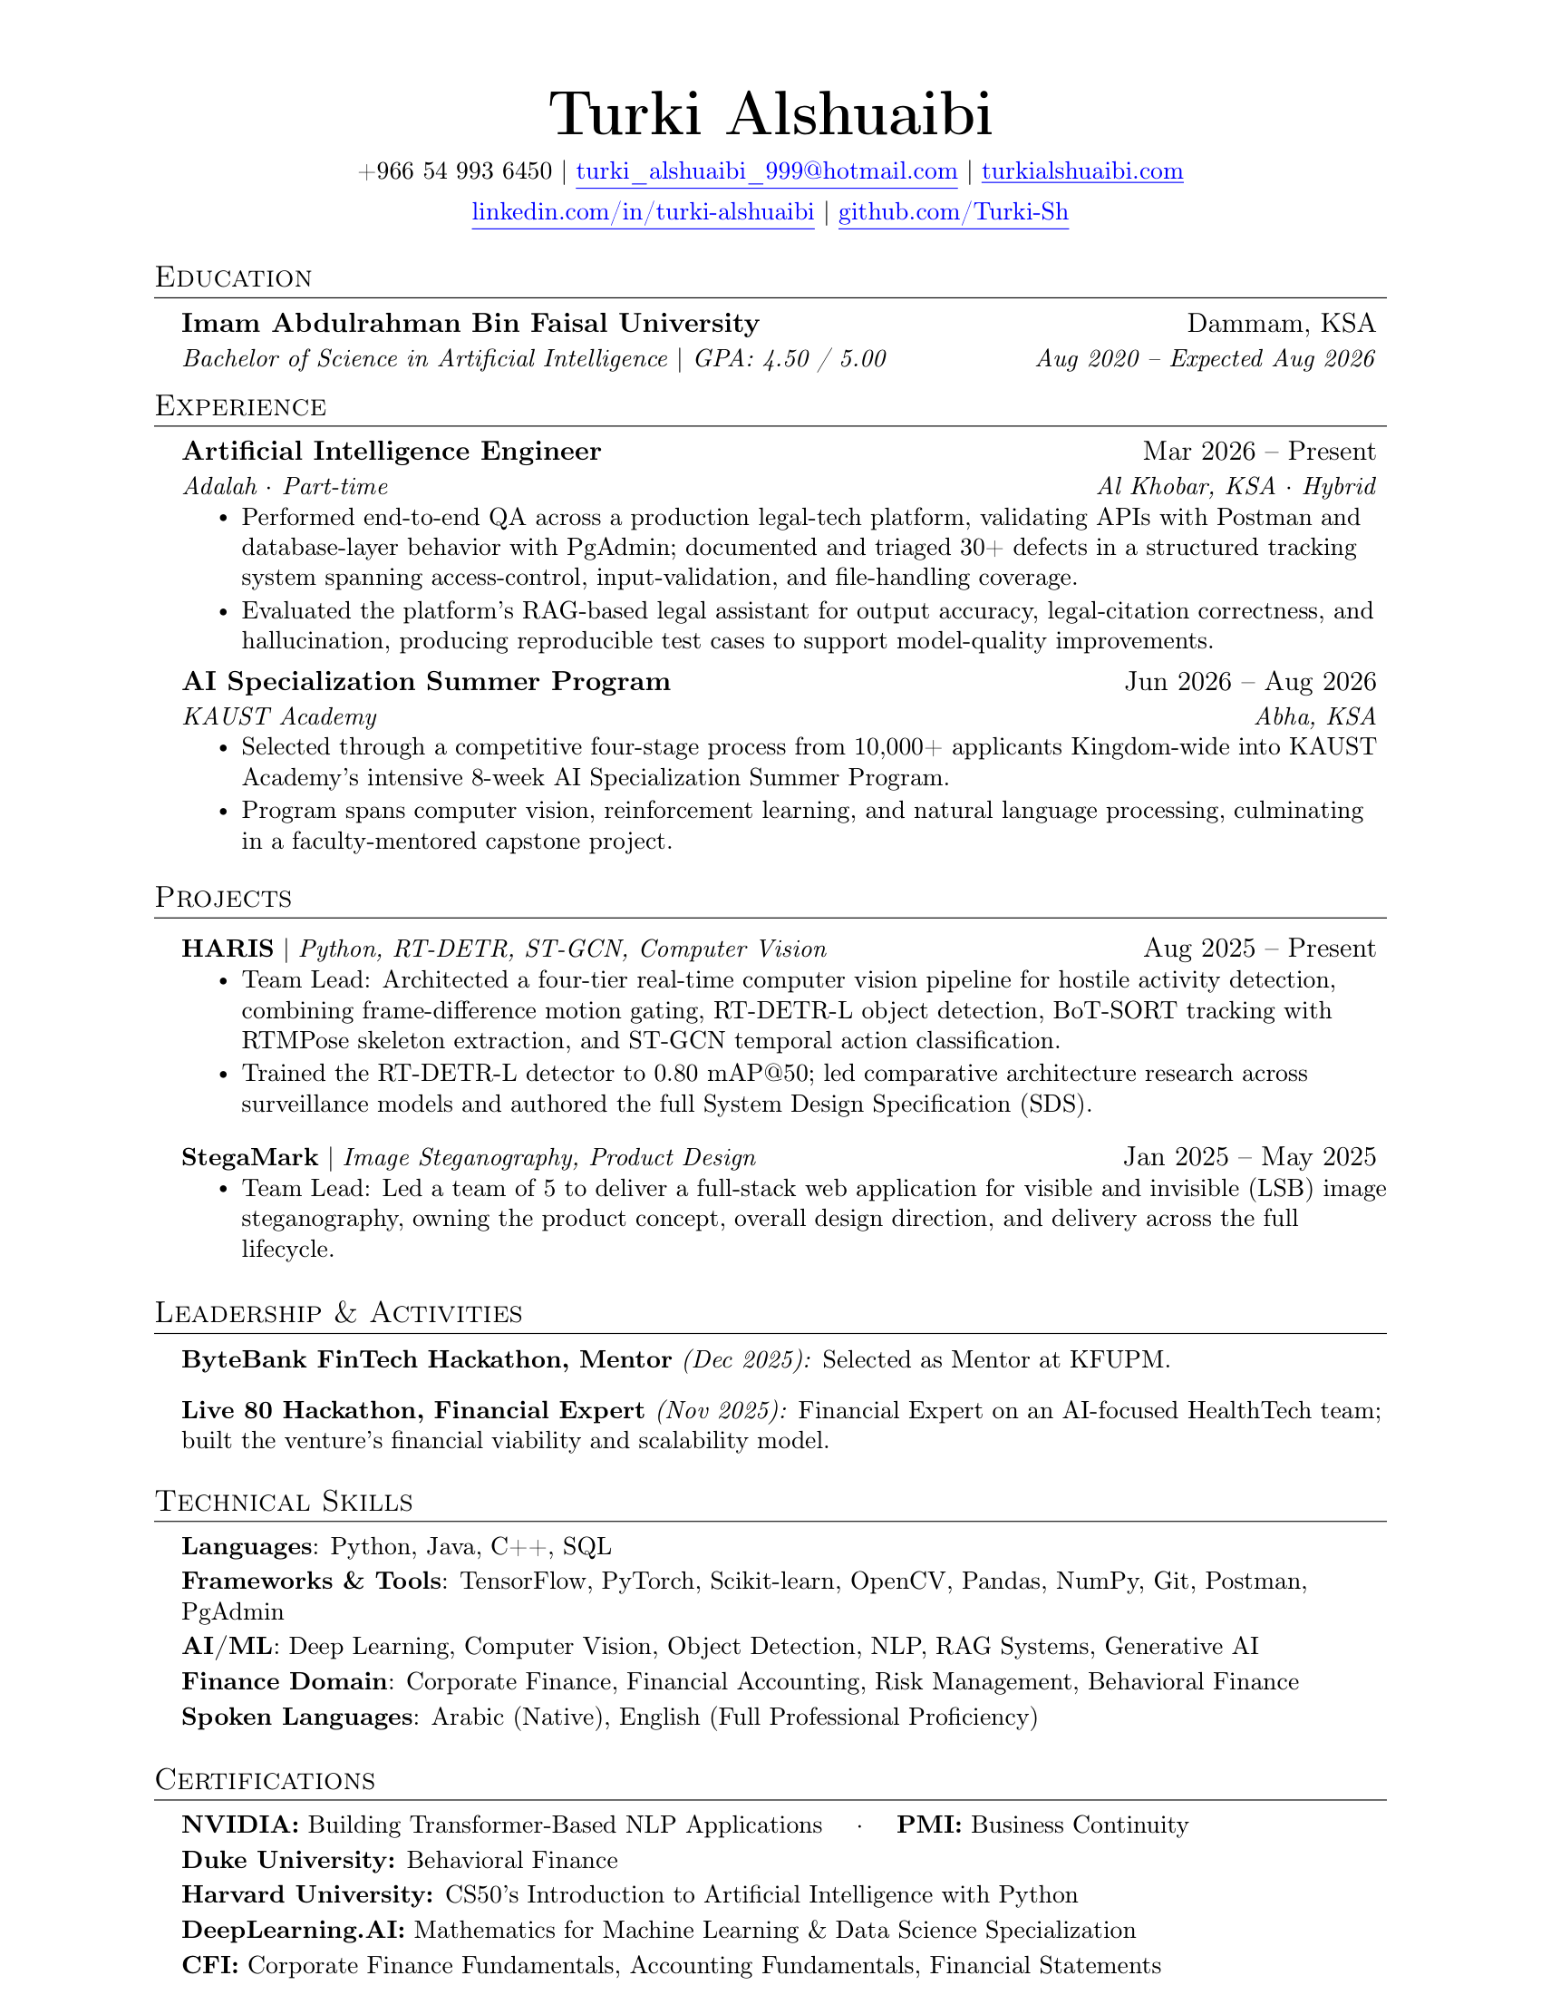
The ATS CV
Beat the robot before you meet the human.
75% of CVs are filtered by an Applicant Tracking System before a person ever reads them.
✓
Single column, no tables or text boxes
Parsers read left-to-right, top-to-bottom. Columns scramble it.
✓
Standard section headers
Experience, Education, Skills, Projects.
✓
Real text, never images or icons for content
If the scanner can't select it, it doesn't exist.
✓
Mirror the job's keywords
Match their exact terms: "Computer Vision," "RAG," "PyTorch."
✕
No headshots, graphics, or fancy fonts
They break the parse and score you lower.
TEMPLATE Overleaf
CHECK IT madaric.site
Score CVs’, Rank opportunities
ATS-friendly LaTeX resume
Source: Jobscan 2024, hiring-manager ATS surveys 2024-2025

Slide 17
Thanks for Attending!
Go Network!
Prepared By: Turki Alshuaibi

