Slide 1



DocuMind AI
STRICT DOCUMENT
QA AGENT
Retrieval-Augmented Generation for Academic Research
RAG-Powered
A production-grade AI assistant that reads uploaded research PDFs, answers complex questions, and always provides page-level citations.
Citation-Grounded
Hallucination-Free
KAVINILA S
CAPSTONE PROJECT

Slide 2

CHALLENGE
Problem Statement
The Hallucination Problem
01
Business Context
Standard LLMs are prone to hallucinating facts — an unacceptable risk for academic and professional use.
Standard LLMs are incredibly intelligent but inherently prone to hallucinating facts out of thin air when they lack specific context.
02
Objective
Academic researchers require 100% cited, fact-grounded answers from their own documents.
03
Use Case
A RAG-based AI assistant that reads uploaded research PDFs and forcibly returns 'I don't know' if the answer is missing.

Slide 3




SYSTEM DESIGN
Architecture Overview
An end-to-end RAG pipeline designed for strict, citation-grounded document question answering.
INGESTION
PDFs parsed via LangChain's PyPDFLoader. Filename and exact page number attached to metadata before chunking.
PREPROCESSING
Natural language queries spell-checked via TextBlob to prevent retrieval misses before embedding lookup.
STORAGE
Documents chunked via RecursiveCharacterTextSplitter and stored locally in a FAISS Vector Database.
RETRIEVAL → GENERATION → UI
Multi-strategy retrieval fetches Top-5 chunks. Google Gemini generates responses. Streamlit UI ties it together.

Slide 4



DATA PIPELINE
Data Collection, Parsing & Chunking
From raw PDFs to indexed, retrievable chunks — every step is engineered to preserve meaning and enable accurate citation.
PDF Parsing
Strategy A — Fine-Grained
Academic Research Papers dataset. LangChain's PyPDFLoader handles raw string extraction. Filename and exact page integer are attached to metadata before chunking occurs.
Size: 700, Overlap: 80. Preserves high granularity. Excellent for pinpoint factual extraction. May break continuity in longer arguments.
Strategy B — Narrative
Why Recursive Splitting?
Size: 1000, Overlap: 100. Retains larger narrative structure. Highly useful when queries demand understanding of long methodology paragraphs.
RecursiveCharacterTextSplitter respects sentence boundaries, preventing semantic loss during splits and preserving the coherence of extracted context.

Slide 5
EMBEDDINGS
Embedding Models Compared
Open-source local inference vs. commercial cloud — both options available to the user via a live UI toggle.
LOCAL / FREE
CLOUD / COMMERCIAL
DEFAULT CHOICE
HuggingFace
Google Gemini
Final Selection
BAAI/bge-small-en
gemini-embedding-001
Recommended Approach
Observation:
Observation:
Observation:
Exceptionally fast and highly reliable for standard academic text mapping. Preferred for local data privacy.
Extremely semantic and handles deeply complex queries, but relies on rate-limited cloud servers.
HuggingFace BAAI is preferred for local data privacy and speed. A UI toggle lets users instantly swap to Gemini for complex semantic queries.

Slide 6




RETRIEVAL
Vector Database & Retrieval Strategy
FAISS — Facebook AI Similarity Search
Lightning-fast, local in-memory vector index. No cloud dependency, keeping documents private and lookups near-instant.
Dense Retrieval — Cosine Similarity
MMR — Max Marginal Relevance
Baseline vector similarity. Fetches exact semantic hits, but results can be highly redundant when the same paragraph dominates the top results.
Balances relevance with diversity. Highly effective at pulling context from multiple different pages rather than overlapping the same passage repeatedly.
Dynamic UI Toggle
Both strategies are exposed as a live toggle in Streamlit, allowing users to tune retrieval for their specific query — factual lookup vs. broad synthesis.

Slide 7
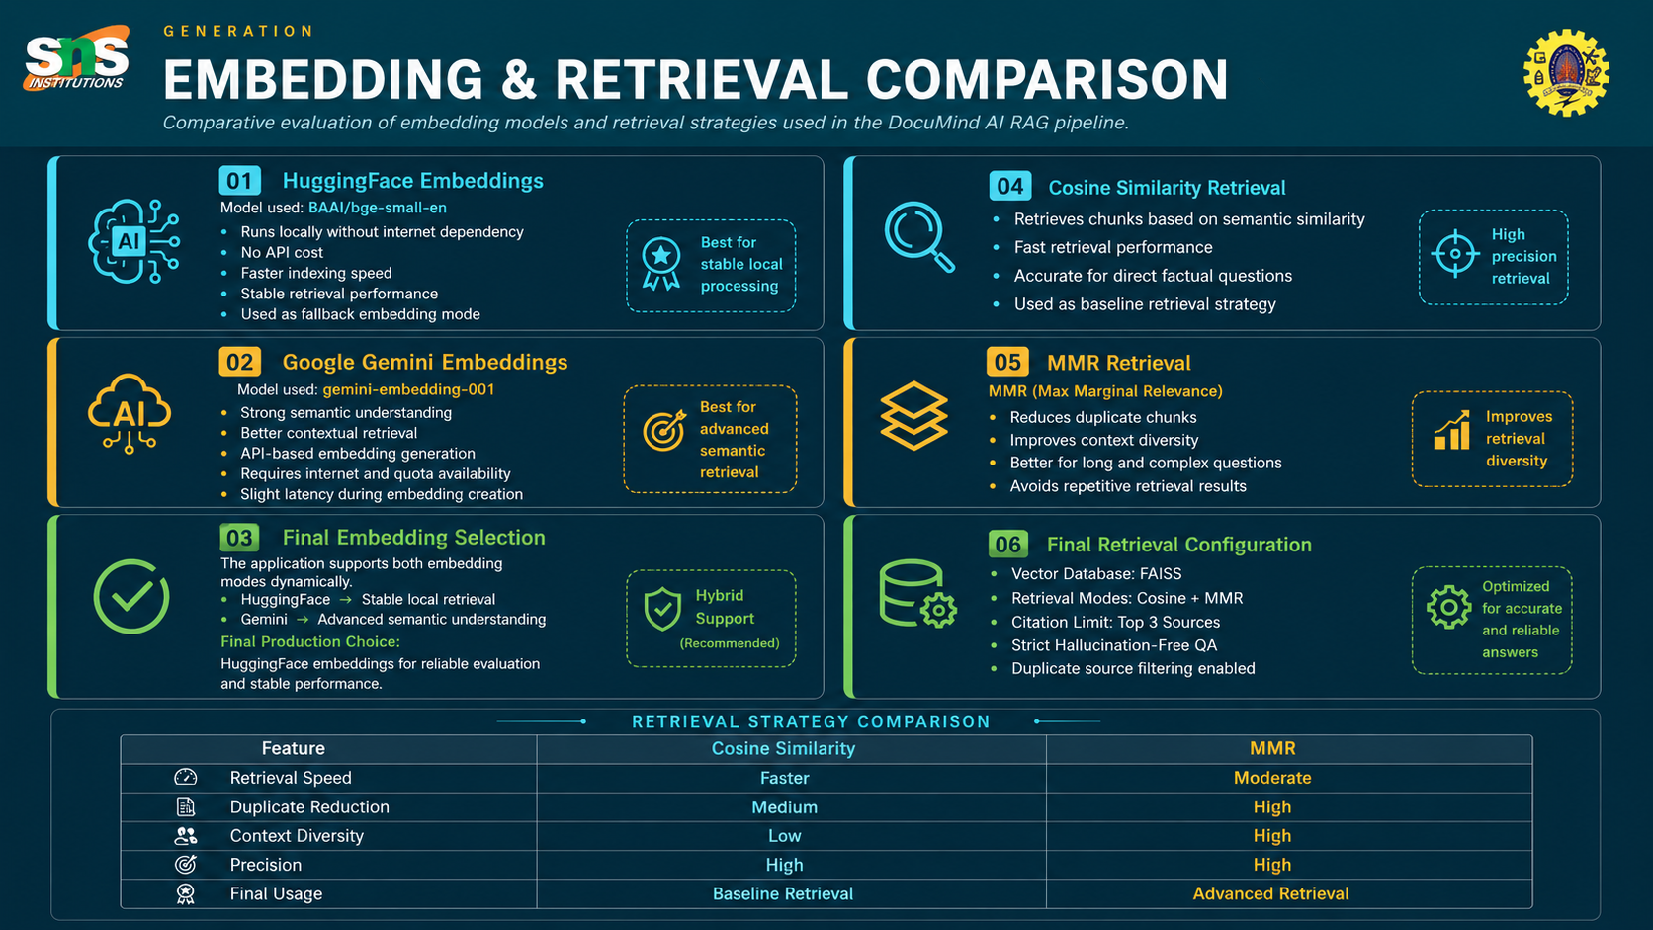
LOCAL / FREE
CLOUD / COMMERCIAL
DEFAULT CHOICE

Slide 8



GENERATION
RAG Pipeline & Prompt Engineering
Constraining LLM behavior through a rigid system prompt is the core mechanism that eliminates hallucinations.
Model: Google Gemini (gemini-1.5-flash / gemini-2.0-flash)
Query Typo Correction
01
Context-Only Grounding
Spell-checking via TextBlob occurs before embedding lookup, ensuring typos like 'ddeep learning' never cause retrieval failures.
Rely ONLY on provided context chunks. External knowledge is strictly prohibited.
02
Session-State Caching
Forced Abstention
Output 'I don't know' explicitly if the context chunks do not contain the answer.
Identical queries instantly return cached responses, saving API tokens and dramatically reducing latency for repeated lookups.
03
Formal Citation
Conversation History
Every answer must formally cite the source document and exact page number.
A rolling window of the last 4 messages is passed to the LLM, enabling contextual follow-up questions within the same session.

Slide 9
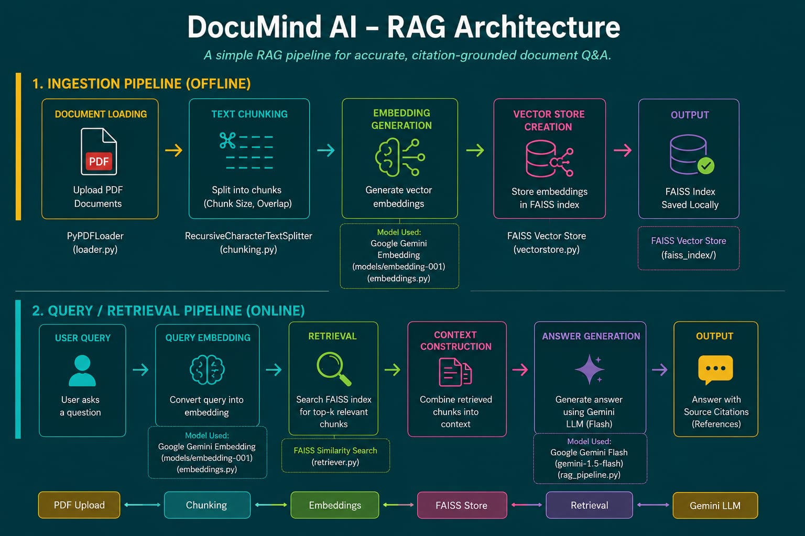

Slide 10

VALIDATION
Results & Output Demo
Three targeted queries validate the core behavior: accurate retrieval, hallucination refusal, and typo resilience.
Query 1 — Factual Extraction
Query 2 — Out-of-Scope Refusal
Query 3 — Typo Correction
Query:
Query:
Query:
"Describe the methodology used in the experiments."
"Who is the president of the United States?"
"ddeep learning"
Result:
Result:
Result:
Successfully extracts steps mapped to [Document 1] Page 4 with accurate page-level citation.
"I don't know. The answer is not available in the uploaded document." — Model successfully refused out-of-bounds knowledge.
System autocorrected to "deep learning", retrieved successfully, and cited accurately.

Slide 11




ENGINEERING
Stretch Goals & Challenges
STRETCH GOALS IMPLEMENTED
CHALLENGES & SOLUTIONS
Conversational Memory
API Rate Limiting (HTTP 429)
Built a chat-history buffer inside Streamlit's st.session_state. The pipeline passes a rolling window of the last 4 messages back to the LLM, enabling contextual follow-up questions.
Graceful failure exceptions were implemented, recommending the user downscale the model size inside the app when Google GenAI endpoints throttle.
Polished Web UI
Embedding Misalignment
A clean, responsive Streamlit web application with user controls, status badges, database replacement toggles, and collapsible citation elements.
Vector embedding misalignment when appending chunks with a different model was solved by building embedding_method.txt metadata config tracking to protect FAISS index loading.

Slide 12
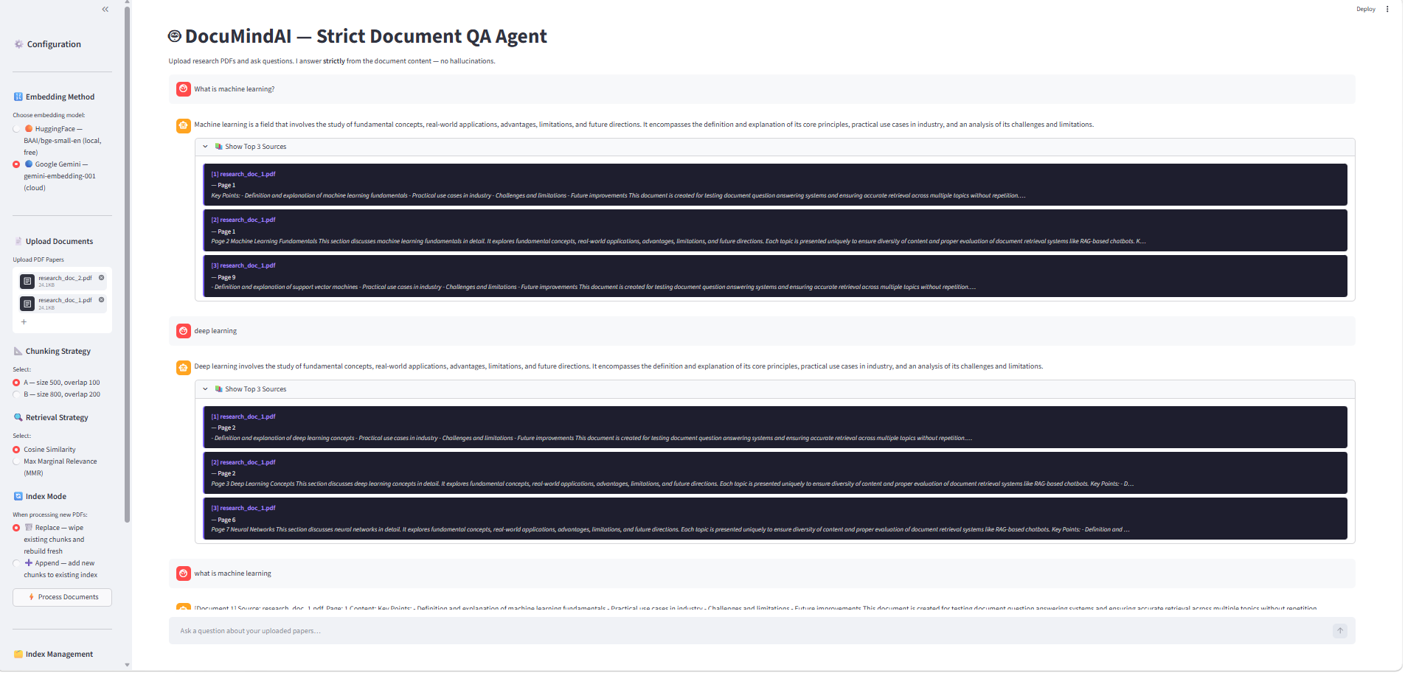
Application Screenshot

Slide 13



LOOKING AHEAD
Conclusion & Future Scope
Built a production-grade, highly reliable academic agent capable of synthesizing research securely, rejecting out-of-context requests, and proving its own claims through citations.
What We Built
A strict, citation-enforced RAG pipeline with multi-strategy retrieval, typo correction, session caching, conversational memory, and a polished Streamlit UI.
Multi-Modal Retrieval
Corrective RAG (CRAG)
Implementing extraction of charts and graphs from research PDFs, extending the agent beyond text-only content into full document comprehension.
When PDF context is insufficient, a strictly constrained fallback to a global Web Search agent would allow the system to acknowledge its limits and retrieve safely from the open web.

