Slide 1
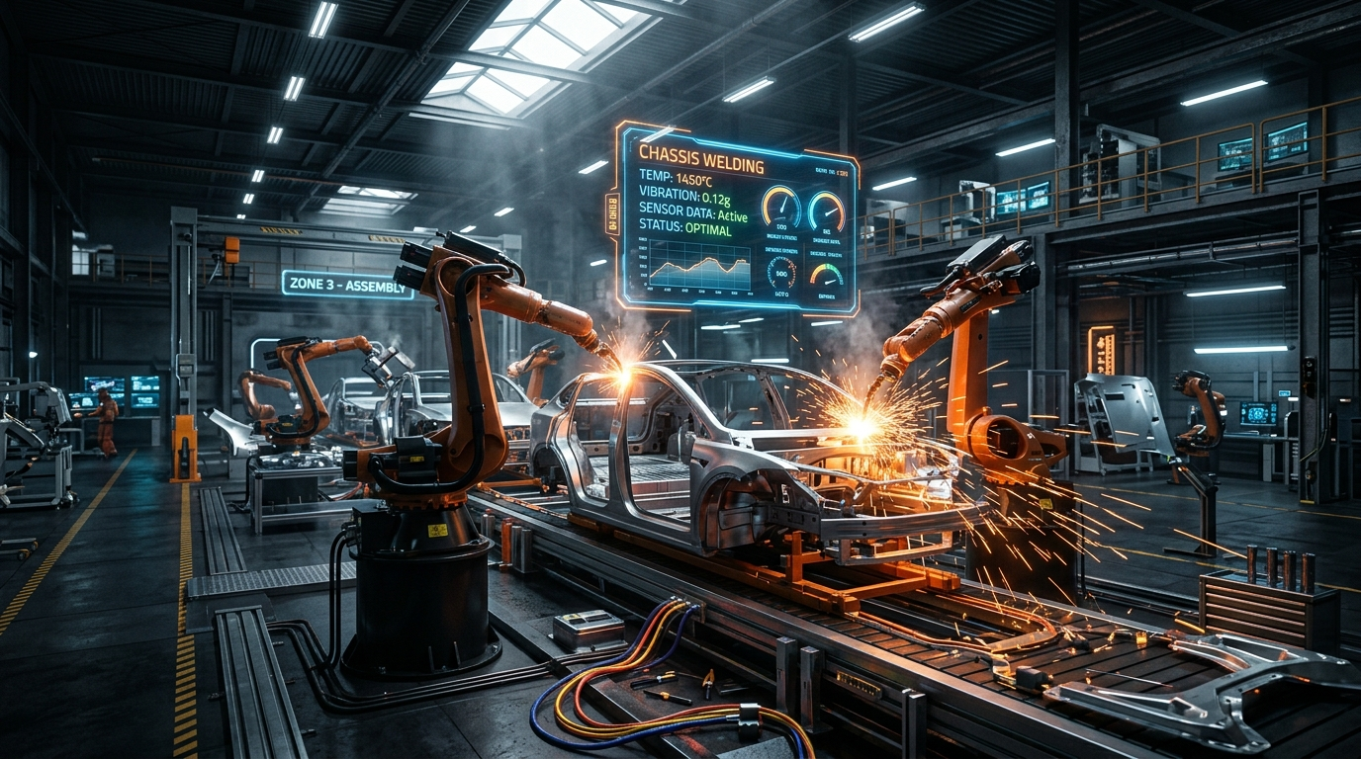
NEXT-GEN INDUSTRIAL IOT & AI PLATFORM
DriveOps-AI
Smart Car Manufacturing &
Production Intelligence
An end-to-end command center that ingests high-frequency automotive telemetry, runs multi-vector deterministic physics evaluations, and delivers autonomous AI root-cause reasoning for zero-downtime plant operations.
4 Vectors
Machine, Quality, Pace, Safety
Deterministic
Zero Hallucination Physics
Gemini AI
LLM Root-Cause Synthesis

Slide 2
INDUSTRY 4.0 TRANSFORMATION
The Manufacturing Problem & The DriveOps Solution
THE PROBLEM: COSTLY UNPLANNED DOWNTIME
Unplanned Stoppages
Automotive assembly lines cost upwards of $22,000/minute during unpredicted robotic stoppages.
Sensor Data Silos
Thermal, vibration, and hydraulic telemetry exist in disconnected formats without unified analysis.
Post-Mortem Reaction
Faults are typically discovered after scrap parts are produced rather than predicted in real time.
Slow Root-Cause Analysis
Technicians spend 45+ minutes diagnosing mechanical error codes manually from station logs.
THE SOLUTION: DRIVEOPS-AI INTELLIGENCE
Real-Time Telemetry Intake
Automated parsing and evaluation of high-frequency CSV/JSON records up to 50MB per shift.
Deterministic Physics Rules
100% reproducible anomaly detection for ISO 10816 vibration, thermal drift, and hydraulic limits.
Generative AI Diagnosis
Gemini 1.5 Flash delivers instant mechanical diagnoses and technician action commands in <2 seconds.
Automated Alert Queue
Immediate severity classification (Critical, High, Medium, Low) with technician acknowledgement tracking.

Slide 3
SYSTEM DESIGN & DATA PIPELINE
End-to-End System Architecture
TIER 1: PRESENTATION LAYER
React 19 + Vite 7 SPA
──────────────────────────
• Interactive plant dashboard with responsive industrial layout
• Recharts live telemetry graphs (Temperature, Vibration, OEE)
• Wouter declarative client-side routing & TanStack Query v5
• Client Deterministic Engine fallback for static deployments
TIER 2: INTELLIGENCE ENGINE
Node.js + Express 5 Service
──────────────────────────
• Modular Machine, Production & Quality Intelligence Engines
• Google Gemini 1.5 Flash structured LLM synthesis layer
• Circuit Breaker (5-min cooldown) with physics rule fallback
• High-throughput RFC-4180 streaming CSV / JSON parsing
TIER 3: DATA & PERSISTENCE
Supabase Cloud + PostgreSQL
──────────────────────────
• Managed Postgres storing machines, telemetry, and alerts
• Drizzle ORM for type-safe relational schemas & migrations
• Supabase Auth: JWT session management & protected routes
• Resilient in-memory store for zero-downtime offline operation

Slide 4
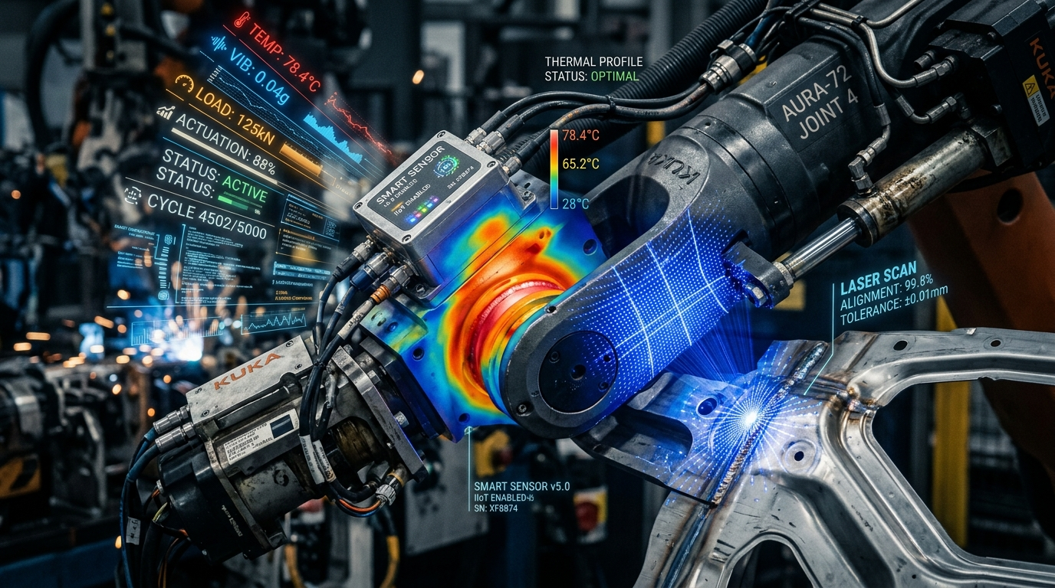
VECTOR 1: PHYSICAL ASSET MONITORING
Machine Health & Physics-Based Telemetry Analytics
CORE TELEMETRY VECTORS & INDUSTRIAL THRESHOLDS
Bearing Temperature (°C)
Thresholds: Nominal: <75°C | Warning: ≥85°C | Critical: ≥90°C
Action: Prevents stator burnout and bearing thermal seizure.
Vibration Velocity (mm/s)
Thresholds: Nominal: <3.0 | Warning: ≥4.5 | Critical: ≥6.0
Action: ISO 10816 vibration standard for mechanical resonance/unbalance.
Hydraulic Pressure (psi)
Thresholds: Safe Window: 70 - 115 psi | Critical: <60 or >125
Action: Ensures precise robotic clamping and prevents hydraulic seal blowouts.
Power Consumption (kW)
Thresholds: Warning: ≥48.0 kW | Critical: ≥55.0 kW
Action: Detects mechanical resistance spikes and electrical surges.
SMART SENSOR INTEGRATION
Industrial IoT sensors transmit high-speed time-series streams. DriveOps-AI maps and normalizes raw telemetry headers on the fly, eliminating the need for rigid vendor-specific CSV templates.

Slide 5
VECTORS 2 & 3: OPERATIONAL EXCELLENCE
Production Throughput & Quality Gate Intelligence
PRODUCTION PACE & TAKT ATTAINMENT
Target Attainment Metric
Formula: (Actual Units / Target Units) × 100%. Tracks planned vs. realized vehicle completions per shift.
Takt Time Gap Evaluation
Quantifies line delays: Attainment gap >15% flags a Minor Gap; >25% triggers Critical Behind alerts.
Bottleneck Mitigation
Identifies starved stations and automatically advises buffer rebalancing to prevent line halts.
QUALITY GATE & DEFECT CLUSTERING
First-Pass Yield (FPY)
Monitors quality pass-rate: Optimal ≥98.0%, Degraded <95.0%, and Critical Spike <90.0%.
Automated Lot Quarantine
When defect counts exceed 10 units, system automatically recommends holding the next 15 units for inspection.
Root-Cause Defect Taxonomy
Tracks defect categories (e.g. geometric variance, spot-weld failure, paint coat thickness) to isolate tooling drift.

Slide 6

REAL-TIME MONITORING & ALERT DISPATCH
Plant Command Center & Operations Fleet View
EXECUTIVE PLANT CONTROL ROOM
Fleet-Wide Live Metrics
Displays plant-wide units produced, shift pace (+14/h), open alerts, and aggregate plant health percentage.
Production Line Readiness
Real-time readiness scoring across Body Line A/B, Paint Line C, and Final Assembly.
Real-Time Alert Queue
Color-coded severity categorization (Critical, High, Medium, Low) with one-click technician acknowledgement.
Shift Audit Reports
Generates comprehensive end-of-shift reports with downloadable CSV audit logs for plant management.

Slide 7
AUTONOMOUS DIAGNOSTICS & FAILOVER
Dual-Layer AI Reasoning & Resilience Architecture
LAYER 1: GENERATIVE AI
Google Gemini 1.5 Flash
──────────────────────────
• Invoked when sensor anomalies are detected
• Deterministic temperature setting (T = 0.2)
• Strict JSON schema enforcement
• Generates 2-sentence mechanical diagnosis
• Prescribes single technician action command
LAYER 2: CIRCUIT BREAKER
5-Minute Dynamic Cooldown
──────────────────────────
• Monitors HTTP 429 quota exhaustion & timeouts
• Automatically trips circuit breaker on network failure
• Prevents request queues & server memory leaks
• Self-healing: automatically probes API health after cooldown
• Guarantees <10ms response even when AI APIs fail
LAYER 3: DETERMINISTIC FALLBACK
Automotive Physics Rules
──────────────────────────
• 100% reproducible deterministic engineering calculations
• Zero hallucination risk for critical plant safety
• Seamless client-side fallback on static hosts (Vercel)
• Same exact mathematical output as backend service
• Zero external API dependencies required

Slide 8
FULL-STACK ENGINEERING BREAKDOWN
Complete Project Technical Specifications
LAYER | CORE TECHNOLOGY | KEY FUNCTION / MODULES | BENEFIT
Frontend UI | React 19, TypeScript, Vite 7 | Wouter Router, Lucide Icons, Sonner Notifications | Sub-second HMR & modern SPA architecture
Styling System | Tailwind CSS v4 | High-tech dark theme, Glassmorphism, Responsive Grid | Curated plant-floor industrial aesthetic
Visualization | Recharts & Framer Motion | Real-time telemetry line charts, animated cards | Instant visual comprehension of machine status
Backend API | Node.js (v20+), Express 5 | Modular Intelligence Engines, RFC-4180 CSV parser | Handles 50MB telemetry intake with low latency
Artificial Intelligence | Google Gemini 1.5 Flash | Prompt engineering with structured JSON (T=0.2) | Autonomous root-cause mechanical reasoning
Database & Auth | Supabase Cloud (PostgreSQL) | Tables: machines, alerts, telemetry; Supabase Auth | Secure JWT authentication & cloud persistence
Reliability Layer | Drizzle ORM & MemoryStore | In-memory seed fallback + Circuit Breaker pattern | 100% operational uptime if database is offline

Slide 9
VALUE DELIVERED & FUTURE EXPANSION
Industrial Impact, Business ROI & Strategic Roadmap
40% Reduction in Unplanned Stoppages
By detecting bearing wear and thermal drift 2-4 hours before mechanical failure, plants prevent catastrophic line freezes.
STRATEGIC EXPANSION ROADMAP
Phase 1: Direct OPC-UA & MQTT Gateway
Transition from batch CSV/REST ingestion to direct microsecond OPC-UA industrial bus streaming.
Phase 2: Acoustic AI Anomaly Detection
Incorporate acoustic sensor microphones to detect subtle harmonic frequency shifts in robotic gearboxes.
Phase 3: Digital Twin 3D Floor Simulation
Interactive Three.js plant CAD visualization with real-time temperature heat-mapping on robotic arms.
Phase 4: Autonomous Robotic Workcell Throttling
Closed-loop feedback to automatically throttle station cycle speed when thermal limits approach warning thresholds.
90% Faster Root-Cause Diagnosis
AI delivers instant technical diagnoses and repair instructions, reducing shift investigation time from 45 min to under 30 seconds.
Zero Hardware Lock-In
Flexible telemetry normalizer works with any sensor standard (Siemens, Fanuc, ABB, KUKA) without requiring costly proprietary PLC adapters.

Slide 10
DriveOps-AI
Smart Car Manufacturing & Production Intelligence
──────────────────────────────────────────────
Live Production Demo: https://driveops-ai.vercel.app
Thank you! Questions & Discussion.

