Slide 1
AMAZON FRESH
AMAZON
RETAIL ANALYTICS
Analytics
SQL
SQL Data Analysis Project
Data Layer
Turning e-commerce data into structured, decision-ready business insights.
BI
Dashboard
360°
PROJECT PRESENTATION
Insights
Presented by
Kavinprasath.R
Customers • Orders • Products • Reviews • Suppliers
Notes:
Title Slide: Introduces the project 'Amazon Fresh Analytics' — a SQL-driven retail analytics project covering Customers, Orders, Products, Reviews, and Suppliers, supported by a Power BI dashboard. Presented by Kavinprasath.R. Key point: sets the scope as an end-to-end data analysis project from raw data to 360° business insights.

Slide 2
AMAZON FRESH ANALYTICS
02
INTRODUCTION
PROJECT PURPOSE
ANALYTICAL FOCUS
Amazon Fresh Analytics is a SQL-based data analysis project designed to analyze customers, orders, products, reviews and suppliers.
The analysis focuses on customer spending, product sales, ratings, Prime membership and supplier/product information.
SQL-DRIVEN SOLUTION
BUSINESS OUTCOME
The project uses SQL queries to retrieve, clean, transform and analyze business data.
The goal is to generate useful insights that can support better business decisions.
Core business themes
Customer Value
Product Sales
Ratings
Prime Members
Supplier Insights
SQL DATA ANALYSIS • POWER BI DASHBOARD
Presented by Kavinprasath.R
Notes:
Introduction: Explains the project purpose and analytical focus. Key points — (1) The project analyzes customers, orders, products, reviews, and suppliers using SQL. (2) Analytical focus is on customer spending, product sales, ratings, Prime membership, and supplier data. (3) SQL is used to retrieve, clean, transform, and analyze data. (4) Business outcome is to generate insights that support better decision-making across five core themes: Customer Value, Product Sales, Ratings, Prime Members, and Supplier Insights.

Slide 3
AMAZON FRESH ANALYTICS
03
PROBLEM STATEMENT
Why structured analytics is needed
01
DATA COMPLEXITY
Large e-commerce datasets contain customer, order, product and supplier information that can be difficult to analyze manually.
02
BUSINESS QUESTIONS
Businesses need to identify high-value customers, top-selling products and frequently ordered categories.
03
DATA QUALITY
Duplicate names, invalid ages and invalid ratings can affect analysis.
04
PROJECT GOAL
Use SQL to organize data, maintain data integrity and extract actionable business insights.
SQL DATA ANALYSIS • POWER BI DASHBOARD
Presented by Kavinprasath.R
Notes:
Problem Statement: Explains why structured analytics is needed. Key points — (1) Data Complexity: large e-commerce datasets are hard to analyze manually. (2) Business Questions: need to identify high-value customers, top-selling products, and popular categories. (3) Data Quality: issues like duplicate names, invalid ages, and invalid ratings affect analysis accuracy. (4) Project Goal: use SQL to organize data, ensure integrity, and extract actionable insights.

Slide 4
AMAZON FRESH ANALYTICS
04
APPROACH
01
DATABASE
02
QUERY
03
CALCULATE
Create and retrieve data from the Amazon Fresh database tables.
Use WHERE, GROUP BY, HAVING and ORDER BY to filter and summarize data.
Apply SUM, COUNT and AVG for business calculations.
04
COMBINE
05
RANK
06
NORMALIZE
Use JOINs and subqueries to answer complex business questions.
Use RANK() to rank customers by total spending.
Normalize product category information toward 3NF using a separate Category table and foreign-key relationship.
SQL → Clean Structure → Analysis → Ranking → Business Insight
SQL DATA ANALYSIS • POWER BI DASHBOARD
Presented by Kavinprasath.R
Notes:
Approach: Describes the six-step SQL methodology. Key points — (1) Database: create and retrieve data from Amazon Fresh tables. (2) Query: use WHERE, GROUP BY, HAVING, ORDER BY to filter and summarize. (3) Calculate: apply SUM, COUNT, AVG for business metrics. (4) Combine: use JOINs and subqueries for complex questions. (5) Rank: use RANK() to rank customers by spending. (6) Normalize: move category data toward 3NF using a separate Category table. Overall flow: SQL → Clean Structure → Analysis → Ranking → Business Insight.

Slide 5
AMAZON FRESH ANALYTICS
05
RESULTS
CUSTOMER VALUE
PRODUCT PERFORMANCE
High-value customers spending more than ₹5,000 were identified and customers were ranked by total spending.
The top 3 products by sales revenue were identified using Order Details and Products data.
CATEGORY DEMAND
PRIME ANALYSIS
The top 3 most frequently ordered product categories were identified.
Cities with the highest concentration of Prime members were analyzed.
ORDER ANALYSIS
DATA INTEGRITY
Orders and order details were joined to analyze order-level product and revenue information.
Primary key, unique, CHECK, DEFAULT and foreign-key constraints improved data integrity.
SQL DATA ANALYSIS • POWER BI DASHBOARD
Presented by Kavinprasath.R
Notes:
Results: Summarizes the key analytical outcomes. Key points — (1) Customer Value: high-value customers (>₹5,000 spend) identified and ranked. (2) Product Performance: top 3 products by revenue identified. (3) Category Demand: top 3 most-ordered categories found. (4) Prime Analysis: cities with highest Prime member concentration analyzed. (5) Order Analysis: orders joined with order details for revenue insights. (6) Data Integrity: enforced via primary key, unique, CHECK, DEFAULT, and foreign-key constraints.

Slide 6
AMAZON FRESH ANALYTICS
06
PROJECT EVALUATION METRICS
DATA INTEGRITY
QUERY ACCURACY
BUSINESS INSIGHT
Primary key, unique, CHECK, DEFAULT and foreign-key constraints.
Correctness of filtering, aggregation, joins, subqueries and ranking.
Identify high-value customers, top products and popular categories.
DATA ORGANIZATION
QUERY EFFICIENCY
COMPLETENESS
Normalization of product category information toward Third Normal Form (3NF).
Appropriate GROUP BY, ORDER BY, LIMIT and JOIN operations.
Coverage of customer, order, product, review and supplier analysis.
SQL DATA ANALYSIS • POWER BI DASHBOARD
Presented by Kavinprasath.R
Notes:
Project Evaluation Metrics: Lists the six criteria used to judge project quality — Data Integrity (constraints), Query Accuracy (correct filtering/joins/ranking), Business Insight (identifying customers/products/categories), Data Organization (3NF normalization), Query Efficiency (proper GROUP BY/ORDER BY/LIMIT/JOIN usage), and Completeness (full coverage of customer, order, product, review, and supplier analysis).

Slide 7
AMAZON FRESH ANALYTICS
07
TECHNICAL STACK
Core SQL capabilities demonstrated
MySQL / SQL
DDL and DML
Primary Key and Foreign Key
CHECK / UNIQUE / DEFAULT
JOINs
Subqueries and Nested Queries
Aggregate Functions
GROUP BY / HAVING / ORDER BY
Window Function – RANK()
Database Normalization – 3NF
Focus: reliable queries + structured data + actionable analysis
SQL DATA ANALYSIS • POWER BI DASHBOARD
Presented by Kavinprasath.R
Notes:
Technical Stack: Highlights the core SQL capabilities demonstrated — MySQL/SQL, DDL and DML, Primary/Foreign Keys, CHECK/UNIQUE/DEFAULT constraints, JOINs, subqueries and nested queries, aggregate functions, GROUP BY/HAVING/ORDER BY, the RANK() window function, and database normalization (3NF). Focus: reliable queries, structured data, and actionable analysis.

Slide 8
AMAZON FRESH ANALYTICS
08
DATASET
CUSTOMERS
ORDERS
Customer details, city, age and Prime membership.
Order ID, customer ID, order date, order amount, delivery fee and discount.
ORDER DETAILS
PRODUCTS
Product ID, quantity, unit price and discount for each order.
Product name, category, subcategory, price, stock quantity and supplier.
REVIEWS
SUPPLIERS
Product ratings used for rating analysis.
Supplier information used for supplier-related analysis.
Database: Amazon
6 core entities support customer, transaction, product and review analysis.
SQL DATA ANALYSIS • POWER BI DASHBOARD
Presented by Kavinprasath.R
Notes:
Dataset: Describes the six core entities in the Amazon database. Key points — Customers (details, city, age, Prime status), Orders (ID, customer, date, amount, delivery fee, discount), Order Details (product, quantity, unit price, discount per order), Products (name, category, subcategory, price, stock, supplier), Reviews (product ratings), and Suppliers (supplier information). Together these support customer, transaction, product, and review analysis.

Slide 9
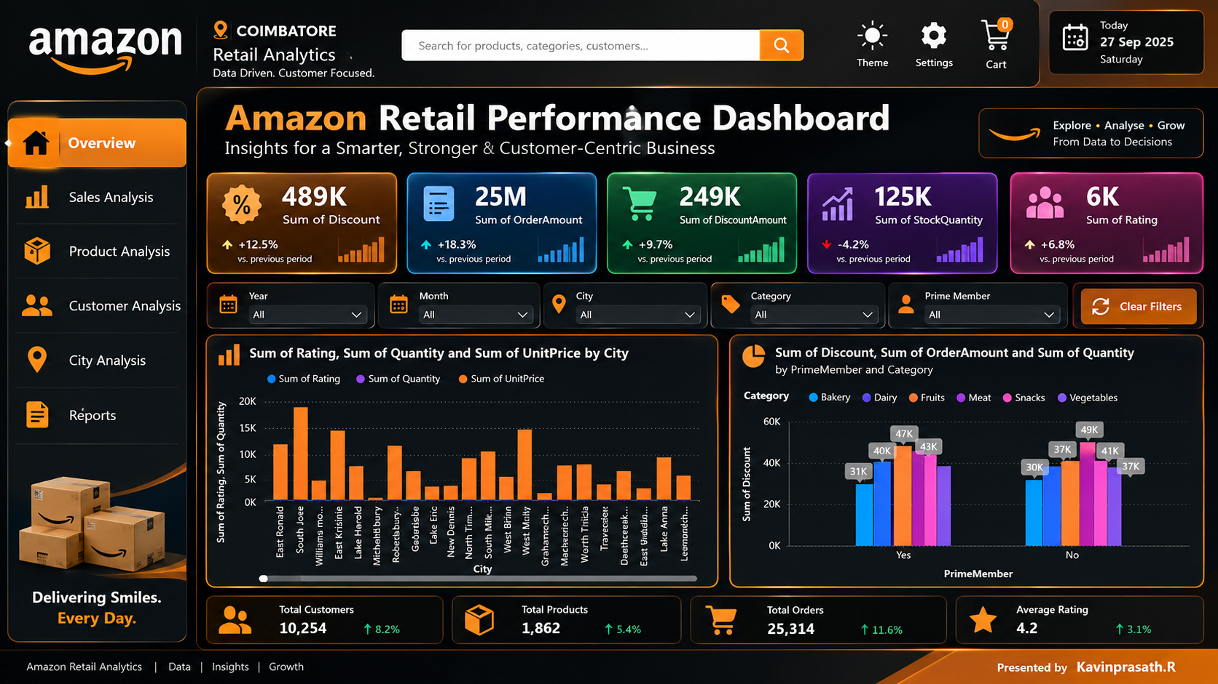
AMAZON FRESH ANALYTICS
Professional Power BI Dashboard
Presented by Kavinprasath.R
Executive overview • KPI monitoring • interactive business analysis
Dashboard Overview
Amazon Retail Performance • Sales • Products • Customers • Inventory • Ratings
Notes:
Power BI Dashboard: Presents the professional Power BI dashboard built on top of the SQL analysis. Key points — provides an executive overview, KPI monitoring, and interactive business analysis across Sales, Products, Customers, Inventory, and Ratings for Amazon Retail Performance.

Slide 10
AMAZON FRESH ANALYTICS
10
CONCLUSION
What the project demonstrates
01
SQL can transform raw e-commerce data into useful business insights.
02
SQL constraints and normalization improve data quality and database structure.
03
Joins, aggregations, subqueries and window functions support detailed business analysis.
04
The project identifies valuable customers, top products, popular categories and Prime-member concentrations.
05
Overall, the analysis provides a strong foundation for data-driven decision-making in an e-commerce environment.
THANK YOU • Questions & Discussion
Kavinprasath.R
SQL DATA ANALYSIS • POWER BI DASHBOARD
Presented by Kavinprasath.R
Notes:
Conclusion: Summarizes what the project demonstrates. Key points — (1) SQL can transform raw e-commerce data into useful business insights. (2) Constraints and normalization improve data quality and structure. (3) Joins, aggregations, subqueries, and window functions enable detailed analysis. (4) The project successfully identifies valuable customers, top products, popular categories, and Prime-member concentration. (5) Overall, it provides a strong foundation for data-driven decision-making in e-commerce. Ends with Thank You — Questions & Discussion.

