Slide 1
SENTINEL
AI-Powered Unified CCTV Intelligence & Investigation Platform
"80,000 Cameras. One Intelligence Layer."
CCTV NETWORK
SENTINEL
COMMAND CENTER
RTSP · ONVIF · Multi-VMS
AI Intelligence Layer
Alerts · Cases · Evidence
PROBLEM STATEMENT
Sentinel
THEME
Smart Automation / Security
CATEGORY
Software
PROBLEM STATEMENT
Gujarat Police CCTV / Video Management & Analytics
TEAM ID
Not alloted
TEAM NAME
Caffeine Clause
TEAM MEMBERS
KJ
Kavya Joshi
PR
Prajinraj Ranawat
VN
Vanshal Nagar
IM
Isha Masani
VS
Vishakha Sharma
RL
Rishit Lad
Team Lead · Full-Stack
AI · Computer Vision
Backend · APIs
Frontend · UI/UX
GIS · Data Engineering
DevOps · Security

Slide 2
FROM CCTV FOOTAGE TO ACTIONABLE INTELLIGENCE
Proposed Solution · built and demonstrated end-to-end
26+ DEPARTMENTS
CORE INNOVATIONS
Police · Traffic · Municipal · Transport
CCTV / VMS SOURCES
RTSP · HLS · ONVIF · Vendor VMS
Unified CCTV Registry + GIS
Cross-Camera Vehicle Intelligence
Every camera mapped, searchable, health-monitored
Plate + appearance + time correlation across feeds
SENTINEL INTELLIGENCE LAYER
Ingestion · Federation · Registry
AI DETECTION · ANPR · TRACKING
AI Investigation Copilot + Graph
Real-Time Alerts & Evidence Chain
YOLO detection + OCR plates + ByteTrack
Ask a question, get journey, map, timeline + graph
Watchlist hits to court-ready, audited evidence
EVENT CORRELATION
Plate + time + camera + location
INVESTIGATION COPILOT & GRAPH
Natural-language search, timeline, entity graph
ALERTS → INCIDENTS → EVIDENCE → CASES
WHY SENTINEL?
Case-ready, audited output
TODAY
WITH SENTINEL
• Camera-by-camera viewing
• Unified statewide search
• Manual footage searching
• AI-assisted investigation + graph
• Isolated, unlinked alerts
• Correlated cross-camera events
• Fragmented evidence
• Case-ready evidence chain

Slide 3
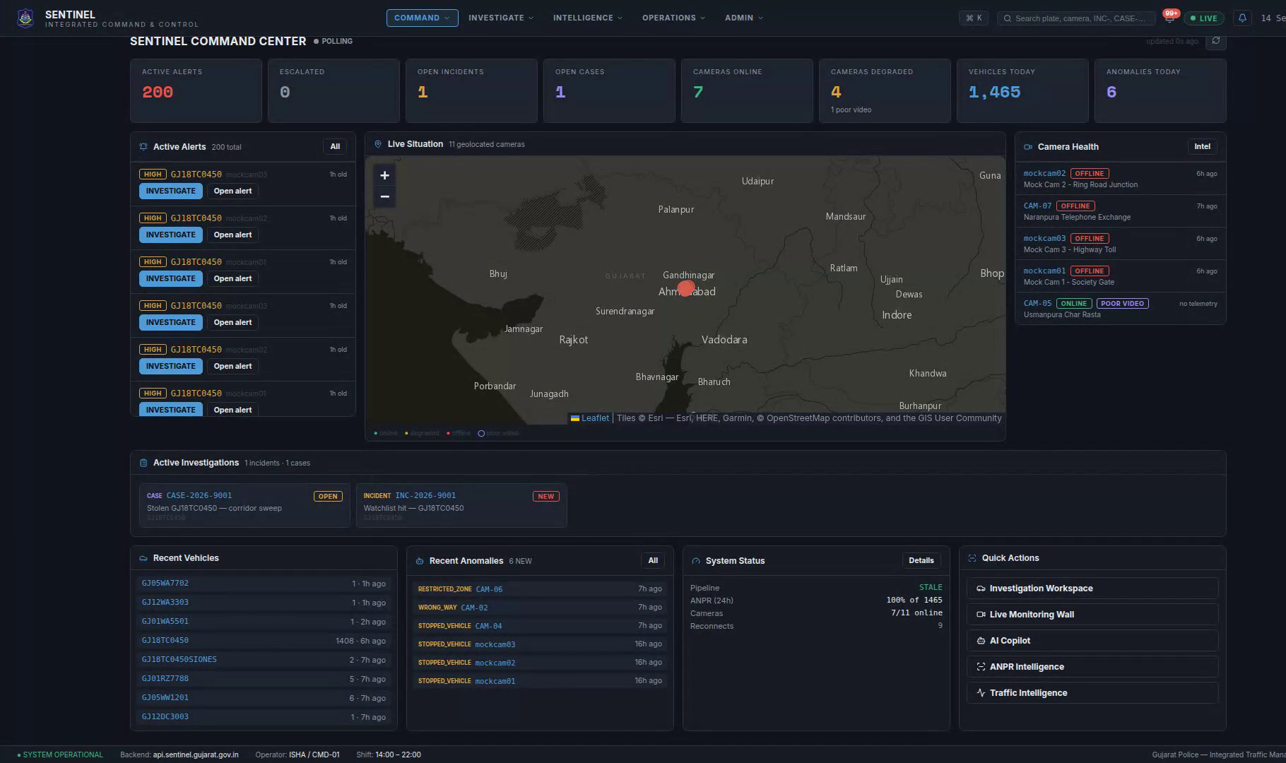
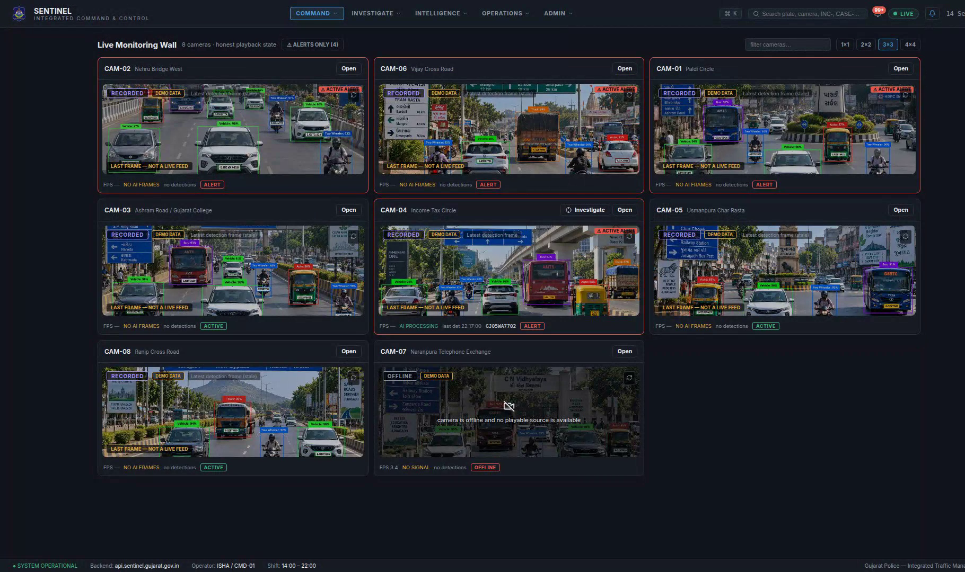
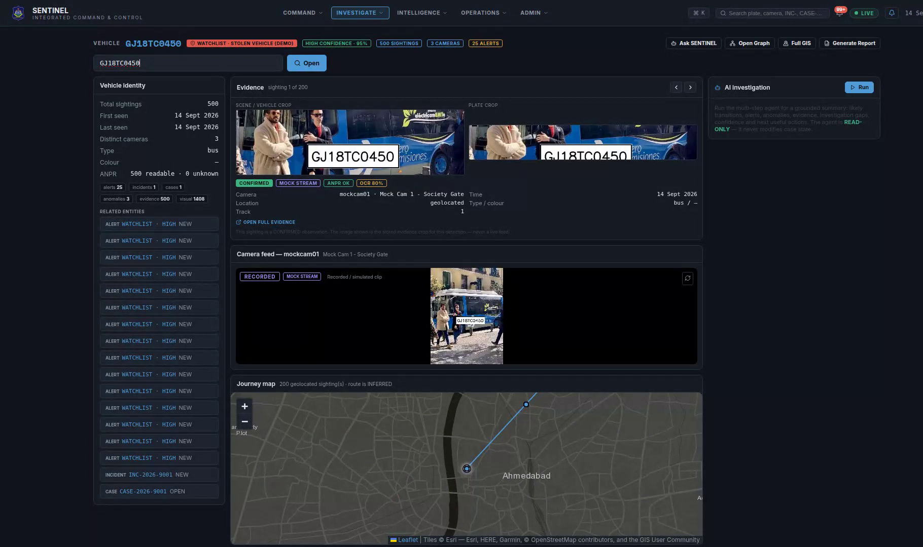
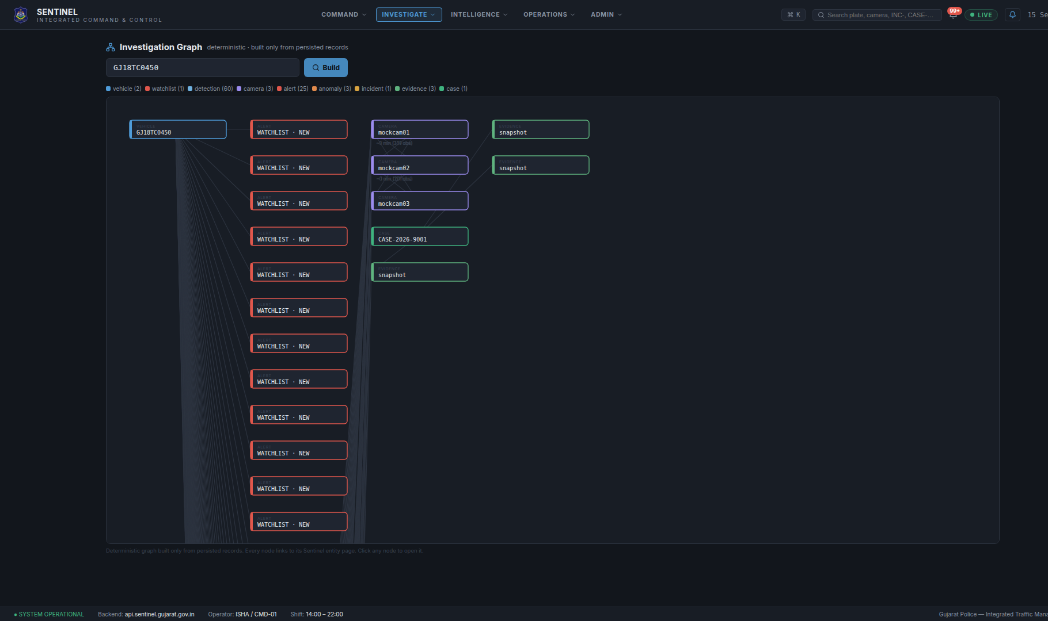
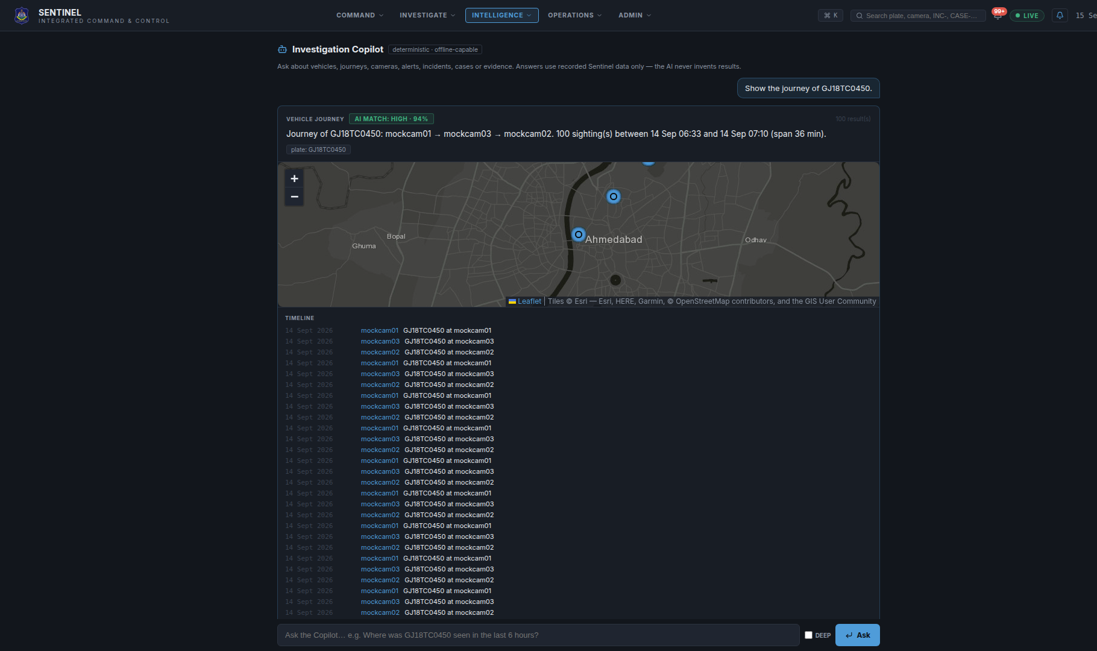
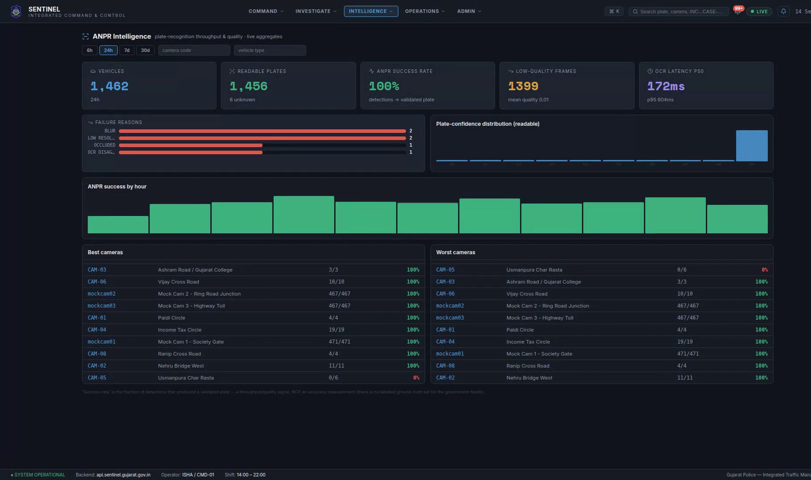
THE PLATFORM — LIVE, NOT MOCKED
Real screens from the running system — live seeded data, not static mockups
Command Center
Live Monitoring Wall — real-time AI detection
Vehicle Investigation Workspace
Investigation Graph
AI Investigation Copilot
ANPR Intelligence

Slide 4
TECHNICAL APPROACH
End-to-end pipeline · technology stack · security by design
CAMERA SOURCES
INGESTION &
FEDERATION
AI VIDEO
ANALYTICS
EVENT
INTELLIGENCE
CORRELATION
ENGINE
INVESTIGATION
LAYER
COMMAND
CENTER
RTSP / HLS / ONVIF / VMS
Vendor-neutral adapters
YOLO + ANPR
+ ByteTrack
Plate · Time ·
Camera · Location
Journey · behaviour
· alerts
Search · Copilot ·
Timeline · GIS · Graph
Alerts · Cases ·
Reports
TECHNOLOGY STACK
Python
FastAPI
React
PostgreSQL / PostGIS
Docker
YOLO
OCR / ANPR
ByteTrack
WebSocket
Object Storage (MinIO)
SECURITY BY DESIGN
RBAC
JWT AUTH
AUDIT LOGS
ENCRYPTION
EVIDENCE ACCESS CONTROL
Metadata-first design — video stays at source, only events and evidence pointers move across the network.

Slide 5
WORKFLOW & SYSTEM INTEGRATION
How one detection becomes a resolved case — and what Sentinel connects to
END-TO-END OPERATIONAL WORKFLOW
SYSTEM INTEGRATION MAP
1
Camera captures frame
SYSTEM
CCTV / VMS Vendors
Command Center UI
AI detects vehicle, reads plate (YOLO + ANPR)
SENTINEL
CORE
2
Match & correlate
SYSTEM
RTSP · ONVIF · HLS adapters
Live ops dashboard for officers
Plate checked against watchlist · cross-camera journey built
• Ingestion
3
Alert raised
SYSTEM
Pushed live to Command Center over WebSocket
• AI Analytics
4
Operator reviews
OPERATOR
Vehicle & Watchlist Data
Realtime Notifications
Opens alert, sees camera, map, AI summary
• Correlation
Investigate
Plate registry · watchlist feed
WebSocket push to every client
5
OPERATOR
Copilot Q&A · Investigation Graph · GIS trail
• Investigation
6
Escalate & attach evidence
OPERATOR
Incident → Case, evidence linked, notes added
• Alerts / Cases
Resolve & audit
GIS / Mapping
Evidence Object Storage
7
OPERATOR
Report generated · every action logged
PostGIS + OpenStreetMap / Esri tiles
MinIO / S3-compatible, access-controlled

Slide 6
FEASIBILITY & VIABILITY
Buildable today · operable by police teams · designed to scale statewide
TECHNICAL
OPERATIONAL
SCALABILITY
• Vendor-neutral architecture
• Single command-centre interface
• Regional / edge AI processing
• Open standards: RTSP / ONVIF
• GIS-based camera management
• Metadata-first architecture
• Modular AI microservices
• Automated alerting workflows
• Load-balanced analytics workers
• PostgreSQL / PostGIS core
• Investigation timelines & graph
• Hot / Warm / Cold storage tiers
• Edge + central processing ready
• Evidence & report generation
• Designed for 80,000-camera scale
SAME ARCHITECTURE — HORIZONTAL SCALE
50 CAMERAS
5,000 CAMERAS
80,000 CAMERAS
Pilot / demo
City-wide
Statewide (Designed)
Architecture layers stay constant — compute and storage scale out.
RISKS → MITIGATION
Bandwidth constraints
Vendor lock-in
AI false positives
System failure
Edge processing at source
Adapter / abstraction layer
Confidence score + human review
HA / DR architecture (Designed)

Slide 7
IMPACT & BENEFITS
From monitoring cameras to understanding events
FASTER RESPONSE
STATEWIDE VISIBILITY
Minutes, not manual searching
Unified view across 26+ departments
◈ SENTINEL
SMARTER INVESTIGATION
One intelligence layer
LOWER OPERATIONAL LOAD
Vehicle → Camera → Event → Evidence → Case
Automates repetitive monitoring
AUDITABLE & SECURE
RBAC + audit trail + controlled evidence access
BEFORE
AFTER
80,000 cameras
Fragmented systems
Manual investigation
Delayed response
80,000 cameras
Unified intelligence
AI-assisted investigation
Faster action
"From monitoring cameras to understanding events."

Slide 8
RESEARCH & REFERENCES
Grounded in open standards, published CV research and proven distributed architecture
OFFICIAL / DOMAIN
AI / COMPUTER VISION
ARCHITECTURE
• Gujarat Police CCTV / Sentinel ecosystem
• YOLO real-time object detection
• Event-driven video analytics patterns
• SIH 2026 Problem Statement SIH26174
• ByteTrack multi-object tracking
• Edge + cloud video processing models
• RTSP & ONVIF interoperability standards
• OCR / ANPR plate-recognition literature
• High-availability distributed systems
• PostGIS geospatial architecture
• Cross-camera vehicle Re-ID research
• Secure RBAC & audit architectures
RESEARCH → SOLUTION
01
02
03
04
RESEARCH
ARCHITECTURE
PROTOTYPE
DEPLOYMENT ROADMAP
Standards, CV papers,
police workflows
Vendor-neutral,
metadata-first design
Working platform on
recorded + live feeds
Edge rollout, HA/DR,
dept. integrations

