Slide 1
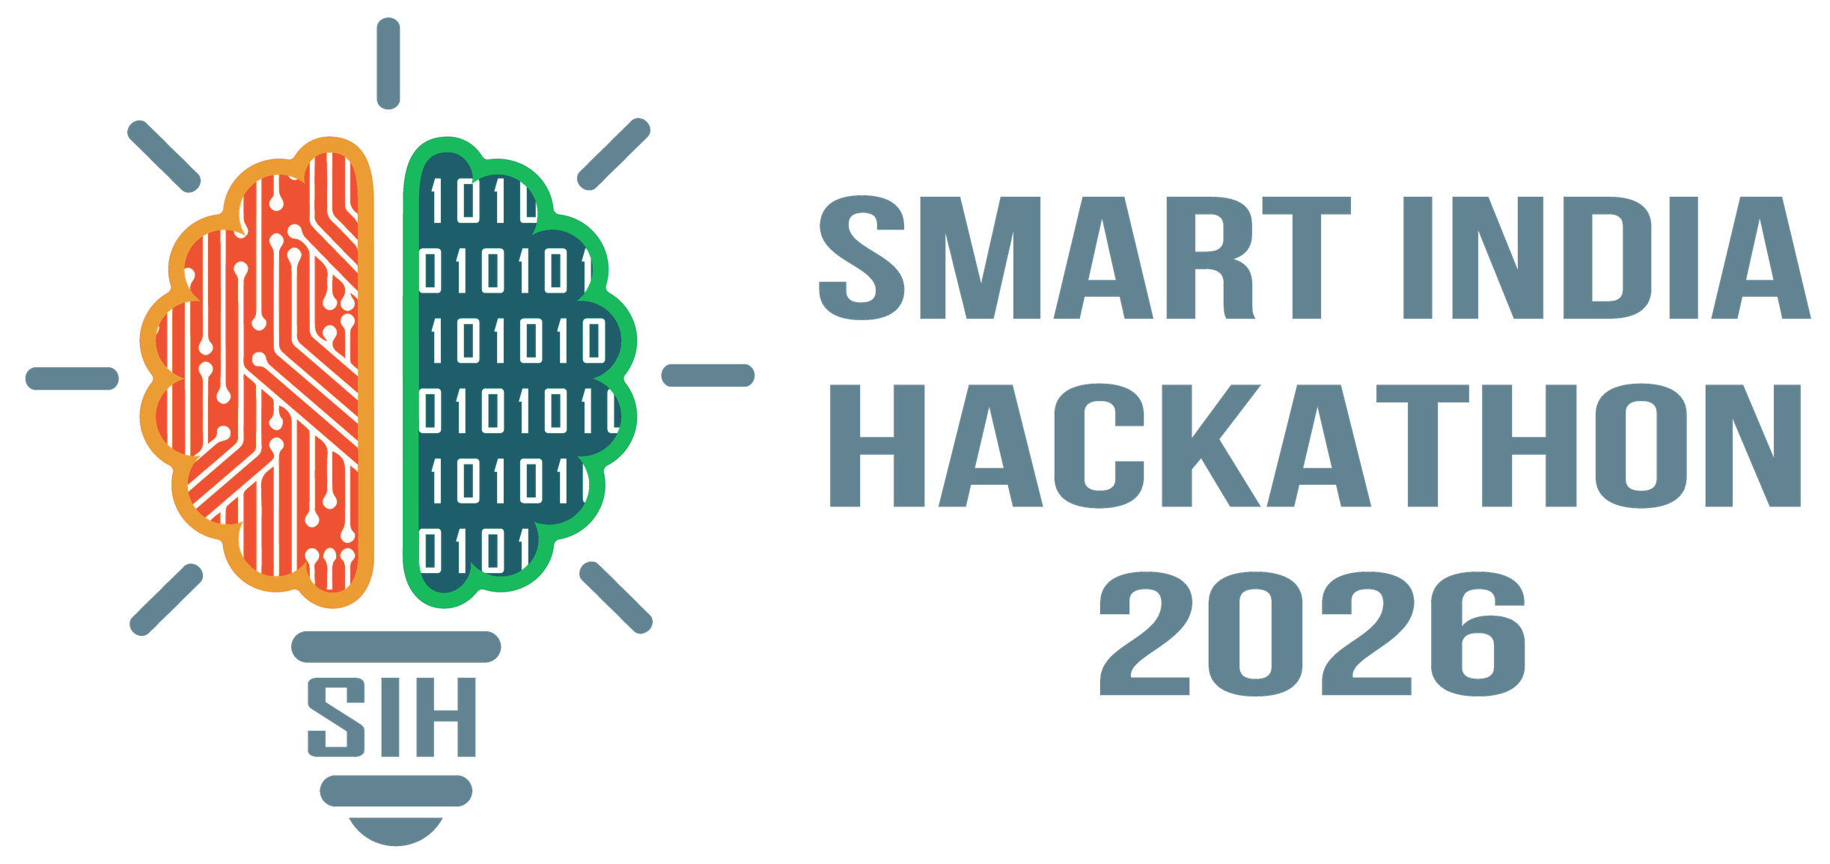
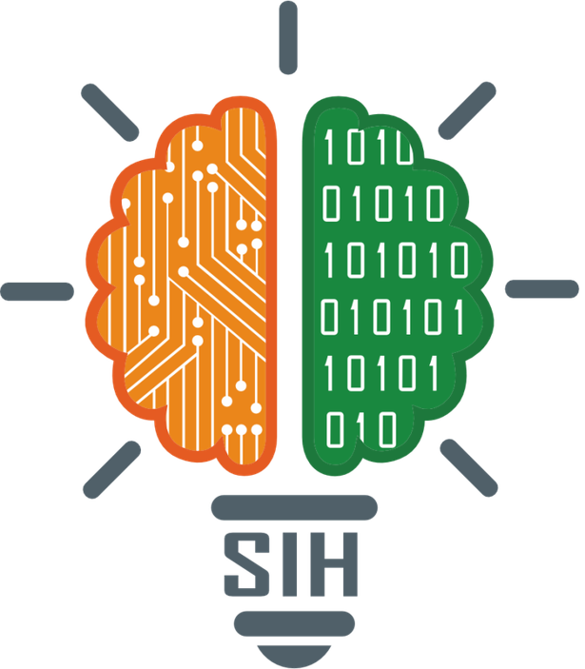
SMART INDIA HACKATHON 2026
HONEY CHAIN
Problem Statement ID – 26021
Problem Statement Title – Honey Chain: A block chain-based system for honey traceability and smart beekeeping management
Theme – Agriculture, FoodTech & Rural Development
PS Category- Software
Team ID-
Team Name – Brainy Brews

Slide 2









Honey Chain : A blockchain, AI & IoT based honey traceability
and smart beekeeping management platform.
Proposed Solution
How it Addresses the Problem
IoT Smart Hive Monitoring
ESP32 nodes stream hive temperature, humidity & weight to live dashboards.
AI Colony Health & Disease Alerts
Explainable health score, IsolationForest anomalies & YOLO Varroa detection.
Productivity & Harvest Prediction
Weight trends forecast harvestable honey and the best harvest window.
Blockchain Batch Provenance
Each harvest minted as an ERC-721 token with SHA-256 hash & IPFS metadata.
QR Consumer Verification
Jar QR opens a public passport: origin, colony health, journey & tamper check.
Tamper-evident hashes expose counterfeit or altered batches.
QR passport rebuilds consumer trust in rural honey.
Early alerts cut colony losses from heat, swarming & mites.
Verified provenance opens premium market linkages.
Proposed Innovations
Explainable Hive Health Score
Hive-to-Jar Digital Passport
Tamper-Evident Provenance
KVIC Command Center
5-factor weighted score; one severe factor escalates status, with plain-language reasons.
Journey built from real IoT, AI and ledger records, with a printable certificate.
Record hash anchored at mint; any later database edit is caught at scan time.
National apiary map, disease surveillance, one-click batch recall and audit trail.
Prototype Link
Demo Procedure — Hive-to-Jar Traceability Validation
Web link
GitHub Link
Video link
IOT TELEMETRY
ANOMALY ALERT
VARROA SCAN
BATCH MINTED
QR VERIFIED
ESP32 node streams temp, humidity & weight
Heatwave → critical alert & health drop
Frame photo → mites detected & flagged
ERC-721 token + IPFS + QR generated
Scan → authentic / tampered / recalled
@SIH Idea submission- Template
2

Slide 3












TECHNICAL APPROACH
IoT Sensing + AI Analytics + Blockchain Provenance + QR Verification
AI Analytics
WHY EACH TECHNOLOGY?
scikit-learn · YOLO
IsolationForest anomalies, Varroa detection, explainable health & yield models
ESP32 IoT Nodes
IoT Hive Nodes
Low-cost (≈ ₹1,500/hive) Wi-Fi sensor node; solar-friendly for rural apiaries.
ESP32 edge sensors
Isolation Forest
Blockchain Layer
Flags abnormal hive conditions without labelled failure data.
Espressif ESP32
Solidity · Ethereum Sepolia
Next.js 14 Portals
Temperature & humidity (SHT31)
Hive weight (HX711 load cell)
Frame photos (phone camera)
Scenario simulator for demos
ERC-721 HoneyBatch with OpenZeppelin roles: Beekeeper mint, KVIC recall
Beekeeper portal
KVIC command center
Consumer QR passport
Live WebSocket updates
HTTP / MQTT
Backend / API
YOLO Vision
FastAPI · Python
Detects Varroa mites on frame photos taken with a phone.
REST + WebSocket APIs, rule engine, alerts & batch lifecycle
IPFS Metadata
ERC-721 + Solidity
Content-addressed JSON
Each batch is a unique, publicly verifiable token with role-based mint & recall.
Origin, weight, health & harvest time pinned; CID stored as token URI
Python 3.12
SHA-256 + IPFS
Tamper-evident record hash with decentralised metadata storage.
Storage
Consumer scans jar QR → instant verification
PostgreSQL · SQLAlchemy
FastAPI + Next.js
Telemetry, alerts, analyses, batches & audit trail
Async APIs, live WebSockets and mobile-friendly dashboards.
HONEY CHAIN DECISION
Deployment: Docker Compose (PostgreSQL + FastAPI + Next.js + IoT simulator) — runs on cloud or NIC / State data centres; per-cluster rollout.
Sensor Data + AI Health Score + Vision Inspection → Verified Harvest → On-chain Batch → Consumer Trust
@SIH Idea submission- Template
3

Slide 4

















FEASIBILITY AND VIABILITY
Low-cost • Rural-ready • Modular • Scalable
1
CAN WE BUILD IT ?
HOW DO WE SOLVE IT?
2
YES — Working Prototype, Open Stack
Robust Pipeline for Rural Conditions
Open-Source Stack
Working Prototype
Low-Cost Hardware
Modular Design
Offline Buffering
Explainable AI
Gas-Efficient Minting
Mobile-First UI
FastAPI, Next.js, Solidity & scikit-learn
End-to-end hive-to-jar flow already live
ESP32 sensor node ≈ ₹1,500 per hive
Swap sensors, models or chain independently
Nodes store & forward readings when network drops
Every health score shows the reason behind it
One token per harvest batch, not per reading
Works on low-end smartphones in the field
FEASIBILITY
&
VIABILITY
3
WHAT CAN GO WRONG?
Can It Scale Across KVIC?
4
Known Challenges + Mitigations
From Prototype
to Real-World Impact
Yes — Cluster-Ready & Govt-Integrable
Poor Connectivity
Data Tampering
Digital Literacy
Transaction Costs
Cluster Rollout
Honey Mission Link
Cloud or On-Prem
Market Access
LoRa/GSM fallback with store-and-forward
Weight, temperature & AI checks cross-validate
Simple UI + cluster training via KVIC
Batch-level minting; Polygon / L2 ready
Per-apiary dashboards for every KVIC cluster
Bee-box beneficiaries mapped to live hives
Dockerised stack runs on NIC / State servers
Verified batches ready for e-commerce & export
@SIH Idea submission- Template
4

Slide 5











IMPACT AND BENEFITS
Empowering Rural Beekeepers with Trusted, Traceable Honey
Stops Counterfeit Honey
Instant Safety Recalls
Tamper-evident provenance exposes fake or adulterated batches.
KVIC revokes a batch; every consumer scan shows the recall.
Higher Beekeeper Income
Better Harvest Timing
Verified origin earns premium prices and direct market access.
Yield forecasts tell beekeepers when to extract honey.
Fewer Colony Losses
Export-Ready Traceability
Early heat, moisture, swarm & Varroa alerts protect hives.
Hive-to-jar records support quality audits & bulk buyers.
Consumer Confidence
Accountable Subsidies
One QR scan proves origin & authenticity.
2.46 lakh Honey Mission bee boxes linked to real output.
Data-Driven Policy
IMPACT
BENEFITS
Scalable Rural Model
KVIC tracks production & disease spread live.
What Difference
Does it Make?
One platform from a single cluster to every state.
What do we gain?
@SIH Idea submission- Template
5

Slide 6
RESEARCH AND REFERENCES
RELATED SYSTEMS / PRIOR ART
AI / TECHNICAL REFERENCES
IBM Food Trust (Hyperledger Fabric)
1. Isolation Forest — Unsupervised Anomaly Isolation
Enterprise blockchain for farm-to-shelf food traceability (e.g. Walmart mango trace in 2.2 s). Permissioned and costly for smallholders; no hive-level IoT monitoring or disease intelligence.
Liu, Ting & Zhou, ICDM 2008 · ieeexplore.ieee.org/document/4781136
2. Varroa Mite Detection with YOLO & SSD Detectors
ibm.com/blockchain/solutions/food-trust
Bilik et al., Sensors 21(8):2764, 2021 · doi.org/10.3390/s21082764
Arnia / BroodMinder Hive Monitoring
3. YOLO — Unified, Real-Time Object Detection
Commercial hive scales and sensors with beekeeper apps. Strong colony monitoring, but data stops at the farm gate — no batch provenance or consumer verification.
Redmon et al., CVPR 2016 · arxiv.org/abs/1506.02640
4. RFID & Blockchain Agri-Food Traceability
arnia.co.uk broodminder.com
Tian, ICSSSM 2016 · doi.org/10.1109/ICSSSM.2016.7538424
Beewise BeeHome (AI-Robotic Hive)
5. Precision Beekeeping — IoT Colony Monitoring
Solar robotic hive with computer vision and automated pest treatment. Very high capital cost, unsuited to rural Indian smallholders, and offers no consumer-facing provenance.
Zacepins et al., Biosystems Engineering 130, 2015 · doi.org/10.1016/j.biosystemseng.2014.12.001
6. ERC-721 Non-Fungible Token Standard
Ethereum Improvement Proposal 721 · eips.ethereum.org/EIPS/eip-721
beewise.ag
POSITIONING — COMPLEMENTARY TO KVIC HONEY MISSION, NOT A REPLACEMENT
Existing Practice (Paper Registers / Labels / Hive Apps)
HONEY CHAIN — Our Technical Contribution
Self-declared labels and manual registers are easy to forge; hive-monitoring apps stop at the farm gate; enterprise ledgers are too costly for rural beekeepers and give consumers no instant proof of origin.
A low-cost, end-to-end hive-to-jar platform combining ESP32 IoT hive telemetry + explainable AI health scoring + YOLO Varroa detection + ERC-721 batch provenance with SHA-256 integrity + QR consumer verification + KVIC recall & audit trail — built to plug directly into KVIC Honey Mission clusters.
@SIH Idea submission- Template
6

