Slide 1



APPLE CATCHER GAME REVIEW-3
BY:
KAVYA S 23CDR072
KEERTHANA S 23CDR074
DATE:
26/04/2025

Slide 2
Problem Description
Apple Catcher is a simple Python game built using the Pygame library where players control a basket to catch falling apples and avoid obstacles.
Players enter their name in the terminal before the game begins, adding a personalized touch to each session.
The game ends after the player collides with obstacles five times, and their final score is recorded.
An SQLite database is used to store each player's name and score, enabling persistent score tracking.

Slide 3
Objectives
To develop a simple and engaging game using Python and the Pygame library.
To enhance user interaction through real-time gameplay and keyboard controls.
To integrate SQLite database for storing and retrieving player scores.
To encourage learning of game development and data management concepts through a fun, interactive project.
3

Slide 4
Types of Modules
Player Input Module
Game Display Module (Pygame Window)
Game Logic & Controls Module
Score Handling Module
Database Module (SQLite Integration)
4

Slide 5
Tech Stack
Python
PyGame Library
SQLite
Command Line Interface
5

Slide 6
Proposed System
A user-friendly terminal interface prompts players to enter their names before launching the game.
The Pygame module is used to create a graphical interface where apples and obstacles fall from the top of the screen
Players control a basket using keyboard arrow keys to catch apples and avoid obstacles in real-time.
The system tracks scores for each apple caught and records a miss for each obstacle hit.
When five obstacles are hit, the game ends, and the player’s name and score are stored in an SQLite database.
The game then retrieves and displays all stored scores, forming a simple leaderboard for replay value and competition.
6

Slide 7
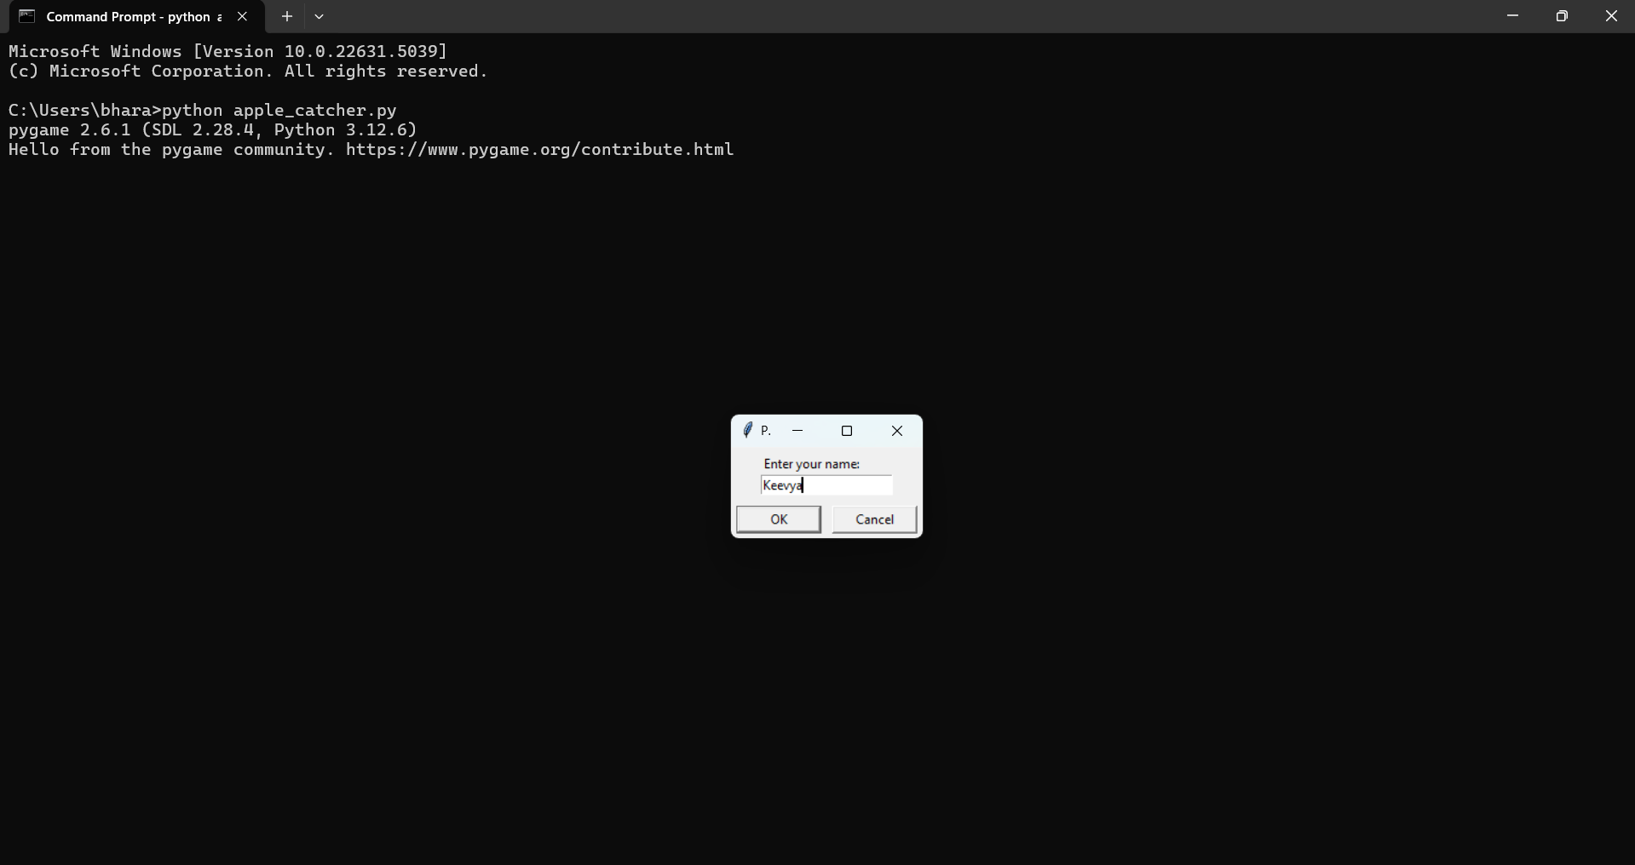
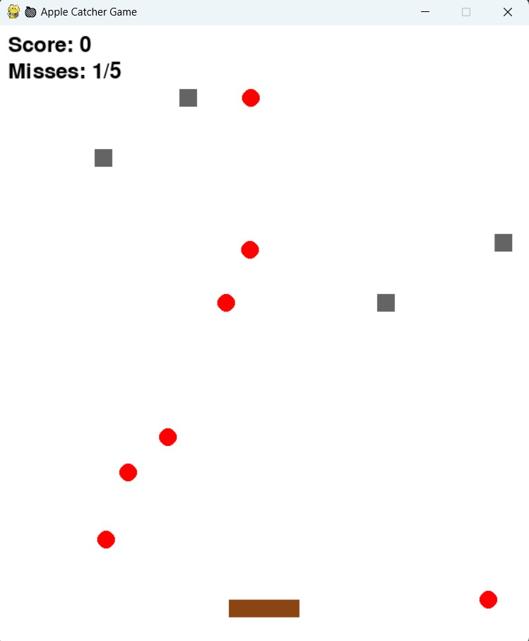

Implementation

Slide 8
Thank you!

