Slide 1
IMAGE CAPTION #1
1주차 리뷰

Slide 2
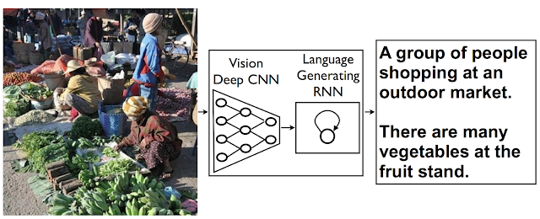
IMAGE CAPTION #1
INTRO
  이미지 캡션 : “자연어”로 “이미지”를 묘사 (im2txt)
CNN : convolution neural network
RNN : recurrent neural network

Slide 3
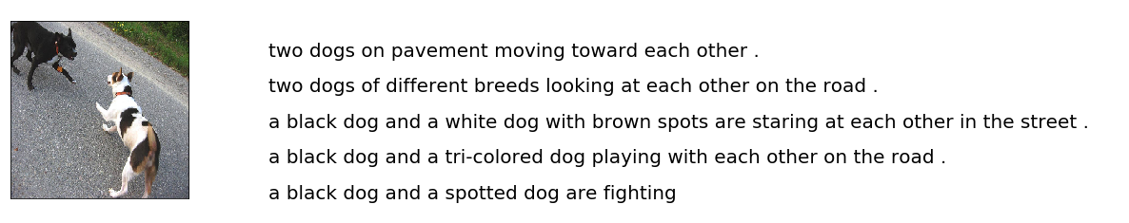
IMAGE CAPTION #1
INTRO
  Datasets
NAME | INFO | NAME | INFO
Flickr8k | 8k with 5 captions 7k for training 1k for validation | MS COCO | 120k with 5 captions 80k for training 40k for validation
* 5 captions meaning

Slide 4
IMAGE CAPTION #1
PROBLEM SOLVING…?
  초보자가 따라할만한 사이트를 찾아보자
  https://fairyonice.github.io/Develop_an_image_captioning_deep_learning_model_using_Flickr_8K_data.html

Slide 5
IMAGE CAPTION #1
2주차
1) colab에서 mount & load
2) text 전처리
3) Image feature extraction by VGG16

Slide 6
IMAGE CAPTION #2
1) Mount & Load

Slide 7
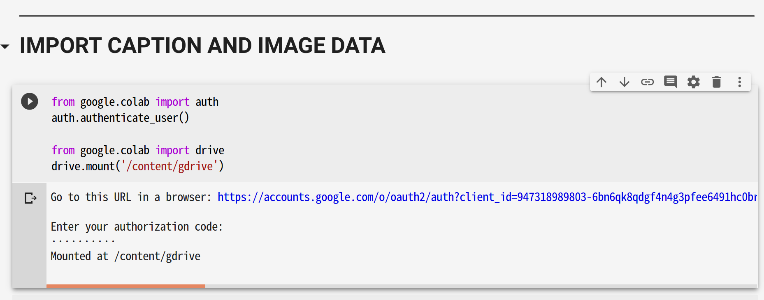
IMAGE CAPTION #2
Mount the google driver with Colab

Slide 8
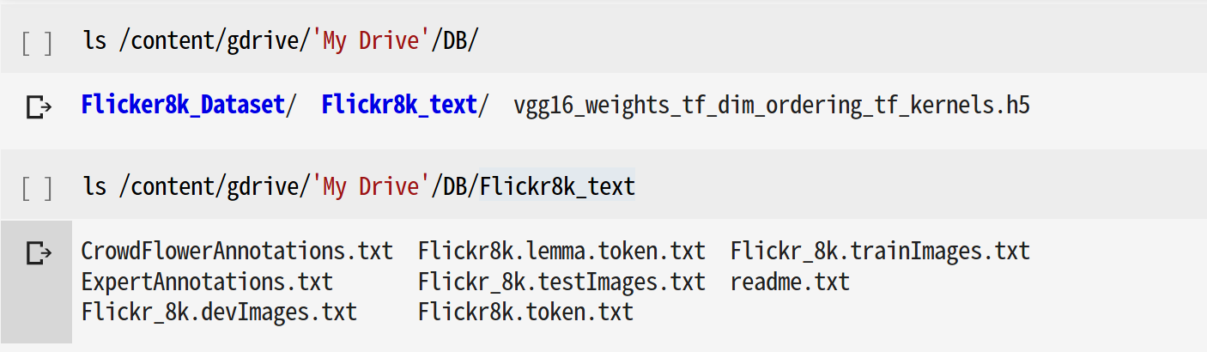
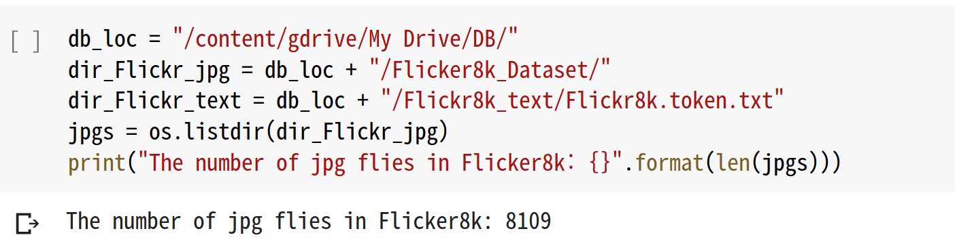
IMAGE CAPTION #2
Mount the google driver with Colab

Slide 9
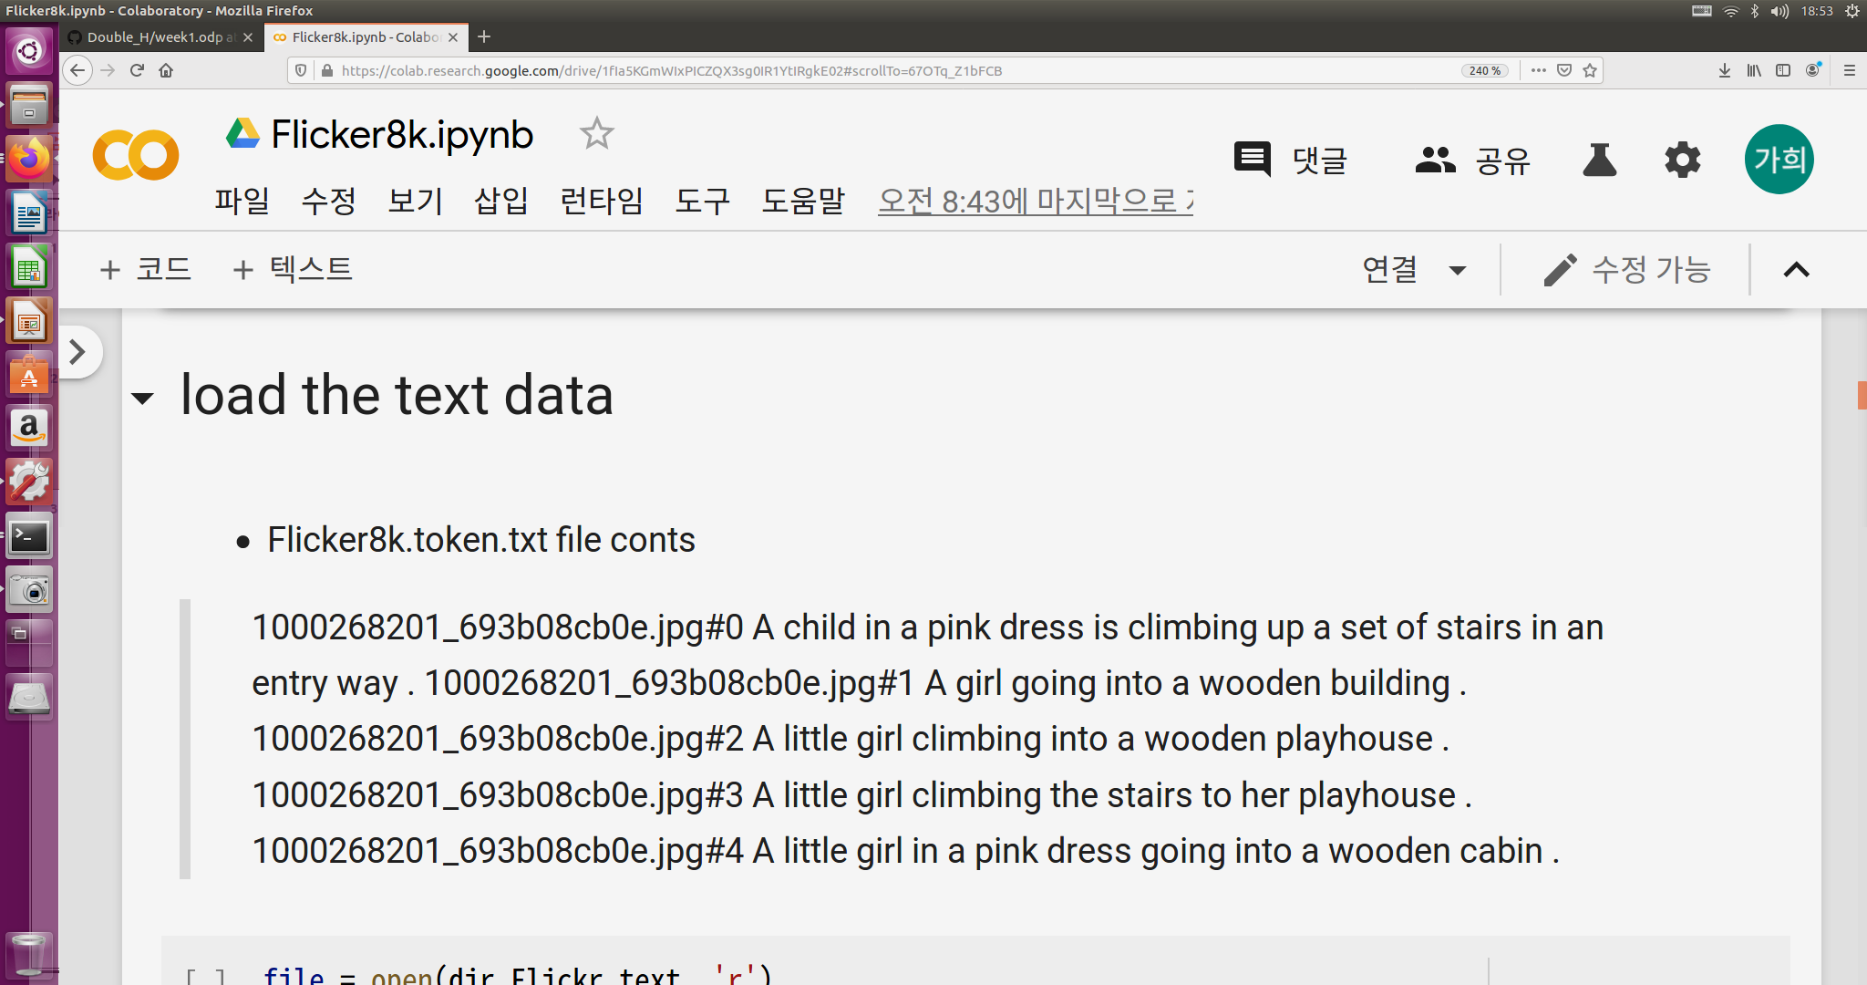
IMAGE CAPTION #2
Load the text data – Fliker8k.token.txt

Slide 10
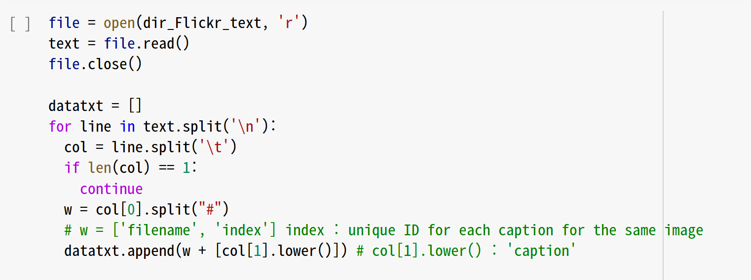
IMAGE CAPTION #2
Load the text data
파일의 내용 전체를 문자열로 돌려준다.
O Fliker8k.token.txt

Slide 11
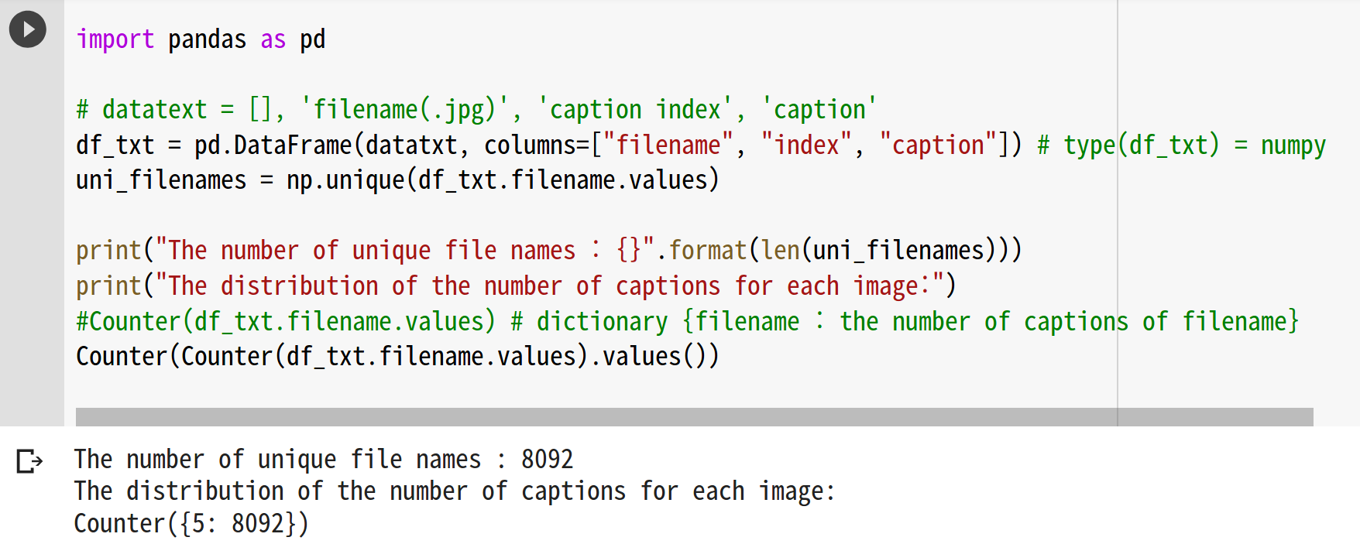
IMAGE CAPTION #2
Load the text data
pd.Dataframe은 테이블 형식의 데이터를 다룰 때 사용한다.
Counter(df_txt.filename.values) : df_txt의 파일이름의 값들을 카운트함
..., '2256320794_0286c31bfa.jpg': 5, '3220200084_3ea129336e.jpg': 5, ...

Slide 12
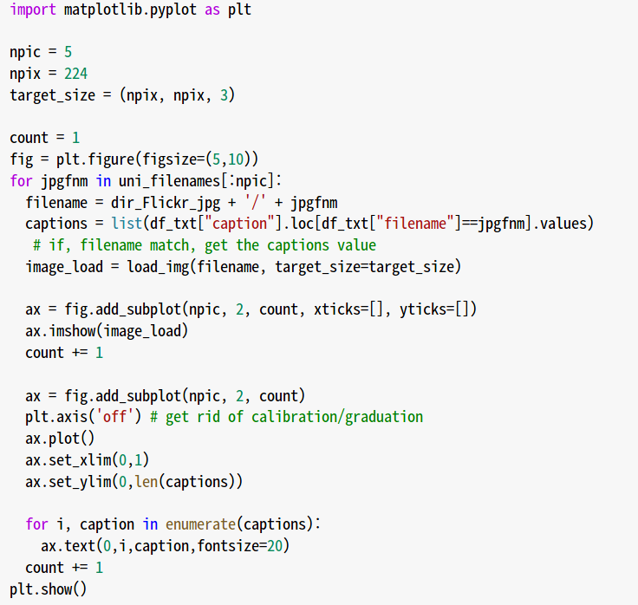
IMAGE CAPTION #2
EXAMPLE OF IMAGE AND CAPTION DATA
컬럼(column)명처럼 명을 기준으로 할 때 많이 쓰임
npic x2 그리드에서 count 번째 subplot

Slide 13
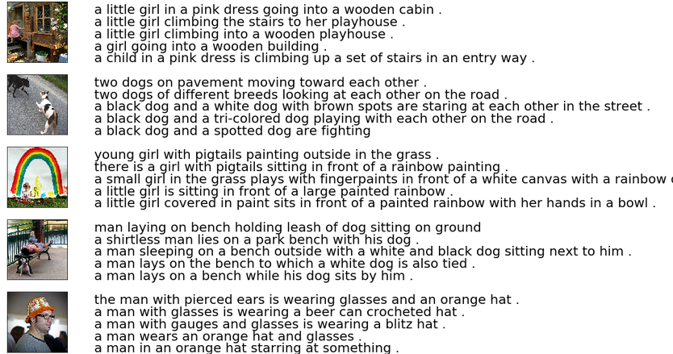
IMAGE CAPTION #2
EXAMPLE OF IMAGE AND CAPTION DATA

Slide 14
IMAGE CAPTION #2
2) Preparation text

Slide 15
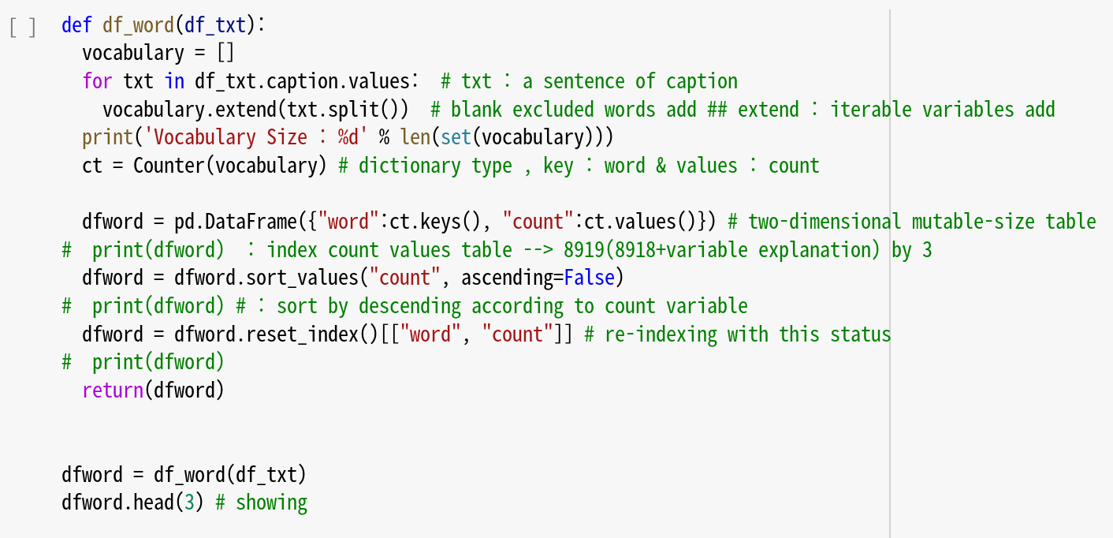
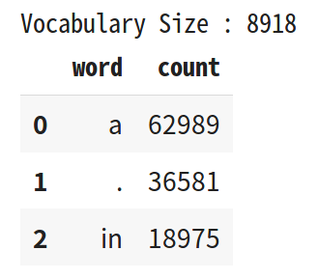
IMAGE CAPTION #2
Word Frequency Check

Slide 16
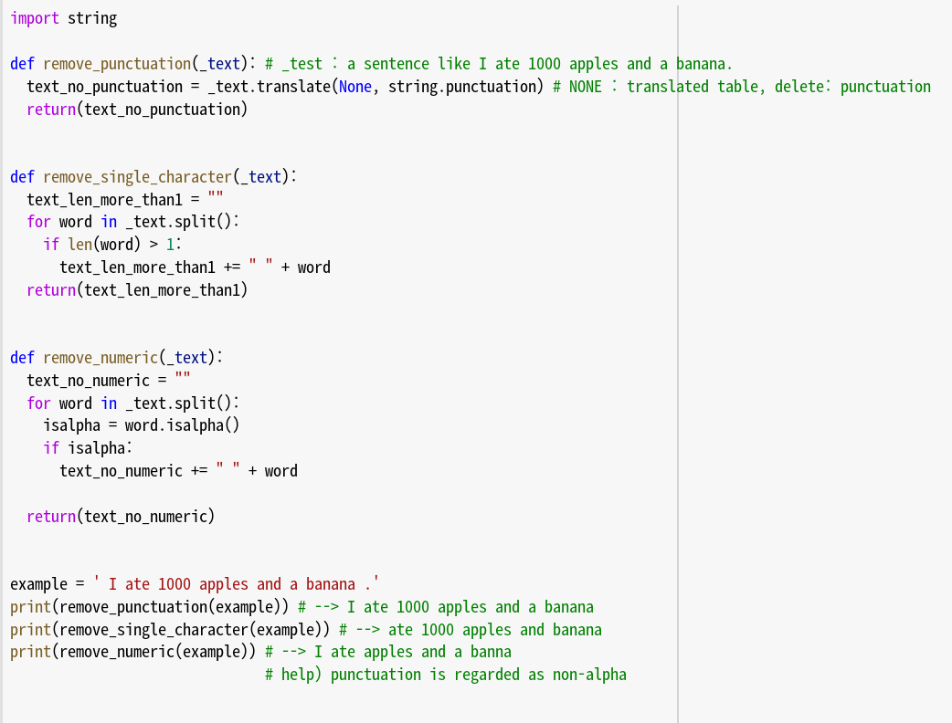
IMAGE CAPTION #2
The Removal of Punctuation, Single, and Numeric characters

Slide 17
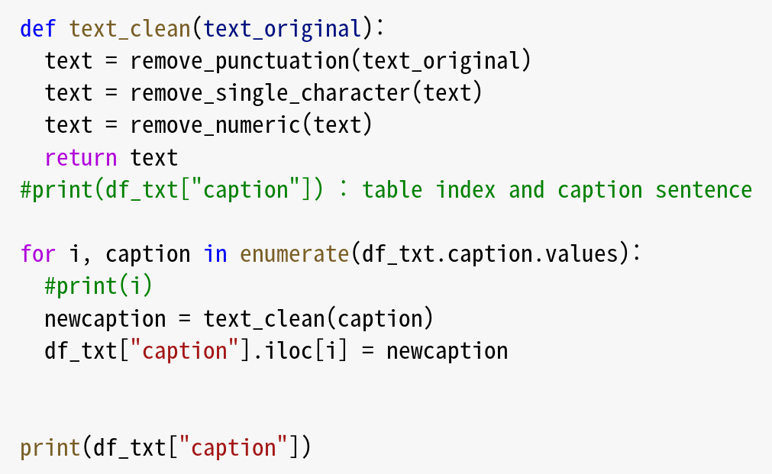
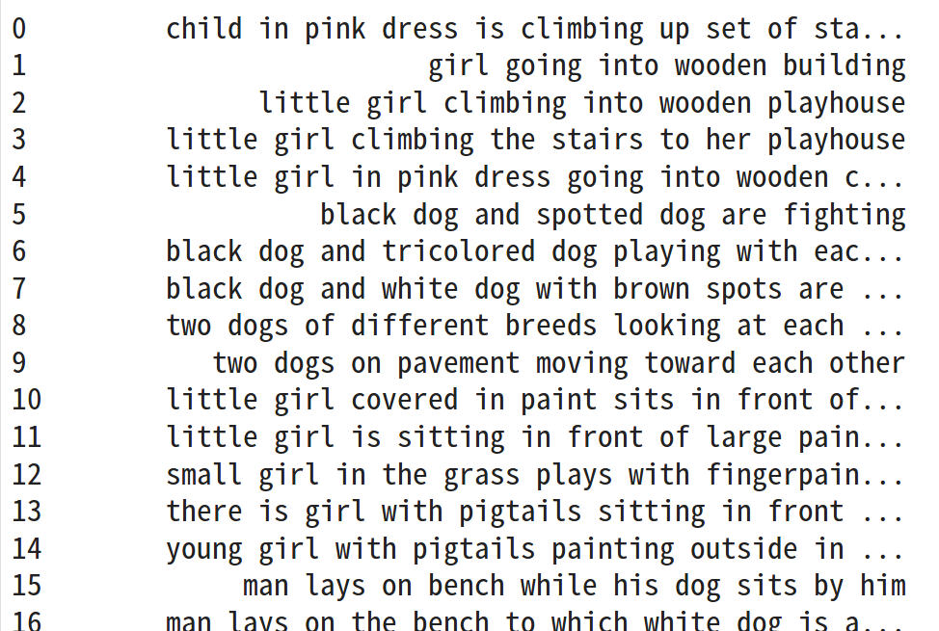
IMAGE CAPTION #2
The Removal of Punctuation, Single, and Numeric characters

Slide 18
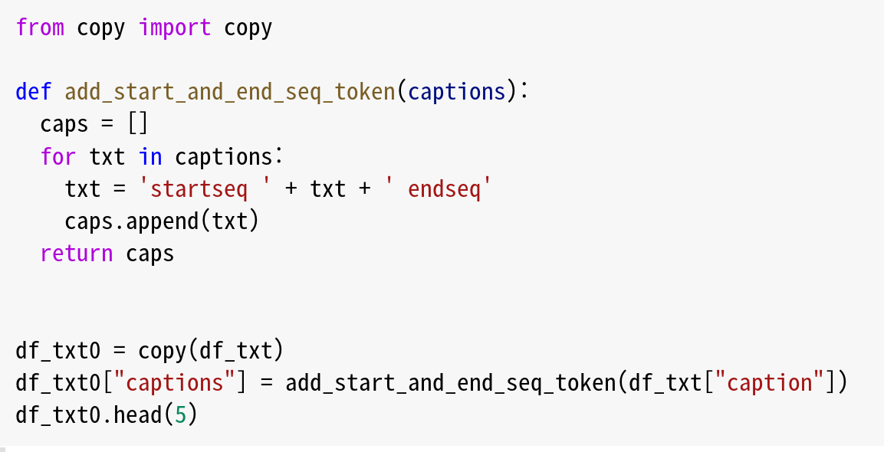
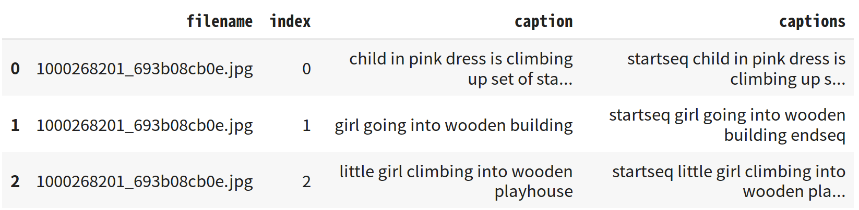
IMAGE CAPTION #2
Add start and end sequence tokens

Slide 19
IMAGE CAPTION #2
3) Preparation Image

Slide 20
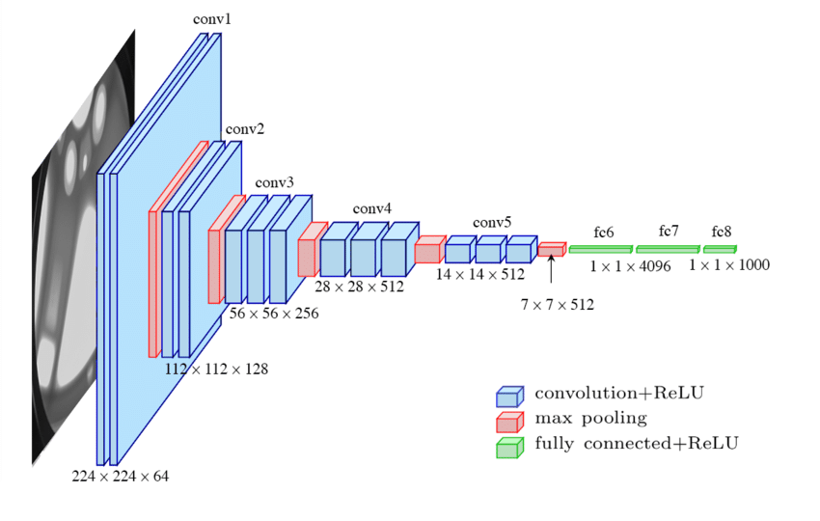
IMAGE CAPTION #2
Create features for each image using VGG16's pre-trained networks

Slide 21
IMAGE CAPTION #2
Create features for each image using VGG16's pre-trained networks
VGG16은 1,000개의 image class를 구분하는 모델
→ 마지막 레이어를 제외 : 특징 추출용 모델로 사용

Slide 22
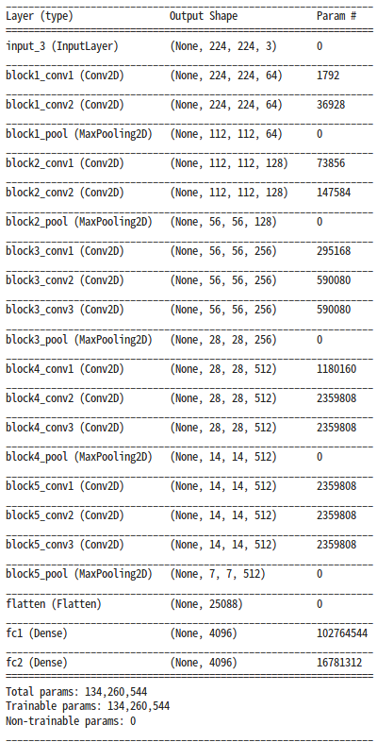
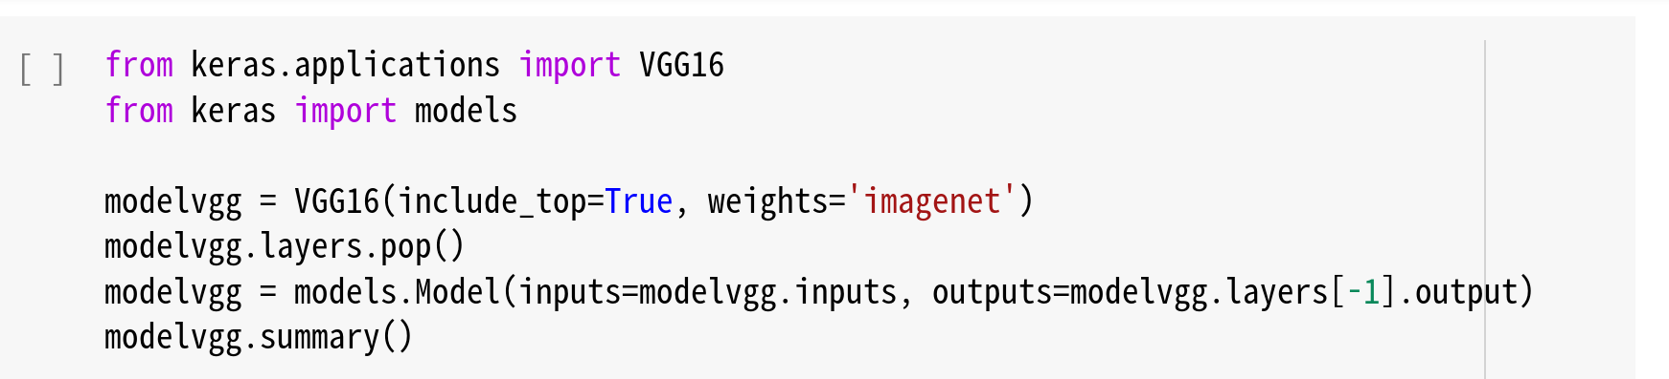
IMAGE CAPTION #2
VGG 16 architecture

Slide 23
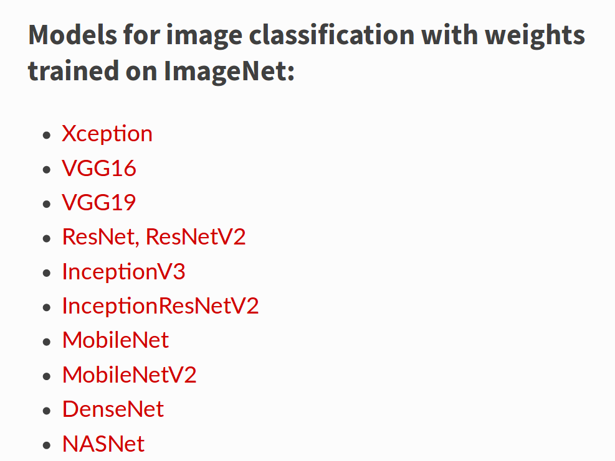
IMAGE CAPTION #2
Available Models in Keras

Slide 24
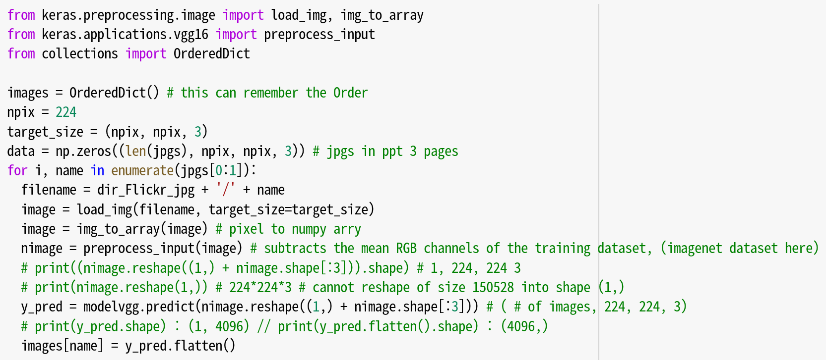
IMAGE CAPTION #2
Create features for each image using VGG16's pre-trained networks

