Slide 1
IMAGE CAPTION #1
CHAPTER 03

Slide 2
IMAGE CAPTION #1
Schedule
#1 : INTRO
#2 : Modeling
#3 : The other Modeling
#4 : Small project – instagram hash tag (?)

Slide 3
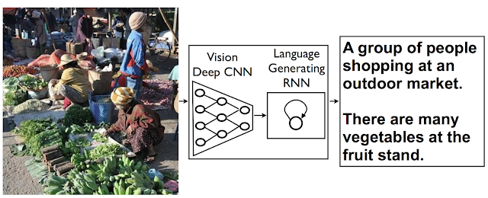
IMAGE CAPTION #1
INTRO
  이미지 캡션 : “자연어”로 “이미지”를 묘사 (im2txt)
CNN : convolution neural network
RNN : recurrent neural network

Slide 4
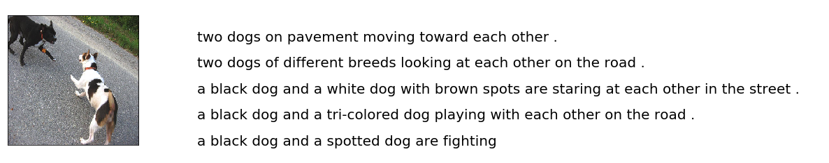
IMAGE CAPTION #1
INTRO
  Datasets
NAME | INFO | NAME | INFO
Flickr8k | 8k with 5 captions 7k for training 1k for validation | MS COCO | 120k with 5 captions 80k for training 40k for validation
* 5 captions meaning

Slide 5
IMAGE CAPTION #1
#1 PROBLEM
1) INSTALL :
keras 일단 버전 안맞음...(책 1버전)
wrapt module error
2) TRAINING :
어떤 deep neural network를 쓸지는 결정이 되었다.
하지만 data를 어떻게 넣는지 모르겠다..... keras에 익숙하지 않아서
3) TEST:
TEST code는 아예 없음..? 이거는 아예 처음부터 짜야함...

Slide 6
IMAGE CAPTION #1
PROBLEM SOLVING…?
  초보자가 따라할만한 사이트를 찾아보자
  https://fairyonice.github.io/Develop_an_image_captioning_deep_learning_model_using_Flickr_8K_data.html

Slide 7
IMAGE CAPTION #1
환경설정 - colab

Slide 8
IMAGE CAPTION #1
출처
  https://vision0814.tistory.com/192
  https://www.groundai.com/project/image-captioning/1
  https://fairyonice.github.io/Develop_an_image_captioning_deep_learning_model_using_Flickr_8K_data.html

