Slide 1
Task 3: Data Analyst Internship
Dashboard Design and Storytelling with Power BI by- Mohd Kaunain

Slide 2
Dataset Overview
- Dataset used: Superstore Sales Data
- Fields: Order Date, Sales, Category, Region, Segment, Quantity
- Source: Kaggle (https://www.kaggle.com/datasets/vivek468/superstore-dataset-final)
- Used for creating KPIs, sales trends, and category insights

Slide 3
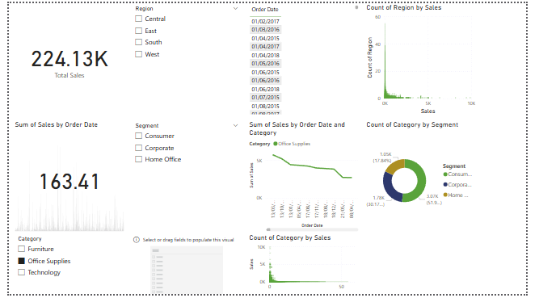
Dashboard Components
- KPI Cards: Total Sales, Quantity Sold, Order Count
- Line Chart: Monthly Sales Trend
- Stacked Bar Chart: Sales by Sub-Category and Region
- Donut Chart: Sales by Segment
- Map: Sales by State
- Slicers: Category, Region, Segment, Order Date

Slide 4
Key Business Insights
- Technology segment generates the highest sales.
- The West region is the top-performing in revenue.
- Office Supplies underperforms in Profit.
- Seasonal spikes in Q4 reflect holiday demand.
- Consistent customer growth in the Consumer segment.

Slide 5
Tools and Techniques Used
- Power BI for data modeling and visualization
- DAX for KPI creation (e.g., total sales, order count)
- Slicers for interactive filtering
- Theme and layout design for storytelling

Slide 6
Submission Info
- GitHub Repository contains:
• Power BI file (.pbix)
• Screenshots or exported PDF of dashboard
• README.md with explanation
- Submission Link: https://forms.gle/S7hRFbGEQJPVeq2T6

