Slide 1



Plant Disease Detection Using Deep Learning
Name- Mohd Kaunain
College- Amity University Noida
AICTE Internship Student Registration ID -STU664074a396f941715500195
AICTE Internship ID - INTERNSHIP_174099535967c57b1f336c3

Slide 2

Learning Objectives
To develop a deep learning model that accurately detects and classifies plant leaf diseases using image data.
Understand the importance of early plant disease detection in agriculture.
Gain proficiency in image preprocessing and augmentation techniques.
Learn how to build and train a CNN using Keras and TensorFlow.
Evaluate the performance of classification models using real-world image data.
Deploy the model for use in agricultural and diagnostic applications.
GOAL
Source :
Dataset link

Slide 3
Tools and Technology used
Python Programming Language
TensorFlow and Keras for deep learning model development
OpenCV for image processing
NumPy and Pandas for data manipulation
Matplotlib for visualization
Google Colab for cloud-based model training and testing

Slide 4
Methodology
Data Acquisition:
Obtained an augmented dataset containing labeled images of healthy and diseased leaves.
Data Preprocessing:
Rescaled images and applied augmentation techniques like rotation and flipping.
Model Development:
Designed a CNN with multiple convolutional and dense layers for classification.
Training and Validation:
Used categorical cross-entropy as loss function and monitored accuracy.
Evaluation:
Assessed model on unseen data using validation split and confusion matrix.

Slide 5
Problem Statement:
Farmers often struggle with timely and accurate identification of plant diseases, which leads to significant crop damage and yield loss. Traditional diagnostic methods are slow, subjective, and dependent on expert availability. An automated solution is necessary to empower field-level decision making.

Slide 6
Solution:
This project presents a solution by leveraging deep learning techniques:
Trained a Convolutional Neural Network on labeled images of plant leaves.
Utilized image augmentation to improve generalization.
Delivered predictions with high confidence across multiple disease categories.
The solution can be scaled for integration into mobile or web apps.
GITHUB LINK - Click Here

Slide 7
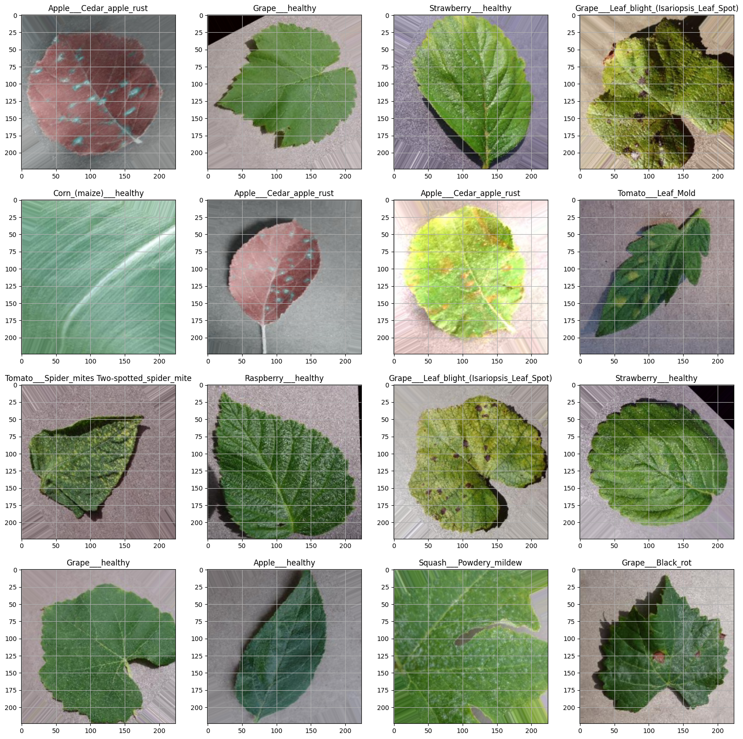
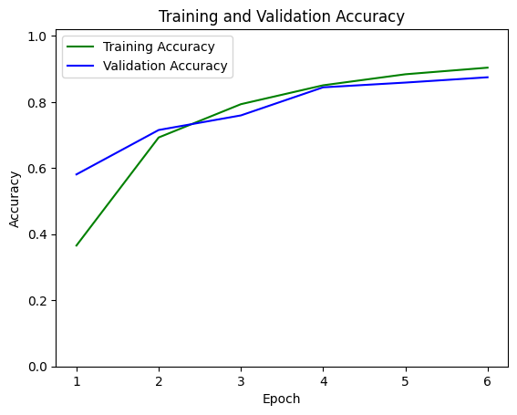

Screenshot of Output:

Slide 8
Conclusion:
This project successfully demonstrates the application of deep learning, specifically Convolutional Neural Networks (CNNs), for the early detection and classification of plant diseases from leaf images. By leveraging tools like TensorFlow, Keras, and OpenCV along with an augmented dataset, the system achieves high accuracy in identifying various plant conditions. This AI-powered diagnostic approach offers a scalable and efficient solution for farmers, helping to minimize crop loss, improve productivity, and promote smarter agricultural practices.

