Slide 1
The global effect of 2008 financial crisis on the number of mental disorder cases
Mini project 1
By Kay Anantanawat
For Data Science class, Institute of Data

Slide 2
Investigate the mental disorder cases between different income countries in 2009
Studies have demonstrated a cyclical link between financial worries and mental health problems such as depression and anxiety.
The global financial crisis in 2008 affected businesses and households.
Low investment, High debts, Job loss
The crisis is expected to affect the number of mental disorder cases globally.
The impact might be different depending on how wealthy the country is.

Slide 3
Does the financial crisis in 2008 affect the number of mental disorder cases in different country differently due to the country’s wealth?

Slide 4
Data
WHO the number mental disorder cases per 100k in 2008 – 2009
Mental disorders: depression, anxiety disorder
Working age group (20 – 60 years old)
World Bank classification of the country’s economic status in the financial year July 2008- June 2009
Income category | Gross income per capita (AUD)
Low income | <= 1,259
Lower middle income | 1,260 – 4,994
Upper middle income | 4,995 – 15,437
High income | >15,437
Global Burden of Disease Collaborative Network.
Global Burden of Disease Study 2019 (GBD 2019) Results.
Seattle, United States: Institute for Health Metrics and Evaluation (IHME), 2020.
Available from https://vizhub.healthdata.org/gbd-results/.
USD to AUD conversion rate in 2009 = 0.79

Slide 5
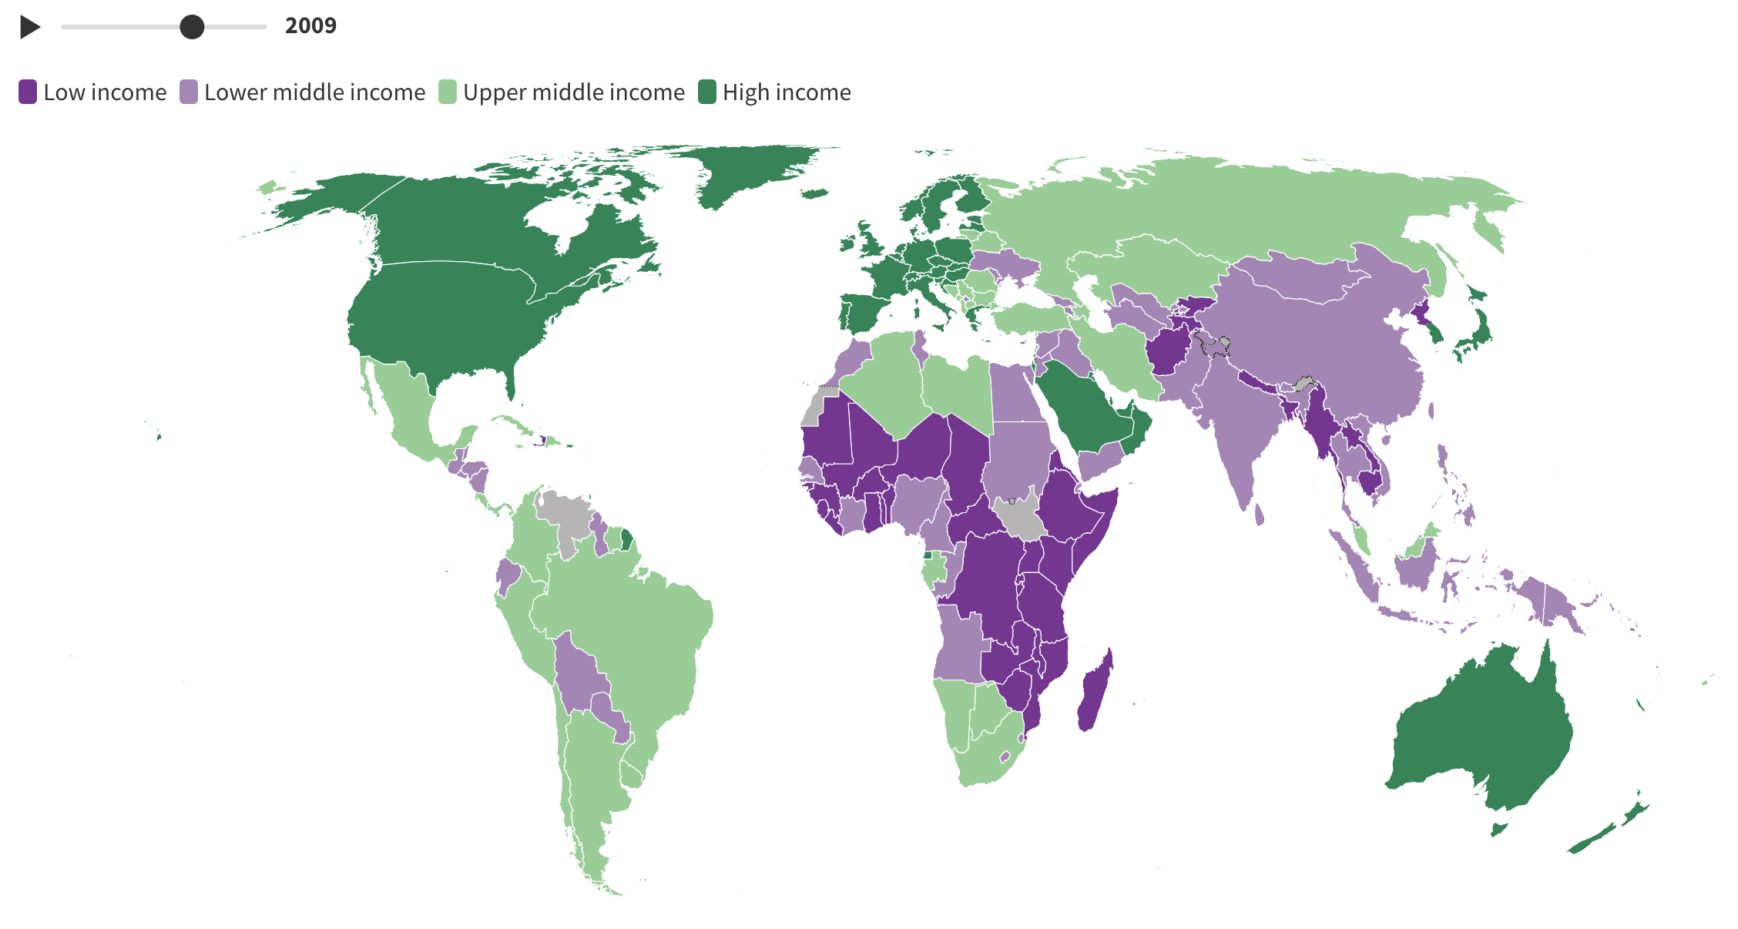
Classification of countries by income in 2009
Income category | Gross income per capita (AUD)
Low income | <= 1,259
Lower middle income | 1,260 – 4,994
Upper middle income | 4,995 – 15,437
High income | >15,437
Notes:
Countries are classified each year on July 1, based on the estimate of their GNI per capita for the previous calendar year. Income groupings remain fixed for the entire World Bank fiscal year (i.e., until July 1 of the following year), even if GNI per capita estimates are revised in the meantime.
It uses gross nation income per capita. US dollars.

Slide 6
Hypothesis testing
H0: There is no difference in the mean number of mental disorder rate among countries in different income groups.
Ha: There are differences in the mean number of mental disorder rate among countries in different income groups.

Slide 7
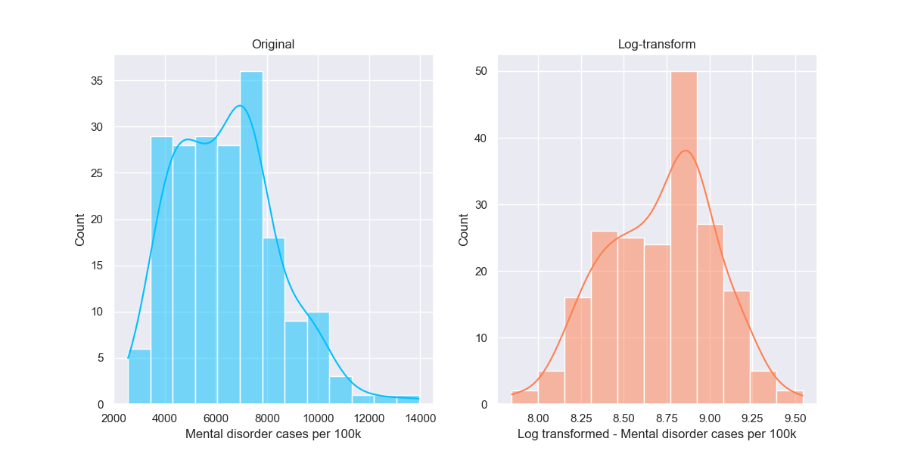
EDA – Mental disorder cases per 100k
N=199
Median = 6,228 cases per 100k

Slide 8
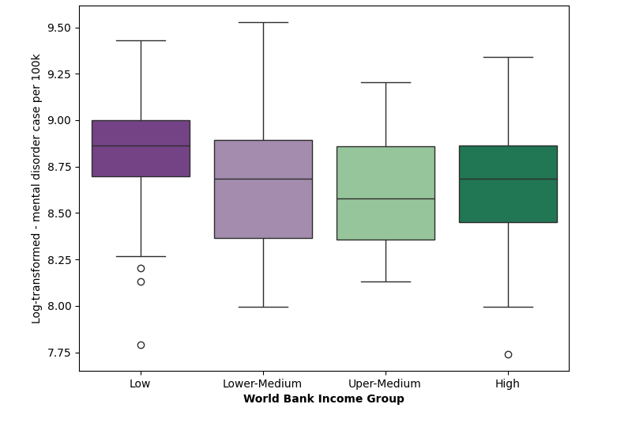
Significant higher number of mental disorder cases in low income countries compare to upper medium income countries.
*
One-way ANOVA : F=2.78, P-value = 0.042; * Posthoc Tukey test - P < 0.05
Notes:
1.2 cases more per 100k.

Slide 9
Does the global financial crisis affect the country with low income more than others?
Yes, but only slightly.
Possible different underlying cause for mental disorder in high income country VS low income country
Cost of living
Government policy

Slide 10
Conclusion and suggestion
Global financial crisis affects every country regardless of the country’s wealth, and slightly more in low income countries.
Further research:
Investigating effects of living costs and government policy on mental disorders cases in countries within the same income group

Slide 11
Thank you Questions?

Slide 13
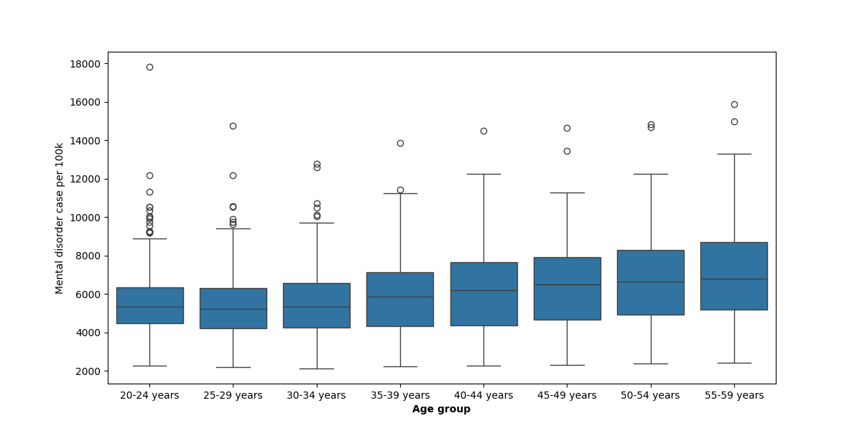
EDA – Mental disorder cases per 100k in different age groups

