Slide 1
Diagnostic markers for hypothyroidism
IOD – Data Science - Mini project 2
Kay Anantanawat

Slide 2
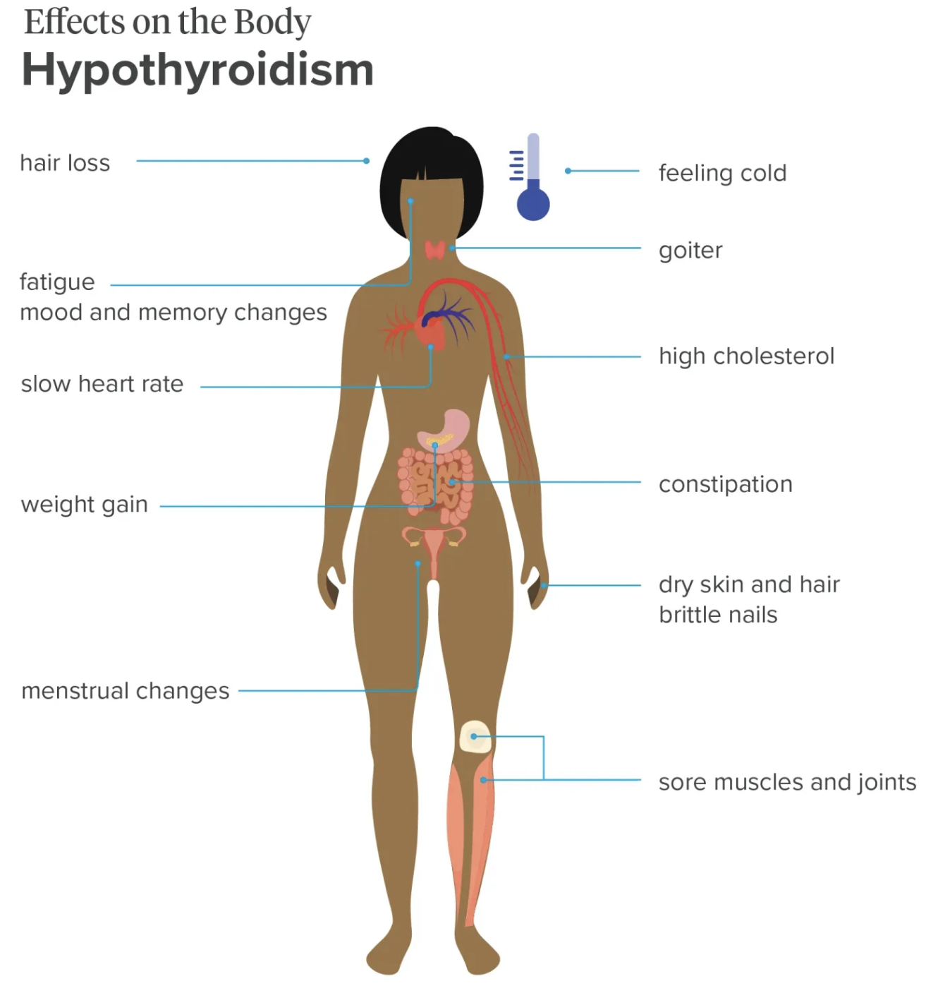
Hypothyroidism
Thyroid gland does not produce enough hormones
Affecting 1 in 33 Australians
Hard to notice the symptoms such as fatigue and weight gain.

Slide 3
Hypothyroidism
Associated with:
Goiter
Lithium treatment
Tumor

Slide 4
Can we predict whether the person has hyperthyroidism based on patient history and the level of hormones?

Slide 5
Data
A dataset collected in 1987 by Garvan Institute, Sydney Australia, published in UC Irvine Machine Learning Repository
26 features, 3163 entries
Continuous data
Age
TSH levels
T3 levels
TT4 level
T4U
FTI
Categorical data - binary
Sex
On thyroxine
On antithyroid medication
Thyroid surgery
Query on thyroxine
Query on hypothyroid
Query on hyperthyroid
Pregnant
Sick
Tumor
Lithium
Goitre
Raw data
Clean data
EDA
Building Model
Test model on unseen data

Slide 6

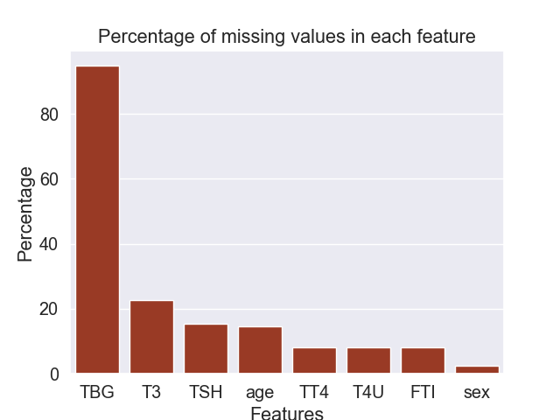

Cleaning data
Remove TBG features
Remove the rows that do not have the hormone level measured
Remove the row with missing value in sex
Convert the categorical data such as medical history to 0 and 1

Slide 7
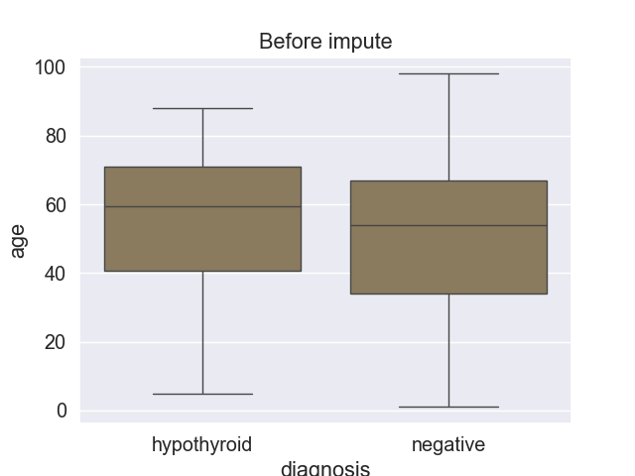
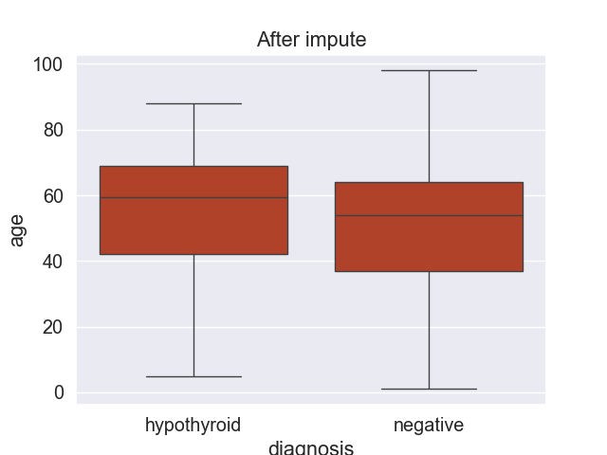
Cleaning data
Impute the age using the median age of each group
After cleaning, there are 2338 records left (74% of the original data).

Slide 8

EDA - summary
Diagnosis:
94% of the data is negative for hypothyroidism
Only 6% has hypothyroidism
Imbalance data
74% of people with hypothyroidism are females.
Medical history whether the patient takes thyroid medications or not is not correlated whether the patient has hypothyroidism.

Slide 9
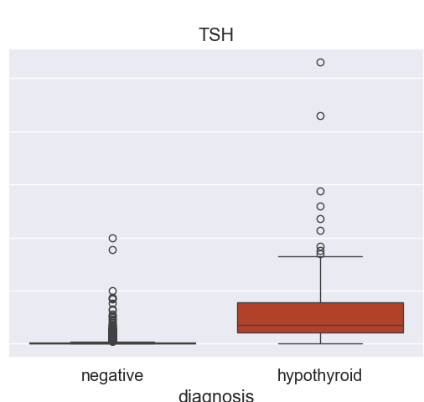
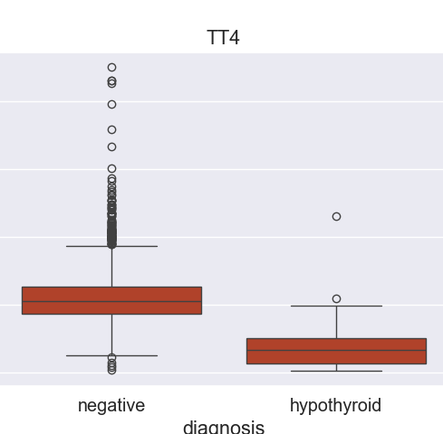
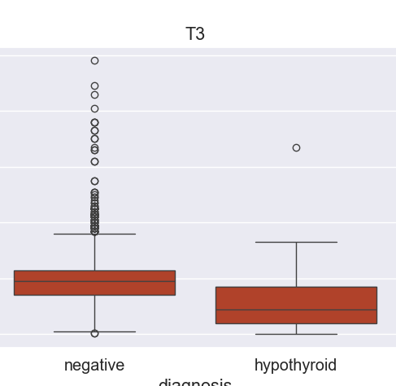

Hormone levels seems to be different between people with and without hypothyroidism.
Diagnosis
Diagnosis
Diagnosis

Slide 10
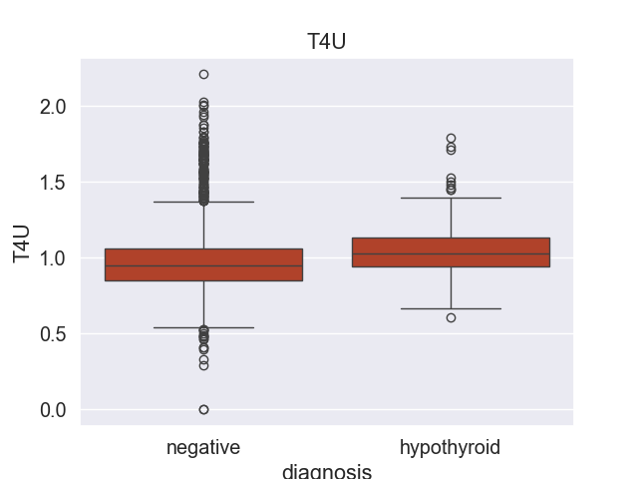
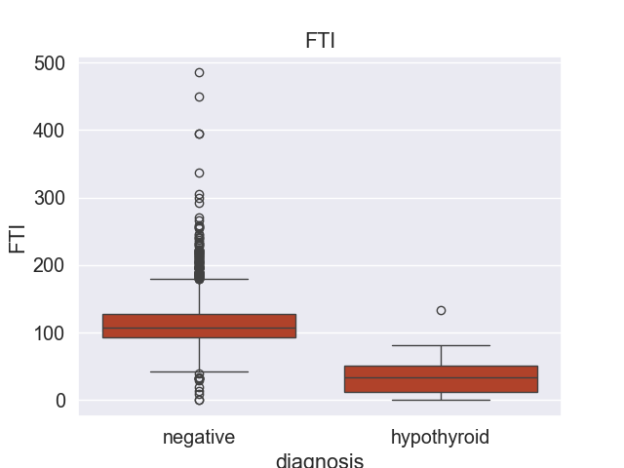
Hormone levels seems to be different between people with and without hypothyroidism.
Diagnosis
Diagnosis

Slide 11
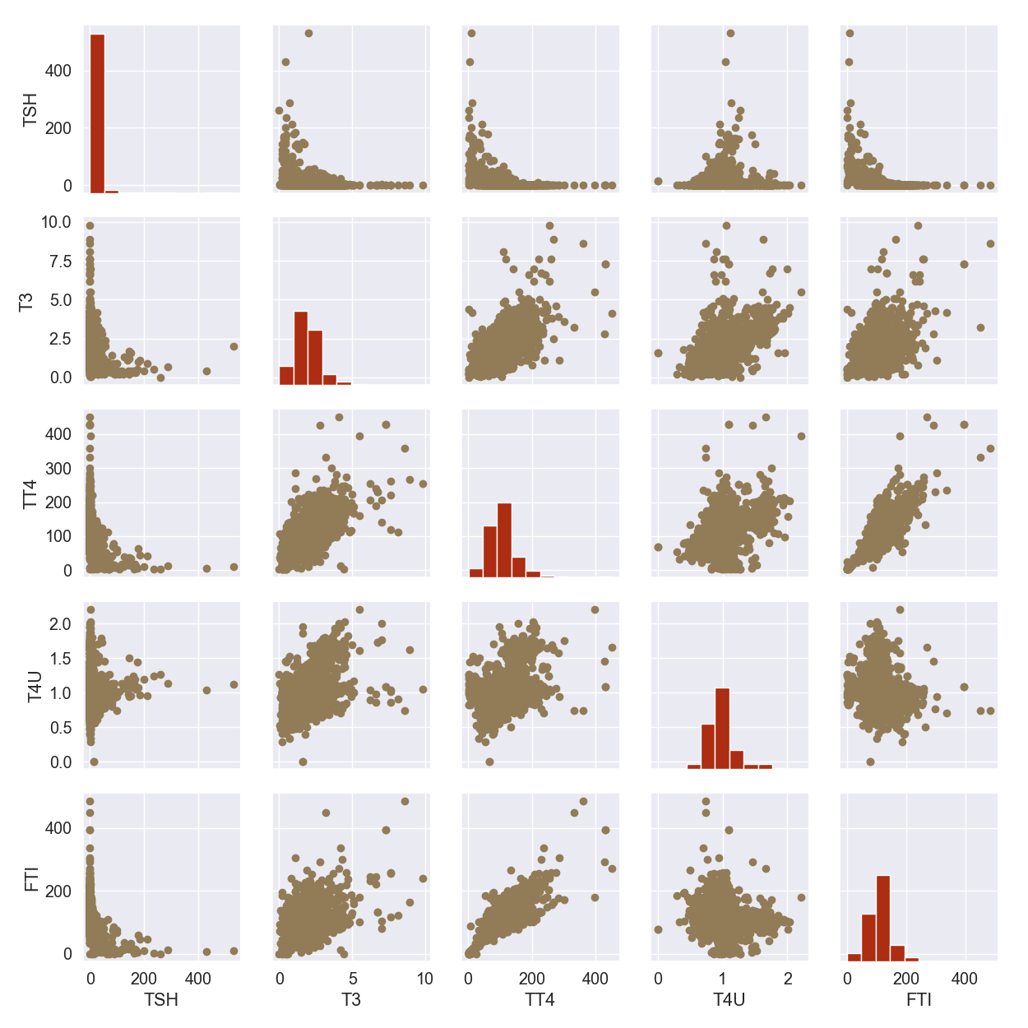
Strong correlation amongst hormones - T3 VS FTI - TT4 Vs FTI - T3 VS TT4 - T3 VS TAU

Slide 12
Model fitting
Features
Continuous
Age
TSH levels
T3 levels
TT4 level
T4U
FTI
Categorical data
(converted to 0 and 1)
Sex
On thyroxine
On antithyroid medication
Thyroid surgery
Query on thyroxine
Query on hypothyroid
Query_on hyperthyroid
Pregnant
Sick
Tumor
Lithium
Goitre
Target: hypothyroidism (1) and negative (0)
Model: Random Forest Classification
Dataset splitted proportionally to the diagnosis group.

Slide 13
Model – Random Forest classifier
 | Training dataset | Testing dataset
Accuracy | 1.000 | 0.9880
Precision | 1.000 | 0.9355
Recall | 1.000 | 0.8529
ROC | 1.000 | 0.9969
The model might be overfit.

Slide 14
Model – Logistic regression (quick check)
 | Training dataset | Testing dataset
Accuracy | 0.9800 | 0.9778
Precision | 0.8837 | 0.9565
Recall | 0.7525 | 0.6471
ROC | 0.9846 | 0.9935
The data is ok.
Logistic regression performs poorer compared to Random Forest.
Random Forest is overfitted and the parameter needs to be adjusted.

Slide 15
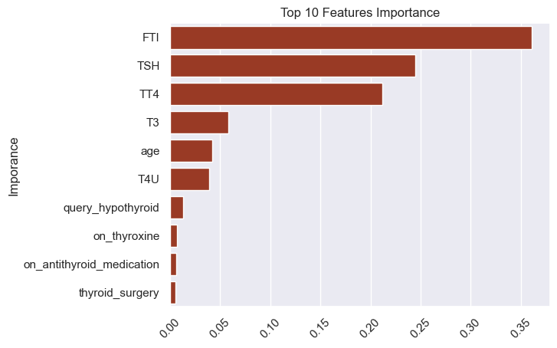
Features Importance
Top 10 Feature Importance
Hormone levels seem to be the main predicters whether the patient has hypothyroidism or not.
Importance

Slide 16
Model – Random Forest classifier - GridSearch
 | Training dataset | Testing dataset
Accuracy | 0.9863 | 1.000
Precision | 0.9333 | 1.000
Recall | 0.8235 | 1.000
ROC | 0.9972 | 1.000
Max features = 3, n_estimators = 1000

Slide 17
Testing with new data
Test the model with the new dataset collected from a different group of patients.
 | Testing
Accuracy | 0.9399
Precision | 0.9167
Recall | 0.2803
ROC | 0.8049
Very poor recall => Many patients with hypothyroidism being diagnose as negative.

Slide 18
Insight from new data
92% of patients that have hypothyroidism but got misclassed to negative.
They have normal hormone levels for FTI, TSH, TT4 and T3 which are the main factors used in this Random Forest model to classify the patients.
This group of patients has compensated hypothyroid, a sub-group of hypothyroidism.

Slide 19
Conclusion & Future work
Two datasets were used to create and test a Random Forest Classification model to predict hypothyroidism.
The model built from the first dataset can predict whether the person has hypothyroidism or not probably based on the hormone level.
The model built from the first dataset performed poorly in the second dataset because the second dataset has a different population.
Future work should include the second dataset in the training dataset to improve accuracy.

Slide 20
Thank you

