Slide 1
Data Mining: Classification and Prediction
Duong Tuan Anh
HCMC University of Technology
July 2011

Slide 2
Outline
1. Classification with decision trees
2. Artificial Neural Networks

Slide 3
1. CLASSIFICATION WITH DECISION TREES
Classification is the process of learning a model that describes different classes of data. The classes are predetermined.
Example: In a banking application, customers who apply for a credit card may be classify as a “good risk”, a “fair risk” or a “poor risk”. Hence, this type of activity is also called supervised learning.
Once the model is built, then it can be used to classify new data.

Slide 4
The first step, of learning the model, is accomplished by using a training set of data that has already been classified. Each record in the training data contains an attribute, called the class label, that indicates which class the record belongs to.
The model that is produced is usually in the form of a decision tree or a set of rules.
Some of the important issues with regard to the model and the algorithm that produces the model include:
  the model’s ability to predict the correct class of the new data,
  the computational cost associated with the algorithm
  the scalability of the algorithm.
Let examine the approach where the model is in the form of a decision tree.
A decision tree is simply a graphical representation of the description of each class or in other words, a representation of the classification rules.

Slide 5
Example 3.1
Example 3.1: Suppose that we have a database of customers on the AllEletronics mailing list. The database describes attributes of the customers, such as their name, age, income, occupation, and credit rating. The customers can be classified as to whether or not they have purchased a computer at AllElectronics.
Suppose that new customers are added to the database and that you would like to notify these customers of an upcoming computer sale. To send out promotional literature to every new customers in the database can be quite costly. A more cost-efficient method would be to target only those new customers who are likely to purchase a new computer. A classification model can be constructed and used for this purpose.
The figure 2 shows a decision tree for the concept buys_computer, indicating whether or not a customer at AllElectronics is likely to purchase a computer.

Slide 6
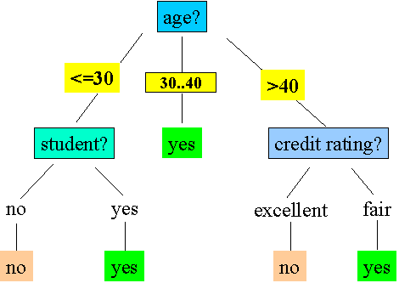
Each internal node represents a test on an attribute. Each leaf node represents a class.
A decision tree for the concept buys_computer, indicating whether or not a customer at AllElectronics is likely to purchase a computer.

Slide 7
Algorithm for decision tree induction
Input: set of training data records: R₁, R₂, …, R_{m} and set of Attributes A₁, A₂, …, A_{n}
Ouput: decision tree
Basic algorithm (a greedy algorithm)
- Tree is constructed in a top-down recursive divide-and-conquer manner
- At start, all the training examples are at the root
- Attributes are categorical (if continuous-valued, they are discretized in advance)
- Examples are partitioned recursively based on selected attributes
- Test attributes are selected on the basis of a heuristic or statistical measure (e.g., information gain)

Slide 8
Conditions for stopping partitioning
- All samples for a given node belong to the same class
- There are no remaining attributes for further partitioning – majority voting is employed for classifying the leaf
- There are no samples left.

Slide 9
Procedure Build_tree(Records, Attributes);
Begin
(1) Create a node N;
(2) If all Records belong to the same class, C then
(3) Return N as a leaf node with the class label C;
(4) If Attributes is empty then
(5) Return N as a leaf node with the class label C, such that the majority of Records belong to it;
(6) select attributes A_{i} (with the highest information gain) from Attributes;
(7) label node N with A_{i};
(8) for each known value a_{j} of A_{i} do
begin
(9) add a branch for node N for the condition A_{i} = a_{j};
(10) S_{j} = subset of Records where A_{i} = a_{j};
(11) If S_{j} is empty then
(12) Add a leaf L with class label C, such that the majority of Records belong to it and return L
else
(13) Add the node return by Build_tree(S_{j}, Attributes – A_{i});
end
end

Slide 10
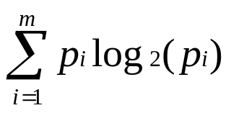
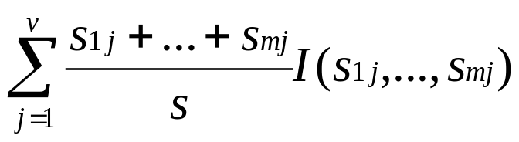
Attribute Selection Measure
The expected information gain needed to classify training data of s samples, where the Class attribute has m values (a₁, …, a_{m}) and s_{i} is the number of samples belong to Class label a_{i} is given by:
I(s₁, s₂,…, s_{m}) = -
where p_{i} is the probability that a random sample belongs to the class with label a_{i}. An estimate of p_{i} is s_{i}/s.
Consider an attribute A with values {a₁, …, a_{v} } used as the test attribute for splitting in the decision tree. Attribute A partitions the samples into the subsets S₁,…, S_{v} where samples in each S_{i} have a value of a_{j} for attribute A. Each S_{i} may contain samples that belong to any of the classes. The number of samples in S_{i} that belong to class i can be denoted as s_{ij}. Entropy of A is given by:
E(A) =

Slide 11
I(s_{1j},…,s_{mj}) can be defined using the formulation for I(s₁,…,s_{m}) with p_{i} being replaced by p_{ij} = s_{ij}/s_{j}. Now the information gain by partitioning on attribute A is defined as:
Gain(A) = I(s₁, s₂,…, s_{m}) – E(A).
Example 3.1: Table 1 presents a training set of data tuples taken from the AllElectronics customer database. The class label attribute, buys_computer, has two distinct values; therefore two distinct classes (m = 2). Let class C1 correspond to yes and class C2 corresponds to no. There are 9 samples of class yes and 5 samples of class no.
To compute the information gain of each attribute, we first use Equation (1) to compute the expected information needed to classify a given sample:
I(s1, s2) = I(9,5) = - (9/14) log₂(9/14) – (5/14)log₂(5/14) = 0.94

Slide 12
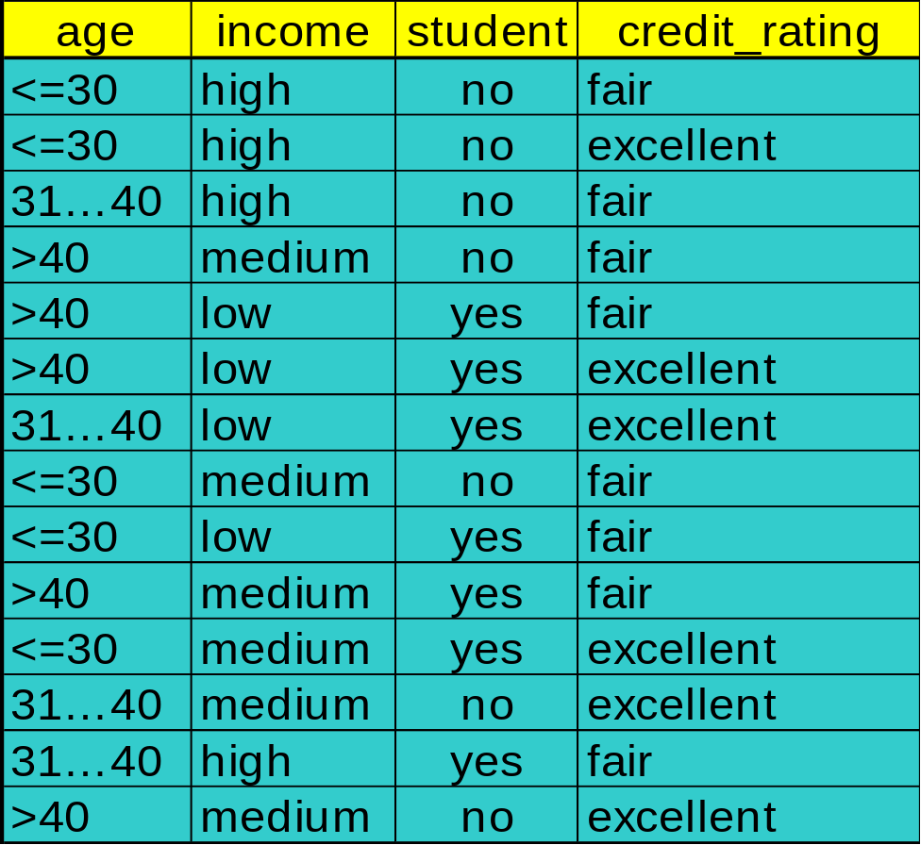
Training data tuples from the AllElectronics customer database
Class
No
No
Yes
Yes
Yes
No
Yes
No
Yes
Yes
Yes
Yes
Yes
No

Slide 13
Next, we need to compute the entropy of each attribute. Let’s start with the attribute age. We need to look at the distribution of yes and no samples for each value of age. We compute the expected information for each of these distributions.
For age =”<= 30”:
s11 = 2 s21 = 3 I(s11, s21) = -(2/5)log₂(2/5) – (3/5)log₂(3/5)= 0.971
For age = “31…40”
s12 = 4 s22 = 0 I(s12, s22) = -(4/4)log₂(4/4) – (0/4)log₂(0/4) = 0
For age = “>40”:
s13 = 3 s23 = 2 I(s13, s23) = -(3/5)log₂(3/5) – (2/5)log₂(2/5)= 0.971
Using Equation (2), the expected information needed to classify a given sample if the samples are partitioned according to age is
E(age) = (5/14)I(s11, s21) + (4/14) I(s12, s22) + (5/14)I(s13, s23) = (10/14)*0.971 = 0.694.

Slide 14
Hence, the gain in information from such a partitioning would be
Gain(age) = I(s₁, s₂) – E(age) = 0.940 – 0.694 = 0.246
Similarly, we can compute Gain(income) = 0.029, Gain(student) = 0.151, and Gain(credit_rating) = 0.048. Since age has the highest information gain among the attributes, it is selected as the test attribute. A node is created and labeled with age, and branches are grown for each of the attribute’s values.
The samples are then partitioned accordingly, as shown in Figure 3.

Slide 15
age?
<= 30
>40
31…40
income student credit_rating class
high no fair no
high no excellent no
medium no fair no
low yes fair yes
medium yes excellent yes
income student credit_rating class
medium no fair yes
low yes fair yes
low yes excellent no
medium yes fair yes
medium no excellent no
income student credit_rating class
high no fair yes
low yes excellent yes
medium no excellent yes
high yes fair yes

Slide 16
Extracting Classification Rules from Trees
Represent the knowledge in the form of IF-THEN rules
One rule is created for each path from the root to a leaf
Each attribute-value pair along a path forms a conjunction
The leaf node holds the class prediction
Rules are easier for humans to understand.
Example
  IF age = “<=30” AND student = “no” THEN buys_computer = “no”
  IF age = “<=30” AND student = “yes” THEN buys_computer = “yes”
  IF age = “31…40” THEN buys_computer = “yes”
  IF age = “>40” AND credit_rating = “excellent” THEN buys_computer = “no”
  IF age = “>40” AND credit_rating = “fair” THEN buys_computer = “yes”

Slide 17
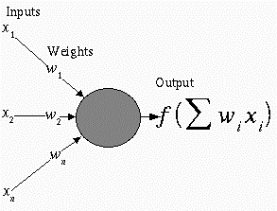
1. NEURAL NETWORK REPRESENTATION
An ANN is composed of processing elements called or perceptrons, organized in different ways to form the network’s structure.
Processing Elements
An ANN consists of perceptrons. Each of the perceptrons receives inputs, processes inputs and delivers a single output.
The input can be raw input data or the output of other perceptrons. The output can be the final result (e.g. 1 means yes, 0 means no) or it can be inputs to other perceptrons.

Slide 18
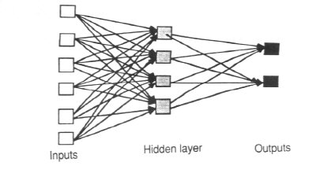
The network
Each ANN is composed of a collection of perceptrons grouped in layers. A typical structure is shown in Fig.2.
Note the three layers: input, intermediate (called the hidden layer) and output.
Several hidden layers can be placed between the input and output layers.
Figure 2

Slide 19
Appropriate Problems for Neural Network
ANN learning is well-suited to problems in which the training data corresponds to noisy, complex sensor data. It is also applicable to problems for which more symbolic representations are used.
The backpropagation (BP) algorithm is the most commonly used ANN learning technique. It is appropriate for problems with the characteristics:
  Input is high-dimensional discrete or real-valued (e.g. raw sensor input)
  Output is discrete or real valued
  Output is a vector of values
  Possibly noisy data
  Long training times accepted
  Fast evaluation of the learned function required.
  Not important for humans to understand the weights
Examples:
  Speech phoneme recognition
  Image classification
  Financial prediction

Slide 20
3. PERCEPTRONS
A perceptron takes a vector of real-valued inputs, calculates a linear combination of these inputs, then outputs
  a 1 if the result is greater than some threshold
  –1 otherwise.
Given real-valued inputs x₁ through x_{n}, the output o(x₁, …, x_{n}) computed by the perceptron is
o(x₁, …, x_{n}) = 1 if w₀ + w₁x₁ + … + w_{n}x_{n} > 0
-1 otherwise
where w_{i} is a real-valued constant, or weight.
Notice the quantify (-w₀) is a threshold that the weighted combination of inputs w₁x₁ + … + w_{n}x_{n} must surpass in order for perceptron to output a 1.

Slide 21
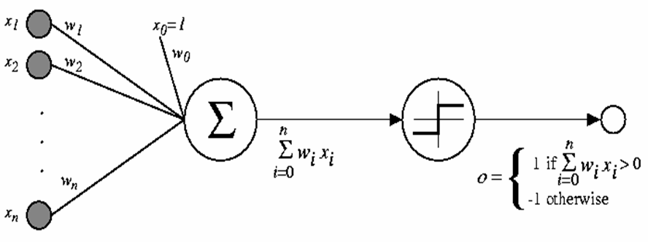
Figure 3. A perceptron

Slide 22
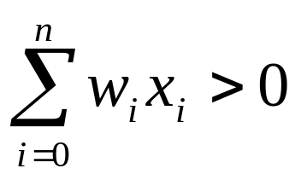
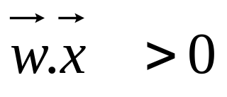
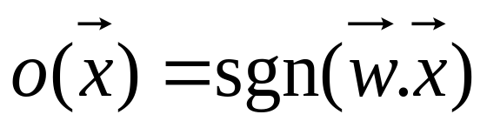
To simplify notation, we imagine an additional constant input x₀ = 1, allowing us to write the above inequality as
or in vector form as
For brevity, we will sometimes write the perceptron function as
Learning a perceptron involves choosing values for the weights w₀, w₁,…, w_{n}.

Slide 23

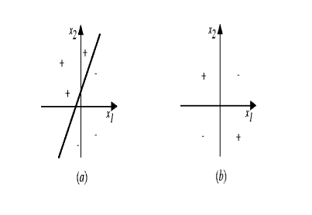
Representation Power of Perceptrons
We can view the perceptron as representing a hyperplane decision surface in the n-dimensional space of instances (i.e. points). The perceptron outputs a 1 for instances lying on one side of the hyperplane and outputs a –1 for instances lying on the other side, as in Figure 4. The equation for this decision hyperplane is
Some sets of positive and negative examples cannot be separated by any hyperplane. Those that can be separated are called linearly separated set of examples.
Figure 4. Decision surface

Slide 24
Perceptron training rule
Although we are interested in learning networks of many interconnected units, let us begin by understanding how to learn the weights for a single perceptron.
Here learning is to determine a weight vector that causes the perceptron to produce the correct +1 or –1 for each of the given training examples.
Several algorithms are known to solve this learning problem. Here we consider two: the perceptron training rule and the delta rule.

Slide 25
One way to learn an acceptable weight vector is to begin with random weights, then iteratively apply the perceptron to each training example, modifying the perceptron weights whenever it misclassifies an example. This process is repeated, iterating through the training examples as many as times needed until the perceptron classifies all training examples correctly.
Weights are modified at each step according to the perceptron training rule, which revises the weight w_{i} associated with input x_{i} according to the rule.
w_{i} ← w_{i} + Δw_{i}
where Δw_{i} = η(t – o) x_{i}
Here:
t is target output value for the current training example
o is perceptron output
η is small constant (e.g., 0.1) called learning rate

Slide 26
Perceptron training rule (cont.)
The role of the learning rate is to moderate the degree to which weights are changed at each step. It is usually set to some small value (e.g. 0.1) and is sometimes made to decrease as the number of weight-tuning iterations increases.
We can prove that the algorithm will converge
  If training data is linearly separable
  and η sufficiently small.
If the data is not linearly separable, convergence is not assured.

Slide 27
Gradient Descent and the Delta Rule
Although the perceptron training rule finds a successful weight vector when the training examples are linearly separable, it can fail to converge if the examples are not linearly separatable. A second training rule, called the delta rule, is designed to overcome this difficulty.
The key idea of delta rule: to use gradient descent to search the space of possible weight vectors to find the weights that best fit the training examples. This rule is important because it provides the basis for the backpropagration algorithm, which can learn networks with many interconnected units.
The delta training rule: considering the task of training an un-thresholded perceptron, that is a linear unit, for which the output o is given by:
o = w₀ + w₁x₁ + ··· + w_{n}x_{n} (1)
Thus, a linear unit corresponds to the first stage of a perceptron, without the threhold.

Slide 28
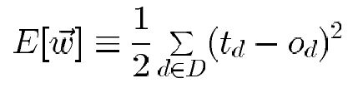
In order to derive a weight learning rule for linear units, let specify a measure for the training error of a weight vector, relative to the training examples. The Training Error can be computed as the following squared error
(2)
where D is set of training examples, t_{d} is the target output for the training example d and o_{d} is the output of the linear unit for the training example d.
Here we characterize E as a function of weight vector because the linear unit output O depends on this weight vector.

Slide 29
Hypothesis Space
To understand the gradient descent algorithm, it is helpful to visualize the entire space of possible weight vectors and their associated E values, as illustrated in Figure 5.
  Here the axes w_{o},w₁ represents possible values for the two weights of a simple linear unit. The w_{o},w₁ plane represents the entire hypothesis space.
  The vertical axis indicates the error E relative to some fixed set of training examples. The error surface shown in the figure summarizes the desirability of every weight vector in the hypothesis space.
For linear units, this error surface must be parabolic with a single global minimum. And we desire a weight vector with this minimum.

Slide 30
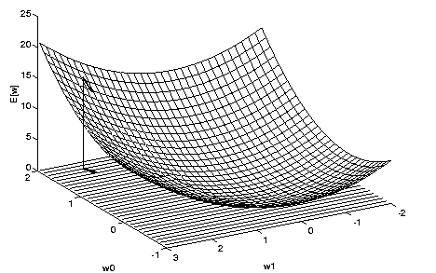
Figure 5. The error surface
How can we calculate the direction of steepest descent along the error surface? This direction can be found by computing the derivative of E w.r.t. each component of the vector w.

Slide 31
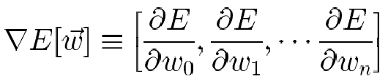
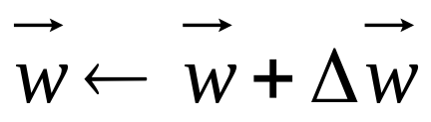

Derivation of the Gradient Descent Rule
This vector derivative is called the gradient of E with respect to the vector <w₀,…,w_{n}>, written ∇E .
(3)
Notice ∇E is itself a vector, whose components are the partial derivatives of E with respect to each of the w_{i}. When interpreted as a vector in weight space, the gradient specifies the direction that produces the steepest increase in E. The negative of this vector therefore gives the direction of steepest decrease.
Since the gradient specifies the direction of steepest increase of E, the training rule for gradient descent is
(4)

Slide 32
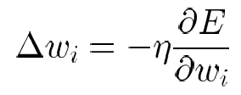
Here η is a positive constant called the learning rate, which determines the step size in the gradient descent search. The negative sign is present because we want to move the weight vector in the direction that decreases E. This training rule can also be written in its component form
w_{i} ←w_{i} + Δw_{i}
where
(5)
which makes it clear that steepest descent is achieved by altering each component w_{i} of weight vector in proportion to ∂E/∂w_{i}.
The vector of ∂E/∂w_{i} derivatives that form the gradient can be obtained by differentiating E from Equation (2), as

Slide 33
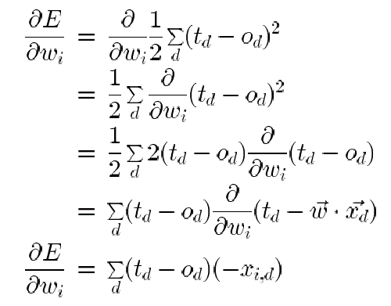
(6)
where x_{id} denotes the single input component x_{i} for the training example d.
We now have an equation that gives ∂E/∂w_{i} in terms of the linear unit inputs x_{id}, output o_{d} and the target value t_{d} associated with the training example. Substituting Equation (6) into Equation (5) yields the weight update rule for gradient descent.

Slide 34

(7)
The gradient descent algorithm for training linear units is as follows: Pick an initial random weight vector. Apply the linear unit to all training examples, then compute Δw_{i} for each weight according to Equation (7). Update each weight w_{i} by adding Δw_{i} , them repeat the process. The algorithm is given in Figure 6.
Because the error surface contains only a single global minimum, this algorithm will converge to a weight vector with minimum error, regardless of whether the training examples are linearly separable, given a sufficiently small η is used.
If η is too large, the gradient descent search runs the risk of overstepping the minimum in the error surface rather than settling into it. For this reason, one common modification to the algorithm is to gradually reduce the value of η as the number of gradient descent steps grows.

Slide 35
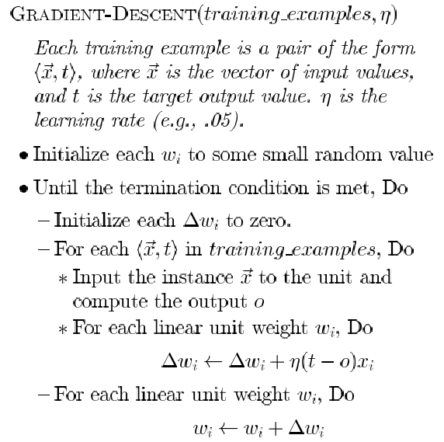
Figure 6. Gradient Descent algorithm for training a linear unit.
(8)
(9)

Slide 36
Stochastic Approximation to Gradient Descent
The key difficulties in applying gradient descent are:
  Converging to a local minimum can sometimes be quite slow (i.e., it can require many thousands of steps).
  If there are multiple local minima in the error surface, then there is no guarantee that the procedure will find the global minimum.
One common variation on gradient descent intended to alleviate these difficulties is called incremental gradient descent (or stochastic gradient descent). The key differences between standard gradient descent and stochastic gradient descent are:
  In standard gradient descent, the error is summed over all examples before upgrading weights, whereas in stochastic gradient descent weights are updated upon examining each training example.
  The modified training rule is like the training rule given by Equation (7) except that as we iterate through each example we update the weight according to
Δw_{i} = η(t – o) x_{i} (10)
  where t, o and x_{i} are the target value, unit output, and the ith input.

Slide 37
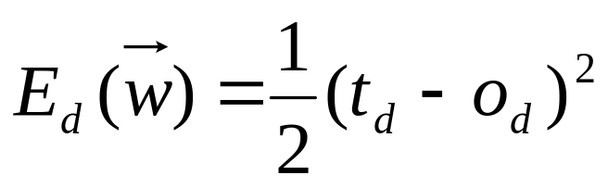
To modify the gradient descent algorithm in Figure 6 to implement this stochastic approximation, Equation w_{i} ←w_{i} + Δw_{i} is simply deleted and Equation Δw_{i} ← Δw_{i} + η(t - o)x_{i} is replaced by
w_{i} ←w_{i} + η(t - o)x_{i}.
One way to view this stochastic gradient descent is to consider a distinct error function defined for each individual training example d as follows
where t_{d} and o_{d} are the target value and the unit output value for training example d.
We come to the stochastic gradient descent algorithm (Figure. 7)

Slide 38
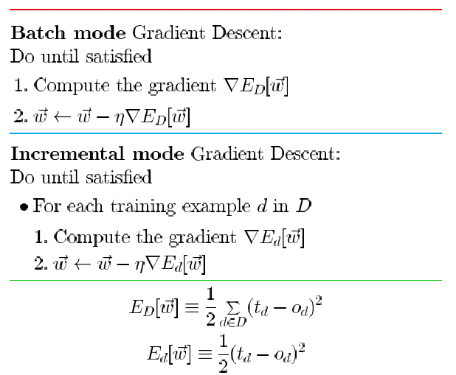
Summing over multiple examples in standard gradient descent requires more computation per weight update step. On the other hand, because it uses the true gradient, standard gradient descent is often used with a larger step size per weight update than stochastic gradient descent.
Figure 7. Stochastic gradient descent algorithm
(11)

Slide 39
Stochastic gradient descent (i.e. incremental mode) can sometimes avoid falling into local minima because it uses the various gradient of E rather than overall gradient of E to guide its search.
Both stochastic and standard gradient descent methods are commonly used in practice.
Summary
Perceptron training rule
  Perfectly classifies training data
  Converge, provided the training examples are linearly separable
Delta Rule using gradient descent
  Converge asymptotically to minimum error hypothesis
  Converge regardless of whether training data are linearly separable

Slide 40
3. MULTILAYER NETWORKS AND THE BACKPROPOGATION ALGORITHM
Single perceptrons can only express linear decision surfaces. In contrast, the kind of multilayer networks learned by the backpropagation algorithm are capaple of expressing a rich variety of nonlinear decision surfaces.
This section discusses how to learn such multilayer networks using a gradient descent algorithm similar to that discussed in the previous section.
A Differentiable Threshold Unit
What type of unit as the basis for multilayer networks ?
  • Perceptron : not differentiable -> can’t use gradient descent
  • Linear Unit : multi-layers of linear units -> still produce only linear function
  • Sigmoid Unit : smoothed, differentiable threshold function

Slide 41
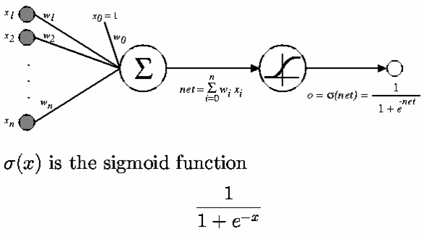
Figure 7. The sigmoid threshold unit.
(12)

Slide 42

Like the perceptron, the sigmoid unit first computes a linear combination of its inputs, then applies a threshold to the result. In the case of sigmoid unit, however, the threshold output is a continuous function of its input.
The sigmoid function σ(x) is also called the logistic function.
Interesting property:
• Output ranges between 0 and 1, increasing monotonically with its input.
We can derive gradient decent rules to train
• One sigmoid unit
• Multilayer networks of sigmoid units ⇒ Backpropagation

Slide 43
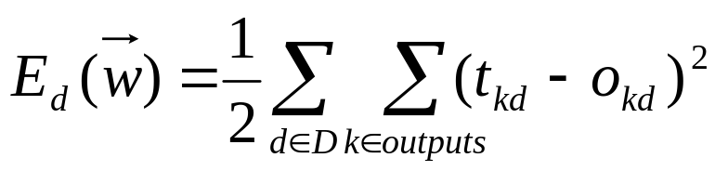
The Backpropagation (BP)Algorithm
The BP algorithm learns the weights for a multilayer network, given a network with a fixed set of units and interconnections. It employs a gradient descent to attempt to minimize the squared error between the network output values and the target values for these outputs.
Because we are considering networks with multiple output units rather than single units as before, we begin by redefining E to sum the errors over all of the network output units
(13)
where outputs is the set of output units in the network, and t_{kd} and o_{kd} are the target and output values associated with the k-th output unit and training example d.

Slide 44
The Backpropagation Algorithm (cont.)
The BP algorithm is presented in Figure 8. The algorithm applies to layered feed-forward networks containing 2 layers of sigmoid units, with units at each layer connected to all units from the preceding layer.
This is an incremental gradient descent version of Backpropagation.
The notation is as follows:
  x_{ji} denotes the input from node i to unit j, and w_{ji} denotes the corresponding weight.
  δ_{n} denotes the error term associated with unit n. It plays a role analogous to the quantity (t – o) in our earlier discussion of the delta training rule.

Slide 45
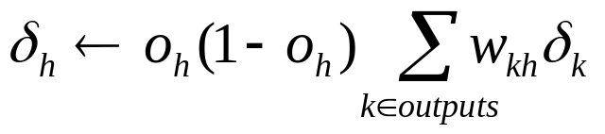
The Backpropagation algorithm (Fig. 8)
Initialize all weights to small random numbers
Until satisfied, do
for each training example, do
1. Input the training example to the network and compute the network outputs
2. For each output k
δ_{k} ← o_{k}(1 - o_{k})(t_{k} – o_{k}) (14)
3. For each hidden unit h
(15)
4. Update each network weight w_{ji}
w_{ji} ← w_{ji} + Δw_{ji}
where
Δw_{ji} = η δ_{j}x_{ji} (16)

Slide 46
In the BP algorithm, step1 propagates the input forward through the network. And the steps 2, 3 and 4 propagates the errors backward through the network.
The main loop of BP repeatedly iterates over the training examples. For each training example, it applies the ANN to the example, calculates the error of the network output for this example, computes the gradient w. r. t. the error on the example, then updates all weights in the network. This gradient descent step is iterated until ANN performs acceptably well.
A variety of termination conditions can be used to halt the procedure.
  One may choose to halt after a fixed number of iterations through the loop, or
  once the error on the training examples falls below some threshold, or
  once the error on a separate validation set of examples meets some criteria.

Slide 47
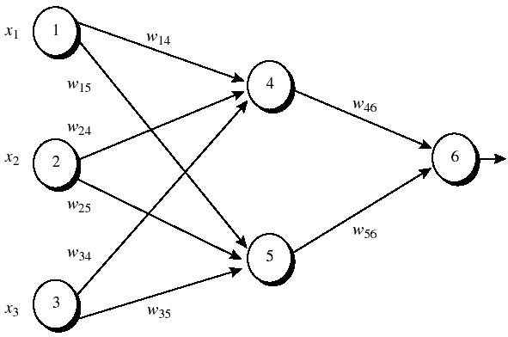
An Example of Back-propagation algorithm
Figure 1: An example of a multilayer feed-forward neural network. Assume that the learning rate η is 0.9 and the first training example, X = (1,0,1) whose class label is 1.
Note: The sigmoid function is applied to hidden layer and output layer.

Slide 48
Table 1: Initial input and weight values
x₁ x₂ x₃ w₁₄ w₁₅ w₂₄ w₂₅ w₃₄ w₃₅ w₄₆ w₅₆ w₀₄ w₀₅ w₀₆
-----------------------------------------------------------------------------------
1 0 1 0.2 -0.3 0.4 0.1 -0.5 0.2 -0.3 -0.2 -0.4 0.2 0.1
Table 2: The net input and output calculation
Unit j Net input I_{j} Output O_{j}
-----------------------------------------------------------------------------------
4 0.2 + 0 -0.5 -0.4 = -0.7 1/(1+e^{0.7})=0.332
5 -0.3 +0+0.2 +0.2 =0.1 1/(1+e^{0.1})=0.525
6 (-0.3)(0.332)-(0.2)(0.525)+0.1 = -0.105 1/(1+e^{0.105})=0.474
Table 3: Calculation of the error at each node
Unit j δ_{j}
-----------------------------------------------------------------------------
6 (0.474)(1-0.474)(1-0.474)=0.1311
5 (0.525)(1-0.525)(0.1311)(-0.2)=-0.0065
4 (0.332)(1-0.332)(0.1311)(-0.3)=-0.0087

Slide 49
Table 4: Calculation for weight updating
Weight New value
------------------------------------------------------------------------------
w₄₆ -03+(0.9)(0.1311)(0.332)= -0.261
w₅₆ -0.2+(0.9)(0.1311)(0.525)= -0.138
w₁₄ 0.2 +(0.9)(-0.0087)(1) = 0.192
w₁₅ -0.3 +(0.9)(-0.0065)(1) = -0.306
w₂₄ 0.4+ (0.9)(-0.0087)(0) = 0.4
w₂₅ 0.1+ (0.9)(-0.0065)(0) = 0.1
w₃₄ -0.5+ (0.9)(-0.0087)(1) = -0.508
w₃₅ 0.2 + (0.9)(-0.0065)(1) = 0.194
w₀₆ 0.1 + (0.9)(0.1311) = 0.218
w₀₅ 0.2 + (0.9)(-0.0065)=0.194
w₀₄ -0.4 +(0.9)(-0.0087) = -0.408

Slide 50

Adding Momentum
Because BP is a widely used algorithm, many variations have been developed. The most common is to alter the weight-update rule in Step 4 in the algorithm by making the weight update on the nth iteration depend partially on the update that occurred during the (n -1)-th iteration, as follows:
(18)
Here Δw_{i,j}(n) is the weight update performed during the n-th iteration through the main loop of the algorithm.
  - n-th iteration update depend on (n-1)th iteration
  - α: constant between 0 and 1 is called the momentum.
Role of momentum term:
- keep the ball rolling through small local minima in the error surface.
- Gradually increase the step size of the search in regions where the gradient is unchanging, thereby speeding convergence.

Slide 51
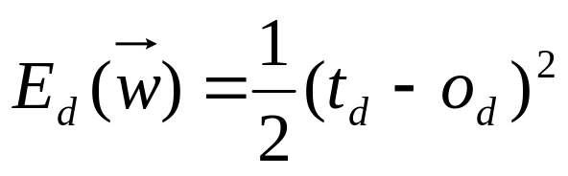


Derivation of the Backpropagation Rule
Recall from the equation:
Stochastic gradient descent involves iterating through the training examples one at a time.
In other words, for each training example d, every w_{ji} is updated by adding to it Δ_{ji}:
(21)
where E_{d} is the error on training example d, summed over all ouput units.

Slide 52
Notation
x_{ji} = the ith input to unit j
w_{ji} = the weight associated with the ith input to unit j
net_{j} = Σ_{i} w_{ji}x_{ji} (the weighted sum of input for unit j)
o_{j} = the output computed by unit j
t_{j} = the target output for unit j
σ = the sigmod function
outputs = the set of units in the final layer of the network
Downstream(j) = the set of units whose immediate inputs include the output of unit j.
Now we derive an expression for ∂E_{d}/ ∂w_{ji} in order to implement the stochastic gradient descent rule in Equation (21).

Slide 53
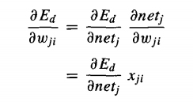
To begin, notice that weight w_{ji} can influence the rest of the network through net_{j}. So, we can use the chain rule to write:
(22)
Now our remaining task is to derive a convenient expression for ∂E_{d}/ ∂net_{j}.
We consider two cases: (1) the case where unit j is an output unit and (2) the case where j is an internal unit.

Slide 54


Case 1: Training rule for output unit weights.
Just as w_{ji} can influence the rest of the network only through net_{j}, net_{j} can influence the network only through o_{j}. So, we can use the chain rule again to write:
(23)
To begin, consider the first term in Equation (23)
The derivatives in the right hand side will be zero for all output units k except when k = j.

Slide 55
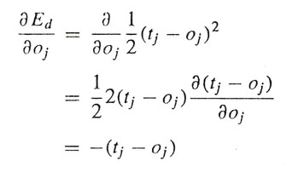

We have:
(24)
Next consider the second term in Equation (23). Since o_{j} = σ(net_{j}), the derivative ∂o_{j}/ ∂net_{j} is just the derivative of the sigmod function, which we have already noted is equal to σ(net_{j})(1- σ(net_{j})). Therefore,
(25)

Slide 56


Substituting expressions (24) and (25) into (23), we obtain:
(26)
And combining this with Equation (21) and (22), we have the stochastic gradient descent rule for output units
(27)
Note this training rule is exactly the weight update rule, implemented by Equation (14) and (15) in the Backpropagation algorithm. Furthermore, we can see that δ_{k} in Equation(14) is equal to the quantity - ∂ E_{d}/ ∂ net_{k}.

Slide 57
Case 2: Training rule for Hidden Unit Weights
In the case where j is an hidden unit in the network, the derivation of the training rule for w_{ji} must take into account the indirect ways in which w_{ji} can influence the network outputs and hence E_{d}.
For this reason, we will find it useful to refer to the set of all units immediately downstream of unit j in the network. We denote this set of units by Downstream(j).
Notice that net_{j} can influence the network outputs (and therefore E_{d}) only through the units in Downstream(j). Therefore, we can write

Slide 58
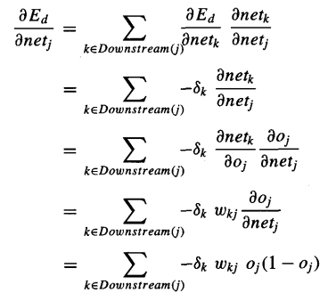

Rearranging terms and using δ_{j} to denote - ∂E_{d}/ ∂net_{j}, we have
and
Δw_{ji} = η δ_{j} x_{ji}

Slide 59
REMARKS ON THE BACKPROPAGATION ALGORITHM
Convergence and Local Minima
  Gradient descent to some local minimum
    Perhaps not global minimum...
  Heuristics to alleviate the problem of local minima
    Add momentum
    Use stochastic gradient descent rather than true gradient descent.
    Train multiple nets with different initial weights using the same data.

Slide 60
NEURAL NETWORK APPLICATION DEVELOPMENT
The development process for an ANN application has eight steps.
Step 1: (Data collection) The data to be used for the training and testing of ANN are collected. Important considerations
are that the particular problem is amenable to ANN solution and that adequate data exist and can be obtained.
Step 2: (Training and testing data separation) Trainning data must be identified, and a plan must be made for testing the performance of ANN. The available data are divided into training and testing data sets. For a moderately sized data set, 80% of the data are randomly selected for training, 10% for testing, and 10% secondary testing.
Step 3: (Network architecture) A network architecture and a learning method are selected. Important considerations are the exact number of nodes and the number of layers.

Slide 61
Step 4: (Parameter tuning and weight initialization) There are parameters for tuning ANN to the desired learning performance level. Part of this step is initialization of the network weights and parameters, followed by modification of the parameters as training performance feedback is received.
  Often, the initial values are important in determining the effectiveness and length of training.
Step 5: (Data transformation) Transforms the application data into the type and format required by the ANN.
Step 6: (Training) Training is conducted iteratively by presenting input and known output data to the ANN. The ANN computes the outputs and adjusts the weights until the computed outputs are within an acceptable tolerance of the known outputs for the input cases.

Slide 62
Step 7: (Testing) Once the training has been completed, it is necessary to test the network.
  The testing examines the performance of ANN using the derived weights by measuring the ability of the network to classify the testing data correctly.
  Black-box testing (comparing test results to historical results) is the primary approach for verifying that inputs produce the appropriate outputs.
Step 8: (Implementation) Now a stable set of weights are obtained.
  Now ANN can reproduce the desired output given inputs like those in the training set.
  The ANN is ready to use as a stand-alone system or as part of another software system where new input data will be presented to it and its output will be a recommended decision.

Slide 63
BENEFITS AND LIMITATIONS OF NEURAL NETWORKS
6.1 Benefits of ANNs
Usefulness for pattern recognition, classification, generalization, abstraction and interpretation of imcomplete and noisy inputs. (e.g. handwriting recognition, image recognition, voice and speech recognition, weather forecasing).
Providing some human characteristics to problem solving that are difficult to simulate using the logical, analytical techniques of expert systems and standard software technologies. (e.g. financial applications).
Ability to solve new kinds of problems. ANNs are particularly effective at solving problems whose solutions are difficult to define. This opened up a new range of decision support applications formerly either difficult or impossible to computerize.

Slide 64
Robustness. ANNs tend to be more robust than their conventional counterparts. They have the ability to cope with imcomplete or fuzzy data. ANNs can be very tolerant of faults if properly implemented.
Fast processing speed. Because they consist of a large number of massively interconnected processing units, all operating in parallel on the same problem, ANNs can potentially operate at considerable speed (when implemented on parallel processors).
Flexibility and ease of maintenaince. ANNs are very flexible in adapting their behavior to new and changing environments. They are also easier to maintain, with some having the ability to learn from experience to improve their own performance.
6.2 Limitations of ANNs
ANNs do not produce an explicit model even though new cases can be fed into it and new results obtained.
ANNs lack explanation capabilities. Justifications for results is difficults to obtain because the connection weights usually do not have obvious interpretations.

Slide 65
Time Series Prediction
Time series prediction: given an existing data series, we observe or model the data series to make accurate forecasts
Example time series
  Financial (e.g., stocks, exchange rates)
  Physically observed (e.g., weather, sunspots, river flow)
Why is it important?
  Preventing undesirable events by forecasting the event, identifying the circumstances preceding the event, and taking corrective action so the event can be avoided (e.g., inflationary economic period)
  Forecasting undesirable, yet unavoidable, events to preemptively lessen their impact (e.g., solar maximum w/ sunspots)
  Profiting from forecasting (e.g., financial markets)

Slide 66
Why is it difficult?
  Limited quantity of data (Observed data series sometimes too short to partition)
  Noise (Erroneous data points, obscuring component)
  Moving Average
  Nonstationarity (Fundamentals change over time, nonstationary)
  Forecasting method selection (Statistics, Artificial intelligence)
Neural networks have been widely used as time series forecasters: most often these are feed-forward networks which employ a sliding window over the input sequence.
The neural network sees the time series X₁,…,X_{n} in the form of many mappings of an input vector to an output value.

Slide 67
A number of adjoining data points of the time series (the input window X_{t-s}, X_{t-s-1},…, X_{t}) are mapped to the interval [0,1] and used as activation levels for the inputs of the input layer.
The size s of the input window corresponds to the number of input units of the neural network.
In the forward path, these activation levels are propagated over one hidden layer to one output unit. The error used for the backpropagation learning algorithm is now computed by comparing the value of the output unit with the transformed value of the time series at time t+1. This error is propagated back to the connections between output and hidden layer and to those between hidden and input layer. After all weights have been updated accordingly, one presentation has been completed.

Slide 68
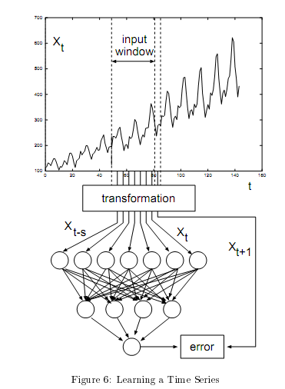

Slide 69
Training a neural network with backpropagation learning algorithm usually requires that all representations of the input set (called one epoch) are presented many times. For examples, the ANN may use 60 to 138 epoches.

Slide 70
Network parameters
The following parameters of the ANN are chosen for a closer inspection:
The number of input units: The number of input units determines the number of periods the ANN “looks into the past” when predicting the future. The number of input units is equivalent to the size of the input window.
The number of hidden units: Whereas it has been shown that one hidden layer is sufficient to approximate continuous function, the number of hidden units necessary is “not known in general”. Some examples of ANN architectures that have been used for time series prediction can be 8-8-1, 6-6-1, and 5-5-1.

Slide 71
The learning rate: η (0< η < 1) is a scaling factor that tells the learning algorithm how strong the weights of the connections should be adjusted for a given error. A higher η can be used to speed up the learning process, but if η is too high, the algorithm will skip the optimum weights. (The learning rate η is constant across presentations).
The momentum parameter α (0 < α < 1) is another number that affects the gradient descent of the weights: to prevent each connection from following every little change in the solution space immediately, the momentum term is added that keeps the direction of the previous step thus avoiding the descent into local minima. (The momentum term is constant across presentations).

Slide 72
SOME ANN APPLICATIONS
ANN application areas:
Tax form processing to identify tax fraud
Enhancing auditing by finding irregularites
Bankruptcy prediction
Customer credit scoring
Loan approvals
Credit card approval and fraud detection
Financial prediction
Energy forecasting
Computer access security (intrusion detection and classification of attacks)
Fraud detection in mobile telecommunication networks

Slide 73
References
J. Han, M. Kamber, Data Mining: Concepts and Techniques, 2nd Edition, 2006, Morgan Kaufmann Publishers.
Tom M. Mitchell, Machine Learning, The McGraw Hill, 1997.

