Slide 1
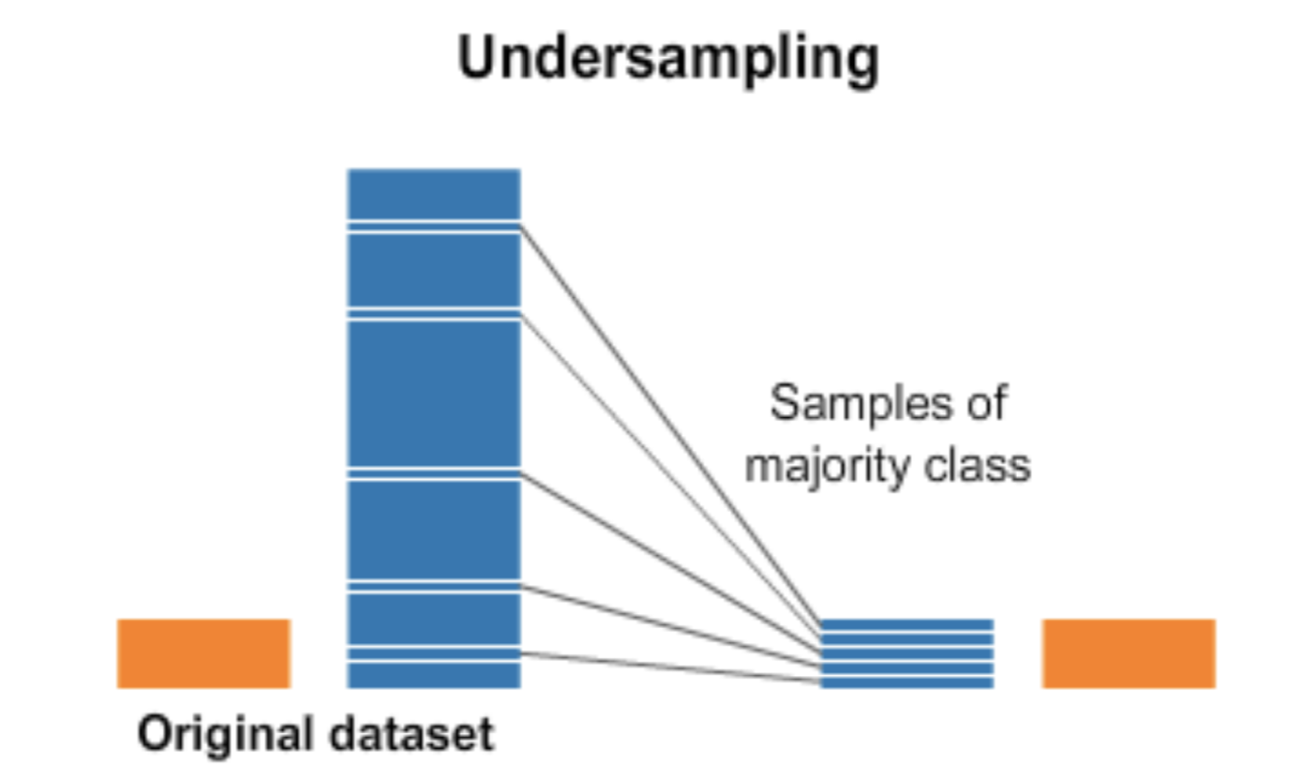
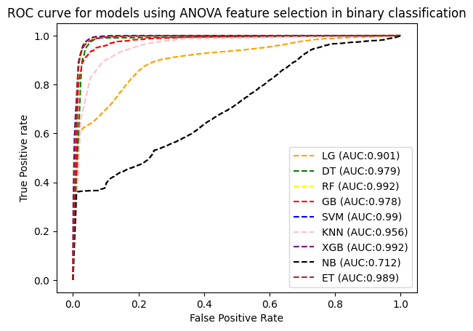
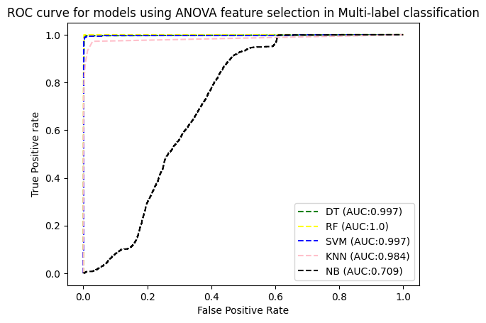
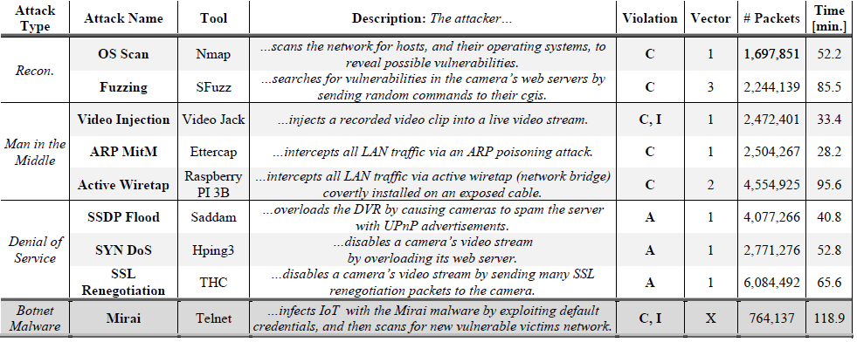
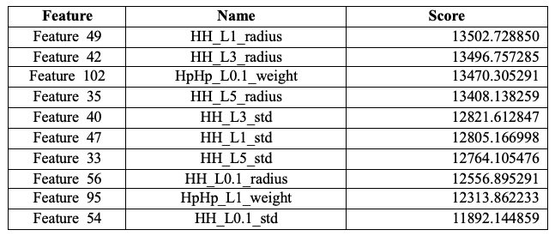
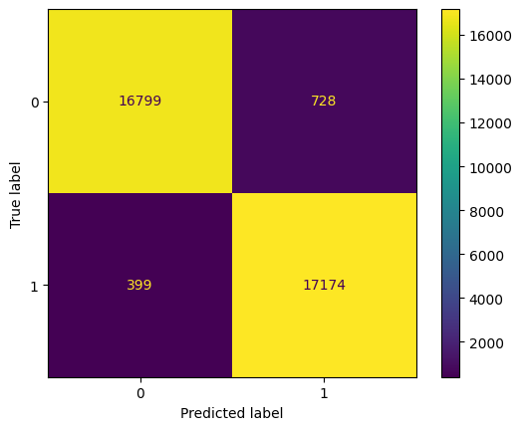
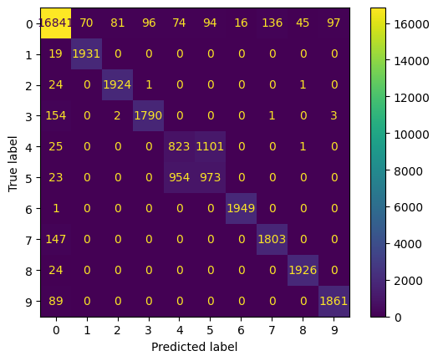
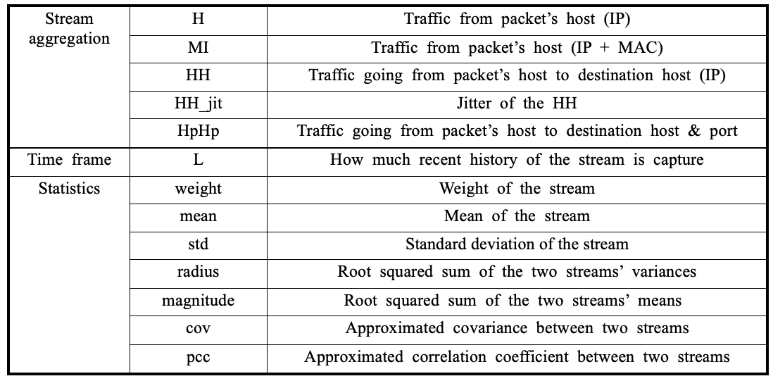
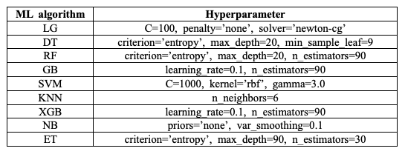


Kitsune Network Attack Classification Using Machine Learning
Kyungbin Lee, Nahid Ebrahimi Majd
Department of Computer Science and Information System
California State University, San Marcos, United States
ABSTRACT
METHODS
RESULTS
The rise of network attacks has emerged as a pressing concern for the technology industry. Either an IP-based commercial surveillance system or a network full of IoT devices are required to identify new types of network attacks or utilize a dynamic analysis. The term “Kitsune” is known for the intelligence and trickery of fox spirits in Japanese folklore. We performed filter methods of feature selection and then applied Decision Tree(DT), Random Forest(RF), Naïve Bayes (NB), Logistic Regression(LR), Support Vector Machine(SVM), k-Nearest Neighbor (KNN), Extreme Gradient Boost(XGB), Gradient Boosting (GB) and Extra Trees (ET) on a Kitsune network Attack dataset that contains 9 types network attack. The experimental results demonstrate that RF classifier with ANOVA feature selection outperforms either in binary classification or in multi-label(family) classification than other ML models.
Dataset
Since each dataset contains millions of network packets, we extract a subset dataset and make samples as Figure 4. Each Attack includes 6,500 benign and 6,500 malicious rows. In the training set, there are total 117,000 rows.
We train each model with the different number of features with ANOVA feature selection method. According to Figure 5 & 6, RF shows the highest AUC score and accuracy in both binary classification and multi-label classification. In Figure 7, we describe the confusion matrix of RF for both classifications.
OBJECTIVE
Figure 4: Undersampling method in machine learning.
The number of network attacks on computer system has been increasing over the years. In the technology industry, network attacks on businesses have become an increasing concern. It is important to build the system to detect various types of network attacks. A successful network attack can have serious implications, including the loss of crucial data, financial losses, and legal liability. Kitsune network attack dataset is a collection of the traffic of 9 types of network attacks captured from either an IP-based commercial surveillance system or a network full of IoT devices. This research investigates the efficiency of various ML models to predict network attack in binary classification and multi-label classification.
Data preprocessing
Data Split: We split the dataset into training data and test data in the ratio of 70:30, using 5-fold validation to generalize the models.
Standardization: Normalization technique is used to convert each of the variables into a similar scale by centering each variable at zero with a standard deviation of 1.
Feature Selection Techniques
We use ANOVA(Analysis of Variance F-value) to calculate the F-value for each feature by comparing the variance of the target variable explained by the feature. There are 115 features in the dataset. In Table 1, we list the feature’s number, name, and score from highest to lowest score.
Figure 5: ROC curve for binary classification.
Figure 6: ROC curve for multi-label classification.
Figure 1: Collection of Kitsune network attack dataset.
Table 1: Top 10 Features F-values applying ANOVA F-test feature selection.
Figure 7: Confusion Matrix of RF
Binary Classification
CONCLUSION
Traffic
With the increasing threat of various types of network attacks, it is important to detect known and new forms of network attacks effectively. In this paper, we designed ML models and performed extensive experiments by filtering method, feature selection method, and ML algorithms along with hyperparameter. The experimental results demonstrate that RF with ANOVA feature selection outperforms.
Benigin
Malicious
Figure 2: Binary classification in Kitsune.
Table 2: Explanation of feature name
Multi-label Classification
GridSearchCV
We use the hyperparameter from GridSearchCV method to get higher accuracy for each ML model. We describe 9 supervised ML algorithms with their hyperparameters in Table 2.
REFERENCE
Traffic
[1] Kim, YeaSul, YeEun Kim, & Hwankuk Kim. "A Comparison Experiment of Binary Classification for Detecting the GTP Encapsulated IoT DDoS Traffics in 5G Network." Journal of Internet Technology [Online], 23.5 (2022): 1049-1060. Web. 12 Jul. 2023
[2] Y.Mirsky, T. Doitshman, Y.Elovici, and A. Shabtai, “Kitsune: An Ensemble of Autoencoders for Online Network Intrusion Detection,” arXiv.org, May 27, 2018. http://arxiv.org/abs/1802.09089 13 Jul. 2023
[3] Kitsune Network Attack Dataset. (2019). UCI Machine Learning Repository. https://doi.org/10.24432/C5D90Q.
Benigin
APR
MitM
Active Wiretap
Fuzzing
Mirai Botnet
OS Scan
SSDP Flood
SYN DoS
SSL
Video Injection
Figure 3: Multi-label classification in Kitsune.
ACKNOWLEDGEMENT
This research was funded by grants from the following agency:
San Diego Foundation
Table 3: ML models with their hyperparameters.

