Slide 1
Jira
The benefits it brings

Slide 2
Why use JIRA software?
Provides transparency for the team and up to date information on the project.
Beneficial for requirements and test case management.
Great for agile teams. Utilizes Scrum and Kanban boards.
Project management teams can track progress through several integrated parts in the program such as built-in roadmaps, reports and analytics, backlogs, issue/task management, and allows workflow customization.

Slide 3
What is JIRA dashboard?
The JIRA dashboard is where team members can view charts, graphs, tasks assigned, and changes made in the project.
The dashboard can be altered and modified to add specific “gadgets” which contain different functions and benefits depending on the project.
Some of these functions include an “Activity Stream” which updates and displays every change made, an “Average Age Chart” which displays the average number of days an issue has been unresolved, and many more beneficial functions.

Slide 4
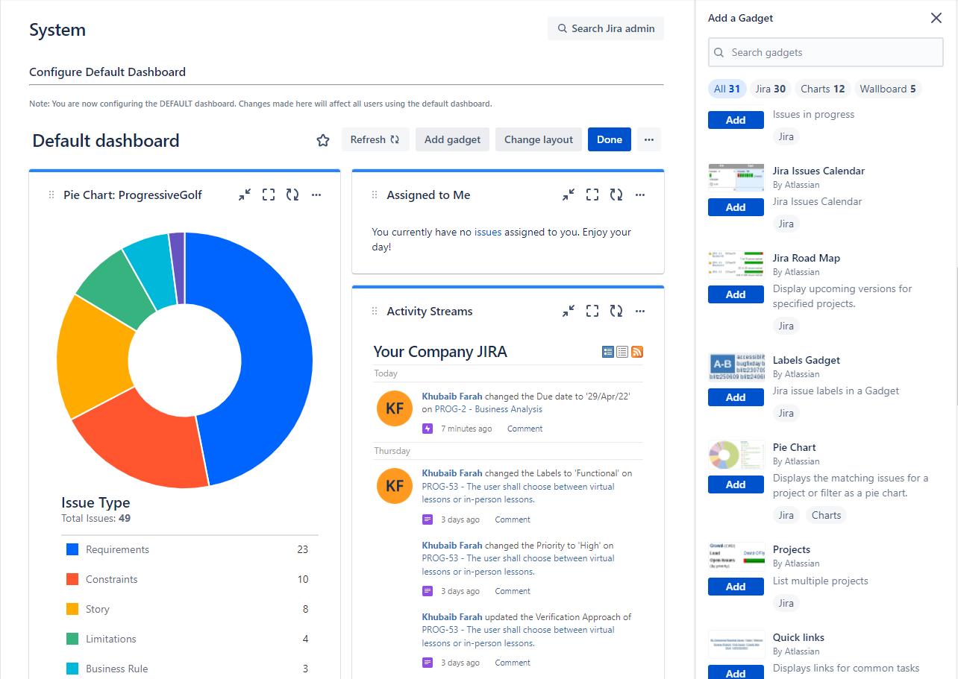
Example of JIRA dashboard

Slide 5
Labeling and linking issues in JIRA
The software allows the user to label issues to define what characteristics each issue possess. Enables categorizing an issue in a more informal way than assigning it to a component or version.
Linking allows you to link an association between two issues on either on or the same or different JIRA servers. This can determine if requirements relate to one another, or cause clashing between one another.

Slide 6
How is security setting helpful in JIRA?
The software allows the user to create and customize permissions so that only specific people can access different parts of the project.
Contains IP allow listing so that people from trusted networks can access the project.
All data is encrypted using AES 256 encryptions.

Slide 7
What does an issue change history include?
There are several things that can be done within the issue change history:
Deletion of a comment
Deletion of a worklog
Creation or deletion of an issue link
Attachment of a file
Changes to an issue field

Slide 8
For an Agile project, how user stories in JIRA are created?
User stories in JIRA can be created from the backlog. JIRA allows the user to create many types of issues and tie them to icons. Through the backlog page, when a user creates an issue, they can choose the issue type and make the issue a “story”, so the viewer knows what is a user story.

Slide 9
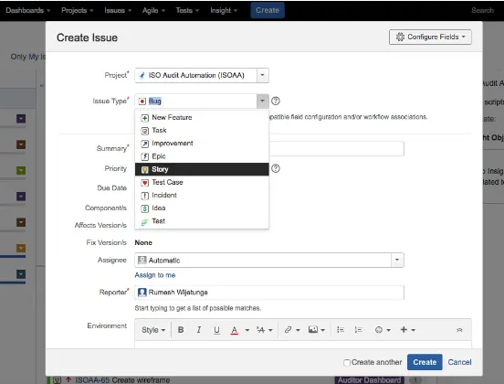
Example of creating a user story being created

Slide 10
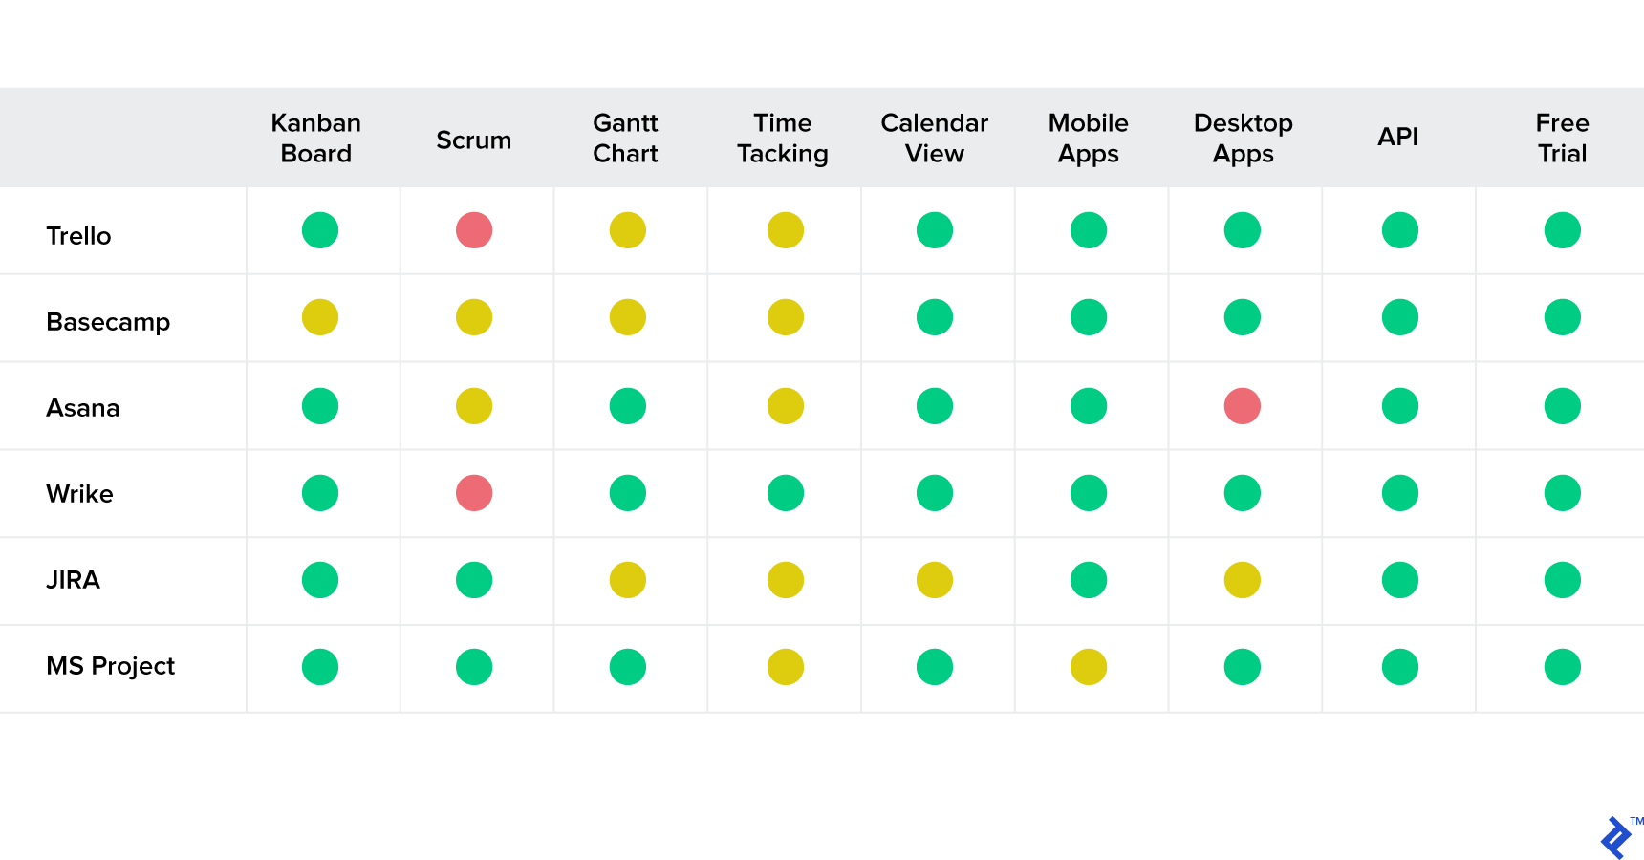
Jira comparison to other products
Green- feature built into the standard version of the tool.
Yellow- Feature available via third-party providers.
Red- Feature is not Available

