Slide 1
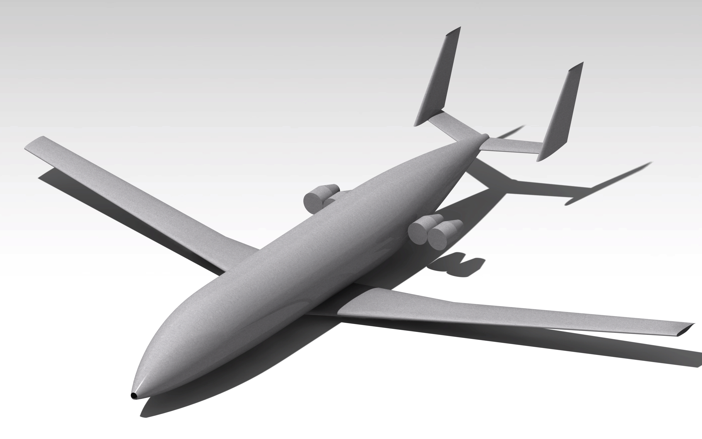
SmartWorks Tail Designer
Nick Noordam 1507486
Roger Coenen 1506862
28-5-2015

Slide 2
Presentation Outline
Tail generating capabilities
Output capabilities
Code Structure
Inputs
Continuation in Tasty

Slide 3
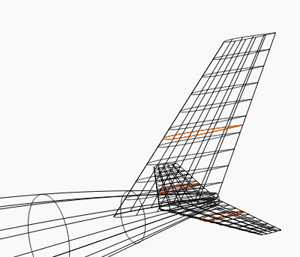
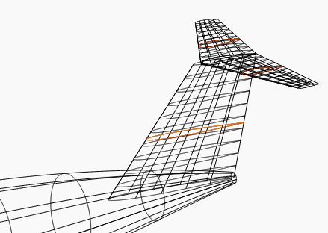
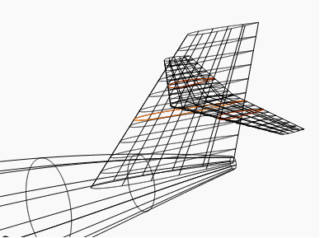
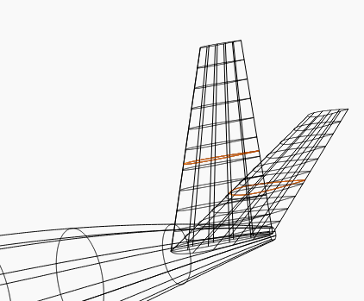
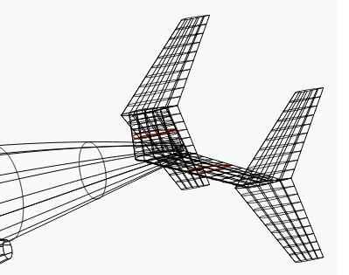
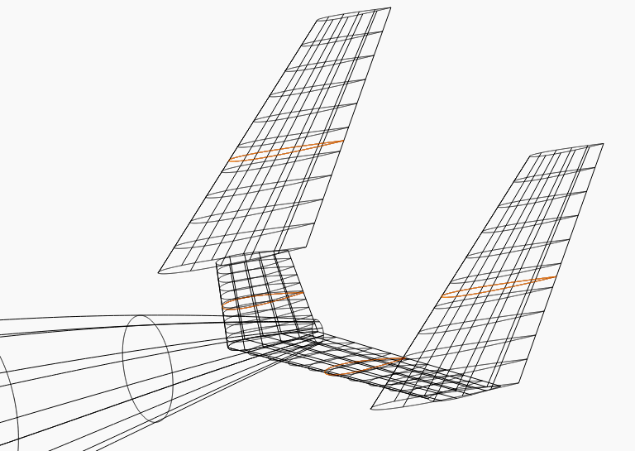
Tail generation capabilities

Slide 4
Output capabilities
Drawings
Trimetric
Front, Top and Side-view
Step file
Q3D input file
PDF tables
inputs
out

Slide 5
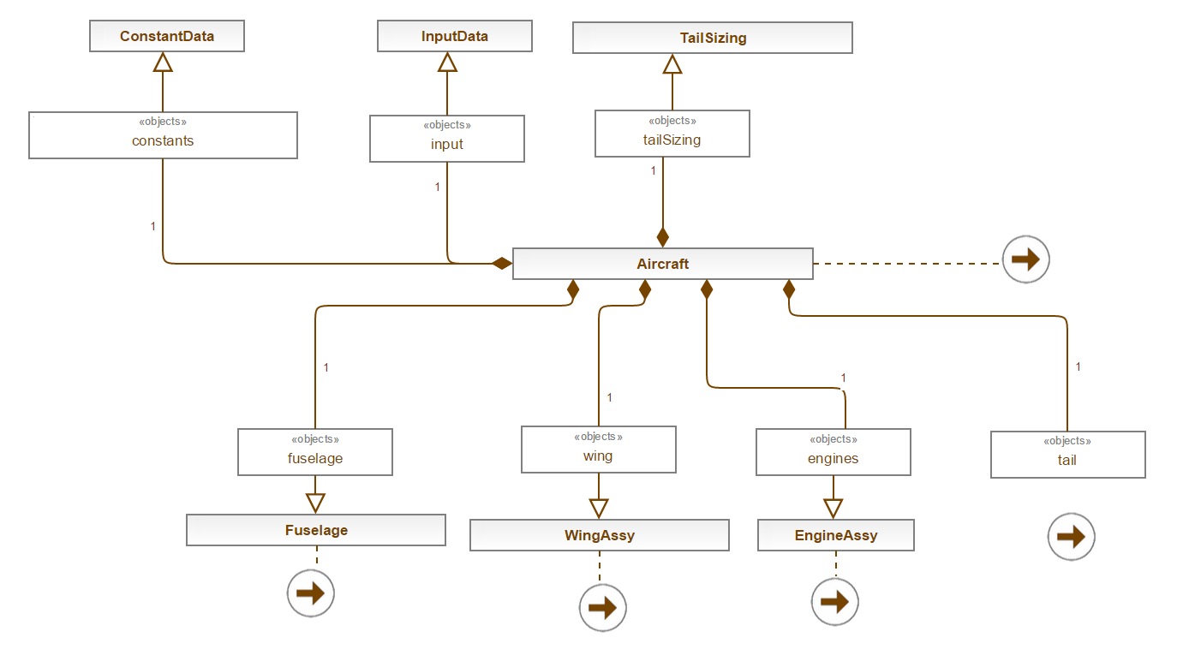
Code Structure

Slide 6
Inputs
Wing
wingSpan - Span
wingChordRoot - Root chord
wingKinkPos - Position of kink in percentage of span
wingTaper - Taper
wingDihedral - Dihedral
wingConfiguration - High/Mid/Low
wingSweepLE - Leading edge sweep

Slide 7
Inputs cnt’d
Tail
tailType - Type of tail (one of six)
Fuselage
finenessRatio - Ratio of length/diameter
fuselageLengthTotal - Total length fuselage
divergence - Tail divergence angle
Engines
engineMounting - Location of engines
engineNumber - Number of engines
engineDiameter - Diameter of engines
engineLength - Length of engines

Slide 8
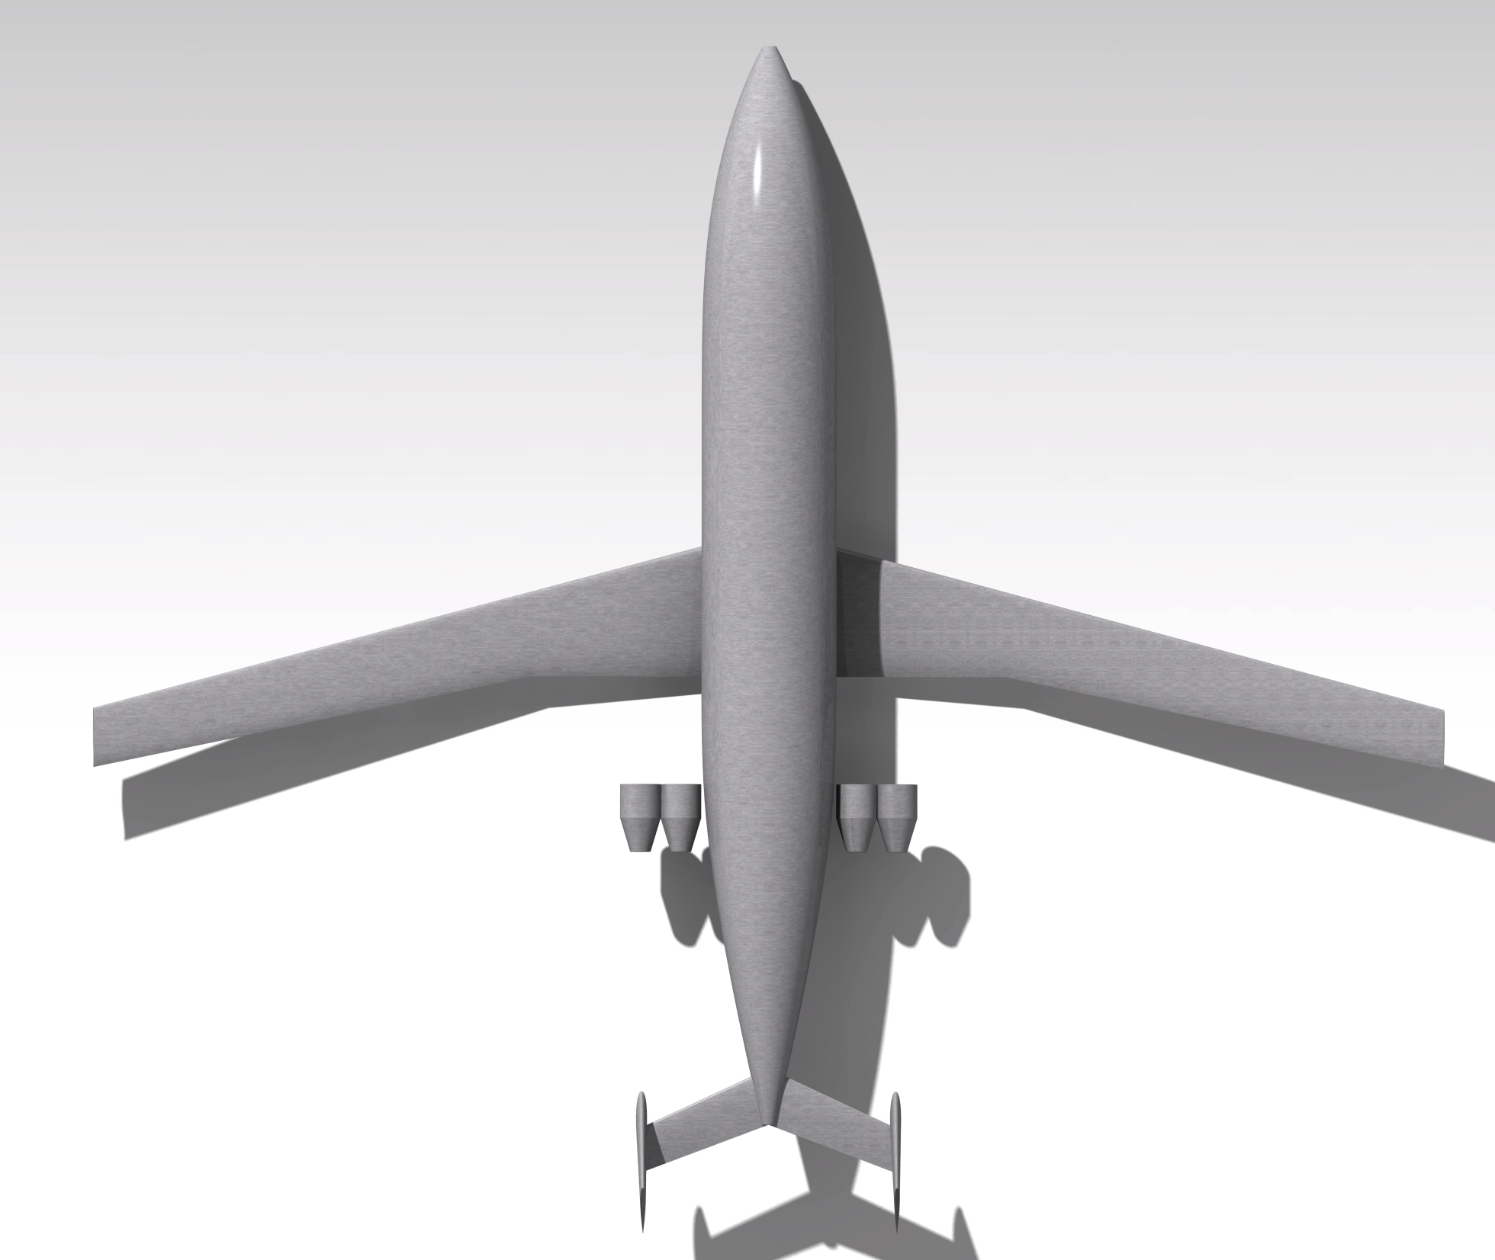
Continue to Tasty

