Slide 1
MongoDB

Slide 2

Index
What is MongoDB
History | Releases
Why MongoDB
Use cases of MongoDB
Nosql vs RDBMS
Clients | Partner Networks
License
Developer Community
Trainings and Certifications

Slide 3
What is MongoDB
Open source database that uses document-oriented data model.
Stores data in JSON-like documents that can vary in structure.
Uses dynamic schemas.
You can change the structure of records.
MongoDB was also designed with high availability ,scalability and auto-sharding.

Slide 4
History
MongoDB was developed in 2007 by a New York based organization 10gen which is now called MongoDB Inc.
Later on in the year 2009, MongoDB was introduced in the market as an open source database server.
The first ready production of MongoDB has been considered from version 1.4 which was released in march 2010.
MongoDB 3.5.7 was the latest and version which was released on may 13, 2017
https://jira.mongodb.org/browse/SERVER?selectedTab=com.atlassian.jira.jira-projects-plugin:versions-panel

Slide 5
Why MongoDB
Nosql
Auto Sharding
Clusters
Replication
GridFS
Indexes - Max 64 indexes per collection
Mapreduce

Slide 6
NoSQL
NoSQL is an approach to databases that represents a shift away from traditional relational database management systems (RDBMS). To define NoSQL, it is helpful to start by describing SQL, which is a query language used by RDBMS. Relational databases rely on tables, columns, rows, or schemas to organize and retrieve data. In contrast, NoSQL databases do not rely on these structures and use more flexible data models.
NoSQL can mean “not SQL” or “not only SQL.”
As RDBMS have increasingly failed to meet the performance, scalability, and flexibility needs that next-generation, data-intensive applications require, NoSQL databases have been adopted by mainstream enterprises.
NoSQL is particularly useful for storing unstructured data, which is growing far more rapidly than structured data and does not fit the relational schemas of RDBMS. Common types of unstructured data include: user and session data; chat, messaging, and log data; time series data such as IoT and device data; and large objects such as video and images.

Slide 7
NoSQL Database Types
Types of NoSQL Databases
Key-value data stores
    Stored values can be any type of binary object (text, video, JSON document, etc.) and are accessed via a key
Document stores
    Typically store self-describing JSON, XML, and BSON documents. They are similar to key-value stores, but in this case, a value is a single document that stores all data related to a specific key
Wide-column stores
    Wide-column NoSQL databases store data in tables with rows and columns similar to RDBMS, but names and formats of columns can vary from row to row across the table. Wide-column databases group columns of related data together
  Graph stores
    A graph database uses graph structures to store, map, and query relationships

Slide 8
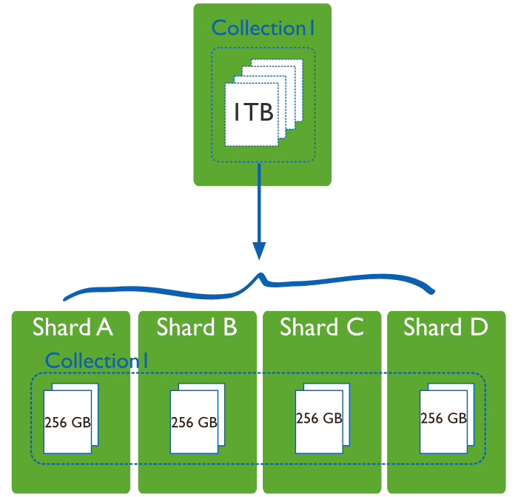
Auto Sharding
Distributing data across multiple machines
Vertical Scaling
Horizontal Scaling

Slide 9
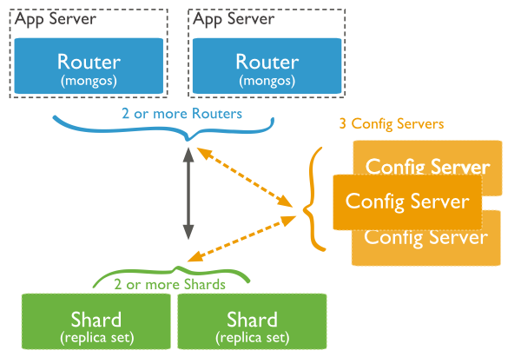
Shard Cluster
shard: Each shard contains a subset of the sharded data. Each shard can be deployed as a replica set.
mongos: The mongos acts as a query router, providing an interface between client applications and the sharded cluster.
config servers: Config servers store metadata and configuration settings for the cluster. As of MongoDB 3.4, config servers must be deployed as a replica set (CSRS).

Slide 10
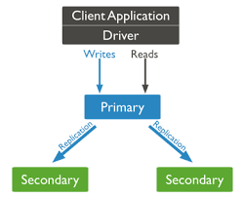
Replication
A replica set is a group of mongod instances that maintain the same data set. A replica set contains several data bearing nodes and optionally one arbiter node. Of the data bearing nodes, one and only one member is deemed the primary node, while the other nodes are deemed secondary nodes.
The primary node receives all write operations. A replica set can have only one primary capable of confirming writes with { w: "majority" } write concern; although in some circumstances, another mongod instance may transiently believe itself to also be primary.

Slide 11
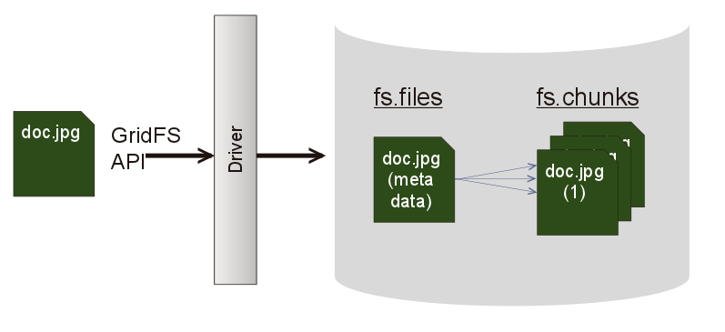
GridFs
GridFS is the MongoDB specification for storing and retrieving large files such as images, audio files, video files, etc. It is kind of a file system to store files but its data is stored within MongoDB collections. GridFS has the capability to store files even greater than its document size limit of 16MB.
GridFS divides a file into chunks and stores each chunk of data in a separate document, each of maximum size 255k.
GridFS by default uses two collections fs.files and fs.chunks to store the file's metadata and the chunks. Each chunk is identified by its unique _id ObjectId field. The fs.files severs as a parent document. The files_id field in the fs.chunks document links the chunk to its parent.

Slide 12
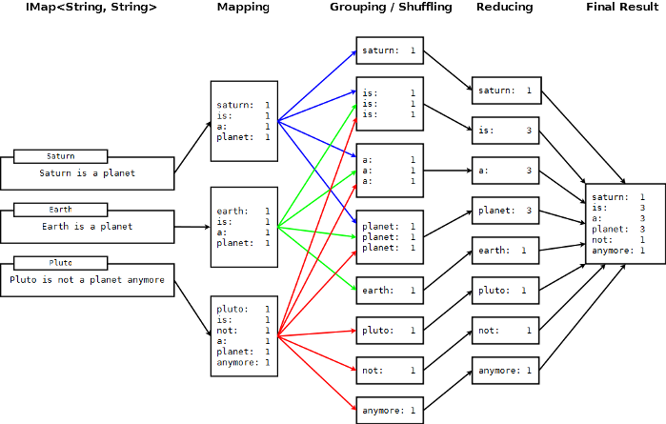
Mapreduce
As per the MongoDB documentation, Map-reduce is a data processing paradigm for condensing large volumes of data into useful aggregated results. MongoDB uses mapReduce command for map-reduce operations. MapReduce is generally used for processing large data sets.

Slide 13
Use Cases of MongoDB
Aadhar
  India’s Unique Identification project, aka Aadhar, is the world’s biggest biometrics database. Aadhar is in the process of capturing demographic and biometric data of over 1.2 billion residents.
  Aadhar has used MongoDB as one of its databases to store this huge amount of data. MongoDB was among several database products, apart from MySQL, Hadoop and HBase, originally procured for running the database search. Here, MySQL is used for storing demographic data and MongoDB is used to store images. According to techcrunch.com, MongoDB has nothing to do with the “sensitive” data.
Shutterfly
  Shutterfly is a popular internet-based photo sharing and personal publishing company that manages a store of more than 6 billion images with a transaction rate of up to 10,000 operations per second. Shutterfly is one of the companies that transitioned from Oracle to MongoDB
  Shutterfly has installed MongoDB for metadata associated with uploaded photos, while for those parts of the application that require richer transactional model, like billing and account management, the traditional RDBMS is still in place

Slide 14
Use Cases of MongoDB
Metlife
  MetLife is a leading global provider of insurance, annuities and employee benefit programs. They serve about 90 million customers and hold leading market positions in the United States, Japan, Latin America, Asia, Europe and the Middle East
  MetLife uses MongoDB for “The Wall”, an innovative customer service application that provides a consolidated view of MetLife customers, including policy details and transactions
  The Wall brings together data from more than 70 legacy systems and merges it into a single record. It runs across six servers in two data centres and presently stores about 24 terabytes of data. MongoDB-based applications are part of a series of Big Data projects that MetLife is working on to transform the company and bring technology, business and customers together
eBay
  eBay is an American multinational internet consumer-to-consumer corporation, headquartered in San Jose. eBay has a number of projects running on MongoDB for search suggestions, metadata storage, cloud management and merchandizing categorization.

Slide 15
NoSQL vs RDBMS
NoSQL vs RDBMS
Scalability
    NoSQL databases use a horizontal scale-out methodology that makes it easy to add or reduce capacity quickly and non-disruptively with commodity hardware
Performance
    By simply adding commodity resources, enterprises can increase performance with NoSQL databases. This enables organizations to continue to deliver reliably fast user experiences with a predictable return on investment for adding resources—again, without the overhead associated with manual sharding
High Availability
    NoSQL databases are generally designed to ensure high availability and avoid the complexity that comes with a typical RDBMS architecture that relies on primary and secondary nodes. Some “distributed” NoSQL databases use a masterless architecture that automatically distributes data equally among multiple resources so that the application remains available for both read and write operations even when one node fails

Slide 16
NoSQL vs RDBMS
NoSQL vs RDBMS
Global Availability
    By automatically replicating data across multiple servers, data centers, or cloud resources, distributed NoSQL databases can minimize latency and ensure a consistent application experience wherever users are located
Flexible Data Modeling
    NoSQL offers the ability to implement flexible and fluid data models
    The result is a simpler interaction between the application and the database and faster, more agile development
Storage
    On linux, one mongod instance can’t store more than 64 TB of data
    On windows, mongod can’t store more than 4 TB of data

Slide 17






Clients
https://www.mongodb.com/who-uses-mongodb

Slide 18





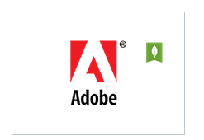
Partner Networks
https://www.mongodb.com/partners/list

Slide 19
License
MongoDB is available at no cost under the GNU Affero General Public License Version 3.
(http://www.gnu.org/licenses/agpl-3.0.html)
Commercial Licence:
  If your legal department has policies regarding use of AGPL software or if you're interested in OEM(Original Equipment Manufacturers)applications, you may prefer to have a commercial license.

Slide 20
Developer Community
Stack Overflow:
  A community forum for specific programming questions.
ServerFault :
  A community forum for questions about server administration and networking, such as hardware or operating system tuning.
Community Support Forum :
  A community forum best suited for open-ended, opinion-based, or general questions about MongoDB. You can post and view the forum via the Google Groups web interface or subscribe to updates via email.
(https://groups.google.com/forum/#!forum/mongodb-dev)

Slide 21
Trainings and Certifications
MongoDB University offers free online courses to teach you how to build and deploy apps on MongoDB.
https://university.mongodb.com/certification
https://www.simplilearn.com/big-data-and-analytics/mongodb-certification-training
Developer Contribution
https://github.com/mongodb/mongo/wiki

Slide 22

Thank You
K Balakrishna

