Slide 1

Functional Neurological Symptom Disorder
Kevin J. Black, M.D.
Departments of Psychiatry, Neurology,
Radiology and Neuroscience

Slide 2
Disclosures
Sources of research support:
  NIMH, NINDS
  Emalex Biosciences
  Zhittya Genesis Medicine
Speaker’s bureaus: none
Stock equity: none
Consulting relationships:
  Noema Pharma AG (unpaid)
Notes:
past 12 months

Slide 3
p.s.
Thank you … school nurses have made a huge difference in my daughter’s life.
(and one of MASN’s past presidents is a friend’s mom)
Notes:
https://www.nasn.org/people/linda-neumann-rn

Slide 4
Outline
Functional neurological symptoms
  History
  Definition
  Clinical characteristics
Example in detail
  Tourette syndrome vs. functional tic-like symptoms
FNSD
  Prognosis
  Treatment
  Resources

Slide 5
Functional neurological symptoms

Slide 6
What is Functional Neurological Symptom Disorder (FNSD)?
One or more symptoms of altered voluntary motor or sensory function
Clinical findings provide evidence of incompatibility between the symptom and recognized neurological or medical conditions
The symptom or deficit is not better explained by another medical or mental disorder
The symptom or deficit causes clinically significant distress, or impairment in social, occupational, or other important areas of functioning, or warrants medical evaluation
Notes:
Per DSM criteria, FNSD includes the presence of one or more symptoms of altered voluntary motor or sensory function. This includes:
Weakness or paralysis
Abnormal movement (tremor, dystonic movement, gait)
Swallowing symptoms
Speech symptoms
Attacks or seizures
Anesthesia or sensory loss
Special sensory symptoms (visual, olfactory, hearing)
Mixed symptoms
Clinical findings provide evidence of incompatibility between the symptoms and recognized neurological or medical conditions. The symptoms or deficit is not better explained by another medical or mental disorder. I will talk more on this in a bit.
The symptom or deficit causes clinically significant distress or impairment.
We recently had an update to our DSM, we are now on the DSM-5TR. This was one of the very few conditions that was slightly altered in this update. The actual diagnostic criteria I listed did not change from our last version, however; it did change the preferred name of this condition should be FNSD, as opposed to Conversion Disorder.
The reason for this change is due to updated research indicating that the process of conversion (physical manifestation of psychological distress) is not established, universal role of stress is not supported – many patients have this condition without identified trauma or stressors
This is progress, though the notion of conversion appears to be a deeply rooted understanding in the medical community. Even our now dated, DSM-5 had dropped the historical criteria for psychological inclusion, meaning that diagnosing FNSD is NOT based on abnormal psychology. Providers can specify if with or without psychological stressor.
There is evidence that rates of trauma, stress and psychiatric comorbidities are higher in patients with FNSD, but recent research has demonstrated low incidence of physical or psychiatric diagnoses to directly explain patients’ symptoms, and trauma is present in only about one-third of patients.
This condition can be a process of stress but not always the result of a psychological stressor- more on this in a moment.
We are requesting that our medical partners use consistent language when discussing this diagnosis with their patients. Please reinforce the FNSD terminology. Do NOT use the terms psychogenic or Conversion!

Slide 7
In other words …
In functional neurological symptom disorder (FNSD), a patient experiences neurological symptoms that cannot be attributed to a lesion or medical condition, but that are genuinely experienced and may cause distress.

Slide 8
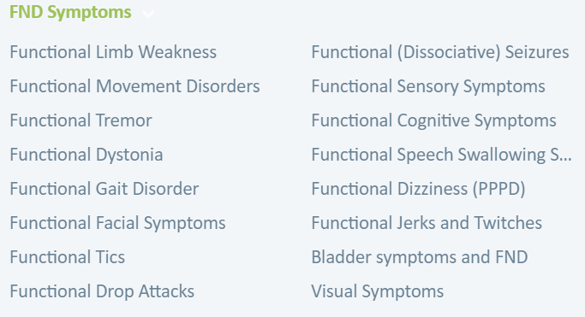
Examples
PNES = psychogenic non-epileptic seizures = pseudoseizures
Functional paralysis
Functional blindness
Functional tremors
— from www.NeuroSymptoms.org

Slide 9
Ideas and names
Historically, understanding FNSD has been challenging.

Slide 10
Ideas and names
Historically, understanding FNSD has been challenging.
Hysterical symptoms
Ancient civilizations used the word “hysteria” due to the erroneous theory that the symptoms were the result of uterine dysfunction (or a wandering uterus)

Slide 11
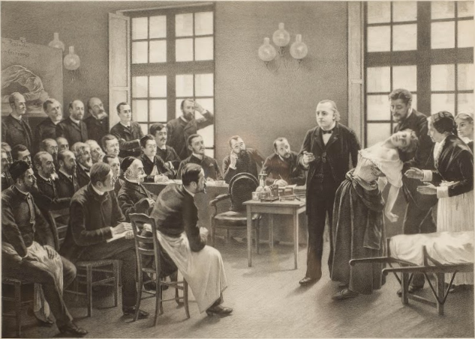
Ideas and names
Historically, understanding FNSD has been challenging.
Hysterical symptoms
Conversion symptoms
‘In the early 20th century, Briquet, Janet, Breuer, Charcot, and Freud recognized the role of attention and physical or emotional triggers in the genesis of functional symptoms, and pointed out the important difference between FND and feigned symptoms.
Notes:
Quotes in this section are from the Malaty et al paper
Jean-Martin Charcot, at the Salpetriere

Slide 12
Ideas and names
Historically, understanding FNSD has been challenging.
Hysterical symptoms
Conversion symptoms
‘In the early 20th century, Briquet, Janet, Breuer, Charcot, and Freud recognized the role of attention and physical or emotional triggers in the genesis of functional symptoms, and pointed out the important difference between FND and feigned symptoms.
‘Freud and Breuer suggested “that … the excess excitation triggered by emotional events is ‘converted’ into somatic phenomena.” This theory in which emotional trauma was the central cause of FND gave rise to the term “conversion disorder” and prevailed until the late 20th century.’
Notes:
Quotes in this section are from the Malaty et al paper
Jean-Martin Charcot, at the Salpetriere

Slide 13
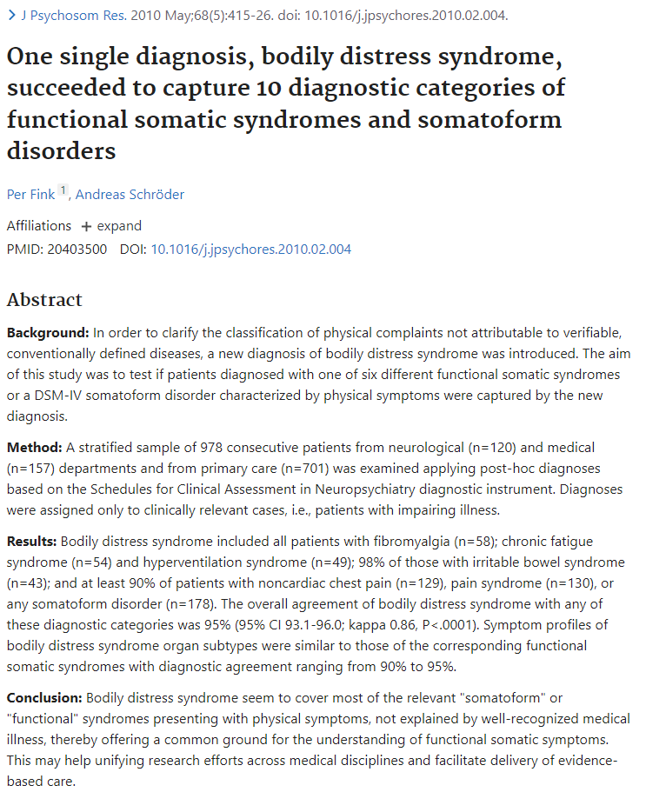
Ideas and names
Historically, understanding FNSD has been challenging.
Hysterical symptoms
Conversion symptoms
Medically unexplained neurological symptoms
Notes:
Quotes in this section are from the Malaty et al paper

Slide 14
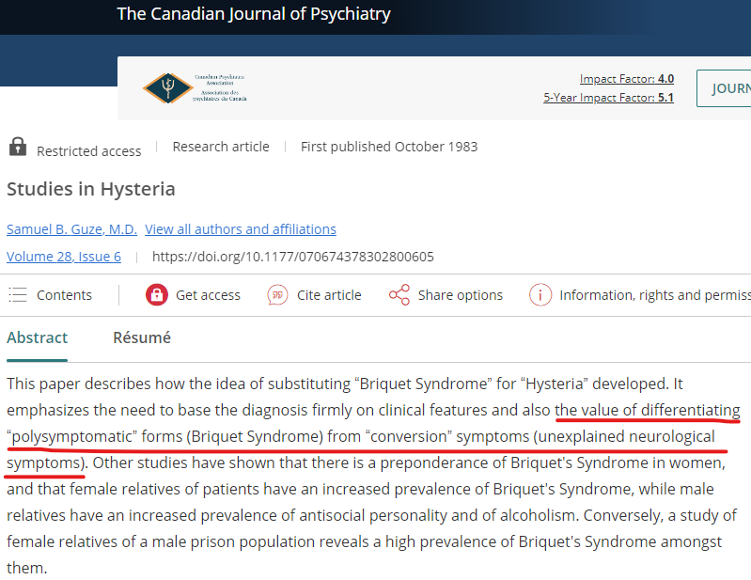
Ideas and names
Historically, understanding FNSD has been challenging.
Hysterical symptoms
Conversion symptoms
Medically unexplained neurological symptoms
Briquet’s syndrome
In the mid-20th century, single putatively functional symptoms often proved on follow-up to represent neurological or systemic disease. This result led the Washington University criteria and their descendants to focus on lifelong, multiple somatizations as a reliable and valid diagnosis. However, this represented the minority of patients with medically unexplained neurological symptoms.
DSM-IV: Somatization Disorder
Notes:
Quotes in this section are from the Malaty et al paper

Slide 15
Ideas and names
Historically, understanding FNSD has been challenging.
Hysterical symptoms
Conversion symptoms
Medically unexplained neurological symptoms
Briquet’s syndrome
New data …
By the end of the 20th century, with modern diagnostic methods, misdiagnosis of known neurological diseases as hysterical occurred only in 0.4% to 4% of patients seen by neurologists, …
… leading to a renascence of interest in these phenomena, and a focus on requiring positive signs for diagnosis (“rule in”) rather than on the absence of evidence for better-understood diagnoses (“rule out”).
Notes:
Quotes in this section are from the Malaty et al paper

Slide 16
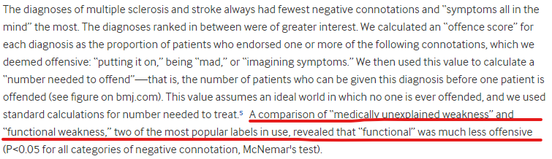
Ideas and names
Historically, understanding FNSD has been challenging.
Hysterical symptoms
Conversion symptoms
Medically unexplained neurological symptoms
Briquet’s syndrome
DSM-5: FNSD
Patient survey: preferred “functional” to other options
Former labels were abandoned based on patient preference in favor of the term “functional” neurological symptoms.
Stone et al, 2002. doi: 10.1136/bmj.325.7378.1449
Notes:
Quotes in this section are from the Malaty et al paper

Slide 17
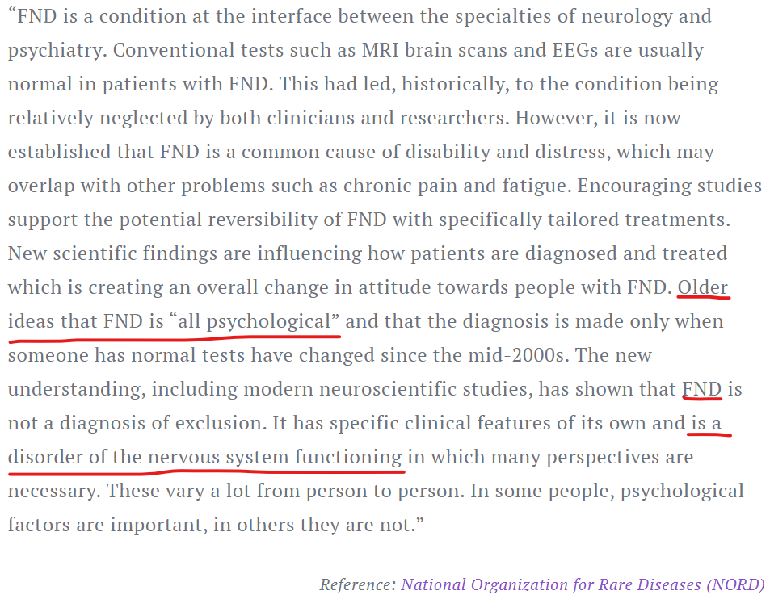
Ideas and names
Historically, understanding FNSD has been challenging.
Hysterical symptoms
Conversion symptoms
Medically unexplained neurological symptoms
Briquet’s syndrome
Patient survey: preferred “functional” to other options
DSM-5: FNSD
FND (no S)
Upsurge in patient-led support groups, internet groups.
Notes:
Quotes in this section are from the Malaty et al paper
Image is from https://fndtogether.com/en/what-is-fnd/

Slide 18
Interesting findings about FNSD
There are differences in neural activity during functional symptoms vs. feigned symptoms, abnormal neural perception or processing of sensory information, absent sense of agency of movements, and abnormal limbic and paralimbic activity.
These studies have contributed to the current understanding of FND as a neuropsychiatric illness with both neurophysiologic differences and psychological manifestations.

Slide 19
FNSD is not …
Malingering (intentionally pretending to have symptoms for gain or to avoid something unpleasant)
Factitious disorder (intentionally creating injuries, abnormal lab tests, etc., to experience the sick role)
Pain disorders (though likely related, the FNSD diagnosis requires unexplained signs of illness)

Slide 20
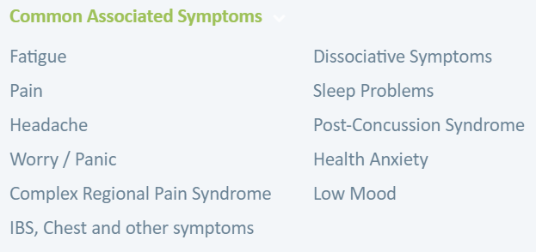
FNSD is often accompanied by …
Medically unexplained non-neurological symptoms
  Fibromyalgia
  Chronic fatigue syndrome
  Irritable bowel syndrome
  Prostatodynia
  Chronic pelvic pain
  etc. etc.
— from www.NeuroSymptoms.org

Slide 21
Then & now
It’s been around forever, but …
… big increase in cases ca. 2019-2022
Social media
COVID-19 pandemic

Slide 22
Example in detail:
Functional tic-like symptoms

Slide 23
… but first, a reminder of Tourette syndrome

Slide 24
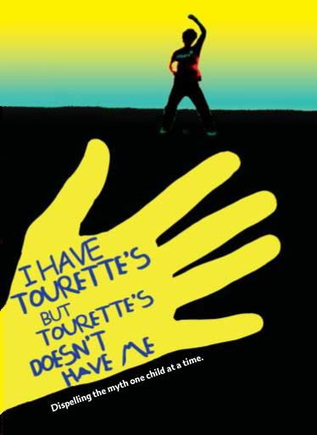
Segment 1
“Tourette syndrome … well, there it is.”

Slide 25
Tourette syndrome is …
… a chronic neuropsychiatric disorder defined by motor and vocal tics that begin before adulthood, vary in manifestations over time, and are not attributable to other causes.

Slide 26
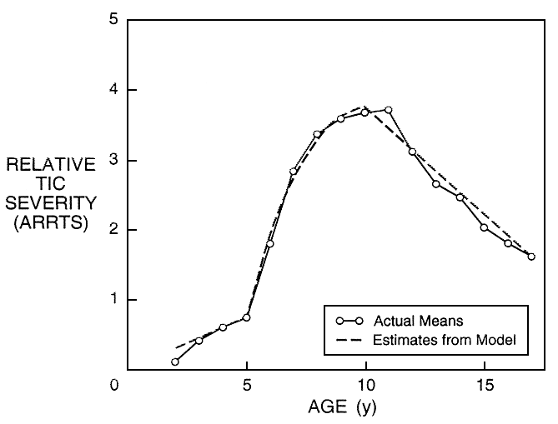
Natural history of chronic tics
3-4 times more common in boys than in girls
Usually starts at ages 5-10 (median 7 years)
Severity peaks at 9-11 years
Severity rarely increases in adulthood
(Leckman et al., Pediatrics, 1998)

Slide 27
Natural history – typical example
A boy starts blinking excessively at age 5 and develops a repetitive, non-rhythmic palatal click several months later.
He has trouble in school with staying in his chair and staying focused on his work. He routinely answers questions before the teacher finishes asking them. He loses 5 lunchboxes in 2 months of school.
By age 7, the blinking persists, while forceful nasal exhalations and shoulder shrugging have replaced the click.
At age 12, he has all the old tics present together with violent head shaking.
In college, subtle head shaking and hardly visible abdominal tensing may be the only remaining tics, with exacerbations during examination week.

Slide 28
… now back to functional tic-like symptoms

Slide 29
Functional tic-like symptoms
Example history
  19-year-old woman, no prior tics, no family history of tics, no OCD, no ADHD
  Sitting with boyfriend after an argument at a family reunion
  Suddenly started repeating “gonna get ya”
  Within 10 minutes was repeating 3 different phrases
  A few days later started flinging food to one side, said it was involuntary
  Had not previously been looking for tic videos, but started “researching” on TikTok
  Within a week, symptoms would last for up to 2 hours without a break of more than 1 minute
  Stopped going to work
  Two physicians with expertise in tic disorders diagnosed functional tic-like behaviors

Slide 30
FTLB features by decreasing PPV
Feature
Movements or vocalizations that are dramatically worse in the presence of others vs. when alone
Coprophenomena at onset
Coprolalia at presentation
Symptoms that dramatically and persistently disrupt the person’s intended actions or communications
Extreme “attacks” of tic-like behavior
Premonitory urges present
Severe symptoms at onset (defined variously in different studies)
Sudden, abrupt onset
Symptoms in extremities before face and neck
Tics involving the body or limbs without a history of tics involving the eyes, face, and head
Inability to suppress
Female
doi: 10.12688/f1000research.129252.2
Notes:
Decreasing clinical utility: from 100% PPV at the top to 73% at the bottom, assuming a prior probability of dx FTLBs of 50%.
Sudden, abrupt onset (NewTics: onset confidence window < 7 days)

Slide 31
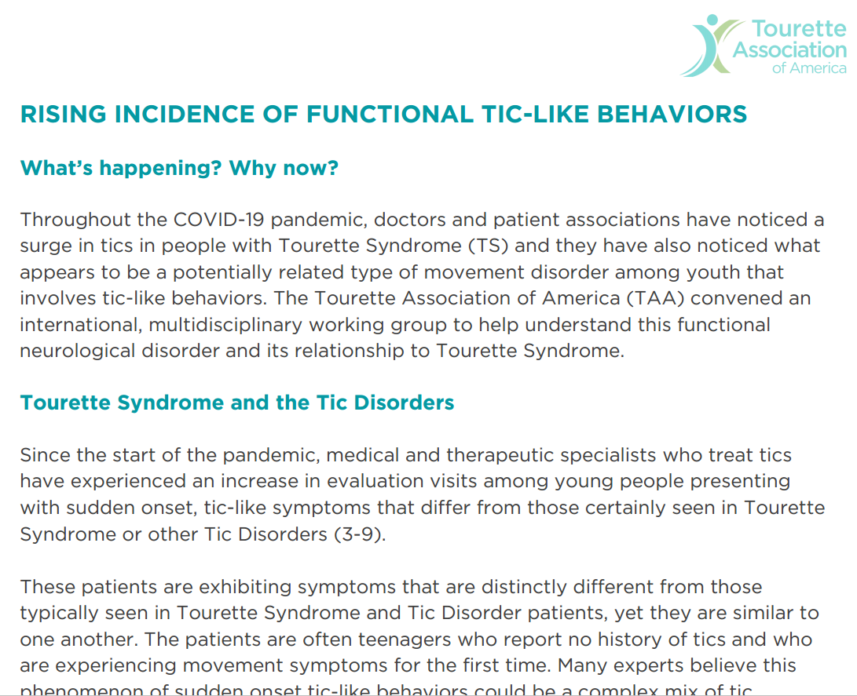
TAA statement on functional tic-like behavior

Slide 32
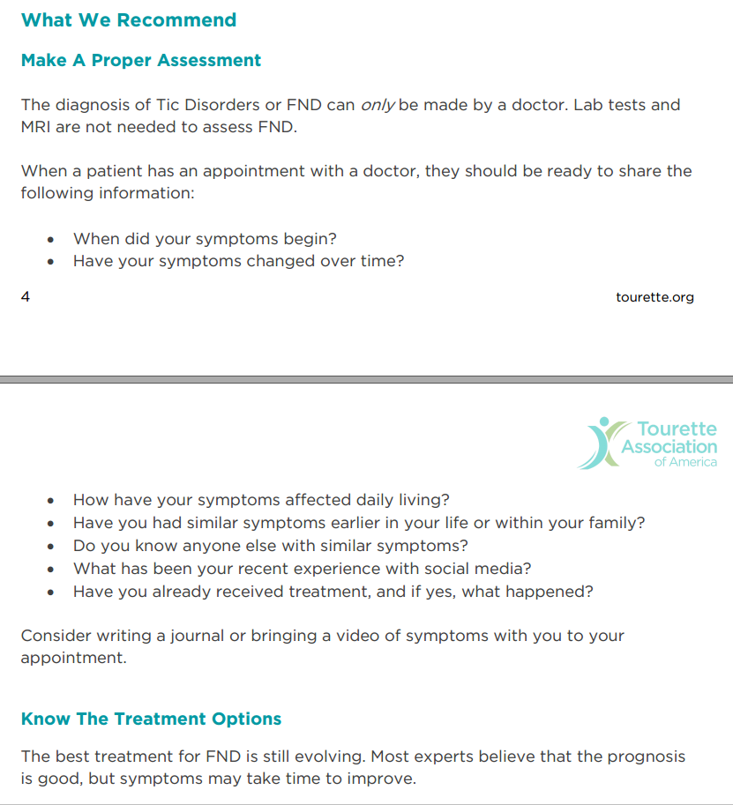
TAA statement on functional tic-like behavior

Slide 33
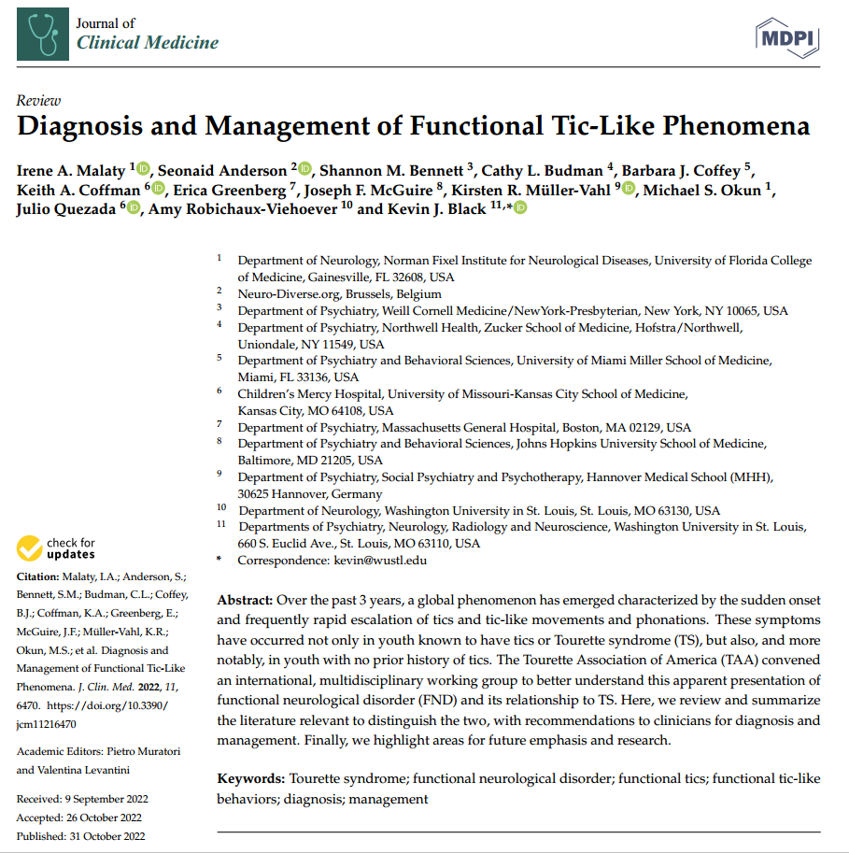
Literature review and publication

Slide 34
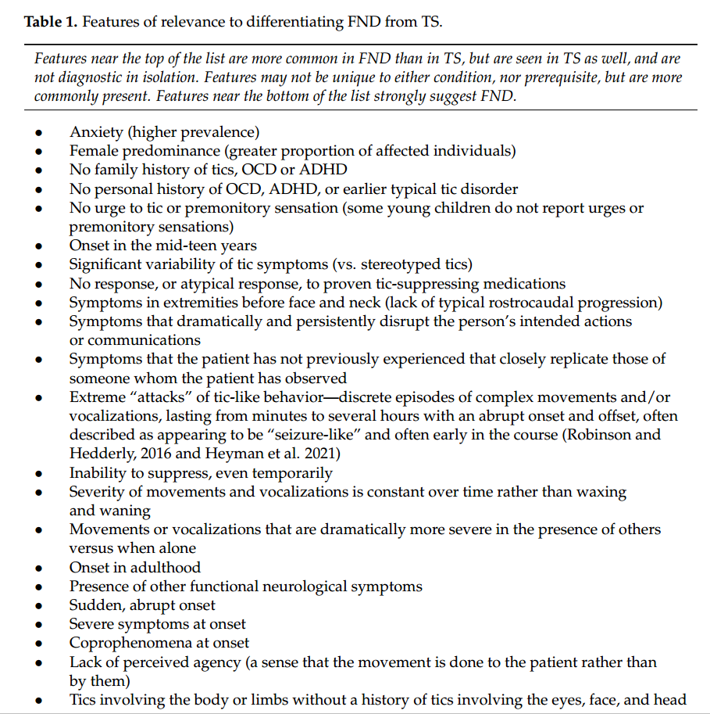
Literature review and publication

Slide 35
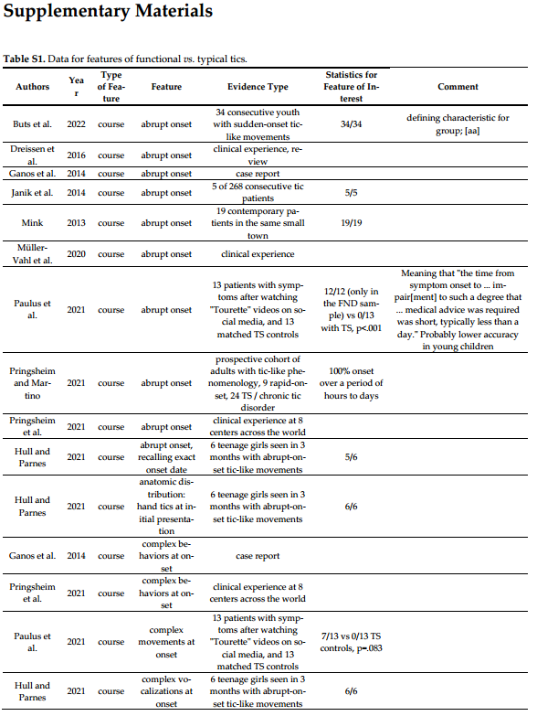
Literature review and publication
Large data table provided as supplement to the paper
21 pp, sorted by clinical feature
Type of clinical feature
  Course
  Demographics
  Initiating factor
  Modifying factor
  Other clinical feature
  Phenomenology
  Severity

Slide 36
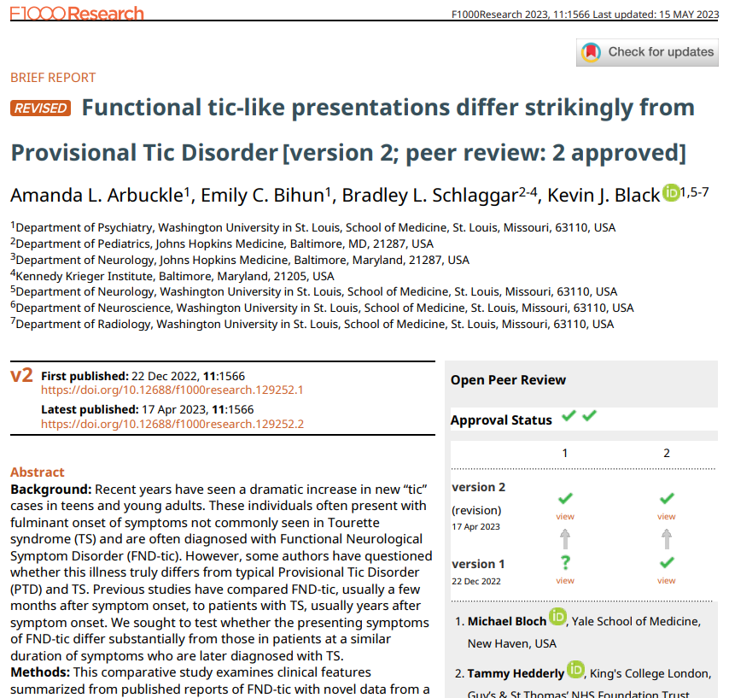
That data has been used at least once ☻

Slide 37
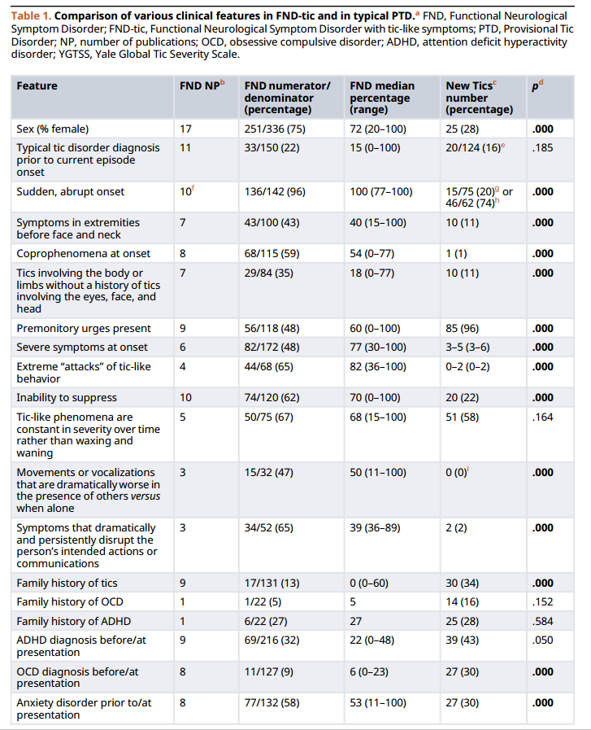
That data has been used at least once ☻

Slide 38
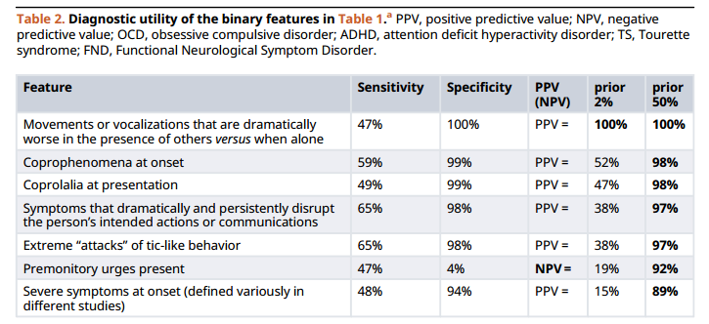
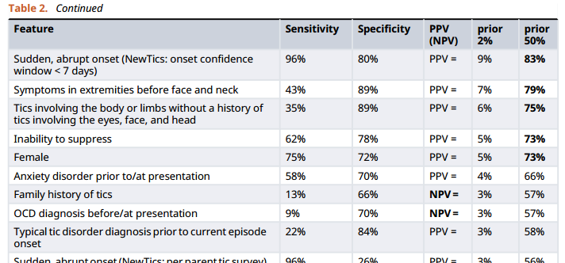
That data has been used at least once ☻

Slide 39
Management

Slide 40
Management 1
Management starts with diagnosis
  Importance of individualized assessment
  Example: Stanford web page on conveying diagnosis ¹
  Some people have both, e.g. epilepsy and PNES
Education is important
Avoid risk, e.g. invasive diagnostic tools or treatments ²
There are some proven specific treatments
  Mostly psychotherapeutic; CBT well proven
Notes:
1
Carson, A.; Lehn, A.; Ludwig, L.; Stone, J. Explaining functional disorders in the neurology clinic: A photo story. Pr. Neurol. 2016, 16, 56–61. [Google Scholar] [CrossRef]
Medina, M.; Giambarberi, L.; Lazarow, S.S.; Lockman, J.; Faridi, N.; Hooshmad, F.; Karasov, A.; Bajestan, S.N. Using Patient-Centered Clinical Neuroscience to Deliver the Diagnosis of Functional Neurological Disorder (FND): Results from an Innovative Educational Workshop. Acad. Psychiatry 2020, 45, 185–189. [Google Scholar] [CrossRef]
Giambarberi, L.; Median, M.; Bajestan, S. Delivering the diagnosis of Functional Neurological Disorder (FND) using clinical neuroscience. Available online: https://med.stanford.edu/psychiatry/patient_care/fnd.html.
2. Brain imaging, electroencephalogram (EEG), and blood work are usually not necessary. They can be harmful as they may introduce ambiguity and confusion regarding the diagnosis and may inadvertently reinforce the state of perceived illness. However, if specific clinical features merit work-up, the clinician may judiciously order investigations in a targeted fashion.

Slide 41
Management 2
Trigger reduction
  Social media content related to symptoms
  Past ACEs, current stressors, social isolation, sleep deprivation
Treat accompanying illnesses e.g. depression or anxiety
Rehabilitative approach: “retraining the brain,” PT, OT
Avoid symptom reinforcement
  Rewards / escapes
  Reinforcing behavior can be entirely natural responses, especially for parents and for the caring professions ²
Notes:
2. … who want to nurture and care for sick kids

Slide 42
Psychologists
Thank you to Drs. S. Thompson & C. Pike (SLCH)

Slide 43
Functional Rehabilitation
Goal of care
To retrain the body and mind to work towards return to function
Modalities of care
Behavioral Health
Physical Therapy, Occupational Therapy, Integrative Medicine
Ongoing follow up care with PCP and/ or medical specialty
Changes in the environment
Notes:
This brings us, finally, to treatment of these conditions. Our psychology services refers to our intervention as “functional rehabilitation” because our overarching goal is to retrain the body and mind to work towards return to function. The modalities involved in this treatment and multifaceted and include-
Behavioral Health- I will talk more on this in a minute
Physical Therapy, Occupational Therapy, Integrative Medicine - Focuses on addressing immobility and functioning, creating daily self-care plans to increase independence and success with ADLs
Consistent scheduled check ins with PCP or other medical provider - more on this on my next slide
Changes in the environment - Modifications to normal routines and expectation, creating a modified daily schedule, adjusting parental responses to child symptoms, daily practice of skills learned in PT/OT

Slide 44
Psychological Intervention
Modalities of Treatment
CBT (Cognitive Behavioral Therapy)
Goals of Treatment
How do we get patients back to functioning?
ACT (Acceptance and Commitment Therapy)
Dual Model Therapy
What can we do to prevent symptoms?
How do we manage symptoms when they occur?
Notes:
Psychology becomes involved after thorough medical work up (give examples)
Common misperception is that we will be working primarily towards symptoms elimination
We will focus on preventing symptom if and when possible, by learning to manage those precipitating and perpetuating factors in a more adaptive way.
But, we are also mainly focused upon helping patients, their families, and any other individuals who will work closely with the patient, such as schools, to manage the symptoms when they occur, all with the goal of minimizing the interference symptoms have upon daily life functioning
The major theoretical approaches we take from are a CBT and ACT framework. Both of which have strong evidence to support the effectiveness of.

Slide 45
Dual Therapy Model
"Primary care" behavioral health services in the community
Anxiety
Depression
Trauma
Other underlying mental health concerns
Brief targeted and specialized intervention at SLCH
6-8 outpatient appointments
Focused on symptom management and improvement in functioning
NOT focused on treatment for underlying psychological concerns
Notes:
We also often recommend a dual model of care, in where we will plan to meet with patients for a brief course of care, targeted upon symptom management and improvements in functioning, without focusing upon any additional underlying psychological conditions (e.g., depression, anxiety). Similar to a PCP, specialization model. We help to refer patients.

Slide 46
Criteria for Treatment
Functional disability as a result of symptoms (i.e., problems with physical functioning, school attendance, social functioning, sleep)
1
Emotional distress about symptoms
2
Persistence of symptoms
3
Notes:
One might assume that all patients with functional or somatic symptoms are good candidates for treatment. And that is mostly true, though there is some criteria we would want to consider before referring to psychology:
Functional disability: school attendance, social functioning, sleep, etc
Emotional distress with symptoms (e.g., motivation)
Persistence of symptoms; some patients have a single event and do not have ongoing concerns

Slide 47
Topics Covered in Functional Rehabilitation
Psychoeducation about Pain/ Symptoms/FNSD and the mind-body connection
Psychoeducation about the rehabilitation model
Behavioral strategies to manage sleep problems
Strategies to increase physical functioning
Strategies to support school re-entry and school success
Relaxation training for autonomic regulation and stress
Cognitive strategies for symptom management and stress
Family intervention
Notes:
Here is a list of some of the common topics we address in our treatment of these conditions. Although, this list in individualized per patient. We may choose to only focus upon school and sleep for one patient, while focusing more broadly for another. Often dependent upon level of symptom interference

Slide 48
Measures of Treatment Success
Improvement is measured by INCREASED FUNCTIONING
Symptom elimination is not the stated goal
Increased or worsening symptoms alone does not warrant increased treatment
Symptoms reduce after patients return to normal activities
Notes:
The measures we use to determine treatment success are tied to our initial goals for treatment. Meaning, we are hoping to improve patient functioning and return to normal activity, not necessarily symptom elimination. Worsened or increased frequency of symptoms alone does not warrant increased treatment.

Slide 49
How to Prepare Patients for Psychology Services
Explain that psychology will help the patient to learn new ways of coping with stress in order to alleviate these symptoms & increase functioning
1
Set reasonable expectations for treatment—not promising to make the symptoms disappear, but increase functioning through coping
2
Send the message that both children and families will take an active role in psychology services
3
Explain that functional rehab model will be focused on coping with symptoms—if further needs arise, a dual therapy model may be utilized
4
Notes:
As our medical partners in the treatment of these conditions, there are some points you can share with patients that may increase their readiness for our services:
Explain the goals and measures of treatment success
Set reasonable expectations
Send the message that this is an active treatment with family involvement
Prepare for the notion of dual model of care

Slide 50
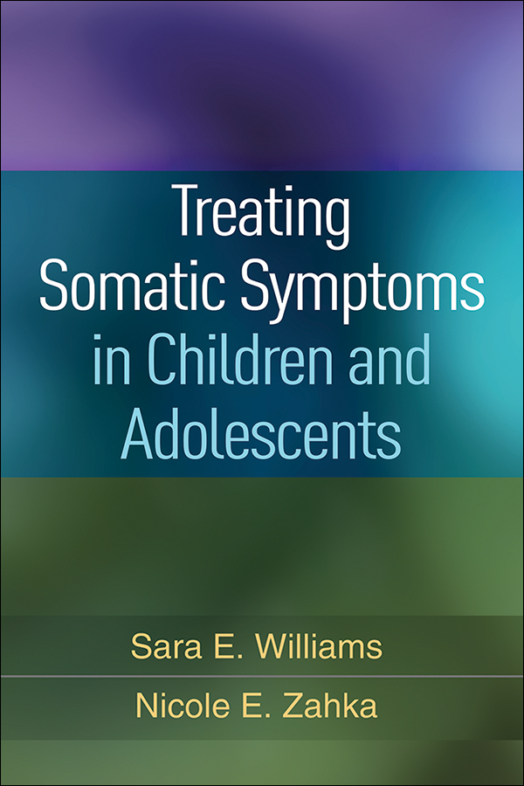
School letter template
Original source: Williams and Zahka, 2017
https://www.guilford.com/books/Treating-Somatic-Symptoms-in-Children-and-Adolescents/Williams-Zahka/9781462529520
Modified by Drs. Pike, Shelton, and Thompson, SLCH Psychology

Slide 51
School letter template 1
504 plan
It will be important for all of @HIS@ teachers to be aware of the following recommendations and re-entry plan:
  Homebound education is generally contraindicated for FNS
  Partial-day attendance, time out of the classroom
  Goal is to increase time at school gradually, with a target date for full-time
The medical team should provide guidance about when FNS should be managed at school, and when school staff should seek medical care.

Slide 52
School letter template 2
If [student] begins to have functional neurological symptoms, remain calm and instruct others to do the same. Panic will increase [student]'s anxiety and intensify symptoms.
If symptoms occur, options include:
  Remove @HIM@ to the nurse’s office, have @HIM@ stay in the room while having the symptoms, or move @HIM@ to another room.
  If @HE@ is still responsive, encourage @HIM@ to use deep breathing strategies, listen to calming music, etc.

Slide 53
School letter template 3
Minimize the amount of interaction and attention paid to the symptoms while simultaneously ensuring @HIS@ safety.
  only 1 person should be with [student] while @HE@ has FNS.
  All others should be doing their regular activities and not attending to the symptoms. This means not talking to @HIM@ or coaching @HIM@ during the symptoms.
  The person with @HIM@ should be there for safety reasons and not attend to [student] while having symptoms. Consider having 1 person who is designated to manage the situation.
  Remove other students from the area and encourage all staff and students to remain calm.

Slide 54
School letter template 4
Do not dwell on the fact that [student] had functional neurological symptoms.
  Resume whatever activity @HE@ had been doing.
  [student] should stay at school the remainder of the day.
Do not focus on the fact that @FNAME@ has functional neurological symptoms.
  Do not repeatedly ask how @HE@ is doing or if @HE@ is feeling like @HE@ might have symptoms. Focus your concern to @HIM@ coping with stressors by aiming to minimize @HIS@ feeling stressed or overwhelmed. Provide opportunities for positive engagement and distraction. Encourage @FNAME@ to verbalize @HIS@ feelings about @HIS@ stress (non-health related) at school.
Encourage @FNAME@ to utilize positive coping strategies to manage @HIS@ stress:
  asking for help, utilizing @HIS@ identified supports, doing things outside of school with peers, etc.
Praise @FNAME@ for positive coping efforts, not for having zero symptoms.
Notes:
Removing a person from school for the day or enrolling @HIM@ in homebound education will get @HIM@ out of the stress and reduce functional neurological symptoms, but not teach @HIM@ strategies to control symptoms as @HE@ transitions into adulthood.

Slide 55
School letter template 5
Track symptoms re: time of day
  Consider at first skipping that time
  Or having him in a safe place during that time
  Provoking situations may become clear with these data
Eliminate conversation between teachers and other students about @HIS@ health issues,
  as this is private health information and likely only adding to @HIS@ stress.
Notes:
Removing a person from school for the day or enrolling @HIM@ in homebound education will get @HIM@ out of the stress and reduce functional neurological symptoms, but not teach @HIM@ strategies to control symptoms as @HE@ transitions into adulthood.

Slide 56
Some closing thoughts …

Slide 57
General comments—YMMV
It’s expected that you may feel overwhelmed when seeing these patients
Diagnosis can be difficult
  Usually needs expert and often subspecialty medical skill to diagnose
Management can be difficult
  Patient & parent acceptance of diagnosis and treatment
  Treatment goals
  Insight and treatment response may be incomplete
On the other hand, often we see improvement, sometimes dramatic
  Children may do better than adults
Avoid basing decisions based on judgments of culpability

Slide 58
Secret, hidden invitation

Slide 59
Please consider our studies …
Does the timing pattern of functional tic-like symptoms differ from the known fractal timing pattern of tics in Tourette syndrome?
  Interviewing children with functional tic-like symptoms and timing their symptoms
An MRI study of children ages 10-14 with Tourette syndrome
  The goal is to look for brain structure and activity changes over a 2-year period that correlate with changes in tic severity
A short-term test of an investigational drug for Tourette syndrome
  Ecopipam, a dopamine D1 receptor antagonist, in children ages 6-17
  🌐 tics.wustl.edu

Slide 60
More resources

Slide 61
Resources
For patients and clinicians
https://neurosymptoms.org/en/
https://www.ninds.nih.gov/health-information/disorders/functional-neurologic-disorder
tics.wustl.edu
https://tourette.org/rising-incidence-of-functional-tic-like-behaviors/
For clinicians
https://med.stanford.edu/psychiatry/patient_care/fnd.html
Medical literature
FND
Espay et al, JAMA Neurol 2018, doi 10.1001/jamaneurol.2018.1264
Aybek and Perez, BMJ 2022, doi 10.1136/bmj.o64
Functional tics
Malaty et al, J Clin Med 2022, doi 10.3390/jcm11216470

Slide 62
Thank you
🌐 tics.wustl.edu
📧 kevin@wustl.edu

