Slide 1
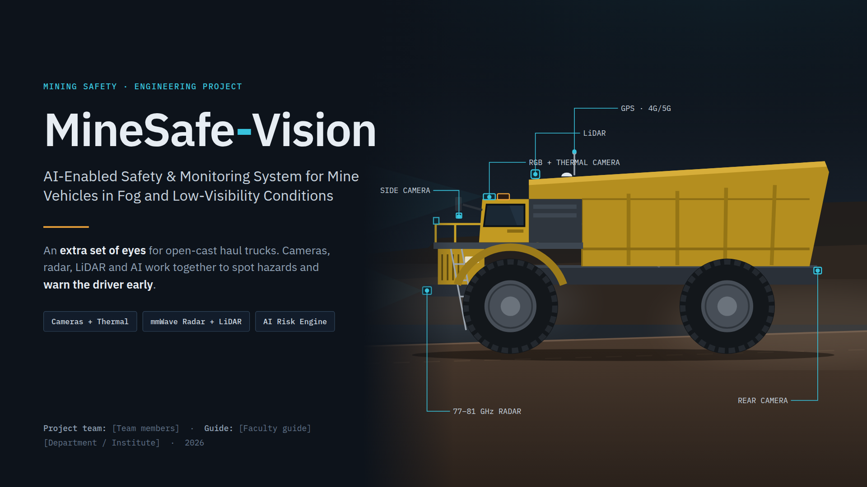
Notes:
Title: MineSafe-Vision – an extra set of eyes for mine haul trucks.

Slide 2
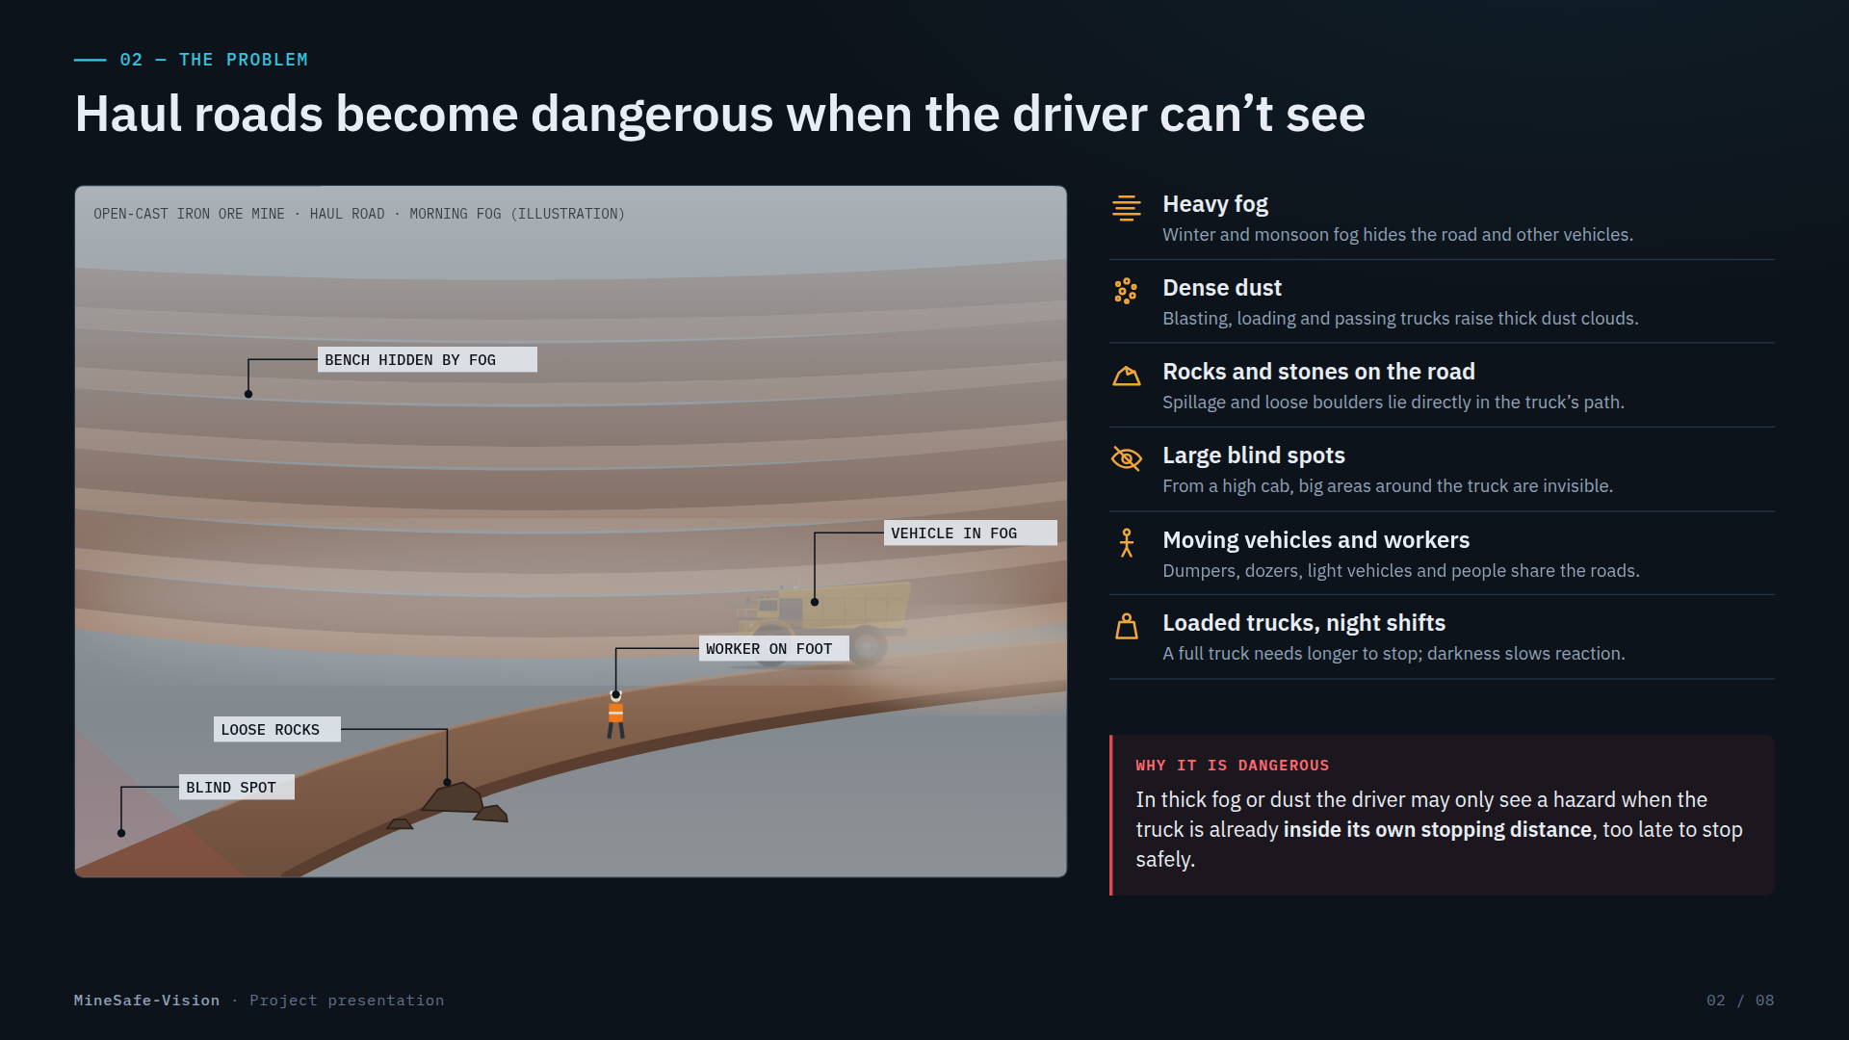
Notes:
The problem: fog, dust, rocks, blind spots, moving vehicles and loaded trucks with long stopping distances.

Slide 3
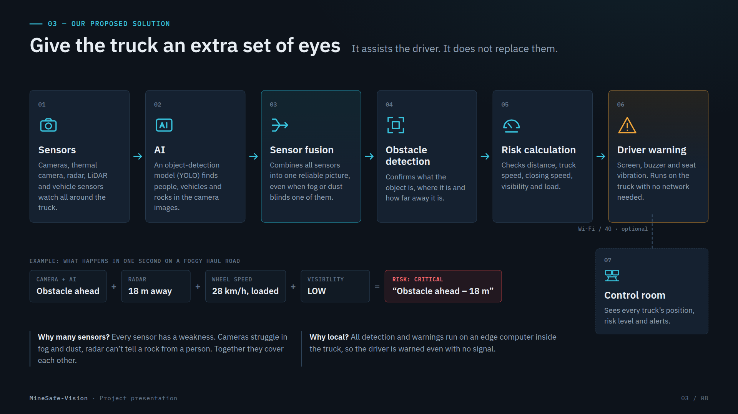
Notes:
Solution: Sensors → AI → Sensor fusion → Obstacle detection → Risk calculation → Driver warning → (optional) Control room.

Slide 4
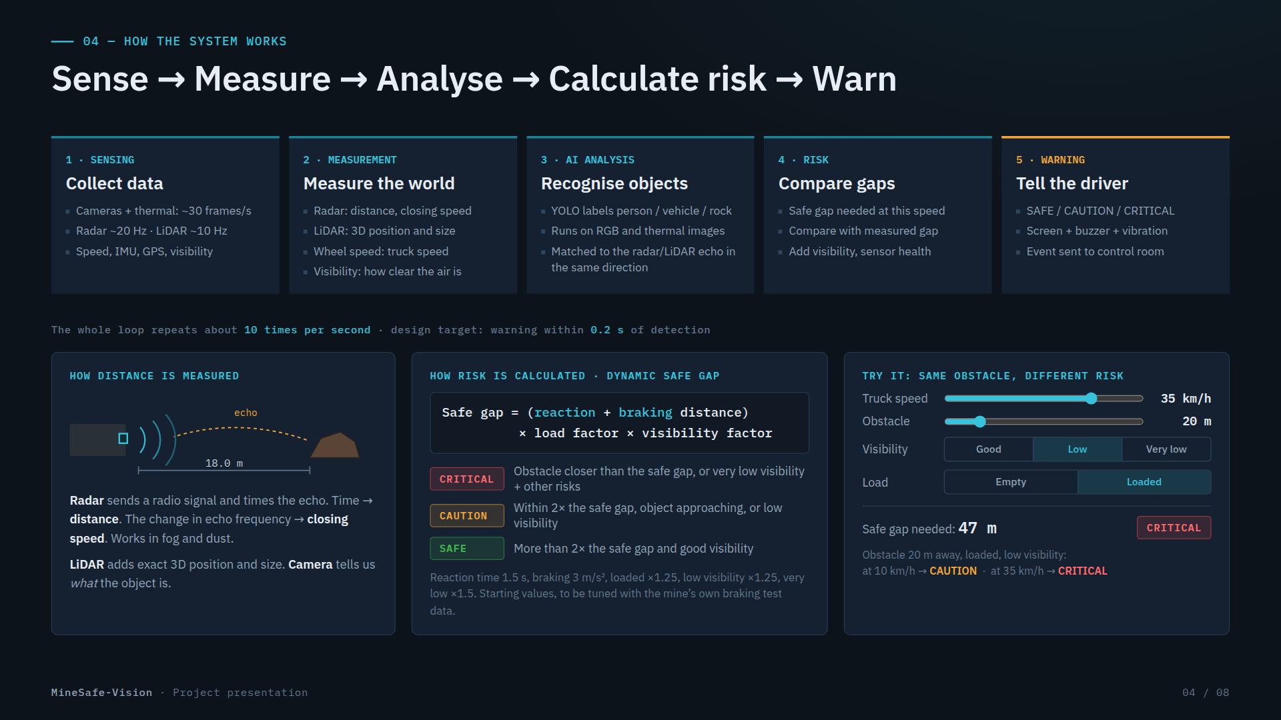
Notes:
How it works: sense, measure, analyse, calculate a dynamic safe gap, warn. Live calculator is in the web version.

Slide 5
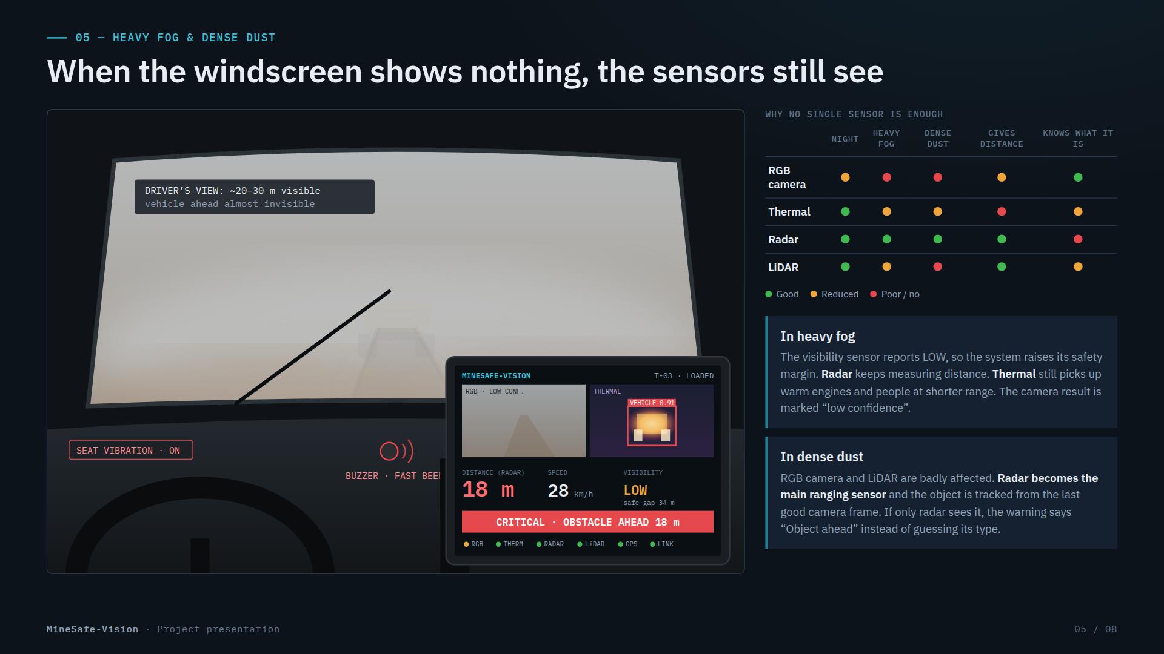
Notes:
Heavy fog and dense dust: radar keeps ranging, thermal helps, visibility sensor raises the safety margin.

Slide 6
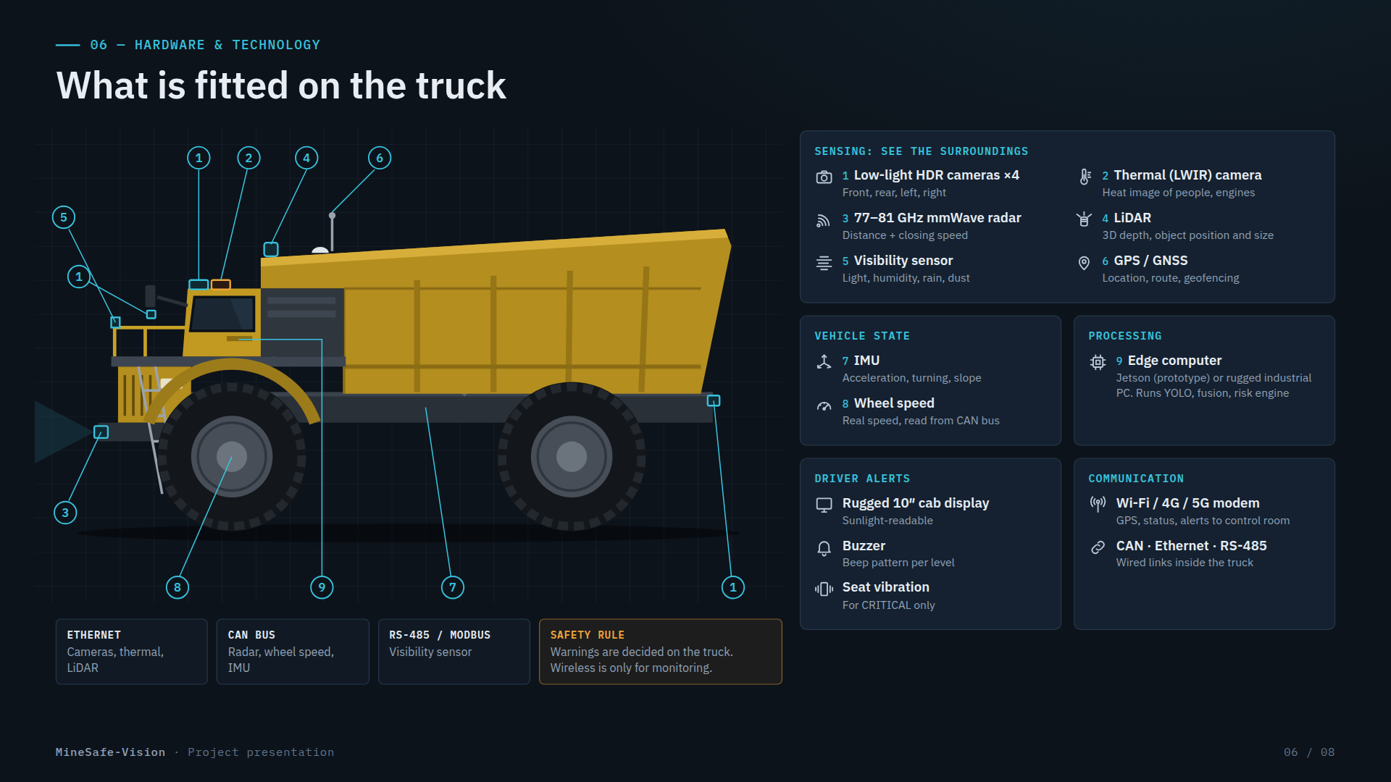
Notes:
Hardware: RGB/HDR cameras, thermal, 77–81 GHz radar, LiDAR, visibility sensor, GPS, IMU, wheel speed, edge computer, display, buzzer, vibration, CAN/Ethernet/RS-485 and Wi-Fi/4G/5G.

Slide 7
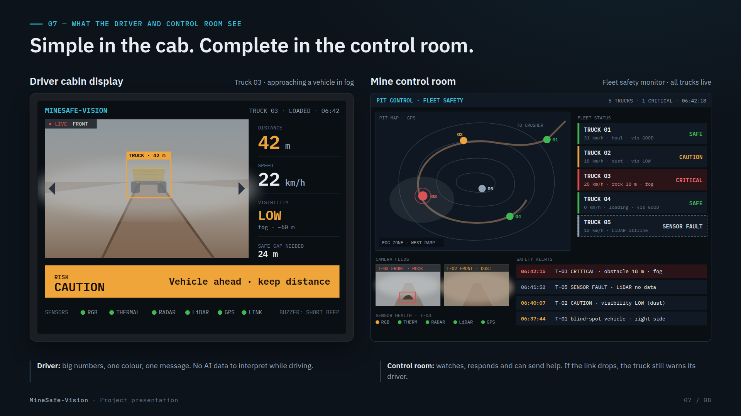
Notes:
Driver display and control room views.

Slide 8
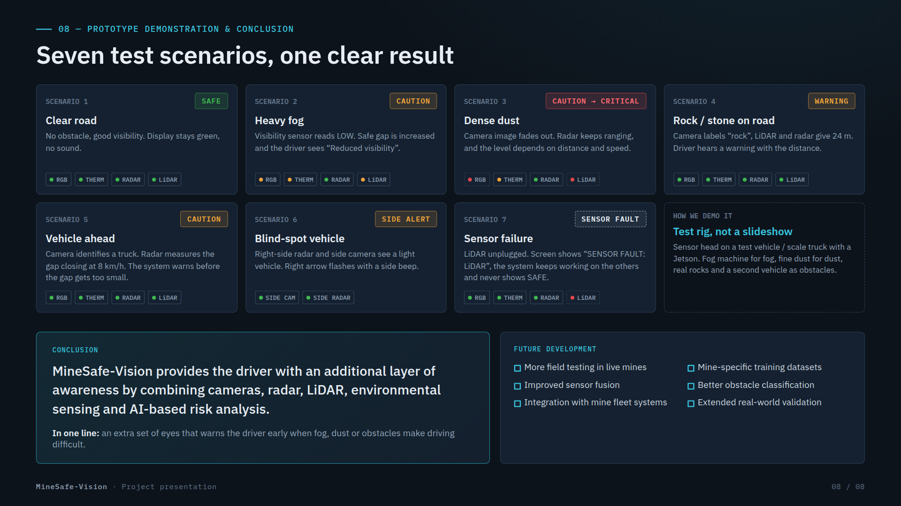
Notes:
Seven demonstration scenarios, conclusion and future development.

