Slide 1


Introduction to the KB APIs
Juliette Lonij, 27 Oct 2016

Slide 2
Why APIs?
KB websites
Browse, search, view, download via Graphical User Interface (GUI)
KB APIs
Search, download underlying data via Application Programming Interface (API)

Slide 3
Introduction to the KB APIs
Types of files and metadata associated with digital objects
Overview of KB data access infrastructure
Getting files through the resolver using persistent identifiers
Querying a collection with the search API
Collecting metadata with the harvest API

Slide 4
What data?
Structural metadata in MPEG21 DIDL format
Descriptive metadata in the Dublin Core (DC) vocabulary, with some KB-specific extensions (DCX)
ALTO files with content and layout information
OCR files containing only the textual content of the item
One or more images of the object, usually in JPEG format

Slide 5
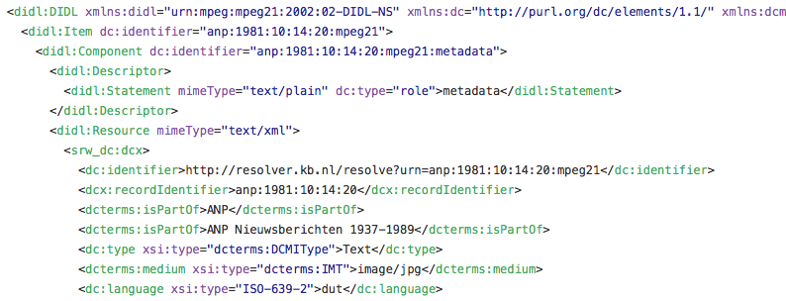
Container
Item
Descriptor
Component
Component
Descriptor
Descriptor
Resource
Resource

Slide 6
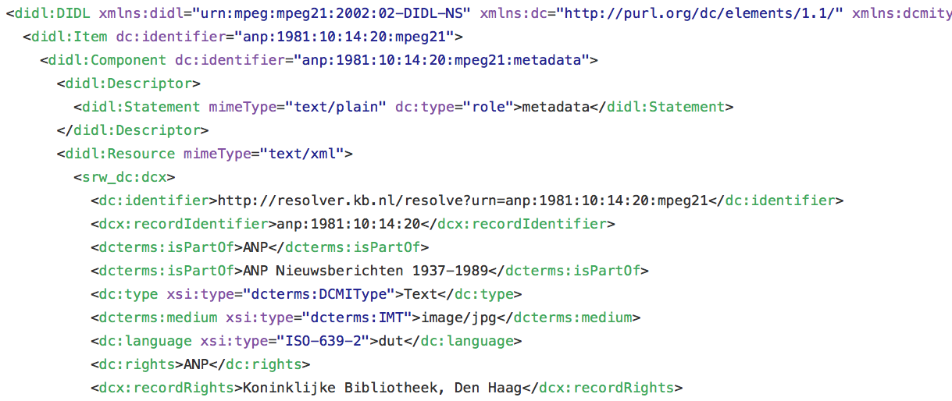

Slide 7
Metadata
storage (KB-MDO)
Data services
Harvest API (OAI-PMH)
Index
Search API (SRU)
Web storage (KB-WO)
KB websites
Resolver

Slide 8
An example data set: ANP Radio Bulletins
About 1.5 million digitized typoscripts from radio news broadcasts between 1937 and 1984
Available through the Delpher website as Radiobulletins collection
KB offers the data under (semi) open licenses:
CC0-license for the metadata
CC-BY-NC-ND-licenses for images and full-text objects

Slide 9
Getting files through the resolver
Persistent identifier in the form of a resolver link http://resolver.kb.nl/resolve?urn=anp:1973:10:18:44:mpeg21
Image can be retrieved by adding the :image suffix: http://resolver.kb.nl/resolve?urn=anp:1973:10:18:44:mpeg21:image
OCR can be retrieved by adding the :ocr suffix: http://resolver.kb.nl/resolve?urn=anp:1973:10:18:44:mpeg21:ocr
ALTO file can be retrieved using the :alto suffix: http://resolver.kb.nl/resolve?urn=anp:1973:10:18:44:mpeg21:alto

Slide 10
Exercise 1: Getting files through the resolver
Find the full text of this tutorial on GitHub: https://github.com/jlonij/intro-kb-apis
Navigate to the Delpher website with your browser and search the collection of radio bulletins for a typoscript of your choice. Find the unique identifier associated with this typoscript.
Open a new tab or window in your browser and retrieve the image, OCR and ALTO files associated with this typoscript. Inspect the results to get an idea of the content and structure of the data that was returned.

Slide 11
The metadata harvest API
Based on the OAI-PMH (Open Archives Initiative Protocol for Metadata Harvesting) protocol
Harvesting metadata of a single record or an entire set
Administrative information to keep copy up to date

Slide 12
Example OAI-PMH request
http://services.kb.nl/mdo/oai?verb=GetRecord &identifier=anp:anp:1981:10:14:20:mpeg21&metadataPrefix=didl
Base URL followed by query string with a number of parameters:
Parameter verb with value GetRecord to specify the operation to be performed
Parameter identifier with the unique object identifier anp:anp:1981:10:14:20:mpeg21
Parameter metadataPrefix to select the required metadata format didl

Slide 13
Exercise 2: Getting started with OAI-PMH
Open a new window or tab in your browser and navigate to the harvest API base URL. Now construct the parameters for retrieving the DIDL structural metadata record for the typoscript of your choice.
Inspect the data returned. In particular, identify the different blocks or components that are included in the response, giving an overview of all data associated with this particular typoscript and the ways in which to obtain them.

Slide 14
OAI-PMH verbs
GetRecord will retrieve a single metadata record from the repository
Identify will retrieve general information about a repository
ListSets will retrieve the names of the data sets in the repository
ListMetadataFormats will retrieve the metadata formats available
ListRecords will retrieve all metadata records from a specified set
ListIdentifiers will retrieve only the identifiers from a specified set

Slide 15
Harvesting an entire set
ListIdentifiers request to harvest first 400 identifiers for the set ANP: http://services.kb.nl/mdo/oai?verb=ListIdentifiers&set=anp &metadataPrefix=didl
Resumption token can be inserted with subsequent requests: http://services.kb.nl/mdo/oai?verb=ListIdentifiers &resumptionToken=anp!2008-09-24T09:09:16.332Z!!didl!2317275
Resulting list of identifiers can now be used to retrieve the full metadata record for each item by issuing GetRecord requests for each identifier

Slide 16
Exercise 3: Harvesting a set with OAI-PMH
Go back to the browser tab or window containing the GetRecord request from the previous exercise. Adjust the query string to get some general information about the KB-MDO repository, using verbs such as Identify, ListSets and ListMetadataFormats.
Now enter the URL to harvest the first 400 identifiers from the ANP set. Find the resumption token at the end of the response and use it to request the next 400 identifiers. Repeat this step a few of times to get an idea of how a piece of software could automatically harvest the identifiers for an entire set by means of this mechanism.

Slide 17
The search API
If you do not wish to retrieve an entire set, but are more interested in getting results for a particular search query
Based on the SRU (Search and Retrieval via URL) standard protocol
Uses CQL (Contextual Query Language) as its query language

Slide 18
Example SRU request
http://jsru.kb.nl/sru/sru?operation=searchRetrieve&x-collection=ANP &query=nobelprijs
Base URL followed by query string with a number of parameters:
Parameter operation with value searchRetrieve to specify the operation
Parameter x-collection with value ANP to select the collection to search
Parameter query to enter the search query nobelprijs

Slide 19
Other SRU parameters
With the operation parameter set to explain, some general information about the service can be obtained
Adjust the number of results returned with the maximumRecords parameter
Use the startRecord parameter if you want to start viewing the result set from a particular record onwards
If you want to add particular bits of information to the display, you can use the x-fields parameter

Slide 20
Exercise 4: Querying the index with SRU
Open a new window or tab in your browser and navigate to the search API base URL. Now construct the parameters for querying the ANP collection with a single keyword of your choice. Find the total number of results for your query.
Use the maximumRecords, startRecord and x-fields parameters to expand and navigate through the results.

Slide 21
CQL query syntax
Keyword string: query="nobelprijs literatuur”
OR- or AND-queries: query=nobelprijs AND literatuur
Wildcards: query=nobelpr*
Restrict to a particular field: query=date=01-01-1960
Restrict to period in time: query=date within "01-01-1960 01-01-1961”

Slide 22
URL encoding
Certain characters, such as spaces, may not appear as part of an URL
Replace them with code: a space should be replaced by %20 or +, for example, and a double quotation mark with %22
Modern browsers do this automatically
More information and encoding service at W3Schools URL Encoding Reference: http://www.w3schools.com/tags/ref_urlencode.asp

Slide 23
Faceting with SRU
http://jsru.kb.nl/sru/sru?operation=searchRetrieve &x-collection=ANP&query=nobelprijs&maximumRecords=0 &x-facetprefix=1&x-facetname=periode &x-facets=indexes:ANPfacets:periode
The maximumRecords parameter has been set to 0, so that only the facetted results are shown
The x-facetprefix parameter can take values from 0 to 3, resulting in different temporal resolutions of the facet

Slide 24
Exercise 5: Advanced SRU options
Experiment with the CQL query language to form more elaborate queries. Search for a string consisting of multiple keywords, for example, and filter the results by selecting a particular date range.
Note the URL encoding that your browser applies to the query (or, if your browser does not offer this functionality, the URL encoding that is returned by the URL Encoding Reference).
Create a faceted view of a result set of your choice by using the x-facets, x-facetname and x-facetprefix parameters.

Slide 25
Other data sets
Data available may vary somewhat across collections, but the use of the APIs will be the same
Data form other collections will be more complex if objects with a hierarchical structure, such as a newspaper issue comprising multiple pages and articles, are involved
Detailed technical instructions for a number of other sets available at the Data Services page of the KB website: https://www.kb.nl/en/resources-research-guides/data-services-apis

Slide 26
Exercise 6: Moving on to other sets
Visit the Data Services page of the KB website at https://www.kb.nl/en/resources-research-guides/data-services-apis and take a look at the open datasets that are available.
Open the technical instructions for a dataset of your choice and try it out with the search and harvest APIs.

Slide 27

Any questions?

