Slide 1
The unjust system: Wrongful profiling caused by poor machine learning algorithms
Career Semester Project
By Keabetswe Ndlovu

Slide 2

Racial Bias on American criminals
The software that is used to profile criminals into categories of their likelihood to commit future crimes and it’s racial bias.
The score used to determine whether a criminal would commit a future crime proved remarkably unreliable in forecasting violent crime: Only 20 percent of people predicted to commit violent crimes actually went on to do so. We also turned up significant racial disparities, just as a Holder feared. In forecasting who would re-offend, the algorithm made mistakes with blak and white defendant at roughly the same rate but in different ways

Slide 3
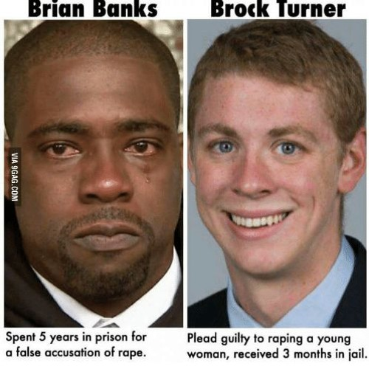
The formula was particularly likely to falsely flag black defendants as future criminals, wrongly labeling them this way at almost twice the rate as white defendants. White defendants were mislabeled as low risk more often than black defendants.
The variables used in order to create the algorithm for determining recidivism scores
Risk scales
General recidivism
Violent recidivism
Recedivism risk screen
On Counter-Intuitive Predictions
Pretrial misconduct
Pretrial release risk
FTA (Failure To Appear)
New Felony arrests
Pretrial Failure
The 137 questions
Criminogenic need scales
Cognitive behavioural
Criminal Associates/Peers
Criminal involvement
Criminal opportunity
Criminal personality
Criminal thinking self report
Current violence
Family criminality
Financial problems

Slide 4
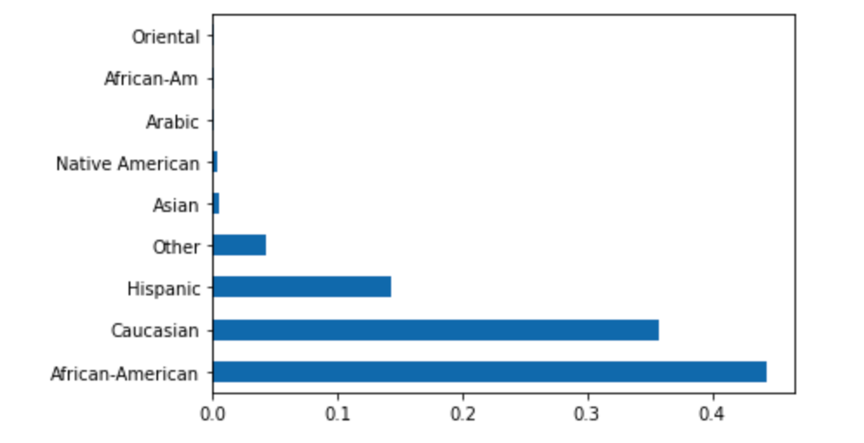
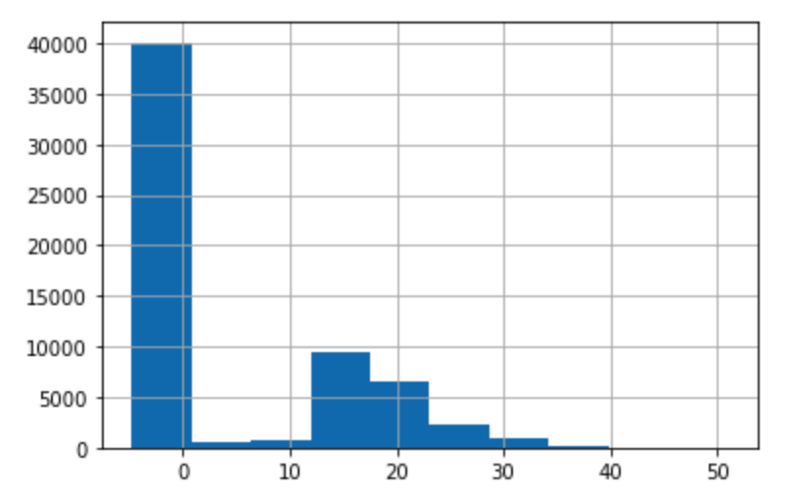
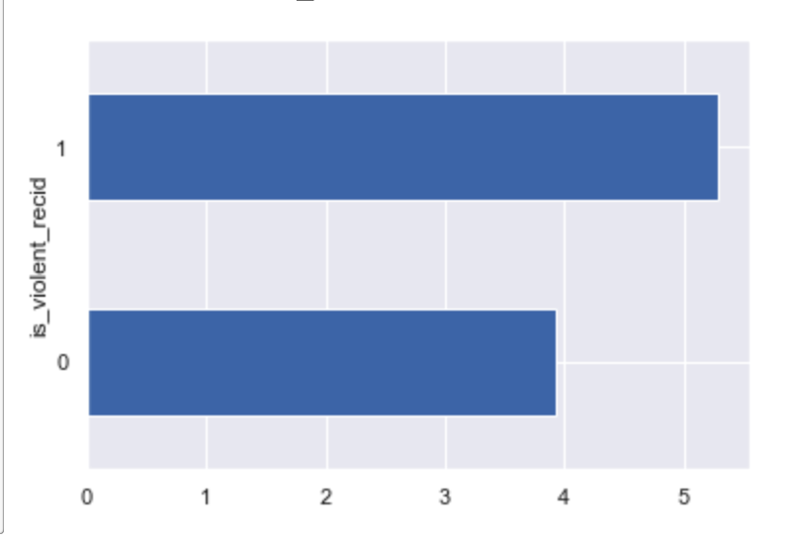
Some possible errors within the data
Some of the things that were noticeable in the data were:
There were two separate columns for African americans labelled ‘African-American’ and ‘African-Am’. Also something to take note of is that ‘African-Am’ appeared to have very few values
The RawScores within the ‘compas-scores-raw’ dataset also appeared to have a strange gap in the scores
Something else that seemed quite strange was the ‘is_violent_recid’ against ‘v_decile_score’ why is it that the violent decile scores are so close to each other?

Slide 5
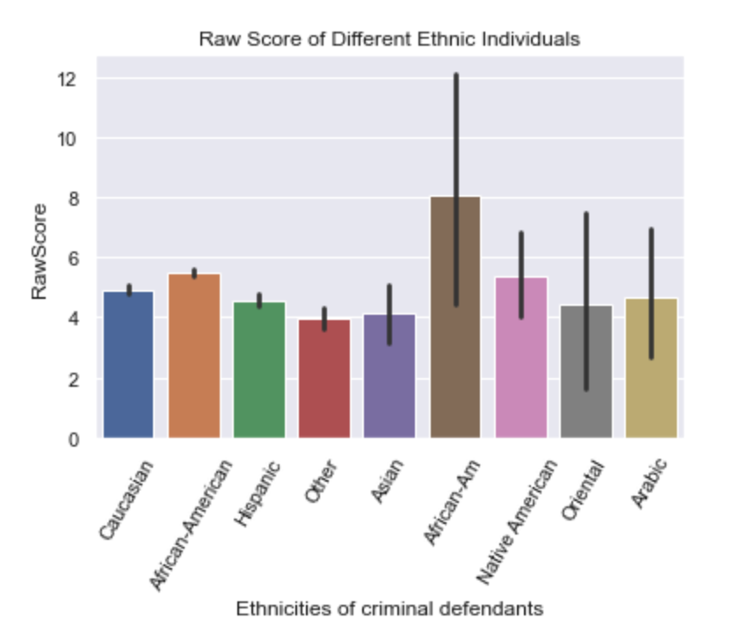
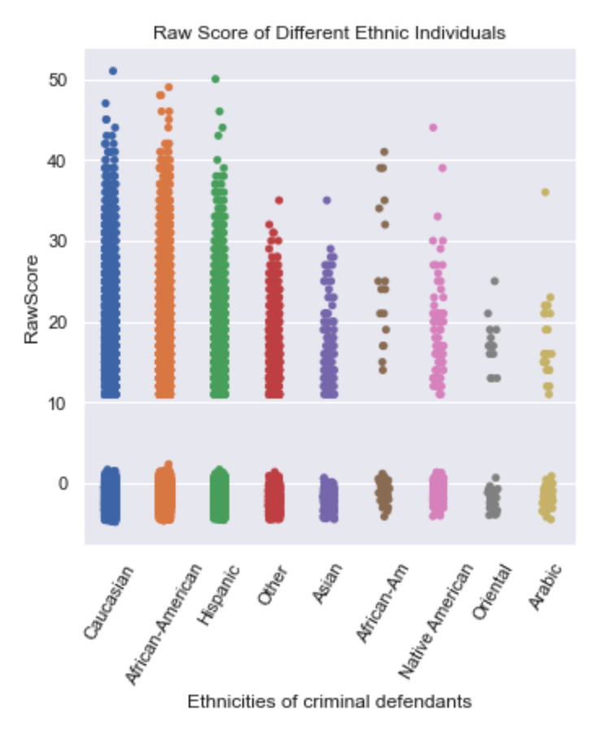
More analysis of the data
When visualizing the data slightly differently it seems as though we get different pictures. The bar graph suggests that the group African-Am have quite high Raw Scores but the scatplot suggests far fewer Criminals with lower average scores

Slide 6
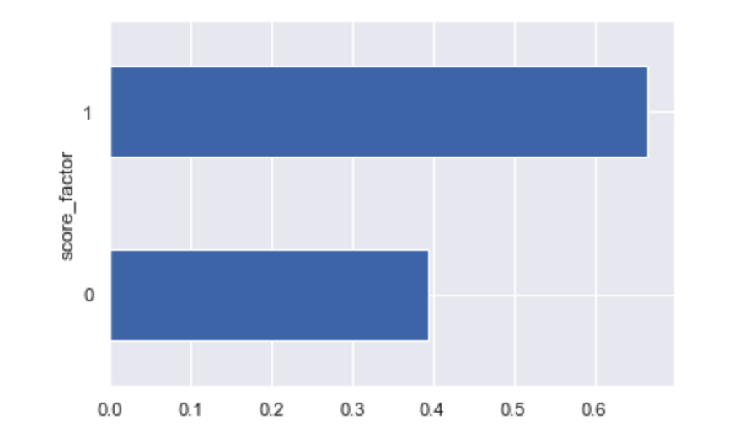
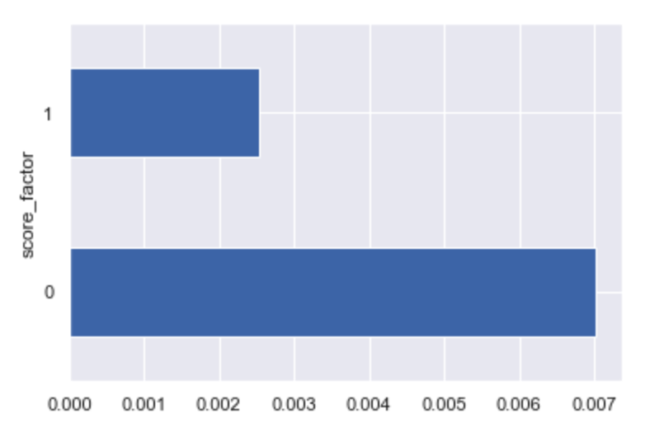
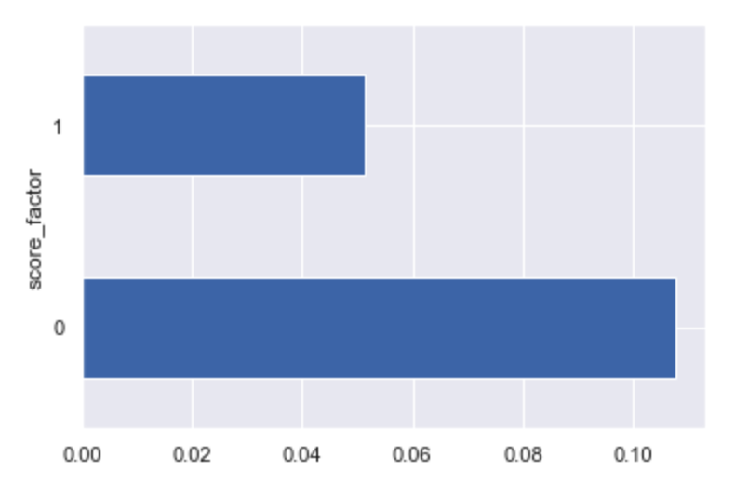
What the data suggests
The data presented in the “cox-violent-parsed_filt” file does suggests that African-Americans have a higher score than all other demographics. Suggestive of the fact that African Americans are a lot more likely to recidivate. In fact it seems like more often than not in this case where as that is not the same for Asians and Hispanics
African-American score
Asian scores
Hispanic scores

Slide 7
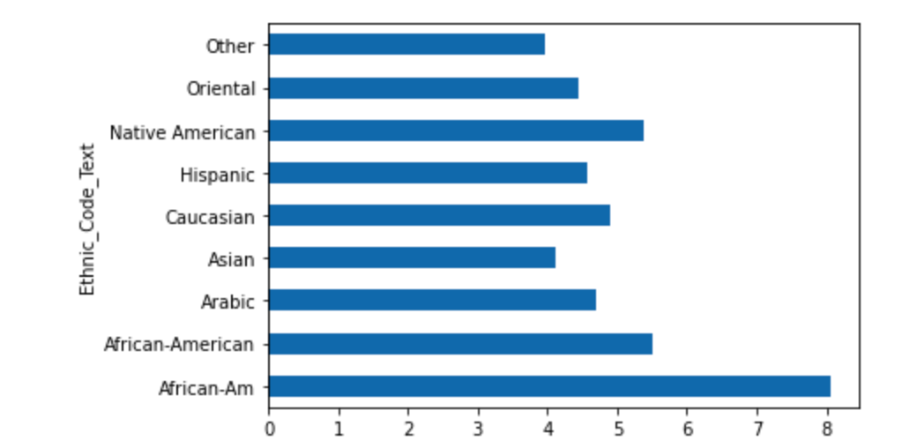
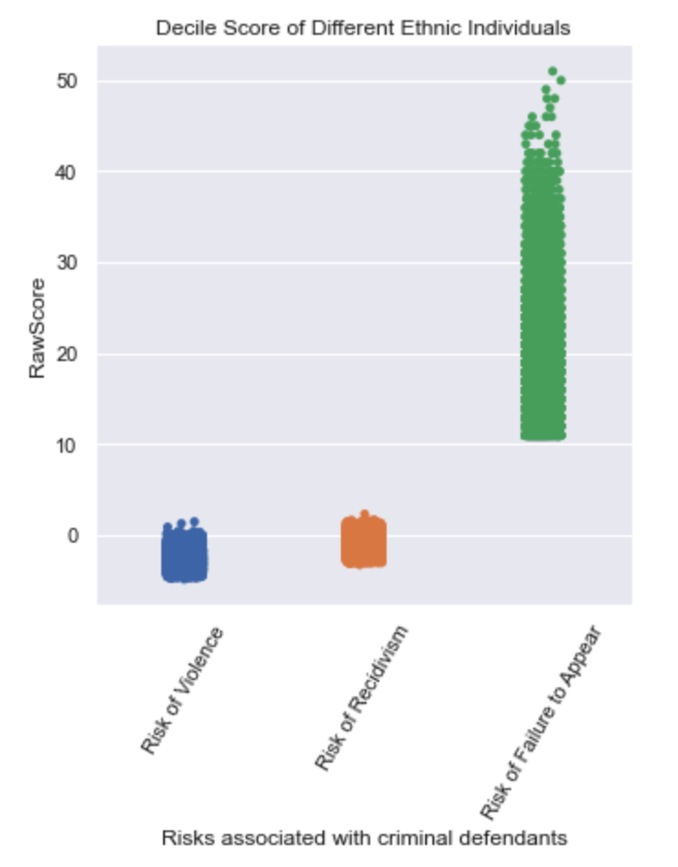
Running some of the data
If we take a look at this graph it suggests that ‘African-Ams’ and ‘Arabs’ have some of the highest Raw Scores which may suggest they are more likely to commit future crimes but in the graph above both demographics seem to have very few people who make up the total count of criminals
When we look at the scores of criminal defendants based on the risks that the present the data suggests something quite interesting. How can the risk of not appearing in court present higher scores than the risk of violence and recidivism? It is possible that African-American defendants are more likely not to appear due to various reasons.
Ultimately what we learn from this data is that there are some discrepancies that need addressing

Slide 8
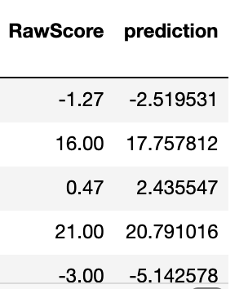
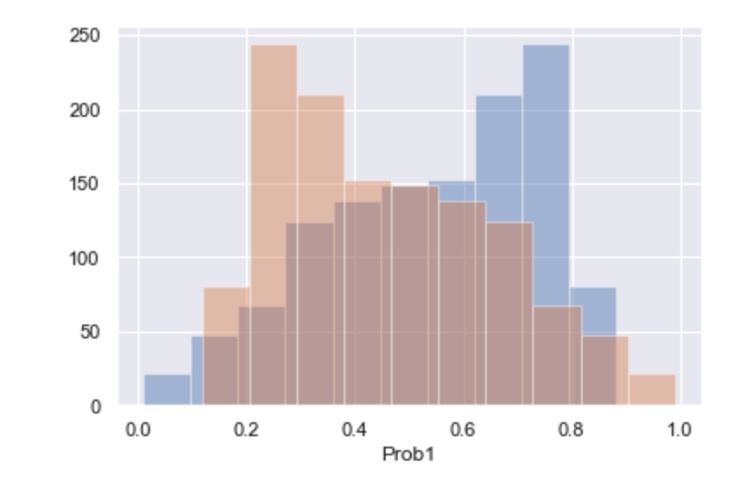
Testing the data using Machine Learning
After testing the model using Linear regression for the “compas-scores-raw” data set. It seems as though the algorithm does not seem to present good results given the variables. This solidifies the fact that there may be an unneccessary racial bias
And if we run a logistic regression on the “propublica_data_for_fairml” data we see the machine is not good at predicting scores for the demographics within the groups provided. It seems as though the machine is in fact switching the target and prediction

Slide 9
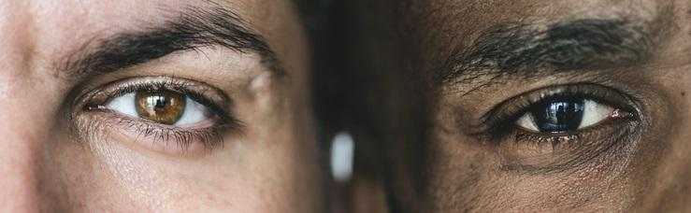
Conclusion
It is clear that within the compas data there is a clear racial bias against african americans. The racial bias is also in no way a good indicator that a criminal will be a recidivist as shown using Machine Learning to test the predictability of a recidivist.

