Slide 1
Financial Analysis of FMCG Sector
Under the guidance of Dr. Prasantha Kumar
24MBMA04 – K Bhavani Venkata Karthik

Slide 2
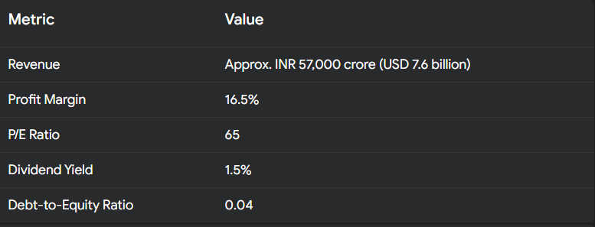
Hindustan Unilever (HUL)

Slide 4
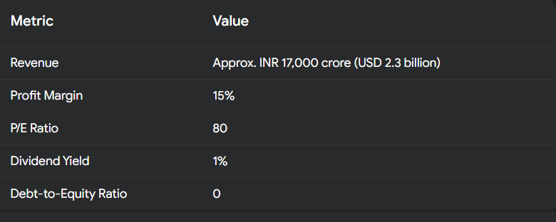
Nestle India

Slide 6
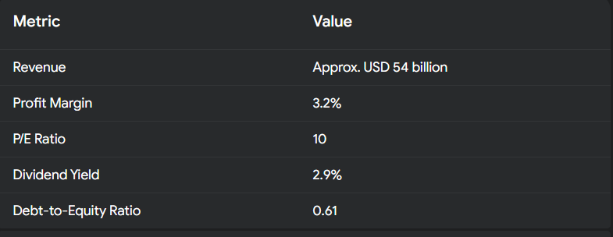
Tyson Foods

Slide 7
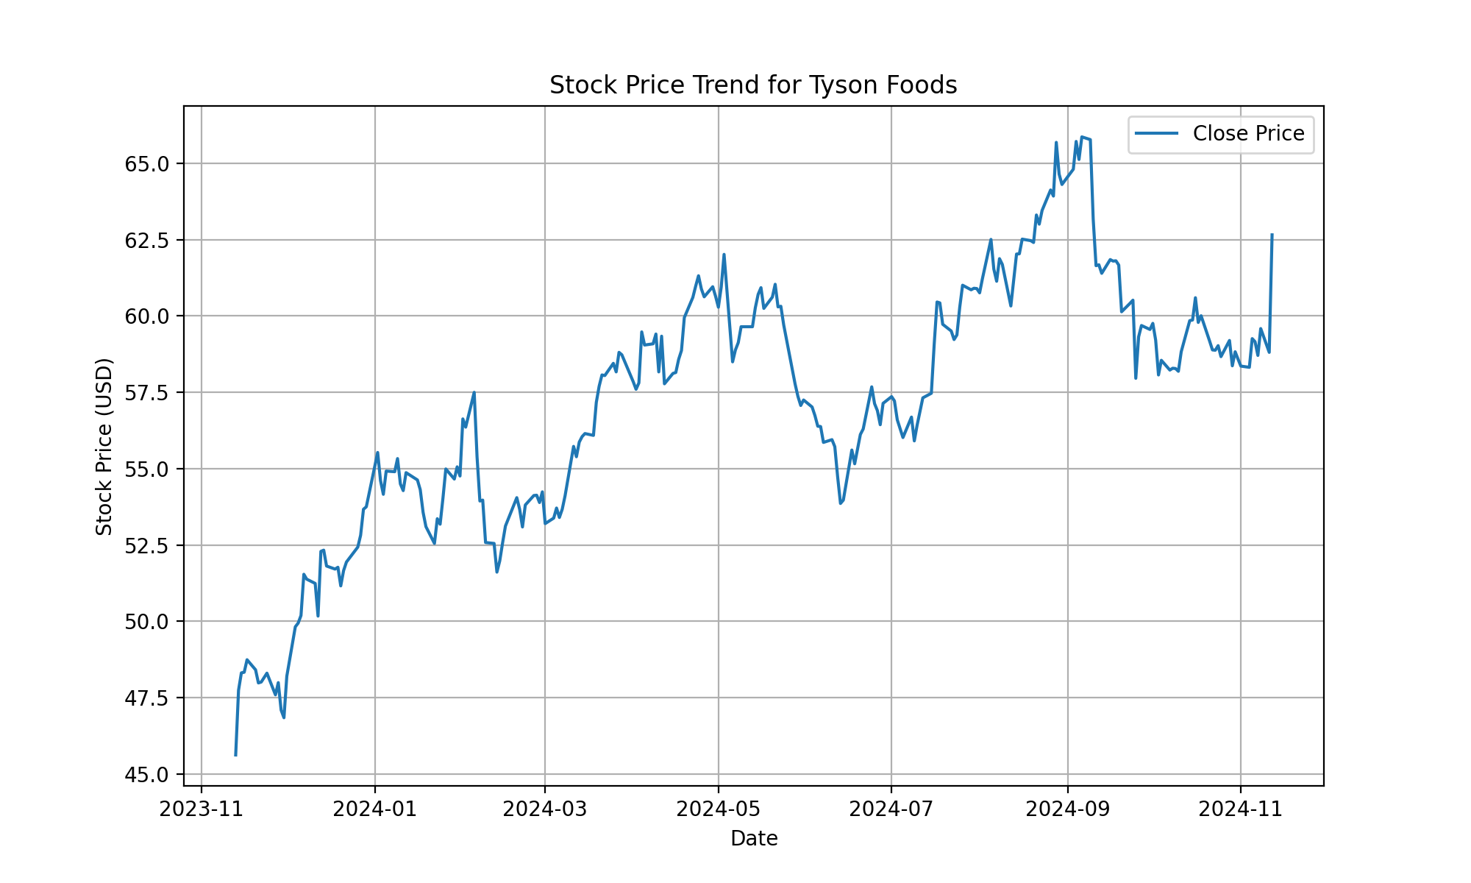
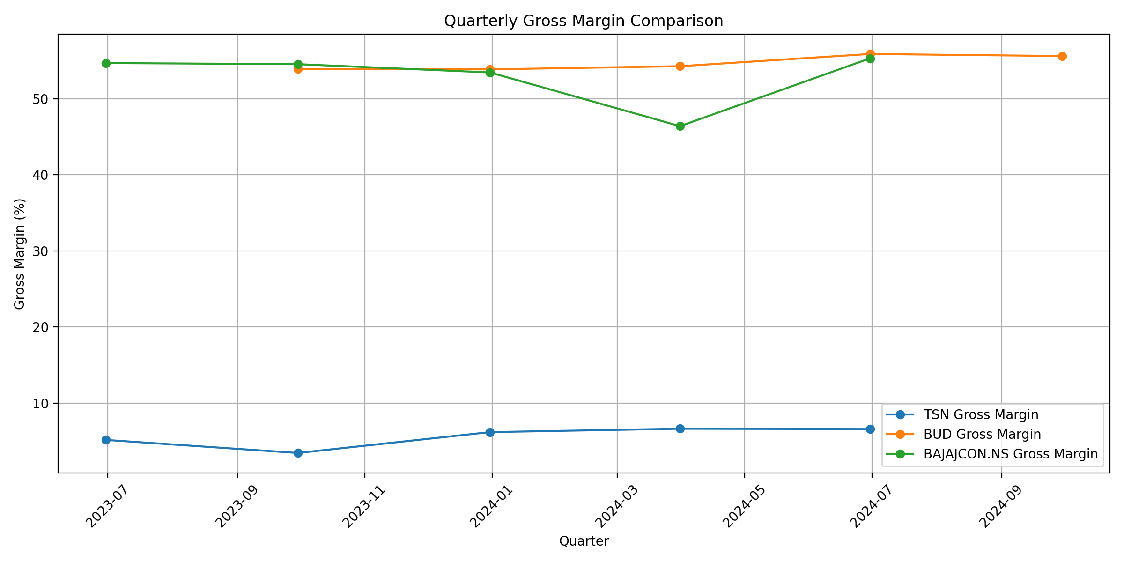

Slide 8
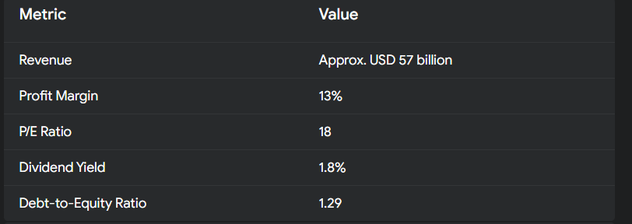
Anheuser-Busch InBev

Slide 9
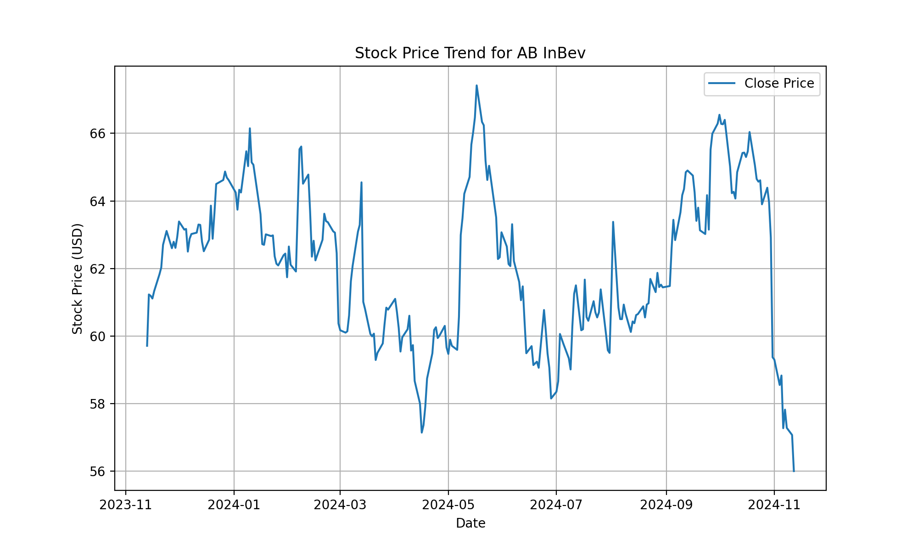
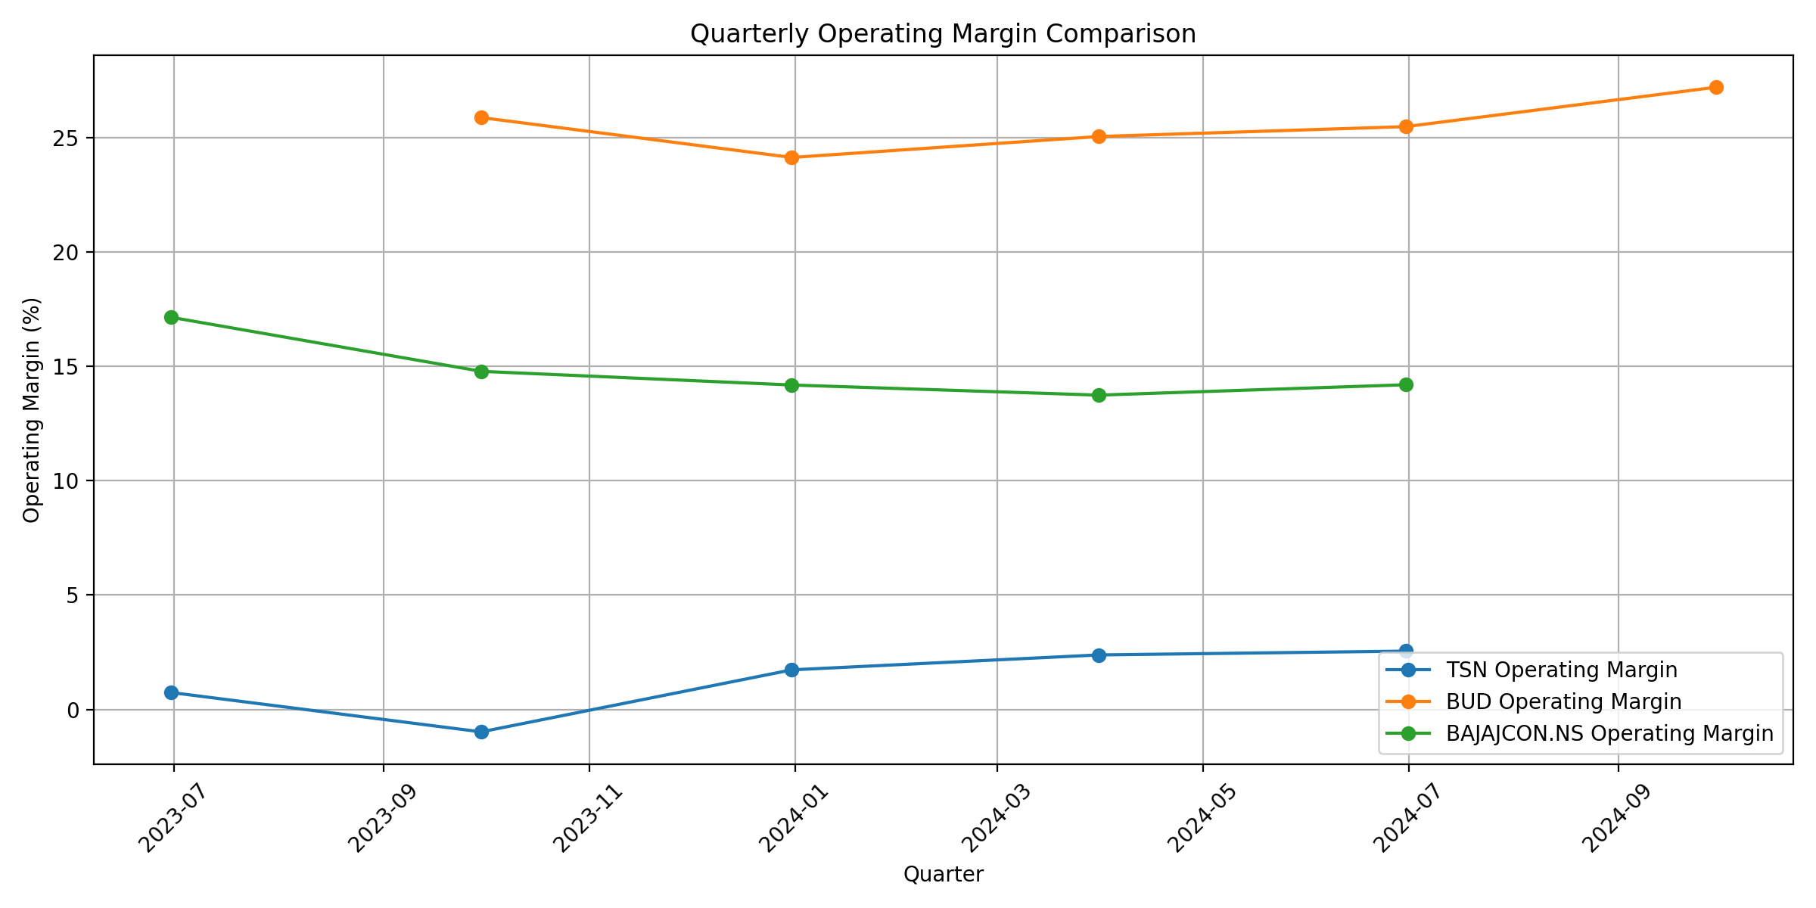

Slide 10
Conclusion
Strong Revenue Generation: Major FMCG companies like ITC Limited, Hindustan Unilever, and Nestle India demonstrate substantial revenue, reflecting the sector's significant market demand and consumer base.
Profitability Insights: Profit margins vary across companies, with leaders like ITC and Dabur showing high profitability (25% and 18%, respectively), indicating effective cost management and pricing strategies.
Valuation Metrics: Companies in this sector generally have high P/E ratios, especially Nestle India (80) and P&G (90), indicating investor confidence but also potentially high expectations for future growth.
Dividend Yields and Investor Returns: Dividend yields are modest across the sector, with ITC providing the highest at 3%, which may appeal to income-focused investors despite a focus on growth reinvestment.

Slide 11
Conclusion (Contd.)
Debt Management: Low debt-to-equity ratios in most companies highlight conservative financial strategies, suggesting robust financial health and lower risk for investors.
Sector Trends and Challenges: The FMCG sector shows resilience but faces challenges from high valuations, increasing competition, and the need to innovate continuously to meet consumer expectations.
Future Outlook: Continued growth in consumer demand, coupled with strong brand positioning and operational efficiency, should support sector expansion, though companies must balance growth with profitability.

Slide 12
Thank You Sir For This Opportunity

