Slide 1
Financial Performance Analysis

Slide 2
Growth Metrics
Double-digit revenue growth seen across multiple quarters
Sales increases ranging from 5.2% to over 100% year-over-year
Consistent expansion in net sales across different sectors
Geographic growth particularly strong in Russian markets
Multiple companies showing sustained growth trajectories

Slide 3
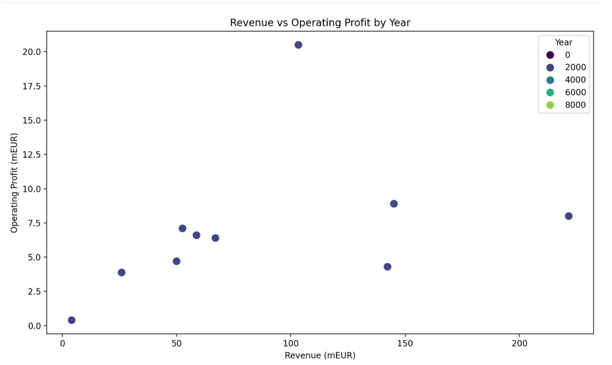

Slide 4
Profitability Trends
Transition from losses to break-even points
Operating profit improvements of up to 34.9%
Profit margins ranging from 7.7% to 9.7% of net sales
Pre-tax profit recoveries from previous losses
Consistent operating profit growth across years

Slide 5
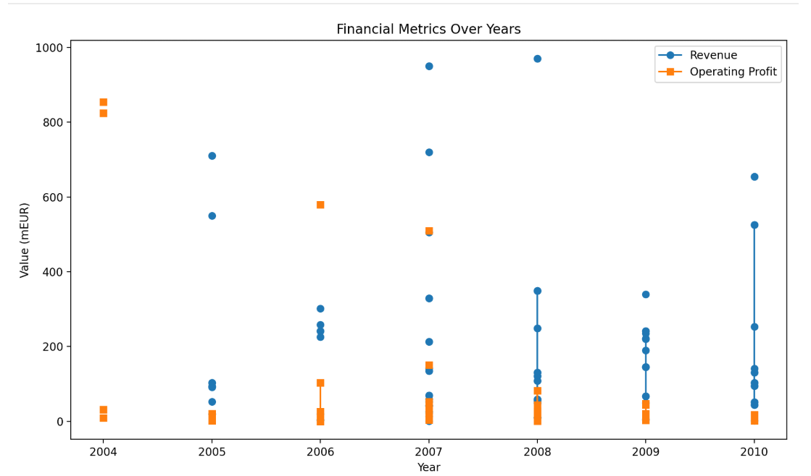

Slide 6
Financial Performance Indicators
Strong quarterly performance improvements
Year-over-year sales increases in EUR terms
Positive trend in consolidated net sales
Improved performance in retail segments
Multiple instances of doubled revenue figures

Slide 7
Operational Efficiency
Successful cost management leading to profit growth
Effective scaling of operations
Improved operational margins
Strategic geographical expansion
Efficient management of divisions (e.g., Foundries, Machine Shop)

Slide 8
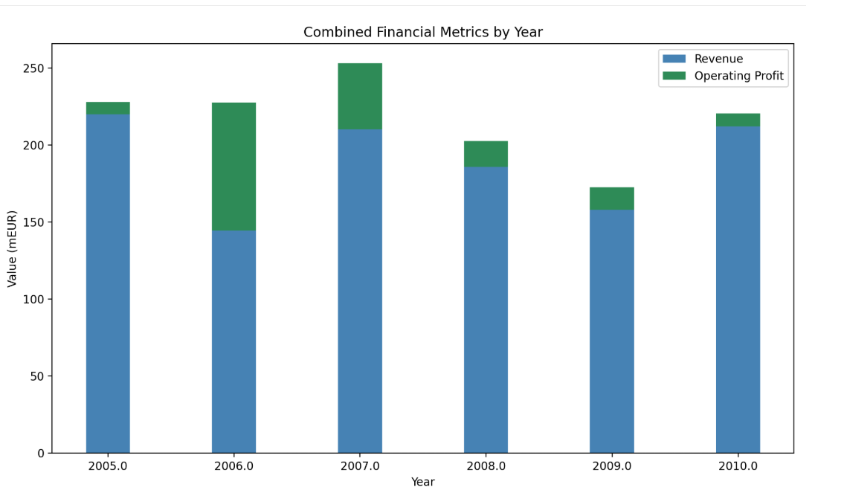

Slide 9
Market Position & Strategy
Strong market presence in Nordic regions
Strategic expansion into emerging markets
Diversification across multiple sectors
Positive market sentiment reflected in stock performance
Successful implementation of growth strategies

Slide 10
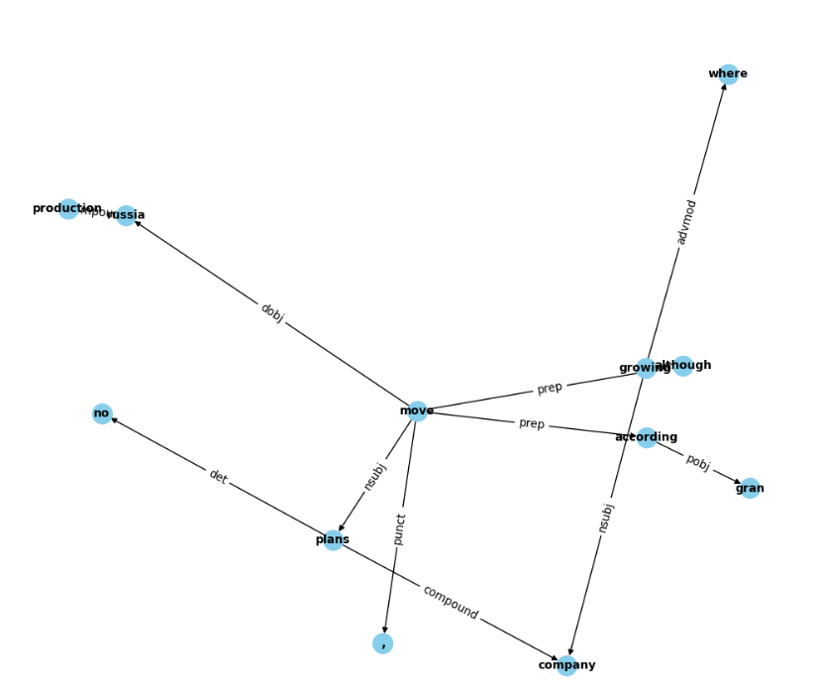

Slide 11
Metric Usage
Mean Squared Error (MSE) is used to evaluate the performance of a regression model predicting stock performance.
Correlation Coefficient is calculated between sentiment scores and predicted stock performance to assess their relationship.
Sentiment Distribution Analysis is performed using PCA (Principal Component Analysis) for visualizing sentiment clustering.
Word Frequency Analysis with CountVectorizer is used to identify the most influential words affecting sentiment.
Positive Sentiment Ratio is computed to gauge overall market sentiment trends and their potential impact on stock performance.

Slide 12
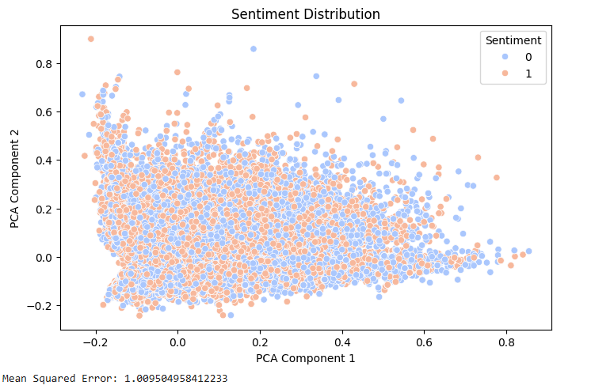

Slide 13
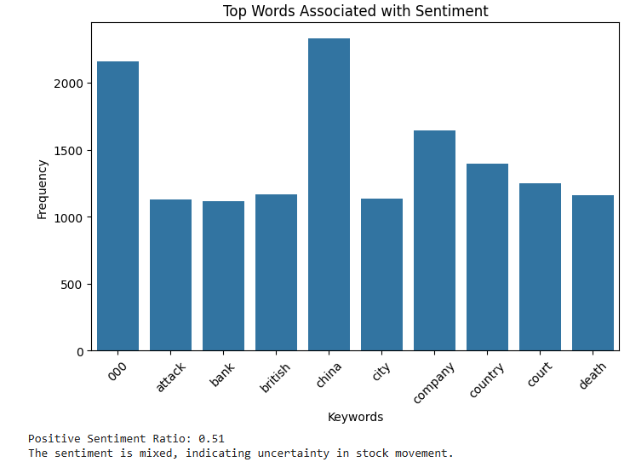

Slide 14
Model Performance
TF-IDF Vectorization is applied to convert text data into numerical features for model training.
PCA Dimensionality Reduction is used to visualize the sentiment distribution effectively.
Linear Regression Model is trained to predict stock performance based on sentiment data.
Train-Test Split (80-20) is used to evaluate the regression model’s performance on unseen data.
Predicted vs. Actual Stock Performance is visualized using scatter plots to assess the regression model's effectiveness.

Slide 15
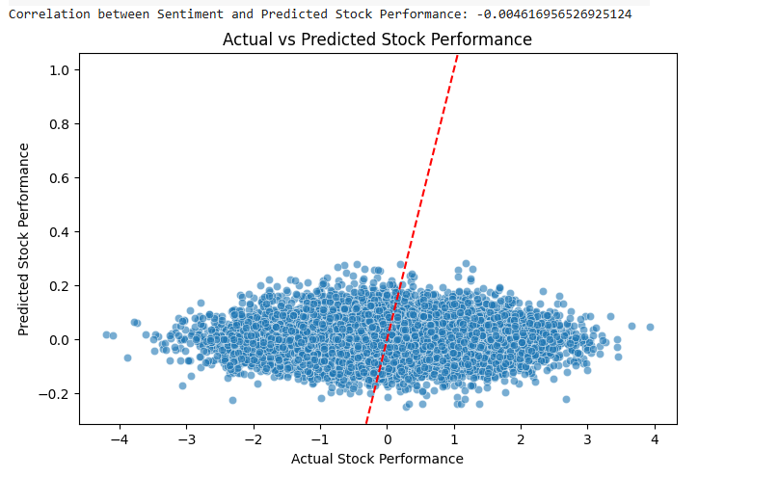

Slide 16
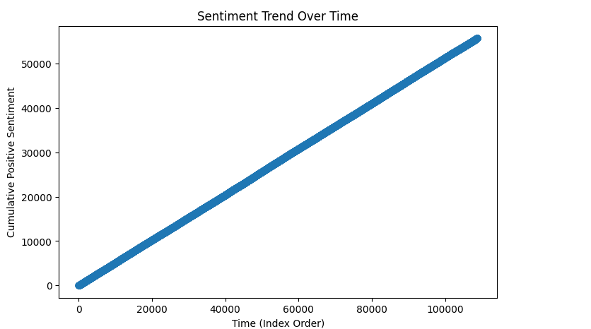

Slide 17
Thank You

