Slide 1
SDN Based QKD Algorithm for Hybrid Networks [1st Review]
Guided By:
Dr. P. Varalakshmi
Members:
K Bhavani Venkata Karthik (2019503511)
Ravi Kant(2019503549)
Batch 1

Slide 2
Outline
Objectives
Existing Architectures
Drawbacks of Existing Architectures
Literature Survey
Implementation
References

Slide 3
Objectives
To adopt and host the KMB09 Quantum Key Distribution(QKD) efficiently on a Software Defined Network
To increase the transmission rate of the KMB09 protocol.
Successful integration of the proposed architecture over a 6G network.
Robustness and security against new age cyber attacks.

Slide 4
Existing Architectures
OpenFlow architecture , SDN solutions three main parts are :-
1. Control plane : Programming forwarding/switching devices and is implemented in network controller device as physical or virtual with single configuration point
2. Data plane : It consists of network devices for forwarding or
switching packets. It communicates through Southbound API
with control plane.
3. Applications plane : It consists of network services and SDN application .It communicates through Northbound API with control plane

Slide 5
Drawbacks of Existing Architectures
Application plane threats : Without authorization and authentication the network can be exploited by applications which bring new functions to network.
Northbound interface threats : Anomalies can be inserted into, without secure connection to controller.
Control plane threats : Centralized controller enforces SDN policy into devices and if it crashes then new policy can not be enforced leading to entire network failure.
Southbound interface threats : Modification of nodes can occur during communication between data plane and control plane leading to integrity issues.
Data plane threats : Security threats come into existence due to addition of compromised device.

Slide 6
Literature Survey

Slide 7
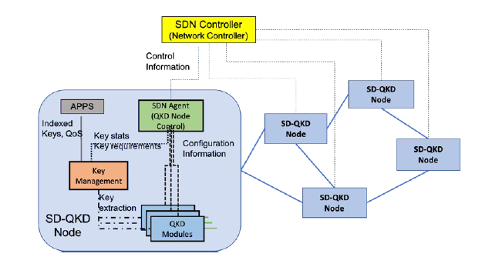
Increasing network reliability by securing SDN communication with QKD
A novel approach to secure communications is provided by Quantum Key Distribution (QKD) that is a physical layer technology capable to securely deliver symmetric encryption keys leveraging on quantum physics properties.
The research demonstrates how to provide unconditionally secure communication at SDN level dramatically improving the reliability of the communication network itself.

Slide 8
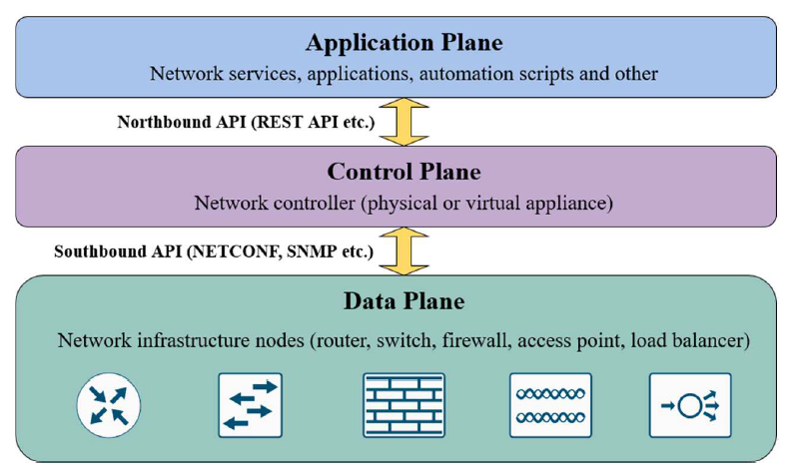
Security Benefits and Drawbacks of Software- Defined Networking
To simplify management and overcome limitations of traditional networks concept of software-defined networking (SDN) was proposed.
The main idea of SDN is separation of control and data planes of devices. Combined control plane into network controller brings intelligence into network and open wider possibilities for automation.
Separated data plane makes it possible for devices to run in headless mode during critical situations when control plane is not functioning. SDN also simplifies managing of security policies, it helps to ensure intime deploying and minimize possibility of mistake.

Slide 9
On the performance of quantum cryptographic protocols SARG04 and KMB09
KMB09 provides improvement in quantum communication distance between Alice and Bob (the classical communicating parties).
KMB09 provides quantum cryptographic security in wireless transmission with adequate transmission rate and security.
Needs to be tested to verify protection against new age cyber-attacks.

Slide 10
Implementation Modules
SDN Simulation
Software Defined Network (SDN) simulations with SDN Controller and Open flow compatibility module. The paradigm of Software Defined Networks (SDN) and OpenFlow architecture, offer a way for the implementation of a programmable network architecture.
KMB09 QKD Protocol Enhancement
QKD uses physics and not math to encrypt data. The main disadvantage of KMB09 QKD protocol is the single photon source requirement. The protocol can be enhanced to resist photon-number-splitting attack if implemented using multiphoton sources.
Hybrid Framework Integration
An architecture for implementing QKD as an integrated service in SDN environment utilizing extended OpenFlow.

Slide 11
Implementation Plan And Tools
NS3 network simulator to be used for simulating the architecture.
Highly efficient and open source networks simulator with integrations to simulate latest domain technology like 6G networks.
OpenFlow will be utilized for efficient integration of hybrid architecture.
OpenFlow is an open API. It provides a standard interface for programming the data plane switches.
Implementation will be a three phased process divided as follows:
1. SDN Simulation
2. KMB09 QKD Protocol Enhancement
3. Hybrid Framework Integration

Slide 12
PROJECT : SDN Based QKD Algorithm for Hybrid Networks | OCTOBER | 4/10/2021 | 4/10/2021 | 4/10/2021 | NOVEMEBER | 4/10/2021 | 4/10/2021 | 4/10/2021 | DECEMEBR
 | Week 1 | Week 2 | Week 3 | Week 4 | Week 1 | Week 2 | Week 3 | Week 4 | Week 1 | Week 2
1. SDN Simulation
2. KMB09 QKD Protocol Enhancement
3. Hybrid Framework Integration
Problem Statement Identification
Literature Survey
SDN simulation on NS3
KMB09 implementation on NS3
Implementation of efficiency enhancement algorithm.
Documentation
Integration of SDN and QKD components into hybrid framework
Testing and Troubleshooting
Final Documentation.

Slide 13
References
P. Comi et al., "Increasing network reliability by securing SDN communication with QKD," 2021 17th International Conference on the Design of Reliable Communication Networks (DRCN), 2021, pp. 1-3, doi: 10.1109/DRCN51631.2021.9477334.
D. Melkov and S. Paulikas, "Security Benefits and Drawbacks of Software-Defined Networking," 2021 IEEE Open Conference of Electrical, Electronic and Information Sciences (eStream), 2021, pp. 1-4, doi: 10.1109/eStream53087.2021.9431466.
M. Lopes and N. Sarwade, "On the performance of quantum cryptographic protocols SARG04 and KMB09," 2015 International Conference on Communication, Information & Computing Technology (ICCICT), 2015, pp. 1-6, doi: 10.1109/ICCICT.2015.7045661.
S. K. Nivetha, N. Senthilkumaran, P. Suguna and T. Vanaja, "Analysing the Performance of Software Defined Network Controllers with Various Topologies," 2021 International Conference on Computer Communication and Informatics (ICCCI), 2021, pp. 1-5, doi: 10.1109/ICCCI50826.2021.9402480.
B. Harshitha, K. N. Madhusudhan and S. Lalitha, "Global Connectivity in Software Defined Network," 2021 7th International Conference on Advanced Computing and Communication Systems (ICACCS), 2021, pp. 1790-1793, doi: 10.1109/ICACCS51430.2021.9441768.

Slide 14
References (continued)
6. S. Roy, R. Dutta, N. Ghosh and P. Ghosh, "Leveraging Periodicity to Improve Quality of Service in Mobile Software Defined Wireless Sensor Networks," 2021 IEEE 18th Annual Consumer Communications & Networking Conference (CCNC), 2021, pp. 1-2, doi: 10.1109/CCNC49032.2021.9369647.
7. Y. Liu, B. Zhao, P. Zhao, P. Fan and H. Liu, "A survey: Typical security issues of software-defined networking," in China Communications, vol. 16, no. 7, pp. 13-31, July 2019, doi: 10.23919/JCC.2019.07.002.
8. E. Khan, S. Meraj and M. M. Khan, "Security Analysis of QKD Protocols: Simulation & Comparison," 2020 17th International Bhurban Conference on Applied Sciences and Technology (IBCAST), 2020, pp. 383-388, doi: 10.1109/IBCAST47879.2020.9044522.
9. A. P. Segara, R. M. Ijtihadie, T. Ahmad and P. Maniriho, "Route Discovery to Avoid Congestion in Software Defined Networks," 2020 6th International Conference on Science in Information Technology (ICSITech), 2020, pp. 62-67, doi: 10.1109/ICSITech49800.2020.9392049.
10.I. B. Djordjevic, "Hybrid QKD Protocol Outperforming Both DV- and CV-QKD Protocols," in IEEE Photonics Journal, vol. 12, no. 1, pp. 1-8, Feb. 2020, Art no. 7600108, doi: 10.1109/JPHOT.2019.2946910.

