Slide 1
Mushroomtour
Made by :
Gábor Erdei(Database)
Bálint Klubert(Backend)
Gergő Tán(Frontend)

Slide 2
What is our project goal?
The aim of our project is helping people get to know about mushrooms and mushrooming .
In this site:
you will get informations about the mushrooms of Zemplén,
you will be able to plan and take part trips with other mushroomers.
There will be a forum where you can search for special topics, and people will be able to share their experiment and knowledge.
There will be a map where you can see the trip routes and mushroom inspection places.

Slide 3






Functions of Mushroomtour
User Profile
Map
Tour organization, join
Forum
Encyclopedia

Slide 4
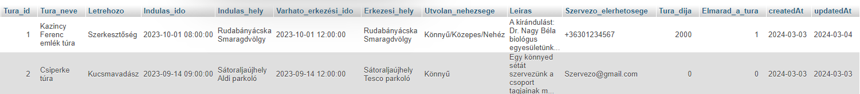
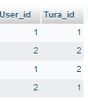
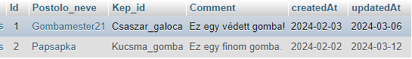
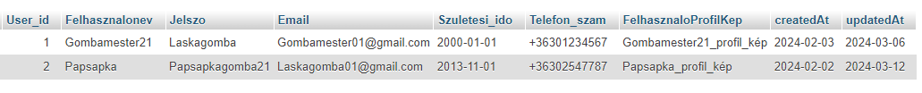
Uploaded tables
Tura_table
Post_table
jelentkezok_turara
felhasznalo

Slide 5
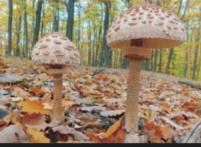
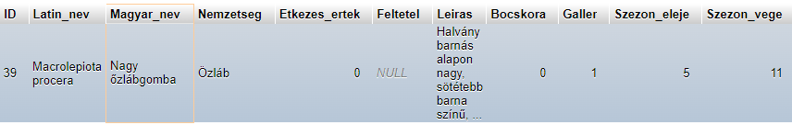
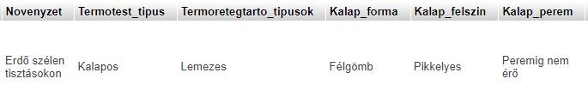
Uploaded tables
Source :Gécziné Nagy Mária, Hegyessy Gábor: Gombák Zemplénből nem csak zemplénieknek (publisher : Zempléni Gombász Egyesület) (2021)

Slide 6

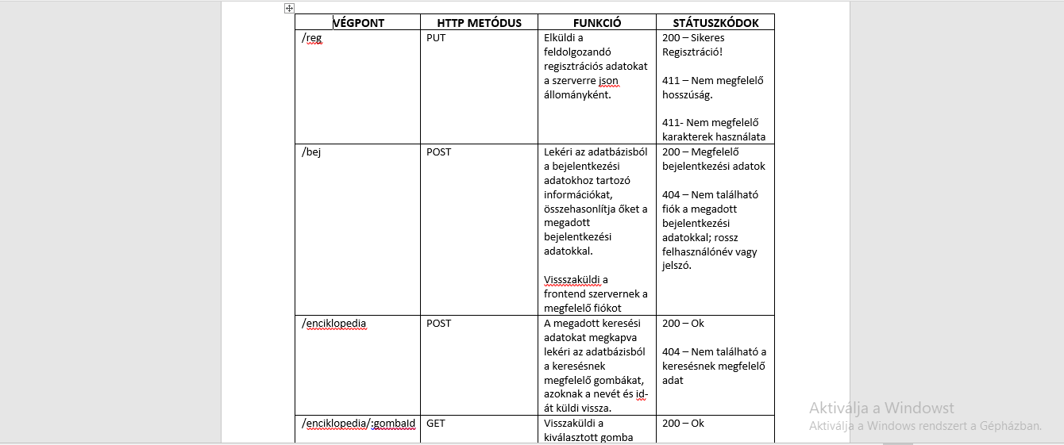
Backend

Slide 7
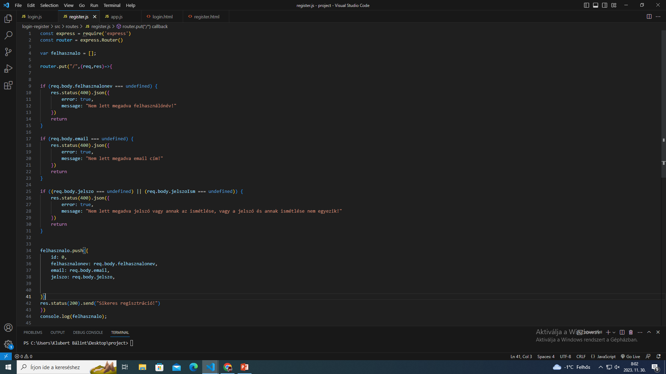
Source Code from the early stage

Slide 8
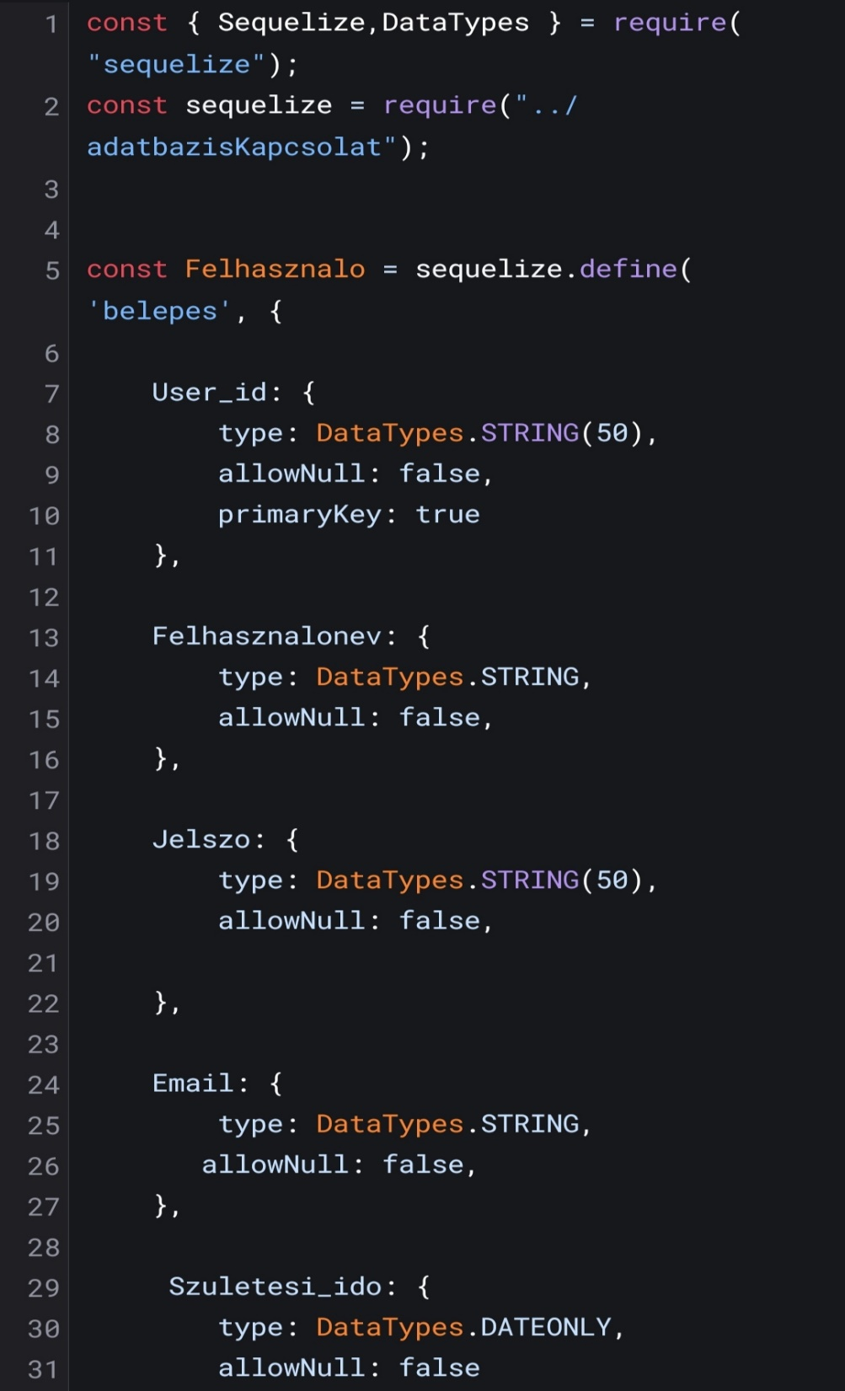
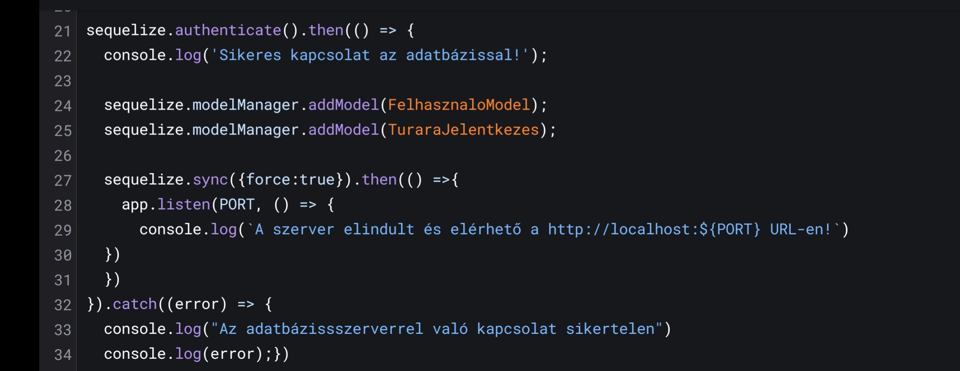
Up to date Codes

Slide 9
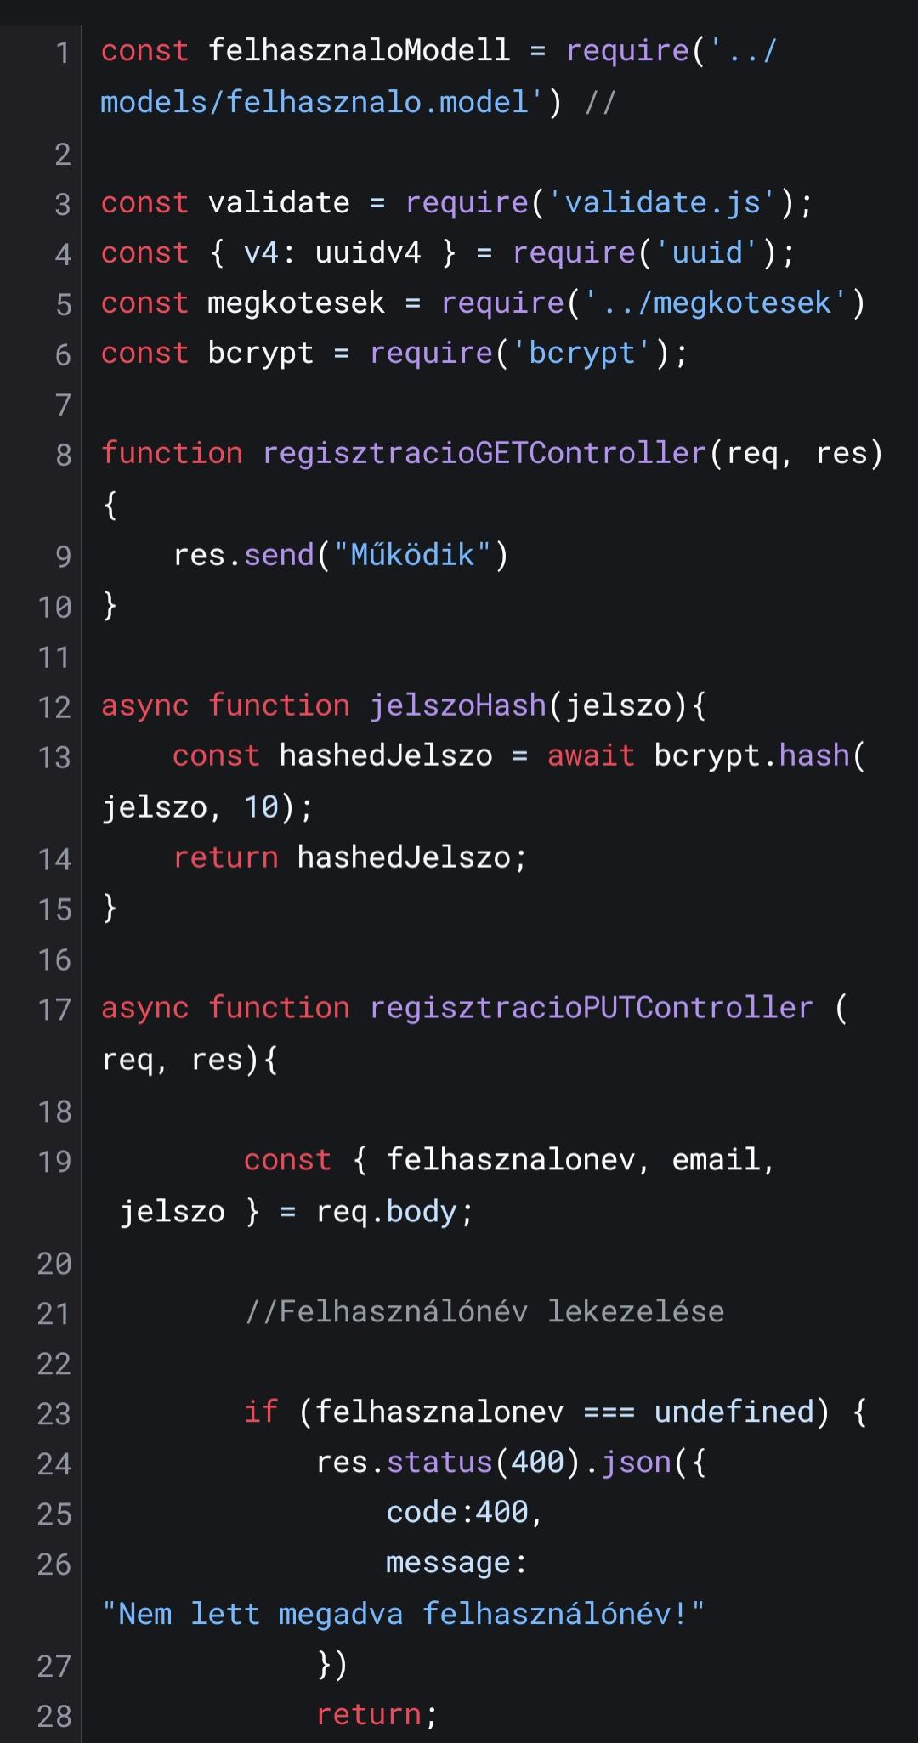
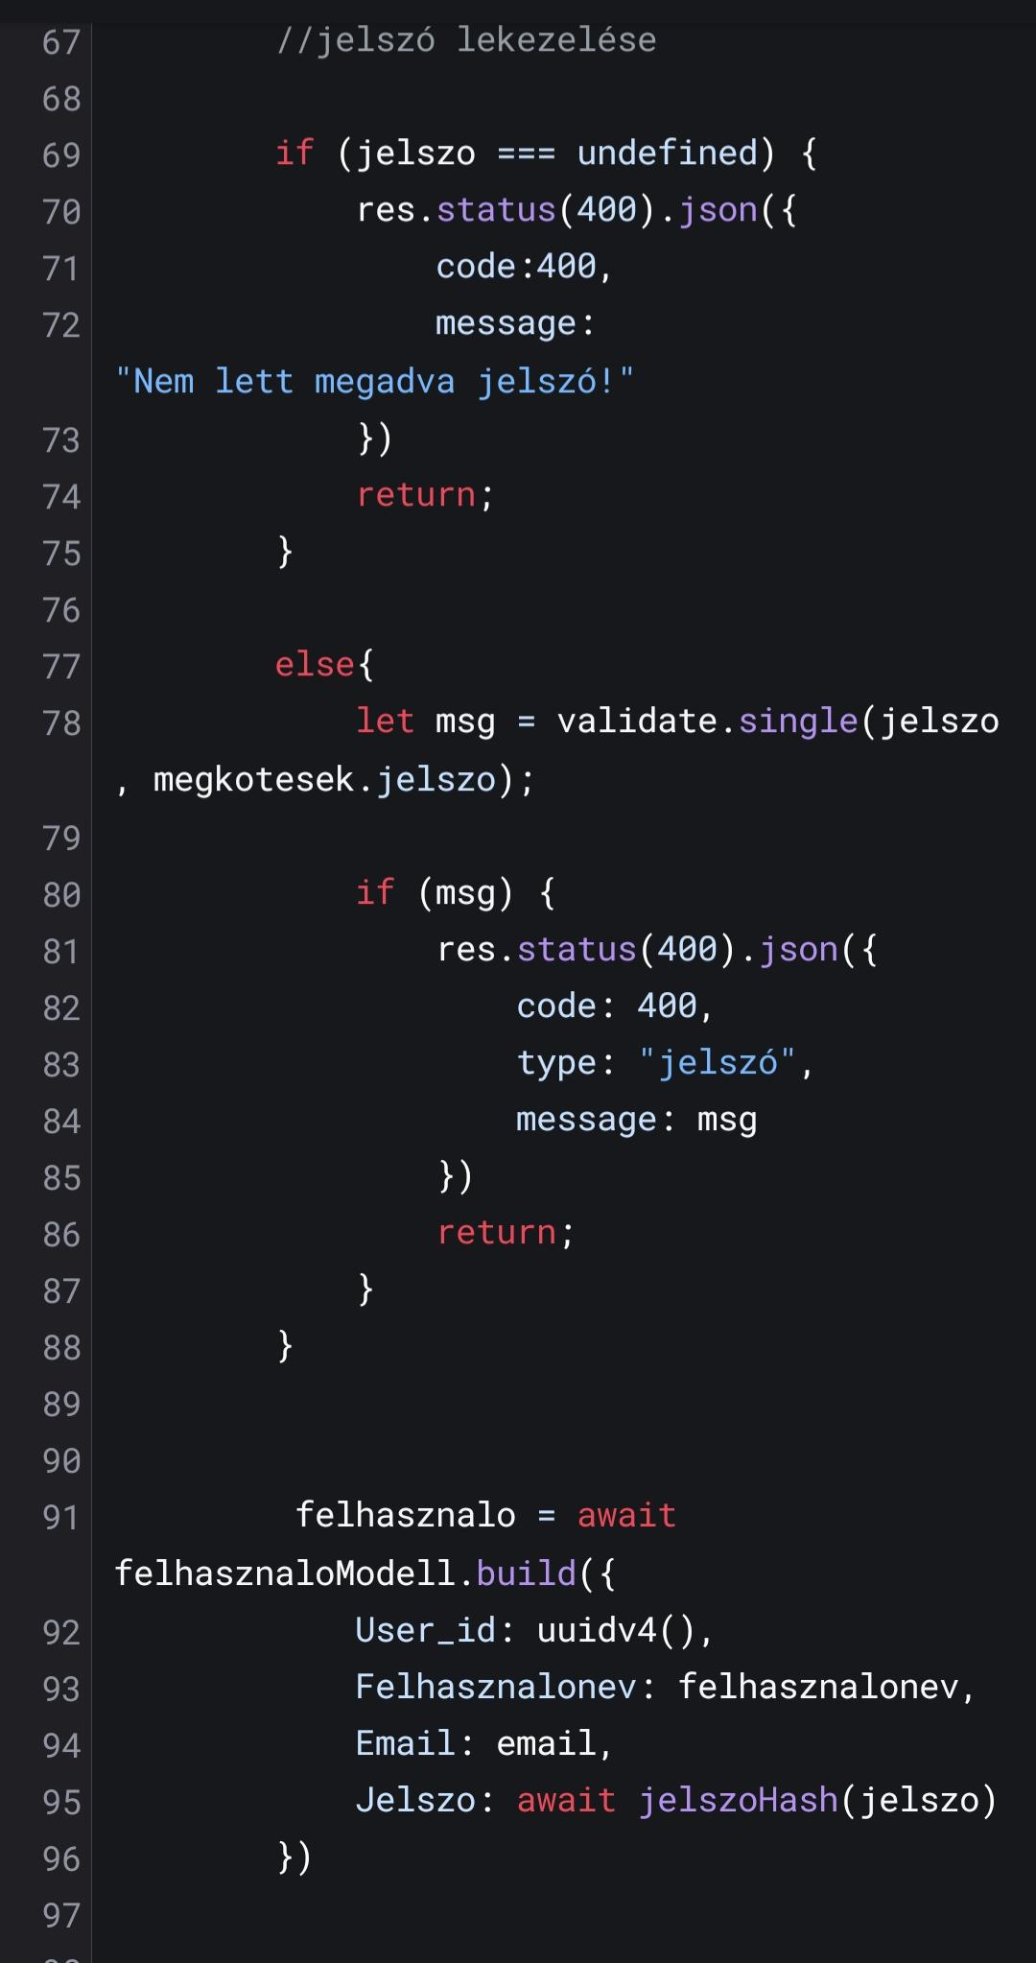
Up To Date Codes

Slide 10
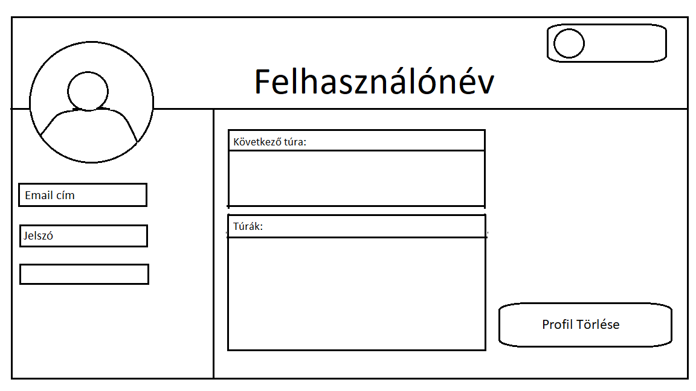
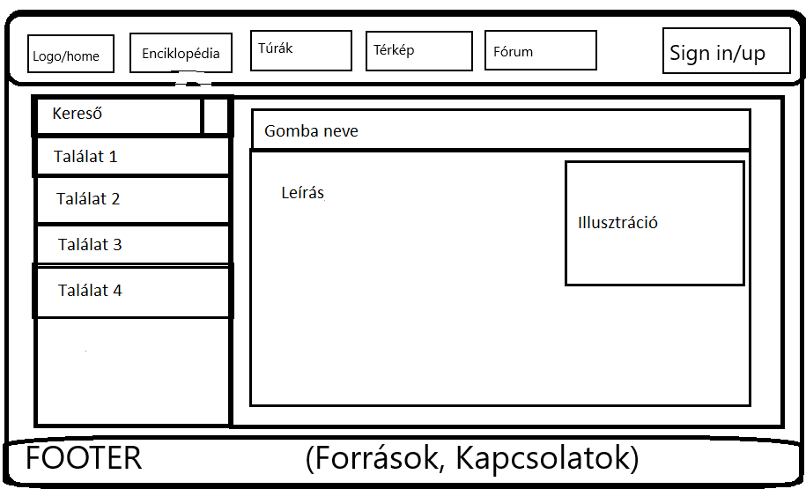
Site plans:

Slide 11
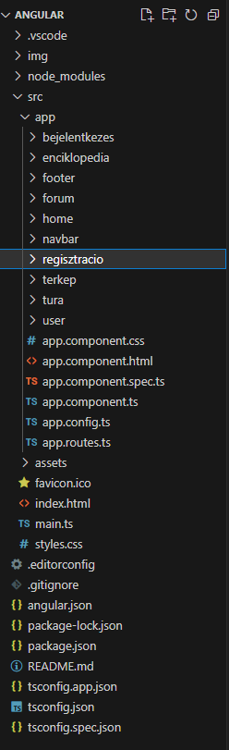
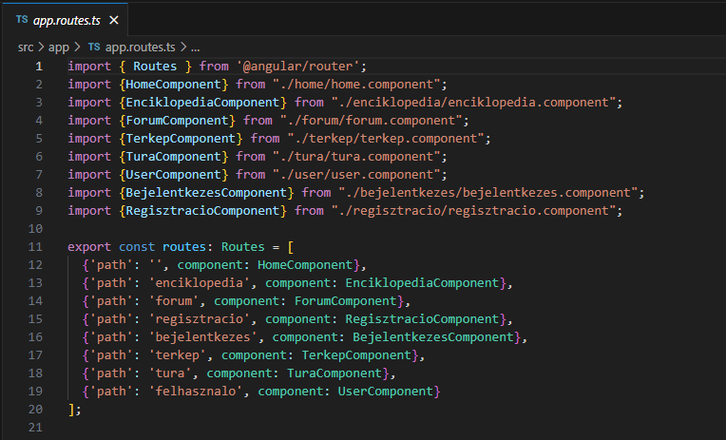
Code for the routing

Slide 12
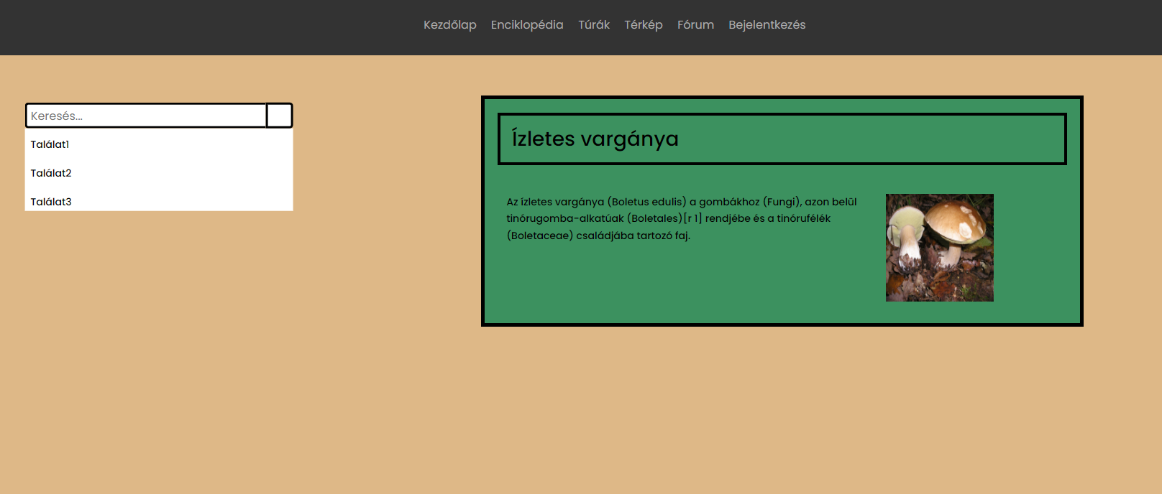
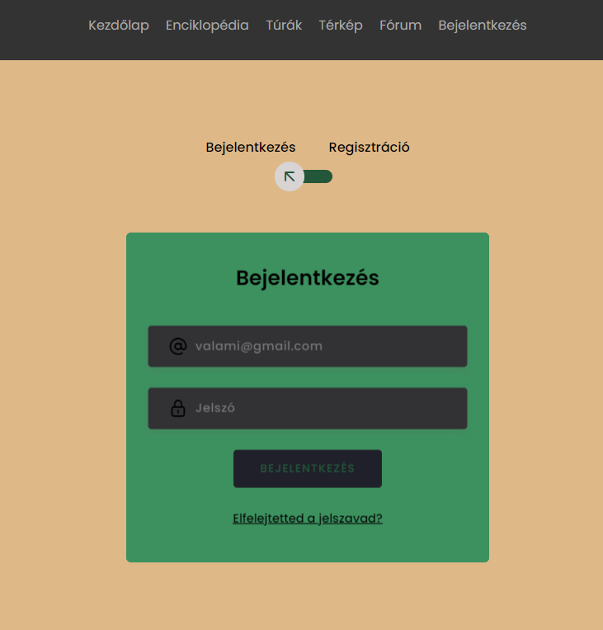
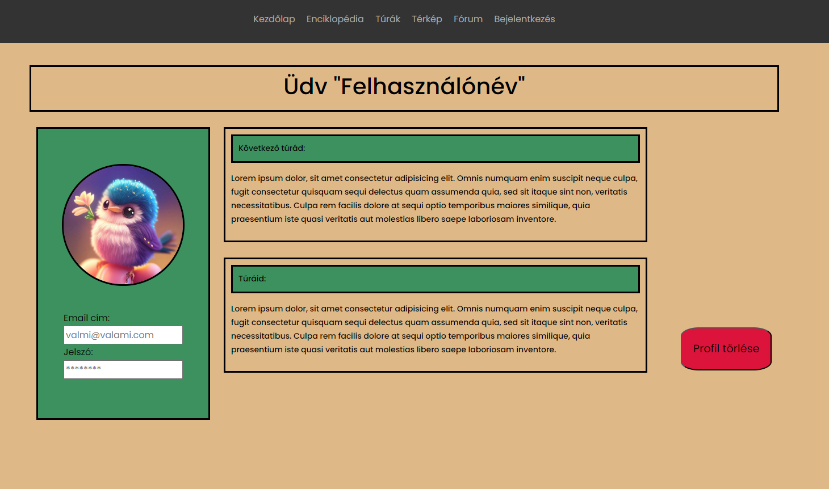
Actual views

Slide 13

Thank you for your attention

