Slide 1

Global Data Jobs Analysis – 2023
Insights into Salaries, Skills & Remote Work
Presented by Keith Billman

Slide 2

Contents
Project Overview
Tasks 1 & 2: Initial Checks & Cleaning
Task 3: Feature Creation
Task 4: Visualizations
Task 5: Time Series Analysis
Task 6: Full & Part-time Comparison
Task 7: Salary Trends
Task 8: Country/Location Comparison
Task 9: Text Parsing & Feature Engineering
Task 10: Interactive Visuals
Summary & Questions

Slide 3
Project Overview & Objectives
Dataset Job_Data.csv
Use Python, Pandas and Matplotlib
Explore Postings
Which Skills are in Demand
Which Roles Earn the Most
How Work Models Differ
How Salaries are Distributed

Slide 4
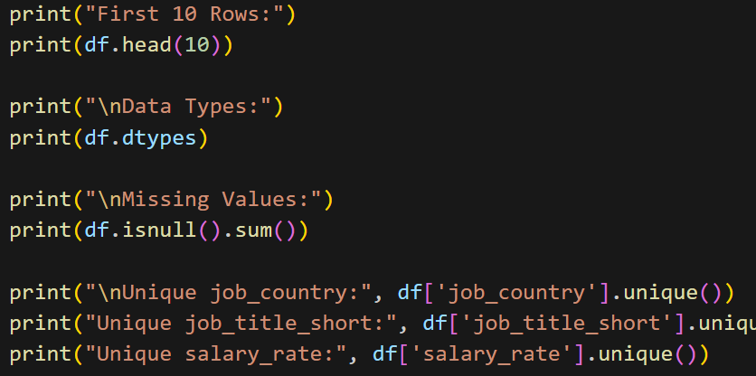
Initial Data Preparation
TASK 1: Data Checks
Display the First Ten Rows
Inspect Data Types
Check for Missing Values
Review Unique Values

Slide 5
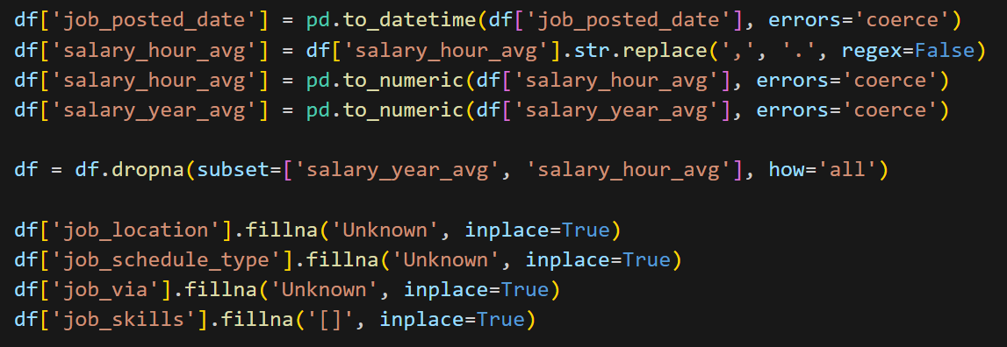
Initial Data Preparation
Task 2: Cleaning the Data
Converting Data Types
Handling Missing Values
Final Verification

Slide 6
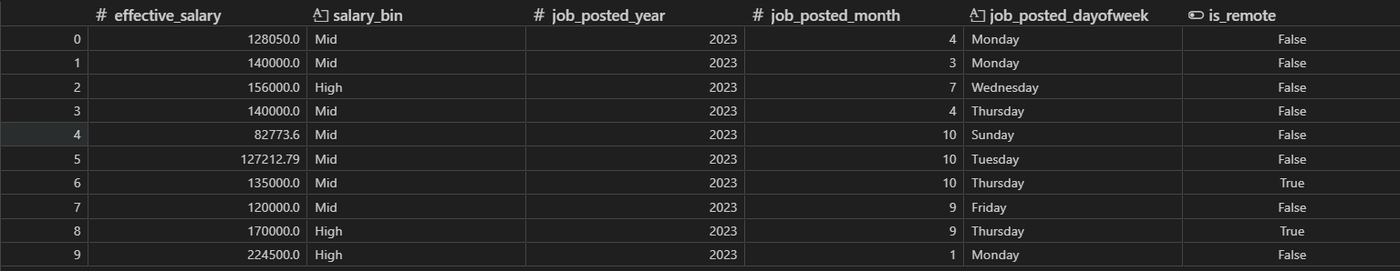
Task 3: Feature Creation
Feature Engineering
Converting hourly to annual salary
Created 'effective_salary' combining annual/hourly data
Extracted year/month/day from job post dates
Categorized salaries into low/mid/high bins based on the „effective_salary“
Create feature „is_remote“ from „job_work_from_home“

Slide 7
Task 4: Analyses
Clear Visualizations
Top 10 Most Frequent Titles
Top 10 In-Demand Skills
Salary by Job Title
Number of Remote Jobs by Year/Month
Salary by Country or US State

Slide 8
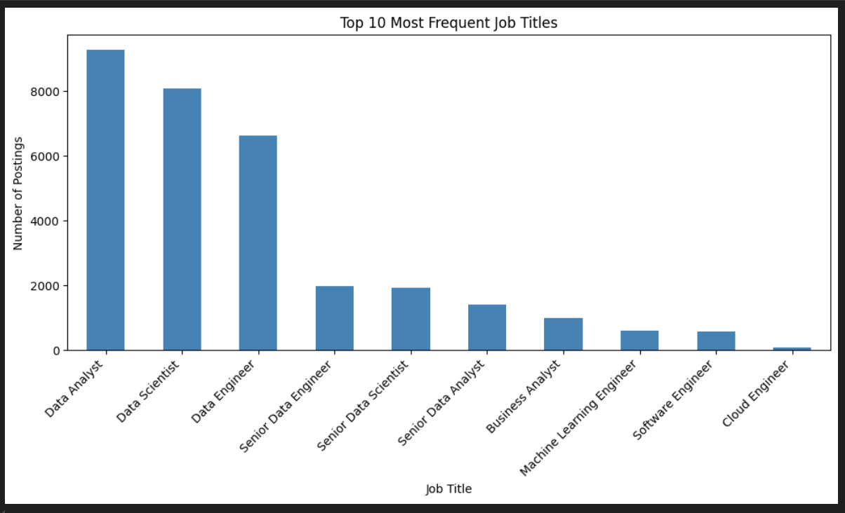
Most Frequent Job Titles

Slide 9
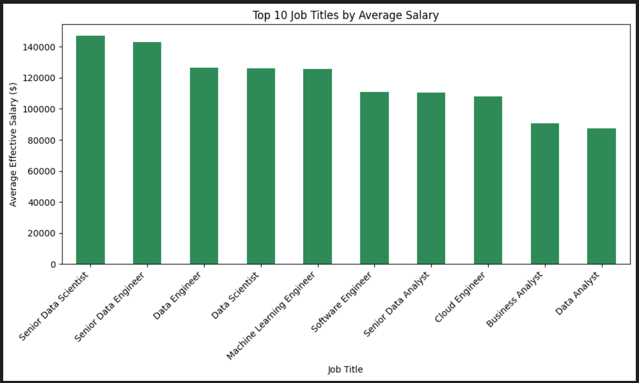
Job Titles by Average Salary

Slide 10
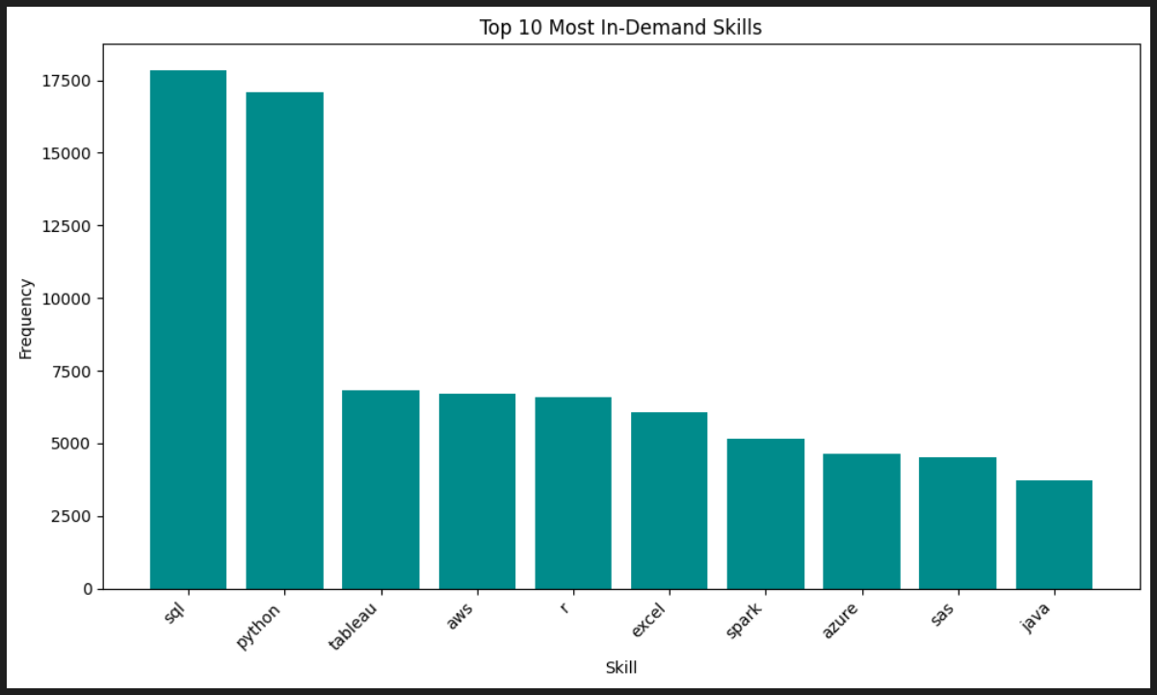
In-Demand Skills

Slide 11
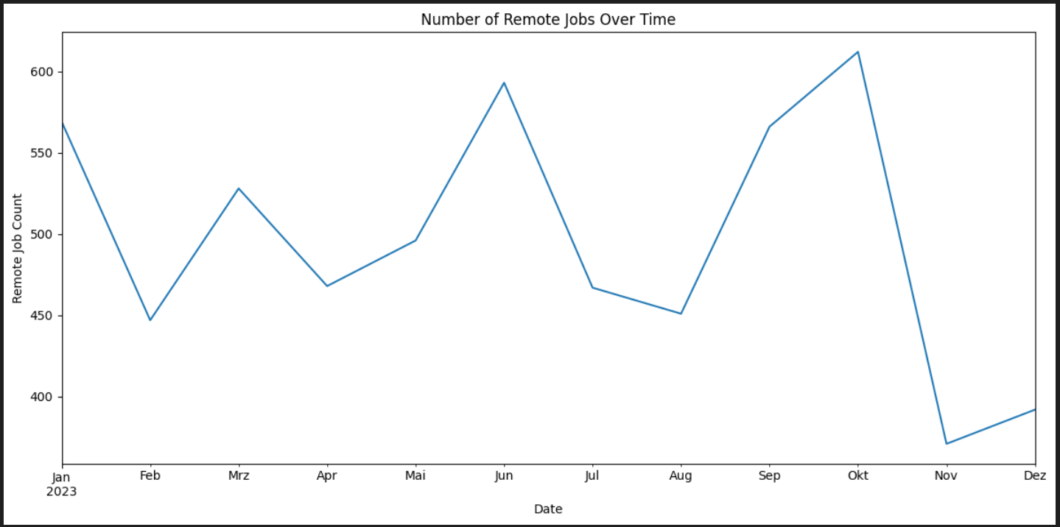
Remote Jobs over Time

Slide 12
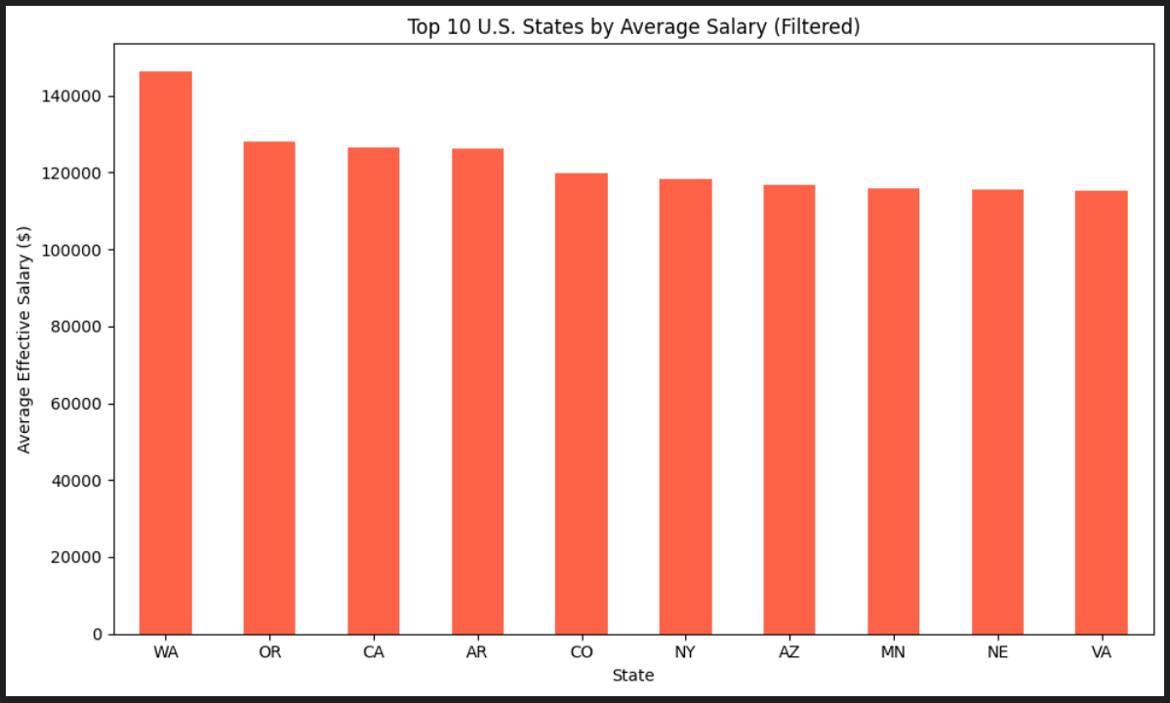
Top 10 States by Salary

Slide 13


Task 5: Time Series Analysis
How has Number of Job Postings changed over time
Seasonal Trends?

Slide 14
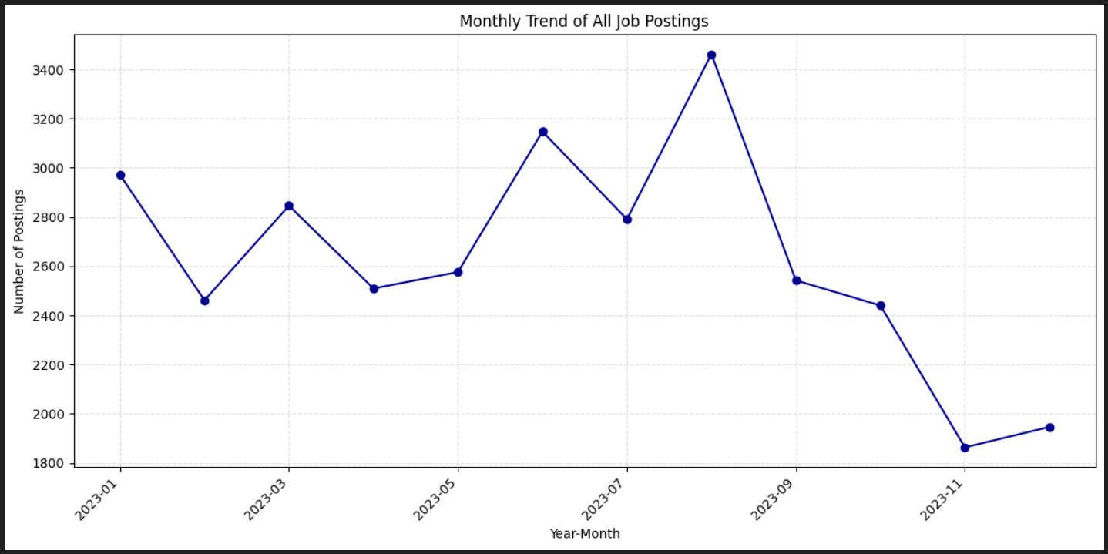
Monthly Trend of All Job Postings

Slide 15
Task 6: Full- & Part-time Comparison
Average Salary
Remote Job Share
Top Skills

Slide 16
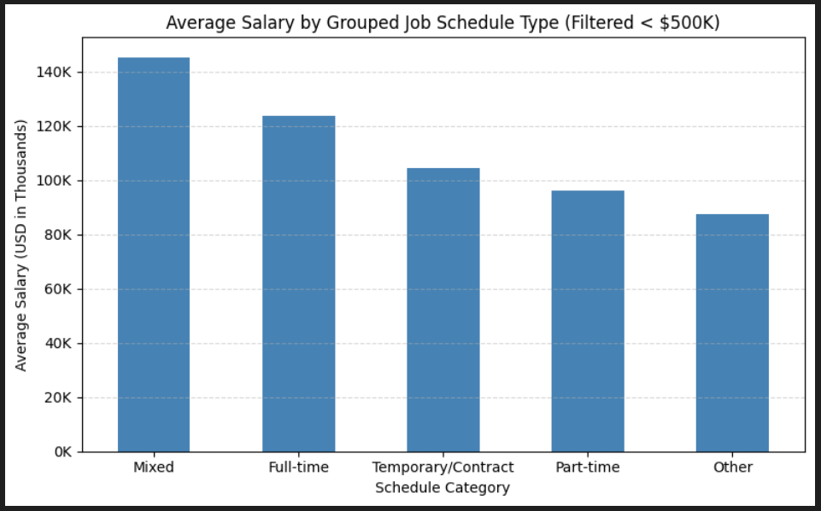
Average Salary by Schedule

Slide 17
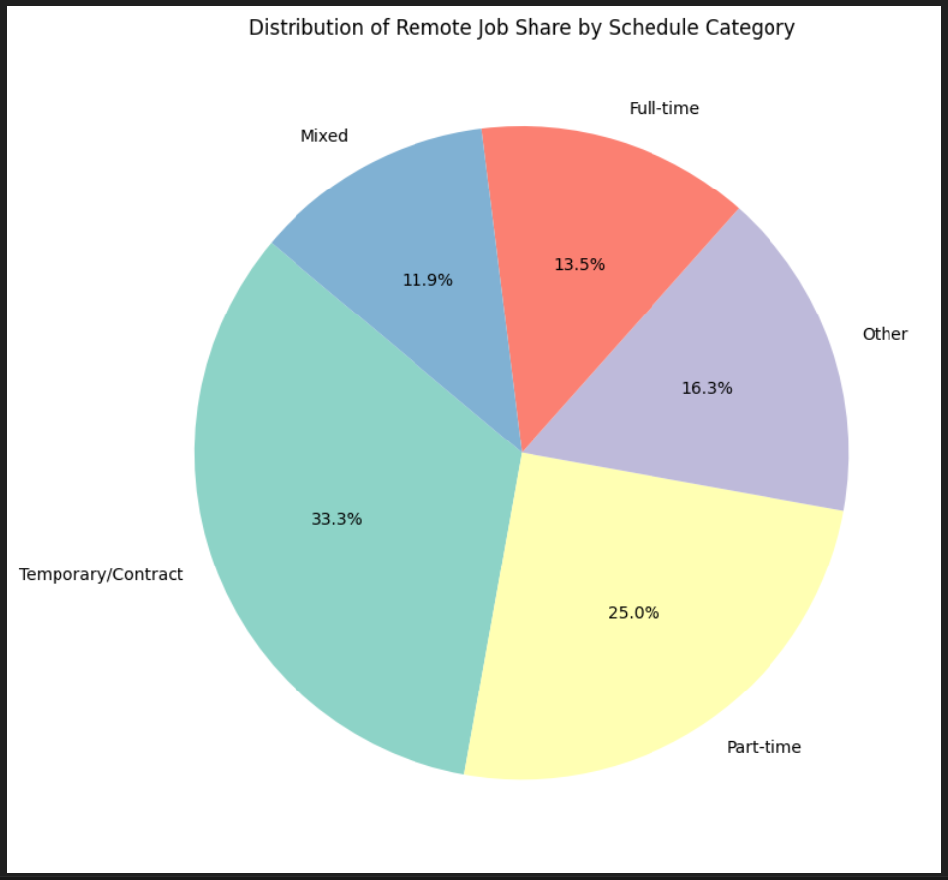
Remote Job Share

Slide 18
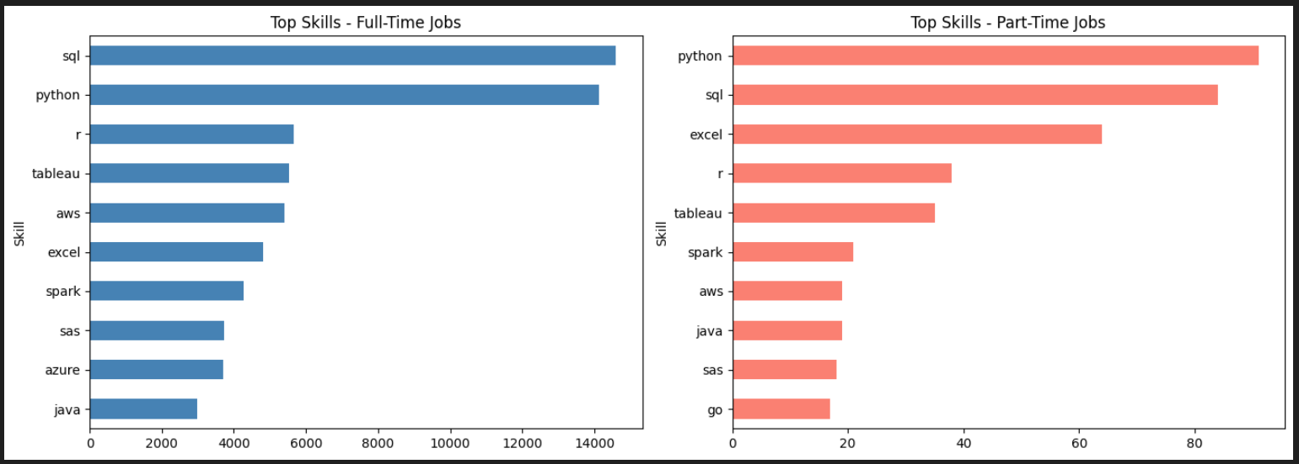
Skills in Full- & Part-Time Jobs

Slide 19
Task 7: Salary Trends
By Job Title
Skills Associated with High Salaries
How do Hourly and Annual Salaries Differ

Slide 20
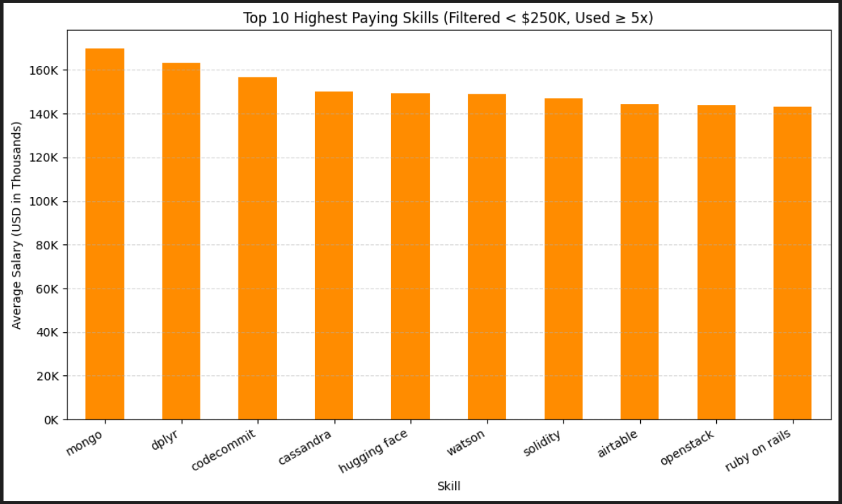
Top Ten Highest Paying Skills

Slide 21
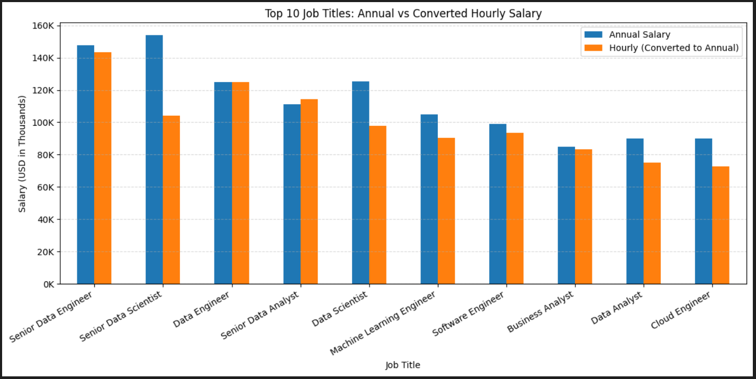
Annual vs. Hourly Converted Salary

Slide 22

Task 8: Location Salary Comparison
Compare Salaries between Countries
Average Salaries by State

Slide 23
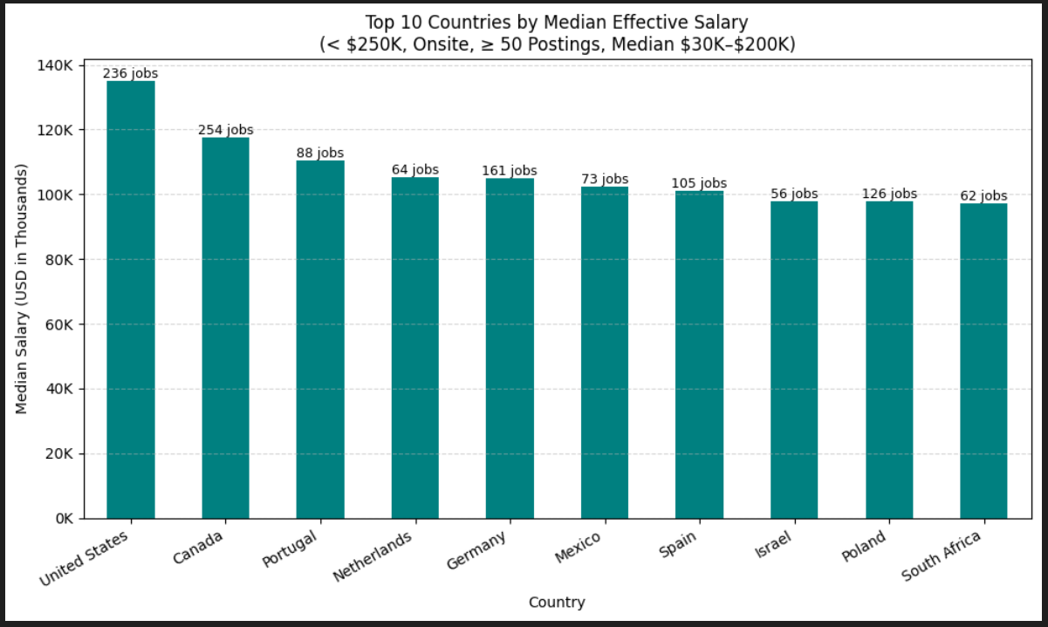
Top 10 Countries by Salary

Slide 24
Task 9: Parsing Skills & Extracting States
Count occurences of individual skills
Cluster similar roles
Extract states from U.S. addresses

Slide 25
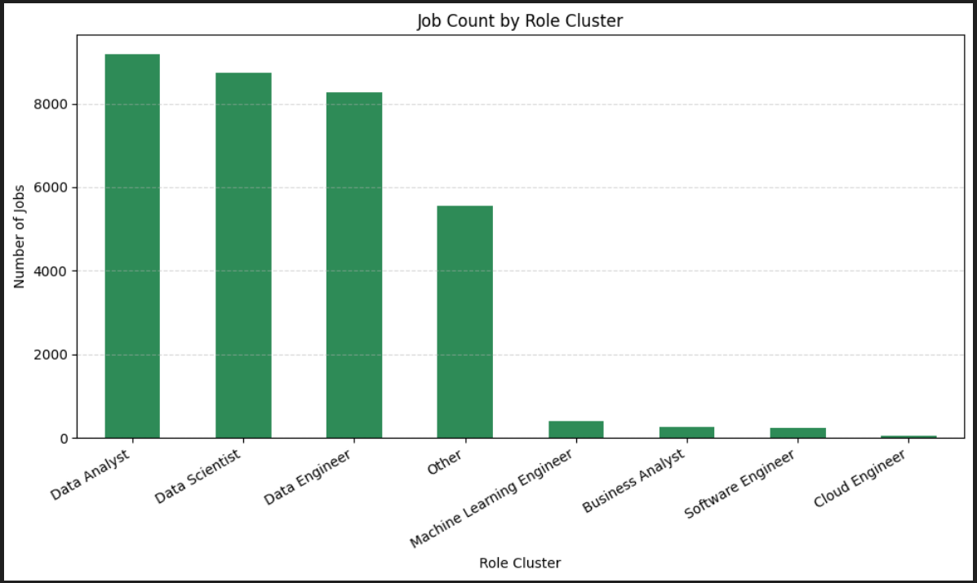
Job Count by Role Cluster

Slide 26
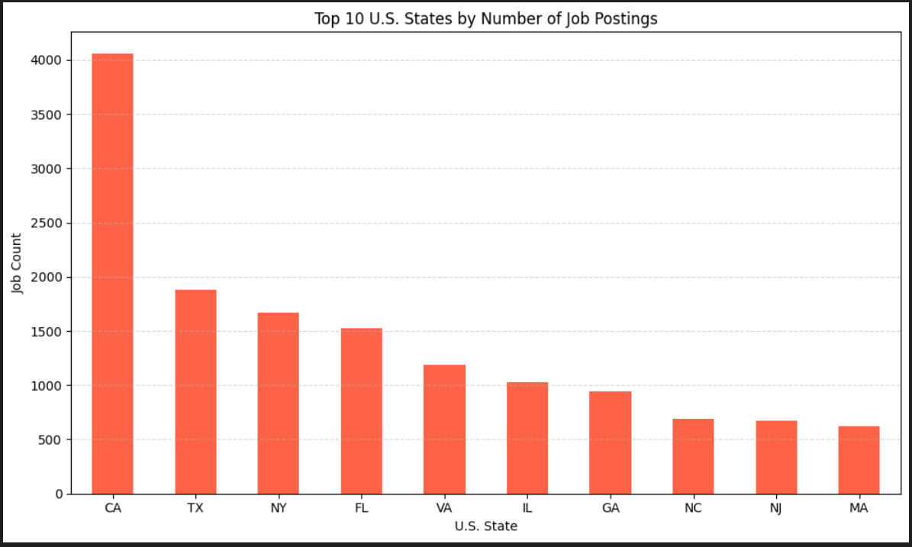
Top 10 States by Postings

Slide 27
Task 10: Interactive Dashboards
Created with Plotly
Explore skills, hourly vs. Annual salary, salary by state
top_10_skills_grouped.html
hourly_vs_annual_hover_only.html
median_salary_by_state.html

Slide 28

Key Takeaways
Salaries
Data Analyst - most frequent job title posted but not highest paid
Job types impact salaries - Senior roles have the highest salaries
Salaries highest for full-time or mixed work
Annual salary pays more than hourly converted to annual
Location significantly impacts earnings and job postings (Western Europe and North America vs. ROW, West Coast vs. Rest of USA)
Skills
SQL & Python - most in-demand
MongoDB and dplyr - highest paid
Remote Work
Remote & onsite job postings trend the same over time
Part-time and temp/contract work offers more remote possibilities than full-time

Slide 29
Unanswered Questions
No „Cost of Living“ data to accurately compare salaries?
Huge gaps in reported and calculated salaries?
How many hours are worked under a yearly salary?
Were salaries paid in local currencies?

Slide 30
Questions?
Questions?
Thank you for your time and attention!

