Slide 1

Customer Segmentation & Campaign Strategy
Presented by: Keith Billman • June 2025

Slide 2
Contents
1. Project Overview/Key Questions
2. Data Cleaning
3. Exploratory Data Analysis (EDA)
4. Customer Segmentation
5. Campaign Response Modeling
6. Defining High-Value Customers
7. Strategic Recommendations
8. Key Takeaways & Q&A

Slide 3
Project Overview/Key Questions
Goal: Understand customer segments, behavior, and response to marketing campaigns.
Key Questions:
What customer groups exist?
Who responds well to discounts/campaigns?
What defines a valuable customer?
Is it worth targeting specific groups?

Slide 4
Dataset Overview: Marktkampagne.csv
Key Dataset Properties
Rows: ~2,200 customers
Columns: 30+ Features
Source: CRM & Marketing Campaign Tracking
Feature Categories -
Demographics: Age, Income, Education Level, Marital Status, Children and Teenagers at Home
Purchase Behavior: Spending on Wine, Fruit, Meat, Sweets, etc.
Channel Activity: Number of Purchases from Web, Catalog, Store, Web Visits per Month
Campaign Interactions: Campaign 1 – Campaign 5 Accepted, Response to Last Campaign
Performance Metrics: Z_Contact_Cost_Factor, Z_Revenue_Factor, Complaint, Customer Since, Days Since Last Purchase

Slide 5
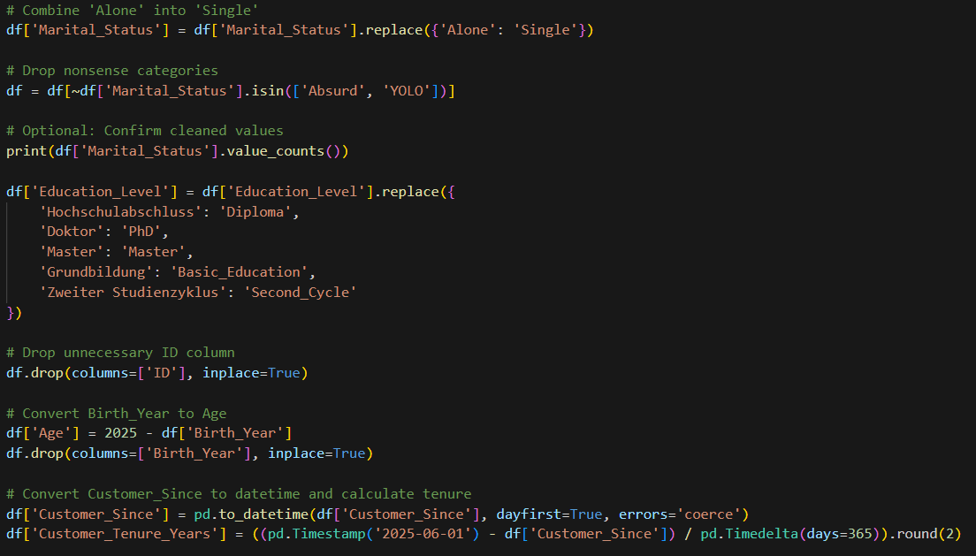
Data Cleaning

Slide 6
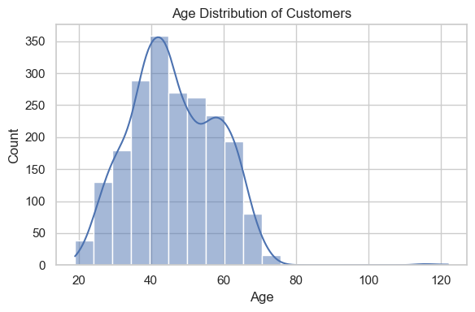
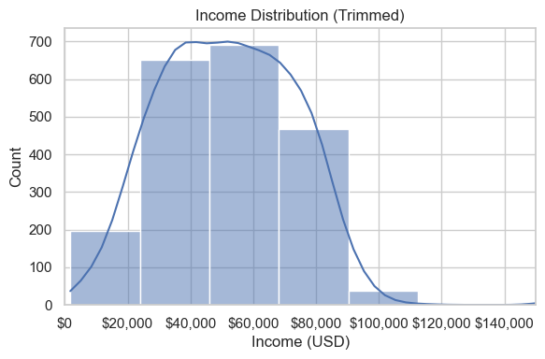
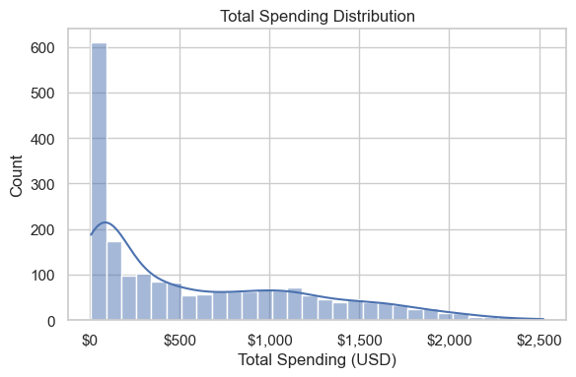
EDA - Distribution

Slide 7
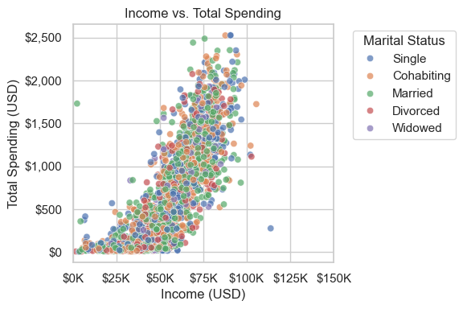
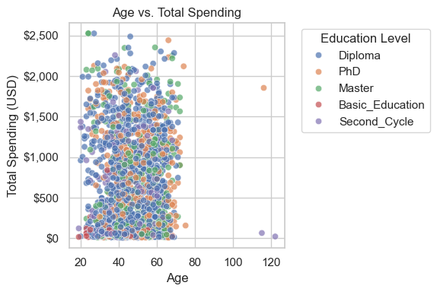
EDA -Relationships

Slide 8
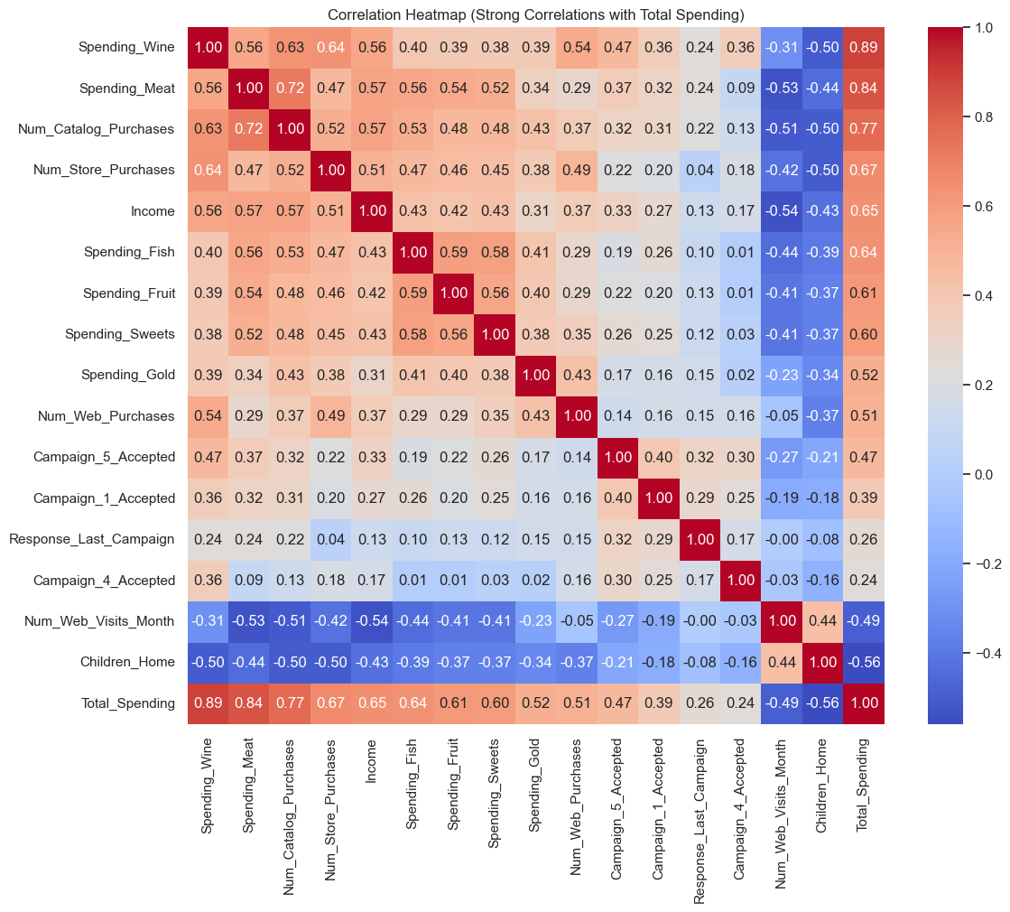
EDA - Correlation

Slide 9

Key Insights from Exploratory Data Analysis
Spending and income distributions show strong variability — ideal for segmentation
No clear spending patterns by marital status or education — these alone don't define customer groups
Spending moderately correlates with income, but high spenders exist across income brackets
Engagement channels (web, catalog, store) show differing usage, indicating behavioral variation

Slide 10
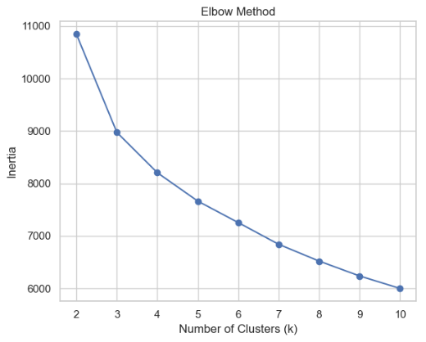
Customer Segmentation/ Clustering

Slide 11
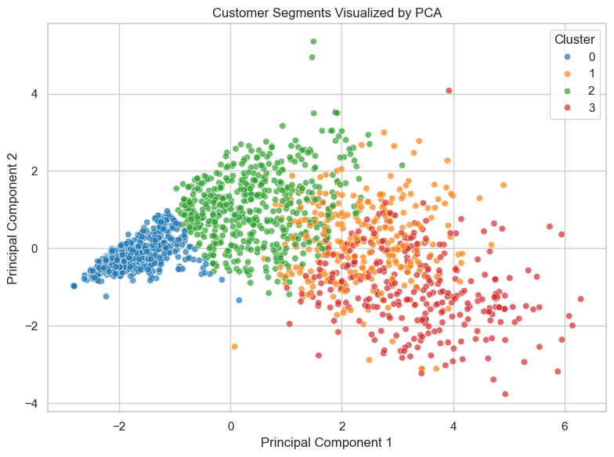
Cluster Visualization (PCA)

Slide 12
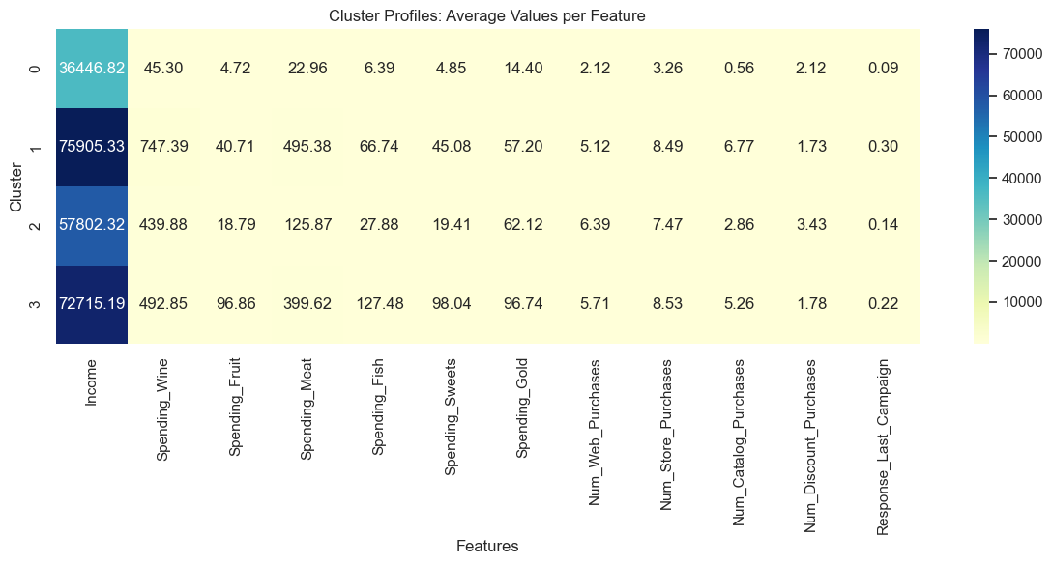
Cluster Profiles

Slide 13
Segment | Value | Response Rate
Luxury | High | High
Active | High | High
Bargain | Medium | Moderate
Passive | Low | Low
Customer Segmentation – Key Takeaways

Slide 14
Campaign Response Modeling
Goal: Predict whether a customer will respond to a marketing campaign
Model Used: Random Forest Classifier
Target Variable: Response_Last_Campaign (binary)
Key Features Used:
Income
Discount Usage
Web/Store Purchases
Cluster

Slide 15
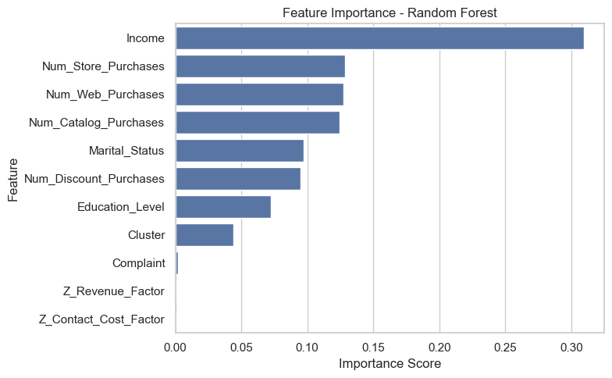
Campaign Response Modeling

Slide 16
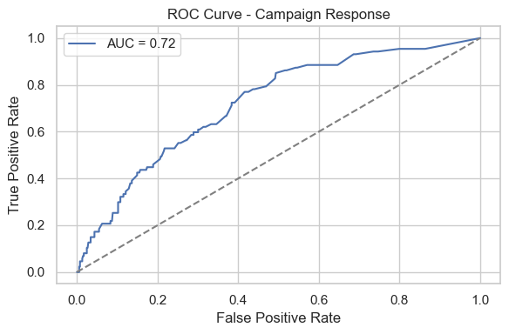
Campaign Response Modeling

Slide 17
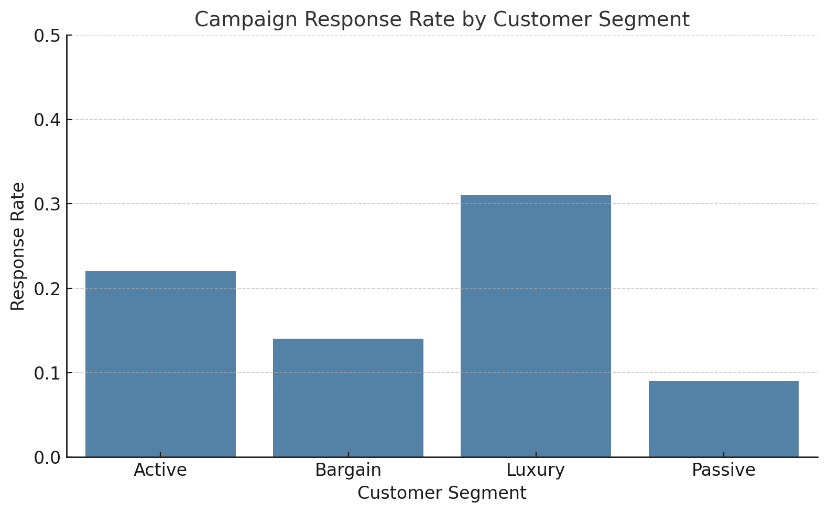
Campaign Response Rate

Slide 18
Defining High-Value Customers
Top 25% of spenders labeled as “Good Customers”
Random Forest model used to predict high-value status
Strong predictors: Income, Cluster, Web activity
Overlap with likely campaign responders

Slide 19
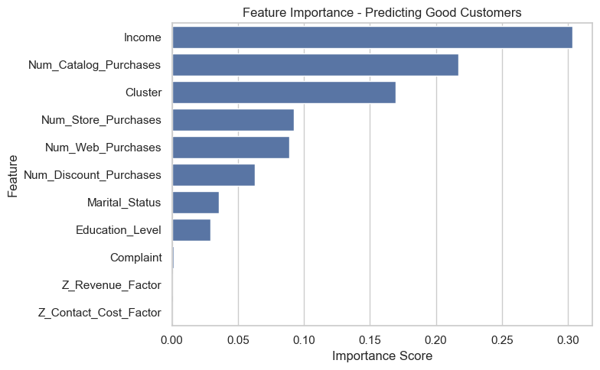
„Good“ Customer Modeling

Slide 20
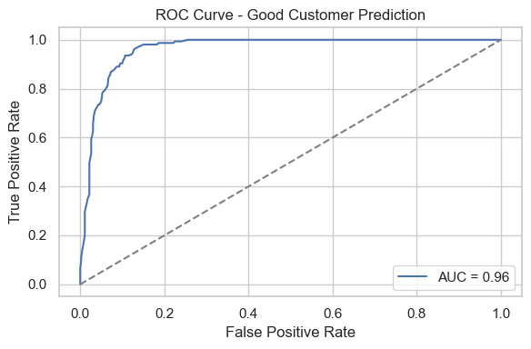
„Good“ Customer Modeling

Slide 21
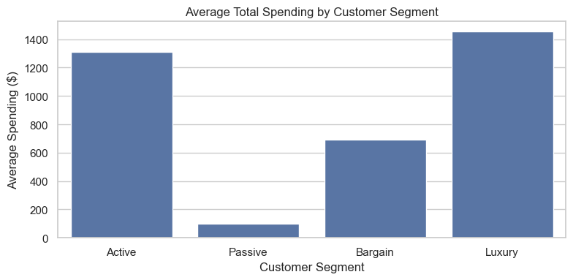
„Good“ Customers

Slide 22
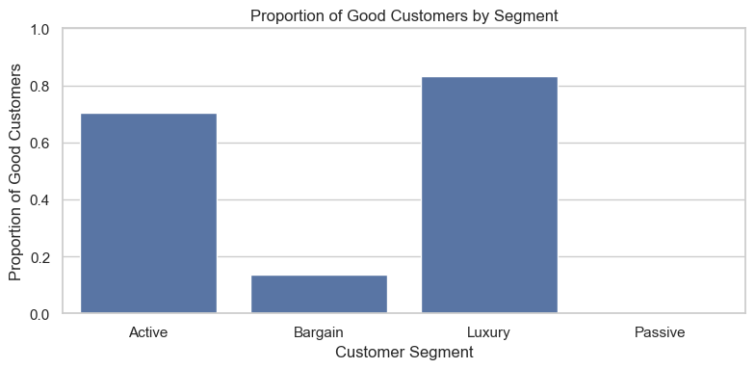
„Good“ Customers

Slide 23
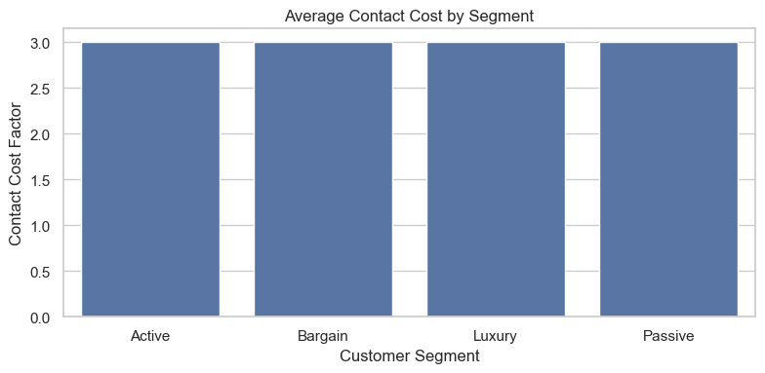
„Good“ Customers

Slide 24
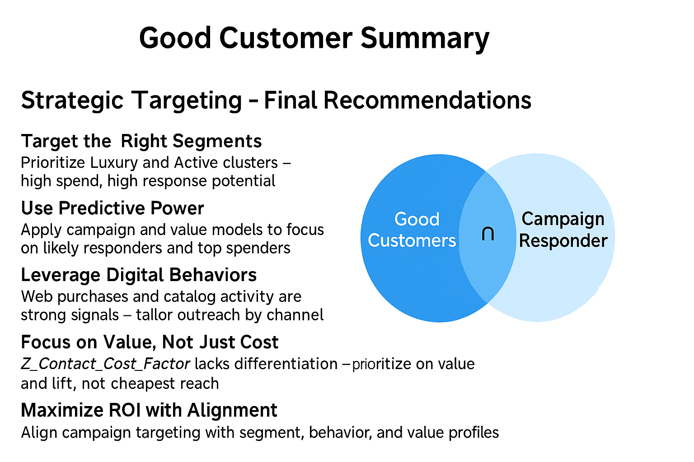

Slide 25
Strategic Recommendations
Segment | Value | Response Rate | Suggested Strategy
Luxury | High | High | Loyalty rewards, VIP access Thank-you gifts
Active | High | High | Personalized emails, Multi-channel outreach, Seasonal offers
Bargain | Medium | Moderate | Clear discount promotions, Savings-focused ads
Passive | Low | Low | Occasional check-ins, Low-cost reengagement

Slide 26
Key Takeaways
Data-driven segmentation works Clustering customers based on behavior revealed four clear, actionable segments.
High-value customers respond more Our top spenders—especially in the Luxury and Active segments—showed the highest campaign responsiveness.
Predictive modeling is effective Random Forest models reliably identified who is likely to respond and to spend more.
Targeting by segment boosts ROI Aligning outreach with segment traits reduces costs and increases effectiveness.

Slide 27

Questions?
Thank you!
Any Questions?

