Slide 1

Composition
Presented by:
Elizer Ponio Jr.

Slide 2
Relationships
In object-oriented programming, objects are related to each other and use the common functionality between them. This is where the topics of Inheritance, Association, Aggregation, and Composition in Java programs come.
Notes:
Regular expressions are widely used in software development and every developer should have a good understanding of them and know how to use them.

Slide 3
Relationships in Java
Relationships
Inheritance
Association
Aggregation
Composition

Slide 4
Relationships in Java
Inheritance
An IS-A relationship signifies that one object is a type of another. It is implemented using ‘extends’ and ‘implements’ keywords.
Example: A car is a type of vehicle.

Slide 5
Relationships in Java
Association
A HAS-A relationship signifies that a class has a relationship with another class.
Example: A car has an engine.

Slide 6
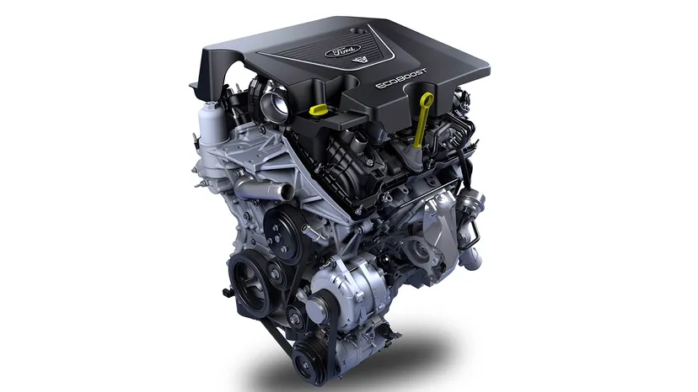

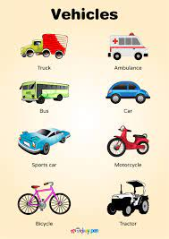
Relationships in Java
has an
Engine
Association
Car
Vehicle
is a
Inheritance

Slide 7
Aggregation and Composition
Aggregation
An aggregation container class and referenced class can have an independent existence.
Composition
A composition reference class cannot exist if the container class is destroyed.

Slide 8
Composition
Is a strong relationship between one class and another.
Other classes cannot exist without the owner or parent class.
For example, A ‘Human’ class is a composition of heart and lungs. When the human object dies, nobody parts exist.

Slide 9
Why use Composition?
Composition offers flexibility and robust code.
Its code reusability feature helps in avoiding code duplication and achieving cost-effectiveness.

